Slide 1

RISK DOMINATION GAME BUILD 1 TEAM 10 SOEN 6441 WINTER 2024 Submitted to: Paquet Joey
40271170 - ANKUSH DESAI
40270119 - ARCHILKUMAR KATRODIYA
40272399 - MIHIR GEDIYA
40292874 - krupali dobariya
40280054 - HONGWU LI

Slide 2
FLOW OF THE PRESENTATION
1. Architectural design of the Project.
2. Class Diagram of Build 1.
3. Coding Conventions and tools used.
4. Demonstration of functional requirements.

Slide 3
ARCHITECTURAL DESIGN
UPDATE
ACTION
CONTROLLER
USER
MODEL
CONTROLLR
VIEW
MODEL
VIEW
FEEDBACK
FEEDBACK
MODEL – VIEW – CONTROLLER ARCHITECTURE

Slide 4
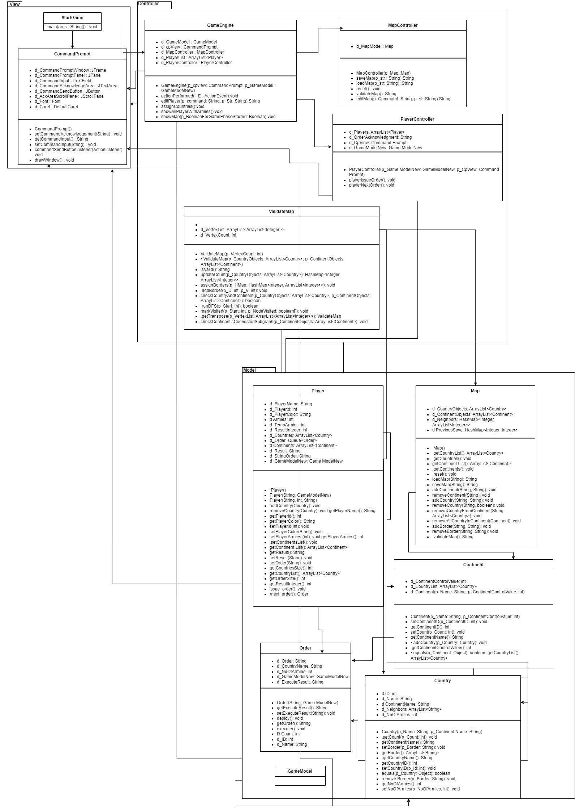
CLASS DIAGRAM

Slide 5
CODING CONVENTIONS AND TOOLS USED
Class names in CamelCase that starts with a capital letter.
Data members start with d_ .
Method parameters start with p_ .
Local variables start with l_ .
Static members start with a capital letter, non-static members start with a lower case letter.
For version control we have used VSCode and Github.
For documentation we have used Javadoc and PlantUML.
For unit testing we have used JUnit.
For Continuous Integration we have used Github Actions.

