Slide 1
React

Slide 2
Topics to discuss
Elements
Javascript Expressions
Components
State and Props
React Lifecyle
Map and Filter

Slide 3
Elements
Describes what you want to see on the screen
React elements are plain objects
Example:
const hello = <h1> Hello World! </h1>
let name = “Kier”;
const helloName = <h1> Hello {name} </h1>;
Note: Elements must be wrapped in an enclosing tag

Slide 4
Javascript Expressions
Arithmetic
10
10+2
String
‘Hello’
‘Hello’ + ‘World!’
Logical
10 === 5 ? ‘10 is equals to 5’ : ’10 is not equals to 5’
10 > 5 ? ‘10 is greater than 5 : ’10 is less than or equal to 5’
Primary expressions
23
‘hello’
sum
Left-hand-side expressions
e = m * ( c * c)
e = ‘mc^2’

Slide 5
Components
Components are like javascript functions
Let you split the UI into independent, reusable pieces, and think about each piece in isolation.

Slide 6
2 Types of Component
Function Component (stateless component)
function Welcome(props) {
return <h1> Hello {props.name} </h1>
}
Class Component (stateful component)
class Welcome extends React.Component {
render() {
return <h1> Hello, {this.props.name} </h1>;
}
}

Slide 7
State and Props
State – managed within the component (similar to variables declared within a function)
Props – (properties) these are like the parameters of a function where props get passed to the component

Slide 8
Using State Correctly
Do not modify state directly
State updates may be asynchronous
React may batch multiple setState() calls into a single call for performance
State Updates are merged
When you call setState(), React merges the object you provide into the current state.
The data flows down

Slide 9
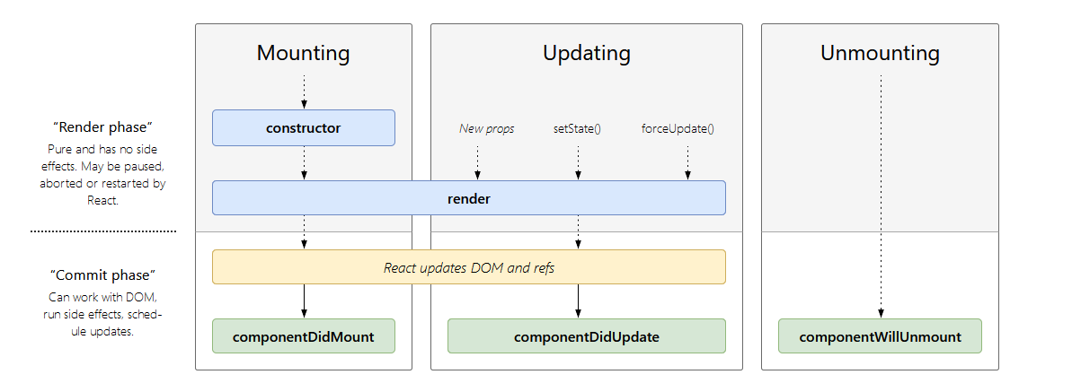
Lifecycle

Slide 10
Map and Filter
Map - creates a new array populated with the results of calling a provided function on every element in the calling array.
Filter - creates a new array with all elements that pass the test implemented by the provided function.

Slide 11
Activity
List of objects
Name : string
Grade : int
Age : int
Subjects : list of string
StudentView
Information
Grades
Subjects

Slide 12
Activity
Student Information
Name: Kier
Age: 22
Information
Name: James
Age: 23
Name:‘Kurt’
Age: 20
Grades
Students with grades >= {passingGrade}
Name: ‘James’
Grade: 85
Name:‘Kurt’
Grade: 90
Subject
Students who took {subject}
Kier
Kurt

Slide 13
Activity
Student data should be in StudentView component
Use state for your data
studentList: [ {name:’kier’,age:22,grade:75,subjects: [‘Math’,’Science’]} ]
Pass the data from StudentView to its child components
Display the data using map
Create a function with a parameter ‘passingGrade’
Use filter to get the students with greater than or equal to ‘passingGrade’
Create a function with a parameter ‘subject’
Use filter to get the students who took ‘subject’

