Slide 1
Multipage
Webside

Slide 2
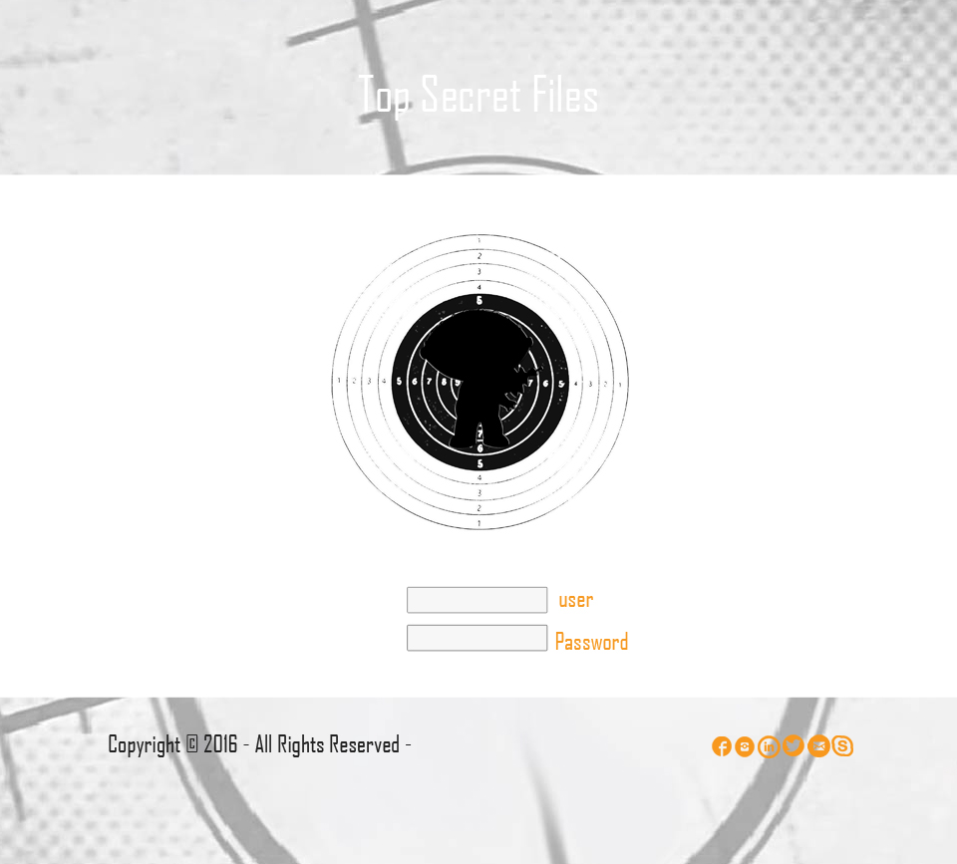
Top Secret Files

Slide 3
Is a full video, pictures and data webpage, where you can find all information about the skills of different secret agents, just people very important can access to this files with the function of find the perfect person to an impossible job.

Slide 4
My character is based in a Seth Macfarlane’s cartoon, and for create it was used Video and Audio editors, like as well Photoshop and iIlustrator editor.
Programs like YT dowloader and windows movie maker help me with this

Slide 5
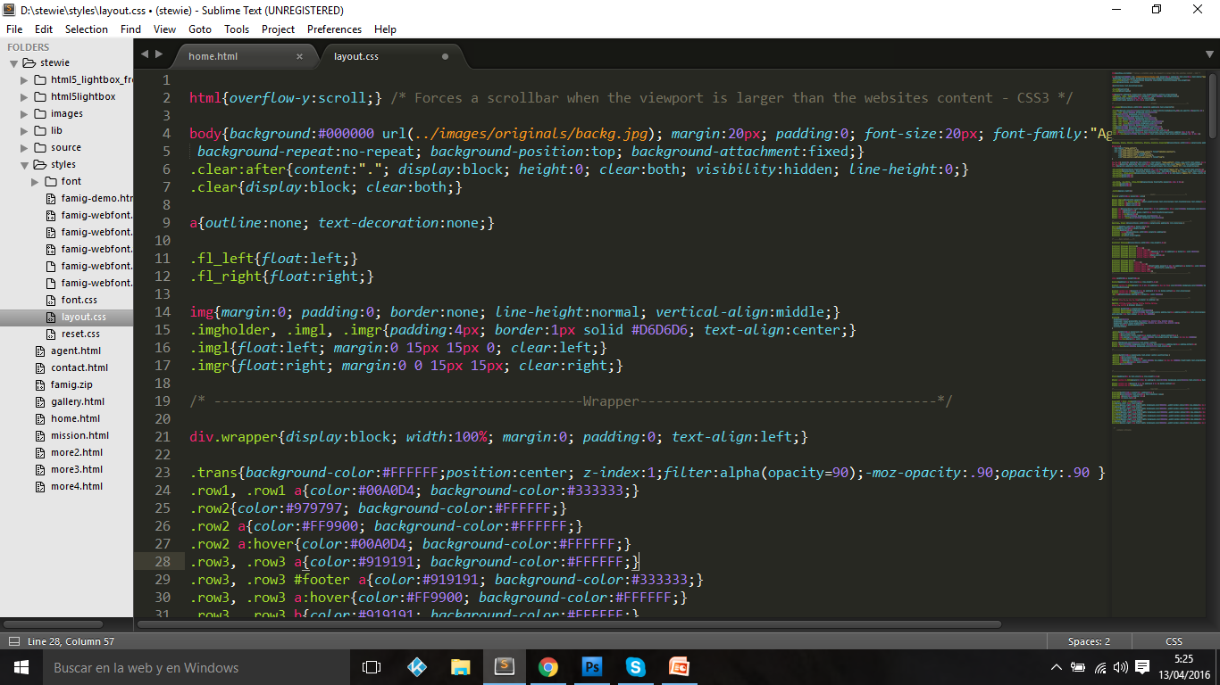

Slide 6
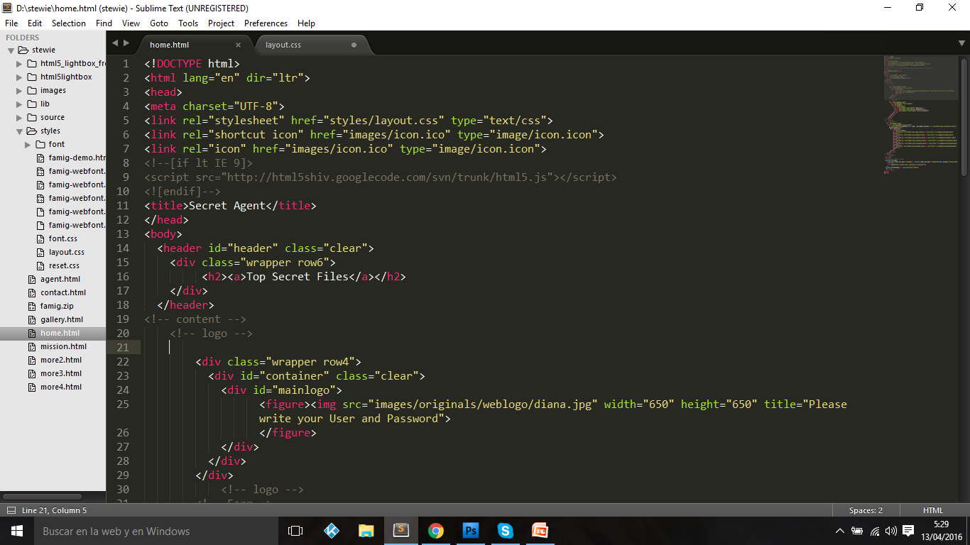

Slide 7
I used skills like:
Fevicon
uxrepo.com
Icomoon
Lightbox
And youtube video tutorials to get specific animations in my page.

Slide 8
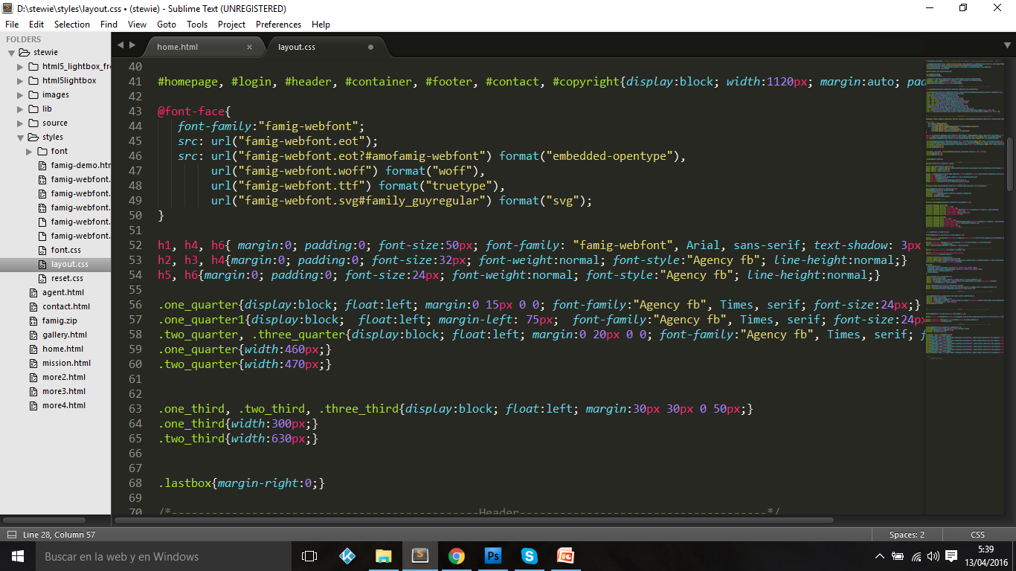

Slide 9
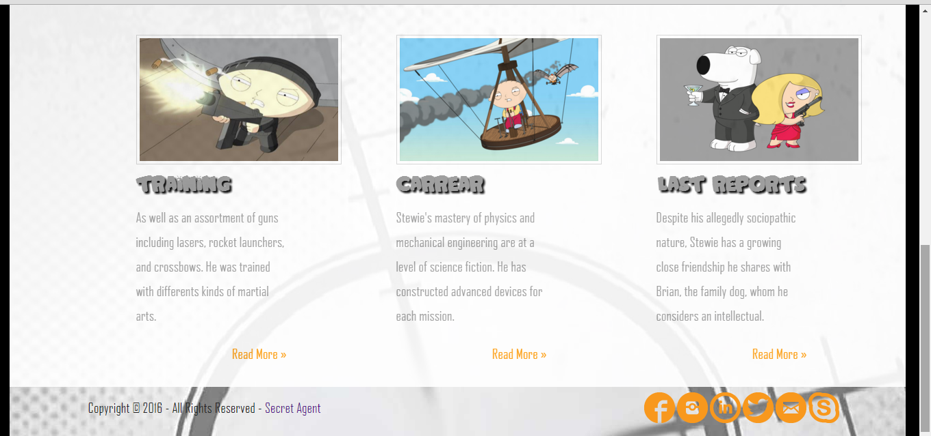

Slide 10
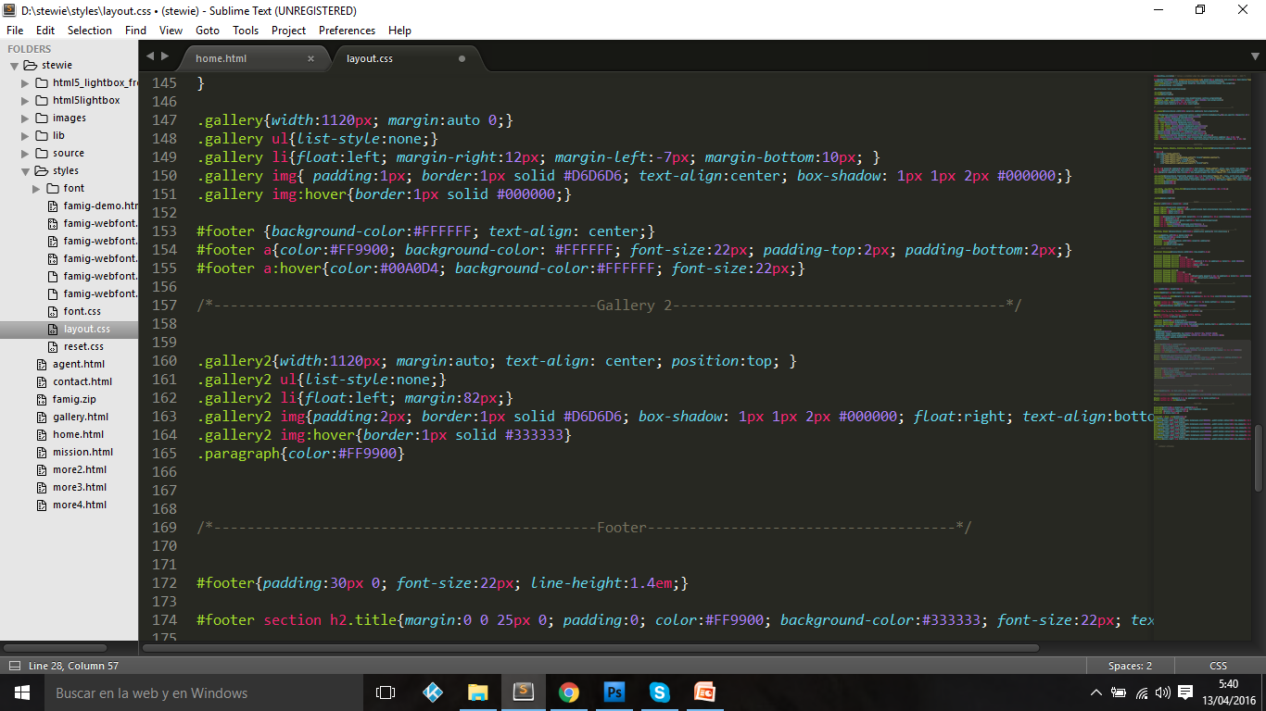

Slide 11
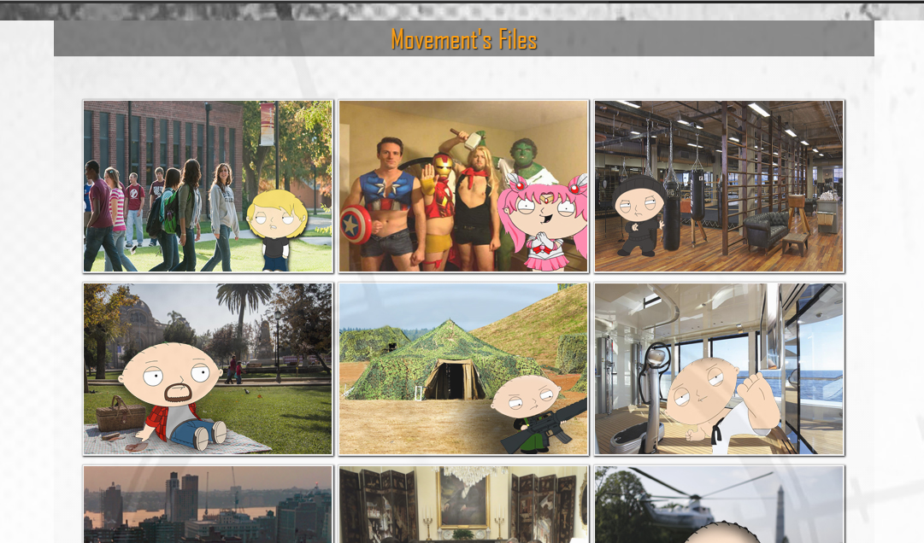

Slide 12
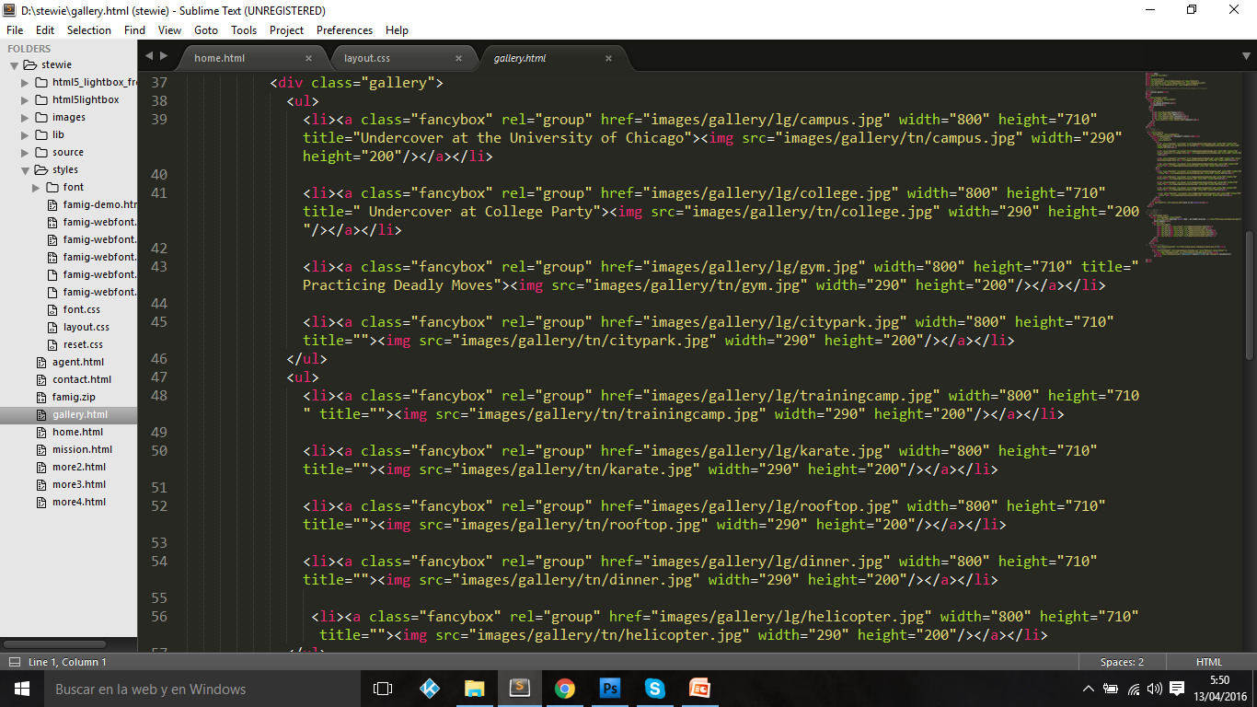

Slide 13
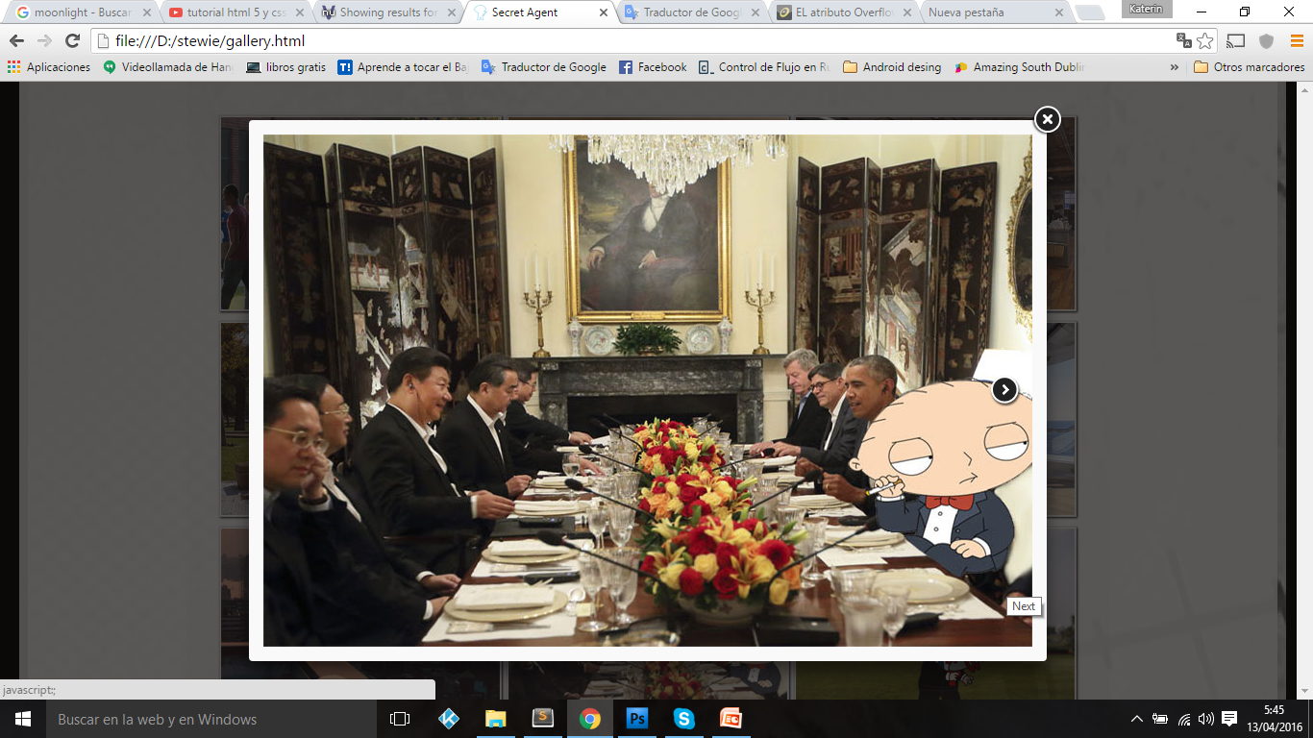

Slide 14
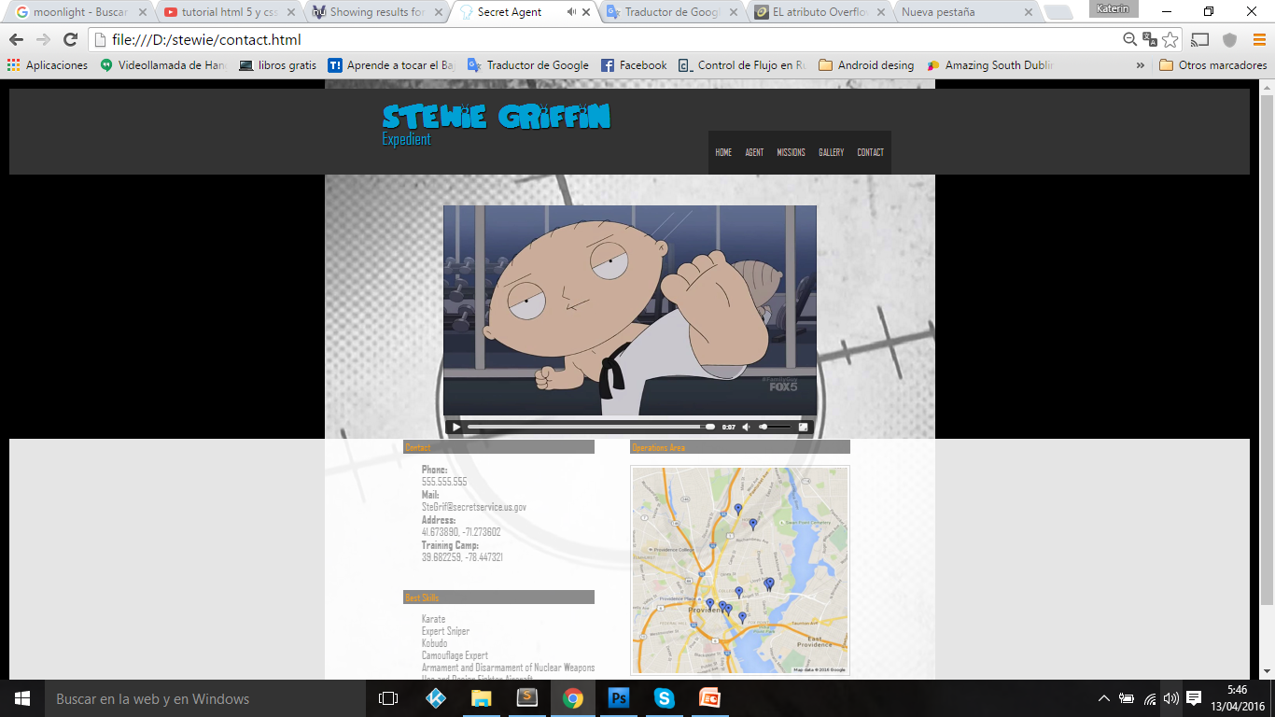

Slide 15
Thanks!

