Slide 1
Japanese Writing Systems
Study cards for beginners

Slide 2

Japanese Writing Systems
Kanji 漢字
Chinese-origin characters that represent meaning. About 2,000-3,000 in common use.
EXAMPLE
一
二
三
ichi
ni
san
(one)
(two)
(three)

Slide 3
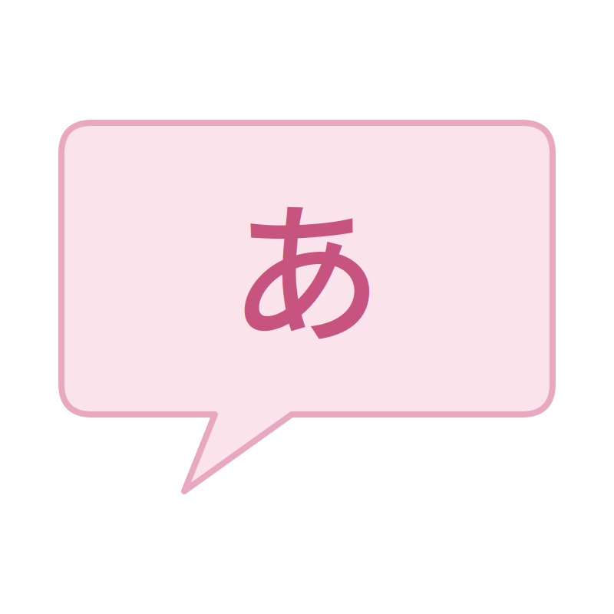
Japanese Writing Systems
Hiragana ひらがな
46 phonetic characters, one per sound. Curved, flowing strokes.
EXAMPLE
あ
い
う
え
お
a
i
u
e
o

Slide 4

Japanese Writing Systems
Katakana カタカナ
46 phonetic characters, mainly for foreign loanwords. Angular, straight strokes.
EXAMPLE
テレビ
terebi
(television)

Slide 5
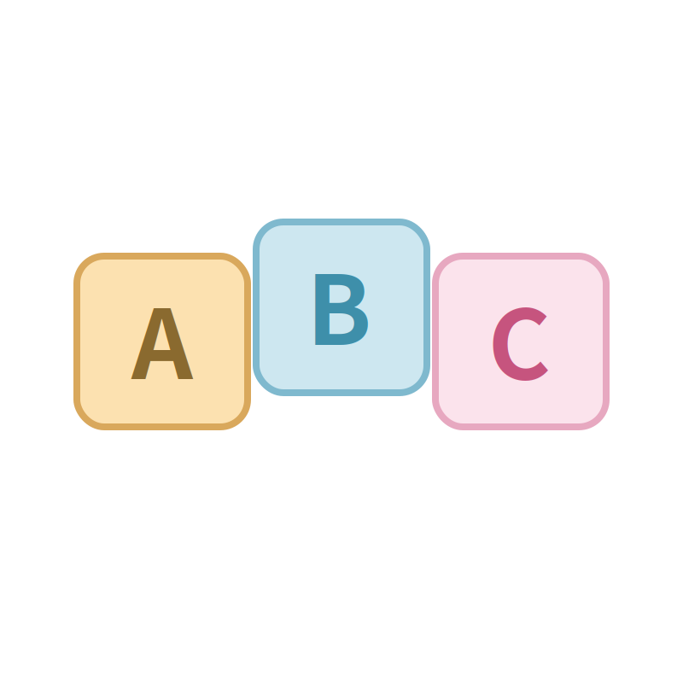
Japanese Writing Systems
Roomaji ローマ字
Japanese sounds written with the English alphabet. 101 sounds total: 5 vowels, 95 consonant-vowel combinations, plus 'n'.
EXAMPLE
paatii
sofaa
chesu
(party)
(sofa)
(chess)

Slide 6
Roomaji Syllables Chart
Basic syllables (a / i / u / e / o) and contracted yōon sounds (ya / yu / yo)
Seion (Plain Sounds)
 | a | i | u | e | o
k | ka | ki | ku | ke | ko
s | sa | shi | su | se | so
t | ta | chi | tsu | te | to
n | na | ni | nu | ne | no
h | ha | hi | fu | he | ho
m | ma | mi | mu | me | mo
y | ya |  | yu |  | yo
r | ra | ri | ru | re | ro
w | wa
a | u | o
kya | kyu | kyo
sha | shu | sho
cha | chu | cho
nya | nyu | nyo
hya | hyu | hyo
mya | myu | myo
rya | ryu | ryo
Dakuon & Handakuon (Voiced Sounds)
 | a | i | u | e | o
g | ga | gi | gu | ge | go
z | za | ji | zu | ze | zo
d | da |  |  | de | do
b | ba | bi | bu | be | bo
p | pa | pi | pu | pe | po
n | n (consonant only)
a | u | o
gya | gyu | gyo
ja | ju | jo
bya | byu | byo
pya | pyu | pyo

Slide 7
Japanese Writing Systems
Long Vowels 長音
Double vowels replace macrons for a long vowel sound (held twice as long). Vowel length changes meaning.
EXAMPLE
koohii
tori
toori
(coffee)
(bird)
(street)

Slide 8
Japanese Writing Systems
Hyphens
Mark word boundaries: after prefixes/before suffixes, between compound words, and before inflected endings.
EXAMPLE
o-cha
Nihon-go
iki-mashoo
(tea)
(Japanese language)
(let's go)

Slide 9
Japanese Writing Systems
Apostrophes
Mark a short pause after the 'n' sound, or show a contraction.
EXAMPLE
gen'in
fun'iki
(cause)
(atmosphere)

Slide 10
Japanese Writing Systems
'N' Sound
Pronounced like 'm' before b/p/m, like 'ng' before g/k, and as a nasal sound before vowels, y/w, and s/sh/h.
EXAMPLE
shinbun
kangae
funsui
denwa
(newspaper)
(thought)
(fountain)
(telephone)

Slide 11
Japanese Writing Systems
Double Consonants 促音
Sounds that merge together are shown by doubling the consonant.
EXAMPLE
hakkiri
massugu
kitte
issho
(clearly)
(straight)
(stamp)
(together)

Slide 12
Japanese Writing Systems
Abbreviations
Notation used in this textbook for questions, answers, and examples.
EXAMPLE
Q
A
S
T
e.g.
(question)
(answer)
(student)
(teacher)
(example)

Slide 13
Japanese Writing Systems
Vowels 母音
5 vowels (a, i, u, e, o), each clear and crisp -- shorter and more clipped than in English.
EXAMPLE
a
i
u
e
o
(father)
(king)
(put)
(pet)
(toe)

Slide 14
Japanese Writing Systems
Voiceless Vowels
Between or after voiceless consonants (k, s, sh, t, ts, ch, h, f, p), 'i' and 'u' are pronounced weakly.
EXAMPLE
tsuki
desu
hisho
(moon)
(to be)
(secretary)

Slide 15
Japanese Writing Systems
Semi-vowel Y 半母音 Y
A shorter, softer 'i' sound. Combines with a, u, or o as one syllable -- not two.
EXAMPLE
kyoo
kiyoo
(today)
(skillful)

Slide 16
Japanese Writing Systems
Semi-vowel W 半母音 W
Only followed by 'a'. 'Wa' is pronounced like 'ua' without rounding the lips.
EXAMPLE
watashi
(I / me)

Slide 17
Japanese Writing Systems
Consonants 子音
Followed by vowels, and lighter than in English. English 'l' and 'v' don't exist in Japanese. 'Z' doesn't vibrate at the tongue tip.
EXAMPLE
sh
ts
f
(she)
(wants)
(foot)

Slide 18
Japanese Pronunciation Guide
Japanese symbols and their English approximate pronunciation
Consonant Sounds
k
as in
kind
ch
as in
change
m
as in
my
j
as in
jumper
s
as in
sound
n
as in
knife
r
as in
ring
d
as in
dog
sh
as in
she
h
as in
hit
g
as in
give
p
as in
pink
t
as in
tongue
f
as in
foot
z
as in
zone
b
as in
big
ts
as in
wants

Slide 19
Japanese Writing Systems
Fu Sound
Made by protruding both lips, as if blowing out a candle.
EXAMPLE
fuyu
(winter)

Slide 20
Japanese Writing Systems
R Sound
A flapping sound, made by quickly touching the tongue tip to the gum behind the upper teeth.
EXAMPLE
arigatoo
(thank you)

Slide 21
Japanese Writing Systems
G Sound (mid-word)
Within a word, 'g' is close to the 'ng' sound, though this is optional.
EXAMPLE
eega
shingoo
kaigi
(movie)
(traffic light)
(conference)

Slide 22
Japanese Writing Systems
Z Sound
Does not vibrate at the top of the tongue the way the English 'z' does.
EXAMPLE
mizu
(water)

Slide 23
Japanese Writing Systems
Double Consonant Sounds
Doubled consonants (kk, ss, ssh, tt, tts, tch, pp) are pronounced with a brief held pause before release, like 'black cat' or 'hot tip' said quickly.
EXAMPLE
kitte
issho
hakkiri
(stamp)
(together)
(clearly)

Slide 24
Japanese Writing Systems
Accent and Rhythm アクセント
Japanese uses pitch (high/low), not stress -- every syllable is the same length and speed, like a metronome that changes pitch. Same spelling with a different pitch pattern can mean something different.
EXAMPLE
dot height = pitch (higher = higher pitch)
a
me
a
me
se
ki
se
ki
ha
ku
shi
ha
ku
shi
(candy)
(rain)
(seat)
(cough)
(doctorate)
(white paper)

Slide 25

ai
love
a
i

Slide 26

ie
house
i
e

Slide 27

ue
above
u
e

Slide 28

oi
nephew
o
i

Slide 29

aoi
blue
a
o
i

Slide 30

iie
no
i
i
e

Slide 31

ooi
many
o
o
i

Slide 32

kaku
to write
ka
ku

Slide 33

kiku
to listen
ki
ku

Slide 34

koko
here
ko
ko

Slide 35

kakaku
price
ka
ka
ku

Slide 36

keeki
cake
ke
e
ki

Slide 37

kyaku
customer
kya
ku

Slide 38

kyoo
today
kyo
o

Slide 39

kyookai
church
kyo
o
ka
i

Slide 40

saka
slope
sa
ka

Slide 41

suu
to smoke
su
u

Slide 42

soko
there
so
ko

Slide 43

sukoshi
a little
su
ko
shi

Slide 44

sekai
world
se
ka
i

Slide 45

shako
garage
sha
ko

Slide 46

shuu
state
shu
u

Slide 47

shookai
introduction
sho
o
ka
i

Slide 48
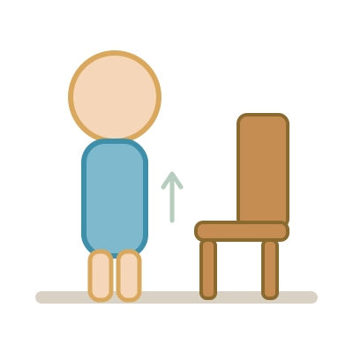
tatsu
to stand
ta
tsu

Slide 49

chiri
dust
chi
ri

Slide 50

tetsu
iron
te
tsu

Slide 51

toki
time
to
ki

Slide 52

chikai
close
chi
ka
i

Slide 53

choo
intestines
cho
o

Slide 54

chakuchi
landing
cha
ku
chi

Slide 55

chuucho
hesitation
chu
u
cho

Slide 56

nani
what
na
ni

Slide 57

niku
meat
ni
ku

Slide 58

nuu
to sew
nu
u

Slide 59

neko
cat
ne
ko

Slide 60
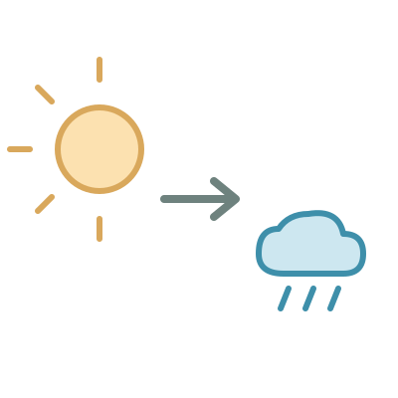
nochi
later
no
chi

Slide 61

nyaa
meow
nya
a

Slide 62

nyuushi
baby tooth
nyu
u
shi

Slide 63
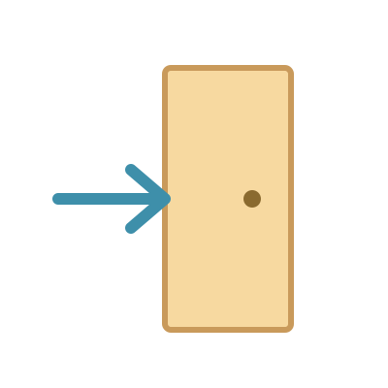
nyuukai
admission
nyu
u
ka
i

Slide 64

hako
box
ha
ko

Slide 65

hifu
skin
hi
fu

Slide 66

fune
ship
fu
ne

Slide 67

heso
navel
he
so

Slide 68

hoshi
star
ho
shi

Slide 69

hyaku
hundred
hya
ku

Slide 70

hyuuhyuu
whiz
hyu
u
hyu
u

Slide 71

hyooka
valuation
hyo
o
ka

Slide 72

mame
bean
ma
me

Slide 73

mimi
ear
mi
mi

Slide 74

momo
peach
mo
mo

Slide 75
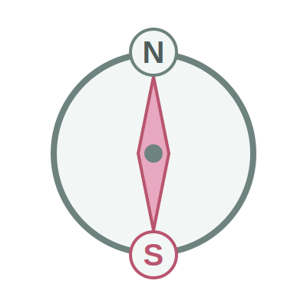
minami
south
mi
na
mi

Slide 76

musume
daughter
mu
su
me

Slide 77

mokuhyoo
aim
mo
ku
hyo
o

Slide 78

myaku
pulse
mya
ku

Slide 79

myoo
odd
myo
o

Slide 80

yama
mountain
ya
ma

Slide 81

yume
dream
yu
me

Slide 82

yoku
desire
yo
ku

Slide 83

yatou
to employ
ya
to
u

Slide 84
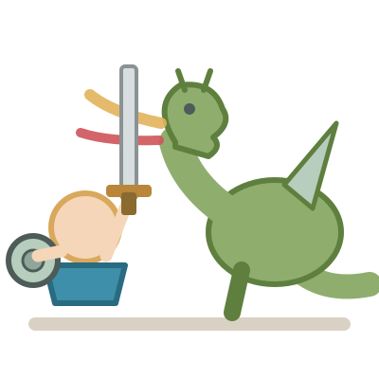
yuuki
bravery
yu
u
ki

Slide 85

yosoku
prediction
yo
so
ku

Slide 86

yuueki
profitable
yu
u
e
ki

Slide 87

yookyuu
demand
yo
o
kyu
u

Slide 88

raku
easy
ra
ku

Slide 89

riku
land
ri
ku

Slide 90

rusu
absence
ru
su

Slide 91

retsu
line
re
tsu

Slide 92

roku
six
ro
ku

Slide 93
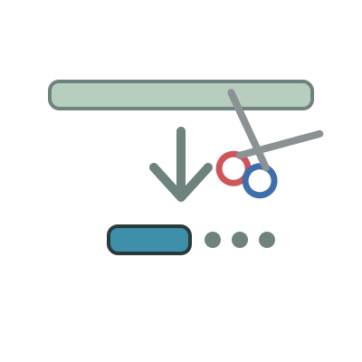
ryaku
omission
rya
ku

Slide 94
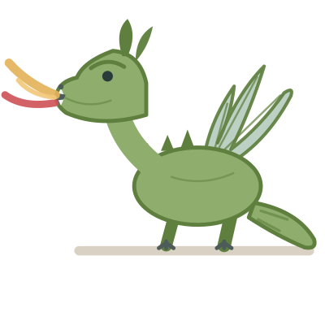
ryuu
dragon
ryu
u

Slide 95

ryoo
amount
ryo
o

Slide 96

washi
eagle
wa
shi

Slide 97

watashi
I (me)
wa
ta
shi

Slide 98

wasureru
to forget
wa
su
re
ru

Slide 99

wariate
assignment
wa
ri
a
te

Slide 100
wariateru
to allot
wa
ri
a
te
ru

Slide 101

wakai
young
wa
ka
i

Slide 102

gai
harm
ga
i

Slide 103

girisha
Greece
gi
ri
sha

Slide 104
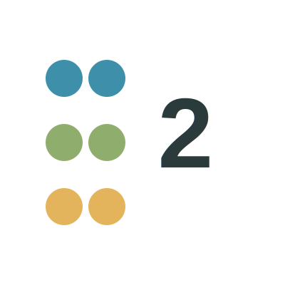
guusuu
even number
gu
u
su
u

Slide 105

geki
drama
ge
ki

Slide 106

gogatsu
May
go
ga
tsu

Slide 107

gyaku
contrary
gya
ku

Slide 108
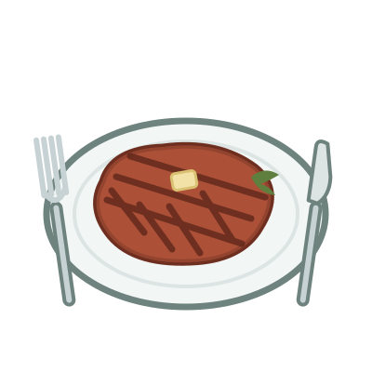
gyuuniku
beef
gyu
u
ni
ku

Slide 109

gyooji
event
gyo
o
ji

Slide 110

zaiko
stock
za
i
ko

Slide 111

jimusho
office
ji
mu
sho

Slide 112

zurui
sly
zu
ru
i

Slide 113

zeetaku
luxury
ze
e
ta
ku

Slide 114
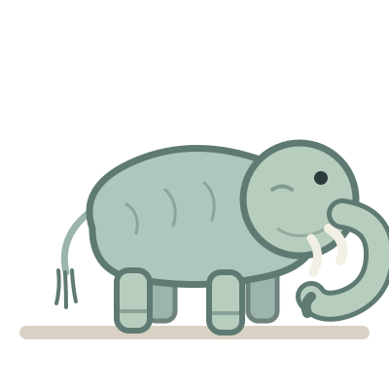
zoo
elephant
zo
o

Slide 115
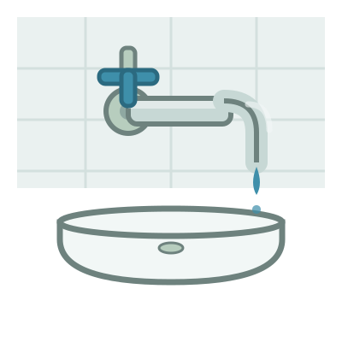
jaguchi
tap
ja
gu
chi

Slide 116

juu
ten
ju
u

Slide 117

joogi
ruler
jo
o
gi

Slide 118

dashi
soup stock
da
shi

Slide 119

deru
to go out
de
ru

Slide 120

doko
where
do
ko

Slide 121

daigaku
university
da
i
ga
ku

Slide 122

detarame
nonsense
de
ta
ra
me

Slide 123

doozo
please
do
o
zo

Slide 124
batsu
punishment
ba
tsu

Slide 125

biiru
beer
bi
i
ru

Slide 126

buta
pig
bu
ta

Slide 127

beni
rouge
be
ni

Slide 128

booshi
hat
bo
o
shi

Slide 129
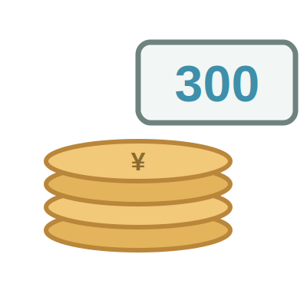
sanbyaku
three hundred
sa
n
bya
ku

Slide 130
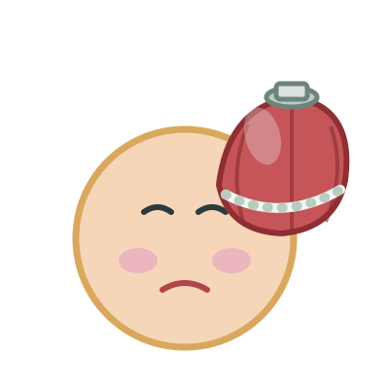
byooki
sickness
byo
o
ki

Slide 131

byoo
a second
byo
o

Slide 132

pan
bread
pa
n

Slide 133

puuru
pool
pu
u
ru

Slide 134

posuto
mailbox
po
su
to

Slide 135

piano
piano
pi
a
no

Slide 136

puragu
plug
pu
ra
gu

Slide 137

pedaru
pedal
pe
da
ru

Slide 138

roppyaku
six hundred
ro
ppya
ku

Slide 139

happyaku
eight hundred
ha
ppya
ku

Slide 140

hantai
opposite
ha
n
ta
i

Slide 141

bentoo
lunch box
be
n
to
o

Slide 142

kanri
administration
ka
n
ri

Slide 143

hanzai
crime
ha
n
za
i

Slide 144
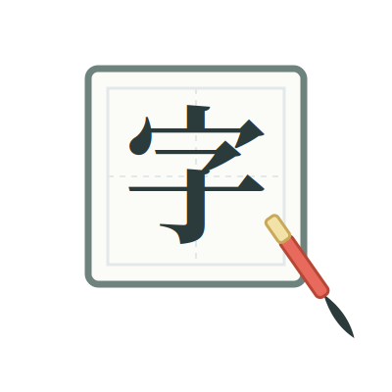
kanji
Chinese character
ka
n
ji

Slide 145
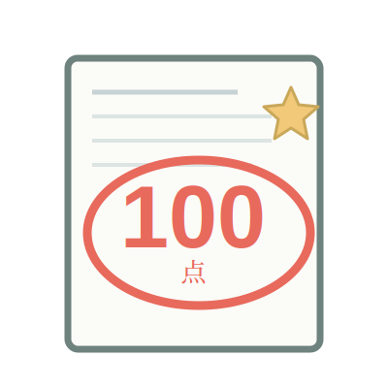
kanpeki
perfect
ka
n
pe
ki

Slide 146

chinmoku
silence
chi
n
mo
ku

Slide 147

shinbun
newspaper
shi
n
bu
n

Slide 148

konban
tonight
ko
n
ba
n

Slide 149

kinpatsu
blond
ki
n
pa
tsu

Slide 150

kankyoo
environment
ka
n
kyo
o

Slide 151

tenki
weather
te
n
ki

Slide 152

mangetsu
full moon
ma
n
ge
tsu

Slide 153

kenshin
devotion
ke
n
shi
n

Slide 154
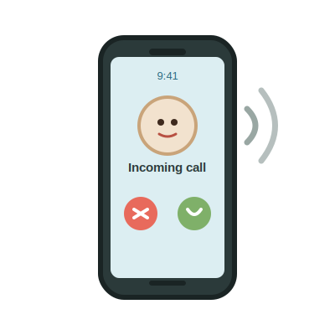
denwa
telephone
de
n
wa

Slide 155

tenin
clerk
te
n
i
n

Slide 156

honya
book store
ho
n
ya

Slide 157

hakkiri
clearly
ha
kki
ri

Slide 158

chotto
a little
cho
tto

Slide 159

massugu
straight
ma
ssu
gu

Slide 160
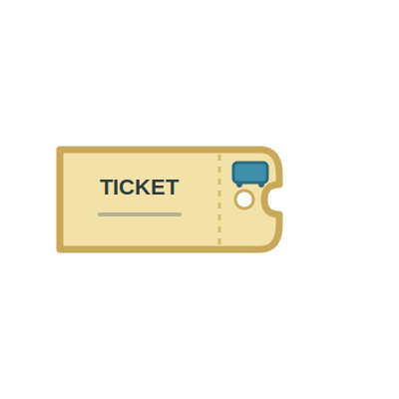
kippu
ticket
ki
ppu

Slide 161

kitte
stamp
ki
tte

Slide 162

ame
rain
a
me

Slide 163

ame
candy
a
me

Slide 164

asa
morning
a
sa

Slide 165

asa
hemp
a
sa

Slide 166

seki
seat
se
ki

Slide 167
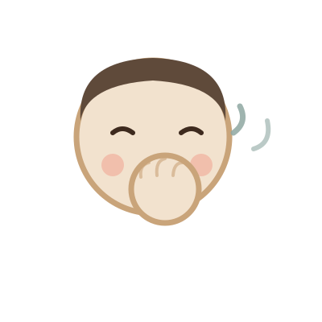
seki
cough
se
ki

Slide 168

atsusa
heat
a
tsu
sa

Slide 169

atsusa
thickness
a
tsu
sa

Slide 170

shujin
husband
shu
ji
n

Slide 171

shuujin
prisoner
shu
u
ji
n

Slide 172

toi
question
to
i

Slide 173

tooi
far
to
o
i

Slide 174

ojisan
uncle
o
ji
sa
n

Slide 175

ojiisan
grandfather
o
ji
i
sa
n

Slide 176

obasan
aunt
o
ba
sa
n

Slide 177

obaasan
grandmother
o
ba
a
sa
n

