Slide 1
Lesson 1 · New Vocabulary
AISATSU Greetings
The basic greetings used throughout Lesson 1 and its opening conversation:
Ohayoo gozai-masu · Konnichiwa · Konbanwa
Oyasumi nasai · Sayoonara
Hajimemashite · Doozo yoroshiku
* said together, when meeting someone for the first time

Slide 2

Lesson 1 · New Vocabulary
Ohayoo gozai-masu
Good morning
おはようございます

Slide 3

Lesson 1 · New Vocabulary
Konnichiwa
Good day / Hello
こんにちは

Slide 4

Lesson 1 · New Vocabulary
Konbanwa
Good evening
こんばんは

Slide 5

Lesson 1 · New Vocabulary
Oyasumi nasai
Good night
おやすみなさい

Slide 6

Lesson 1 · New Vocabulary
Sayoonara
Good bye
さようなら

Slide 7

Lesson 1 · New Vocabulary
Hajimemashite
How do you do?
はじめまして

Slide 8

Lesson 1 · New Vocabulary
Doozo yoroshiku
Nice to meet you
どうぞよろしく

Slide 9
Lesson 1 · Exercises
Exercise 1 (1) & (3) Substitution Drill
(1) Watashi wa Seeko desu.
(3) Watashi wa Seeko de wa ari-masen.
Substitute the underlined word for each of these:
Jon · Nihon-jin · Amerika-jin · Oosutoraria-jin · Chuugoku-jin*
* Chuugoku-jin = Chinese

Slide 10

Lesson 1 · Exercises
Seeko
Seeko — a girl's name
せいこ

Slide 11

Lesson 1 · Exercises
Jon
John — a man's name
ジョン

Slide 12
Lesson 1 · Exercises
✓
Watashi wa Jon desu.
✕
Watashi wa Jon de wa ari-masen.

Slide 13
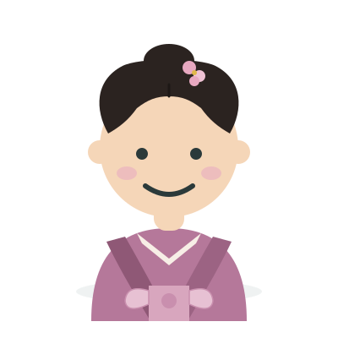
Lesson 1 · Exercises
Nihon-jin
Japanese person
日本人

Slide 14
Lesson 1 · Exercises
✓
Watashi wa Nihon-jin desu.
✕
Watashi wa Nihon-jin de wa ari-masen.

Slide 15

Lesson 1 · Exercises
Amerika-jin
American person
アメリカ人

Slide 16
Lesson 1 · Exercises
✓
Watashi wa Amerika-jin desu.
✕
Watashi wa Amerika-jin de wa ari-masen.

Slide 17

Lesson 1 · Exercises
Oosutoraria-jin
Australian person
オーストラリア人

Slide 18
Lesson 1 · Exercises
✓
Watashi wa Oosutoraria-jin desu.
✕
Watashi wa Oosutoraria-jin de wa ari-masen.

Slide 19
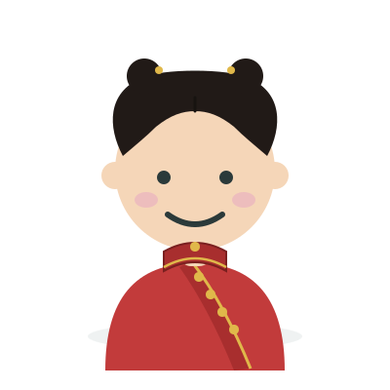
Lesson 1 · Exercises
Chuugoku-jin
Chinese person
中国人

Slide 20
Lesson 1 · Exercises
✓
Watashi wa Chuugoku-jin desu.
✕
Watashi wa Chuugoku-jin de wa ari-masen.

Slide 21
Lesson 1 · Exercises
Exercise 1 (2) & (4) Substitution Drill
(2) Watashi wa Nihon-jin desu.
(4) Watashi wa Nihon-jin de wa ari-masen.
Substitute the underlined word for each of these:
watashi-tachi · anata · anata-tachi · kare · kanojo
we · you · you (plural) · he · she

Slide 22

Lesson 1 · Exercises
watashi-tachi
we
私たち

Slide 23
Lesson 1 · Exercises
✓
Watashi-tachi wa Nihon-jin desu.
✕
Watashi-tachi wa Nihon-jin de wa ari-masen.

Slide 24

Lesson 1 · Exercises
anata
you
あなた

Slide 25
Lesson 1 · Exercises
✓
Anata wa Nihon-jin desu.
✕
Anata wa Nihon-jin de wa ari-masen.

Slide 26

Lesson 1 · Exercises
anata-tachi
you (plural)
あなたたち

Slide 27
Lesson 1 · Exercises
✓
Anata-tachi wa Nihon-jin desu.
✕
Anata-tachi wa Nihon-jin de wa ari-masen.

Slide 28

Lesson 1 · Exercises
kare
he
彼

Slide 29
Lesson 1 · Exercises
✓
Kare wa Nihon-jin desu.
✕
Kare wa Nihon-jin de wa ari-masen.

Slide 30

Lesson 1 · Exercises
kanojo
she
彼女

Slide 31
Lesson 1 · Exercises
✓
Kanojo wa Nihon-jin desu.
✕
Kanojo wa Nihon-jin de wa ari-masen.

Slide 32
Lesson 1 · Exercises
Exercise 1 (5) & Exercise 2 Question & Answer Drill
(5) Anata wa Seeko-san desu ka?
P. Hai, Seeko desu.
N. Iie, Seeko de wa ari-masen.
Substitute the underlined word, then answer both ways:
Jon · Nihon-jin · Amerika-jin · Oosutoraria-jin · Chuugoku-jin*
* Chuugoku-jin = Chinese

Slide 33
Lesson 1 · Exercises
Anata wa Jon-san desu ka?
✓
Hai, Jon desu.
✕
Iie, Jon de wa ari-masen.

Slide 34
Lesson 1 · Exercises
Anata wa Nihon-jin desu ka?
✓
Hai, Nihon-jin desu.
✕
Iie, Nihon-jin de wa ari-masen.

Slide 35
Lesson 1 · Exercises
Anata wa Amerika-jin desu ka?
✓
Hai, Amerika-jin desu.
✕
Iie, Amerika-jin de wa ari-masen.

Slide 36
Lesson 1 · Exercises
Anata wa Oosutoraria-jin desu ka?
✓
Hai, Oosutoraria-jin desu.
✕
Iie, Oosutoraria-jin de wa ari-masen.

Slide 37
Lesson 1 · Exercises
Anata wa Chuugoku-jin desu ka?
✓
Hai, Chuugoku-jin desu.
✕
Iie, Chuugoku-jin de wa ari-masen.

Slide 38
Lesson 1 · Extra Study
Numbers (I) 0 ~ 100
The basic numbers, used to build every number up to 100:
Zero · Ichi · Ni · San · Yon · Go
Roku · Nana · Hachi · Kyuu · Juu · Hyaku
11 = 10 + 1 (juu-ichi) 20 = 2 × 10 (ni-juu)
Note: 4, 7, and 9 each have two readings — both are used.

Slide 39
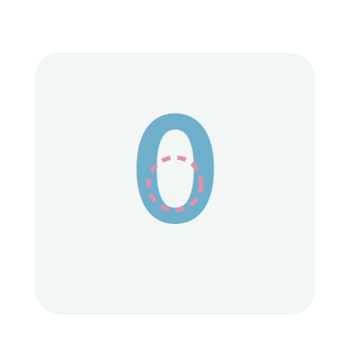
Lesson 1 · Extra Study
Zero
zero (also: ree)
ゼロ

Slide 40

Lesson 1 · Extra Study
Ichi
one
一

Slide 41
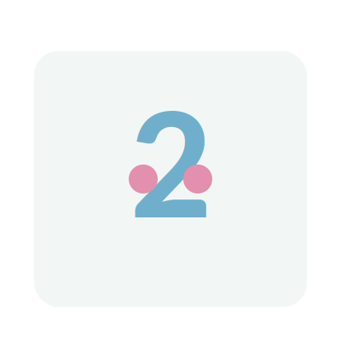
Lesson 1 · Extra Study
Ni
two
二

Slide 42

Lesson 1 · Extra Study
San
three
三

Slide 43

Lesson 1 · Extra Study
Shi / Yon
four
四

Slide 44

Lesson 1 · Extra Study
Go
five
五

Slide 45

Lesson 1 · Extra Study
Roku
six
六

Slide 46

Lesson 1 · Extra Study
Shichi / Nana
seven
七

Slide 47

Lesson 1 · Extra Study
Hachi
eight
八

Slide 48

Lesson 1 · Extra Study
Ku / Kyuu
nine
九

Slide 49

Lesson 1 · Extra Study
Juu
ten
十

Slide 50
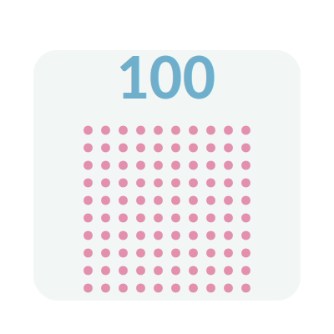
Lesson 1 · Extra Study
Hyaku
hundred
百

Slide 51
Lesson 1 · Extra Study
Months -gatsu
Months are simply a number + "-gatsu":
Ichi-gatsu (1) → January
Three months use a special reading instead of the usual number:
Shi-gatsu (Apr.) · Shichi-gatsu (Jul.) · Ku-gatsu (Sep.)

Slide 52
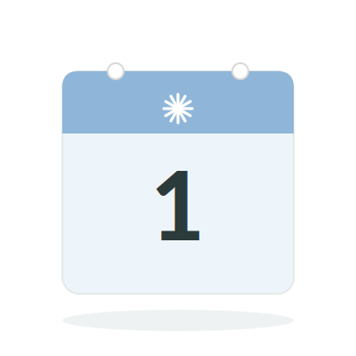
Lesson 1 · Extra Study
Ichi-gatsu
January
一月

Slide 53
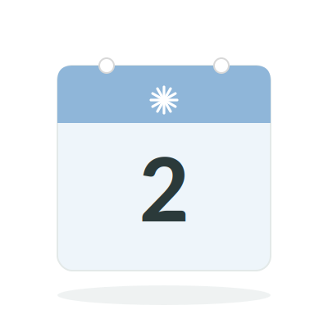
Lesson 1 · Extra Study
Ni-gatsu
February
二月

Slide 54
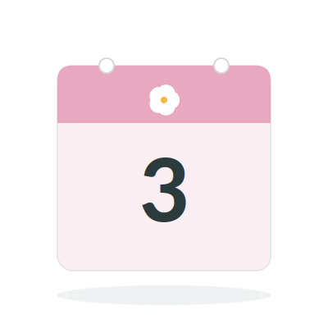
Lesson 1 · Extra Study
San-gatsu
March
三月

Slide 55
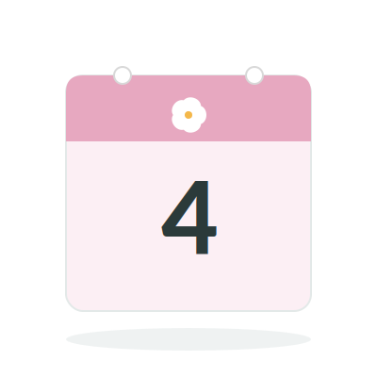
Lesson 1 · Extra Study
Shi-gatsu
April
四月

Slide 56
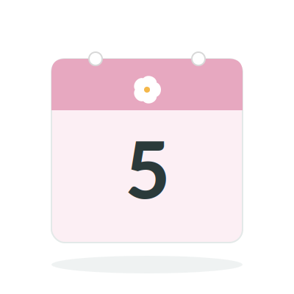
Lesson 1 · Extra Study
Go-gatsu
May
五月

Slide 57
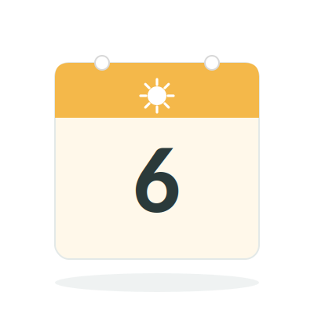
Lesson 1 · Extra Study
Roku-gatsu
June
六月

Slide 58
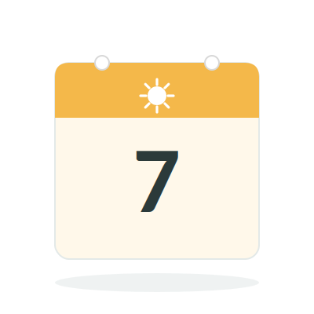
Lesson 1 · Extra Study
Shichi-gatsu
July
七月

Slide 59
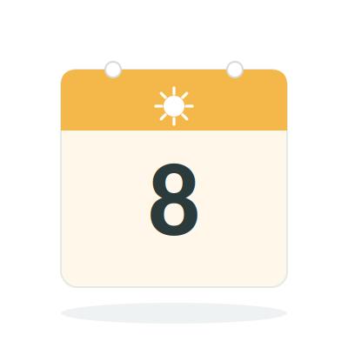
Lesson 1 · Extra Study
Hachi-gatsu
August
八月

Slide 60
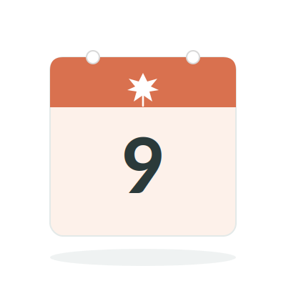
Lesson 1 · Extra Study
Ku-gatsu
September
九月

Slide 61
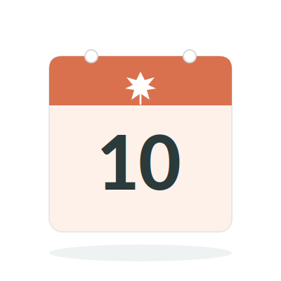
Lesson 1 · Extra Study
Juu-gatsu
October
十月

Slide 62
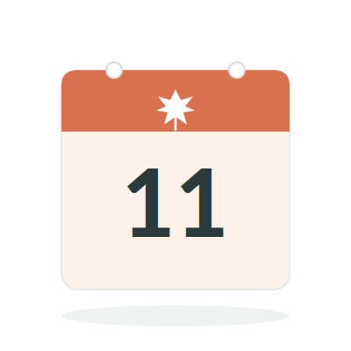
Lesson 1 · Extra Study
Juu-ichi-gatsu
November
十一月

Slide 63
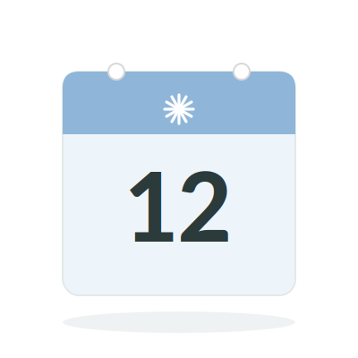
Lesson 1 · Extra Study
Juu-ni-gatsu
December
十二月

Slide 64
Lesson 1 · Extra Study
Time -ji · o'clock
Telling time on the hour is a number + "-ji":
Ichi-ji (1) → 1 o'clock
Three hours use a special reading instead of the usual number:
Yo-ji (4:00) · Shichi-ji (7:00) · Ku-ji (9:00)

Slide 65
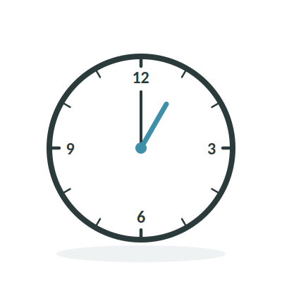
Lesson 1 · Extra Study
Ichi-ji
1 o'clock
一時

Slide 66
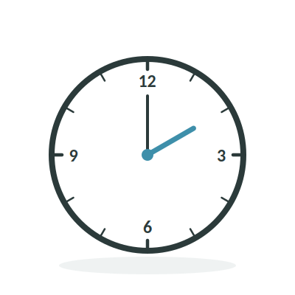
Lesson 1 · Extra Study
Ni-ji
2 o'clock
二時

Slide 67
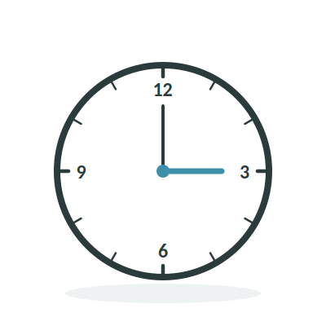
Lesson 1 · Extra Study
San-ji
3 o'clock
三時

Slide 68
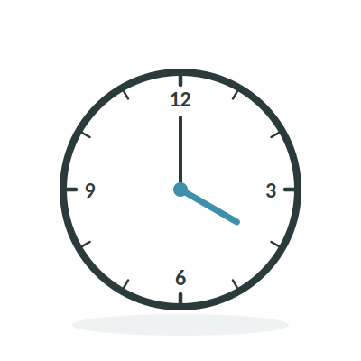
Lesson 1 · Extra Study
Yo-ji
4 o'clock
四時

Slide 69
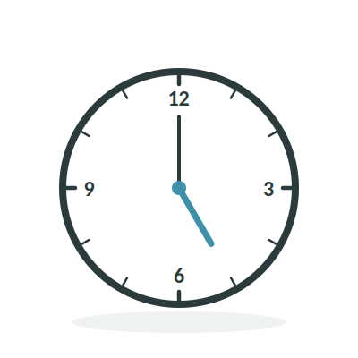
Lesson 1 · Extra Study
Go-ji
5 o'clock
五時

Slide 70
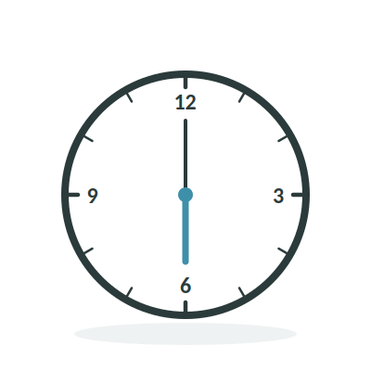
Lesson 1 · Extra Study
Roku-ji
6 o'clock
六時

Slide 71
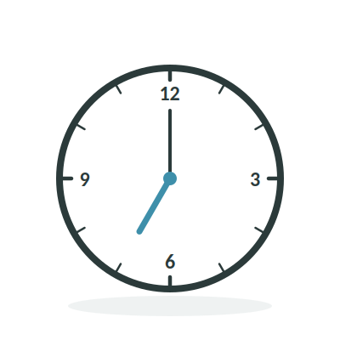
Lesson 1 · Extra Study
Shichi-ji
7 o'clock
七時

Slide 72
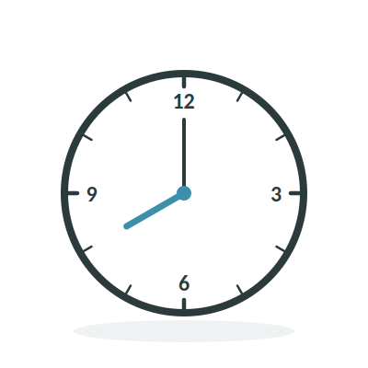
Lesson 1 · Extra Study
Hachi-ji
8 o'clock
八時

Slide 73
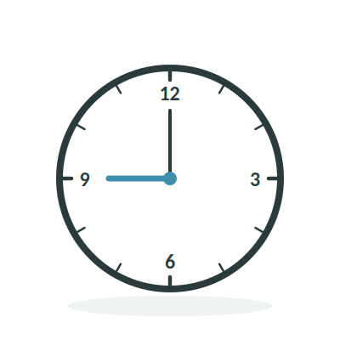
Lesson 1 · Extra Study
Ku-ji
9 o'clock
九時

Slide 74
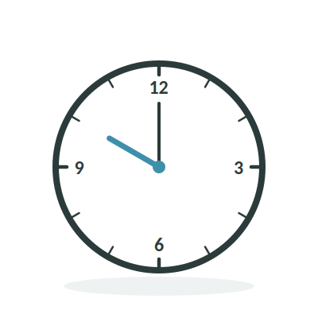
Lesson 1 · Extra Study
Juu-ji
10 o'clock
十時

Slide 75
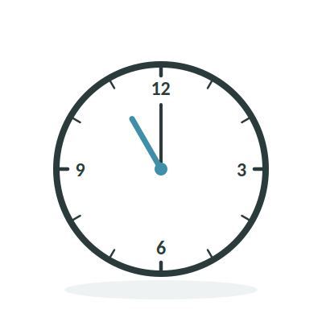
Lesson 1 · Extra Study
Juu-ichi-ji
11 o'clock
十一時

Slide 76
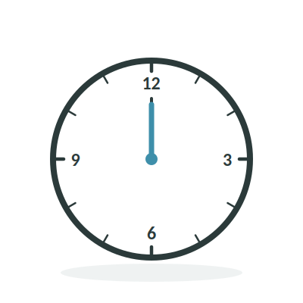
Lesson 1 · Extra Study
Juu-ni-ji
12 o'clock
十二時

