Slide 1
Japanese Writing Systems
Study cards for beginners

Slide 2

Japanese Writing Systems
Kanji 漢字
Chinese-origin characters that represent meaning. About 2,000-3,000 in common use.
EXAMPLE
一
二
三
ichi
ni
san
(one)
(two)
(three)

Slide 3
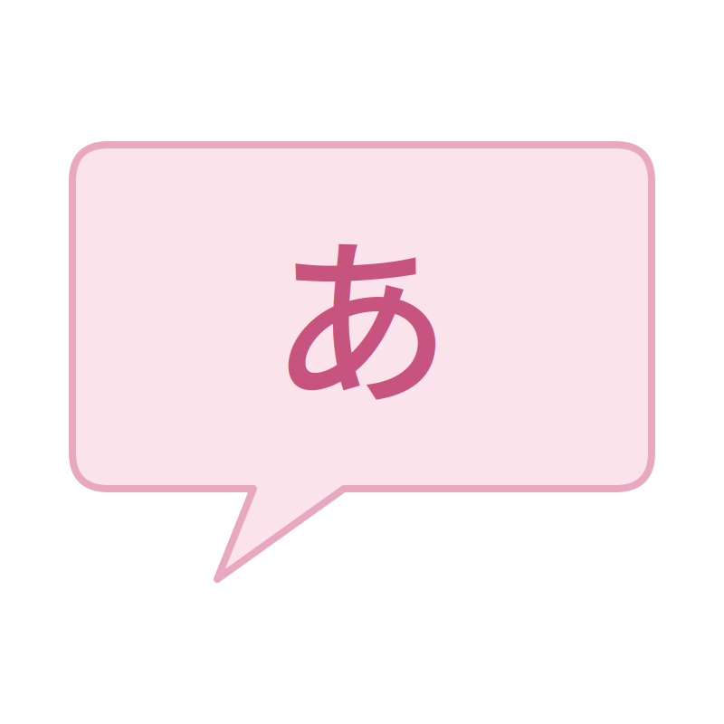
Japanese Writing Systems
Hiragana ひらがな
46 phonetic characters, one per sound. Curved, flowing strokes.
EXAMPLE
あ
い
う
え
お
a
i
u
e
o

Slide 4

Japanese Writing Systems
Katakana カタカナ
46 phonetic characters, mainly for foreign loanwords. Angular, straight strokes.
EXAMPLE
テレビ
terebi
(television)

Slide 5
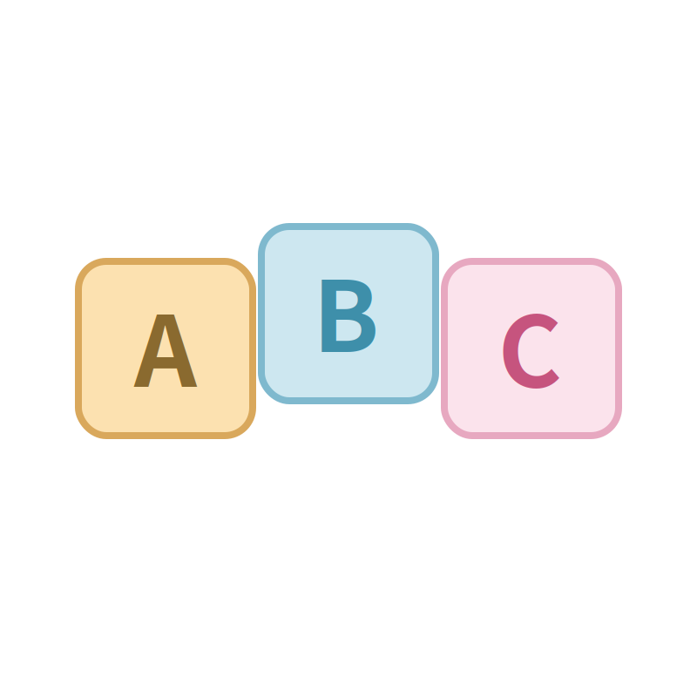
Japanese Writing Systems
Roomaji ローマ字
Japanese sounds written with the English alphabet. 101 sounds total: 5 vowels, 95 consonant-vowel combinations, plus 'n'.
EXAMPLE
paatii
sofaa
chesu
(party)
(sofa)
(chess)

Slide 6
Roomaji Syllables Chart
Basic syllables (a / i / u / e / o) and contracted yōon sounds (ya / yu / yo)
Seion (Plain Sounds)
 | a | i | u | e | o
k | ka | ki | ku | ke | ko
s | sa | shi | su | se | so
t | ta | chi | tsu | te | to
n | na | ni | nu | ne | no
h | ha | hi | fu | he | ho
m | ma | mi | mu | me | mo
y | ya |  | yu |  | yo
r | ra | ri | ru | re | ro
w | wa
a | u | o
kya | kyu | kyo
sha | shu | sho
cha | chu | cho
nya | nyu | nyo
hya | hyu | hyo
mya | myu | myo
rya | ryu | ryo
Dakuon & Handakuon (Voiced Sounds)
 | a | i | u | e | o
g | ga | gi | gu | ge | go
z | za | ji | zu | ze | zo
d | da |  |  | de | do
b | ba | bi | bu | be | bo
p | pa | pi | pu | pe | po
n | n (consonant only)
a | u | o
gya | gyu | gyo
ja | ju | jo
bya | byu | byo
pya | pyu | pyo

Slide 7
Japanese Writing Systems
Long Vowels 長音
Double vowels replace macrons for a long vowel sound (held twice as long). Vowel length changes meaning.
EXAMPLE
koohii
tori
toori
(coffee)
(bird)
(street)

Slide 8
Japanese Writing Systems
Hyphens
Mark word boundaries: after prefixes/before suffixes, between compound words, and before inflected endings.
EXAMPLE
o-cha
Nihon-go
iki-mashoo
(tea)
(Japanese language)
(let's go)

Slide 9
Japanese Writing Systems
Apostrophes
Mark a short pause after the 'n' sound, or show a contraction.
EXAMPLE
gen'in
fun'iki
(cause)
(atmosphere)

Slide 10
Japanese Writing Systems
'N' Sound
Pronounced like 'm' before b/p/m, like 'ng' before g/k, and as a nasal sound before vowels, y/w, and s/sh/h.
EXAMPLE
shinbun
kangae
funsui
denwa
(newspaper)
(thought)
(fountain)
(telephone)

Slide 11
Japanese Writing Systems
Double Consonants 促音
Sounds that merge together are shown by doubling the consonant.
EXAMPLE
hakkiri
massugu
kitte
issho
(clearly)
(straight)
(stamp)
(together)

Slide 12
Japanese Writing Systems
Abbreviations
Notation used in this textbook for questions, answers, and examples.
EXAMPLE
Q
A
S
T
e.g.
(question)
(answer)
(student)
(teacher)
(example)

Slide 13
Japanese Writing Systems
Vowels 母音
5 vowels (a, i, u, e, o), each clear and crisp -- shorter and more clipped than in English.
EXAMPLE
a
i
u
e
o
(father)
(king)
(put)
(pet)
(toe)

Slide 14
Japanese Writing Systems
Voiceless Vowels
Between or after voiceless consonants (k, s, sh, t, ts, ch, h, f, p), 'i' and 'u' are pronounced weakly.
EXAMPLE
tsuki
desu
hisho
(moon)
(to be)
(secretary)

Slide 15
Japanese Writing Systems
Semi-vowel Y 半母音 Y
A shorter, softer 'i' sound. Combines with a, u, or o as one syllable -- not two.
EXAMPLE
kyoo
kiyoo
(today)
(skillful)

Slide 16
Japanese Writing Systems
Semi-vowel W 半母音 W
Only followed by 'a'. 'Wa' is pronounced like 'ua' without rounding the lips.
EXAMPLE
watashi
(I / me)

Slide 17
Japanese Writing Systems
Consonants 子音
Followed by vowels, and lighter than in English. English 'l' and 'v' don't exist in Japanese. 'Z' doesn't vibrate at the tongue tip.
EXAMPLE
sh
ts
f
(she)
(wants)
(foot)

Slide 18
Japanese Pronunciation Guide
Japanese symbols and their English approximate pronunciation
Consonant Sounds
k
as in
kind
ch
as in
change
m
as in
my
j
as in
jumper
s
as in
sound
n
as in
knife
r
as in
ring
d
as in
dog
sh
as in
she
h
as in
hit
g
as in
give
p
as in
pink
t
as in
tongue
f
as in
foot
z
as in
zone
b
as in
big
ts
as in
wants

Slide 19
Japanese Writing Systems
Fu Sound
Made by protruding both lips, as if blowing out a candle.
EXAMPLE
fuyu
(winter)

Slide 20
Japanese Writing Systems
R Sound
A flapping sound, made by quickly touching the tongue tip to the gum behind the upper teeth.
EXAMPLE
arigatoo
(thank you)

Slide 21
Japanese Writing Systems
G Sound (mid-word)
Within a word, 'g' is close to the 'ng' sound, though this is optional.
EXAMPLE
eega
shingoo
kaigi
(movie)
(traffic light)
(conference)

Slide 22
Japanese Writing Systems
Z Sound
Does not vibrate at the top of the tongue the way the English 'z' does.
EXAMPLE
mizu
(water)

Slide 23
Japanese Writing Systems
Double Consonant Sounds
Doubled consonants (kk, ss, ssh, tt, tts, tch, pp) are pronounced with a brief held pause before release, like 'black cat' or 'hot tip' said quickly.
EXAMPLE
kitte
issho
hakkiri
(stamp)
(together)
(clearly)

Slide 24
Japanese Writing Systems
Accent and Rhythm アクセント
Japanese uses pitch (high/low), not stress -- every syllable is the same length and speed, like a metronome that changes pitch. Same spelling with a different pitch pattern can mean something different.
EXAMPLE
dot height = pitch (higher = higher pitch)
a
me
a
me
se
ki
se
ki
ha
ku
shi
ha
ku
shi
(candy)
(rain)
(seat)
(cough)
(doctorate)
(white paper)

