Slide 1

ai
love
a
i

Slide 2

ie
house
i
e

Slide 3

ue
above
u
e

Slide 4

oi
nephew
o
i

Slide 5

aoi
blue
a
o
i

Slide 6

iie
no
i
i
e

Slide 7

ooi
many
o
o
i

Slide 8

kaku
to write
ka
ku

Slide 9

kiku
to listen
ki
ku

Slide 10

koko
here
ko
ko

Slide 11

kakaku
price
ka
ka
ku

Slide 12
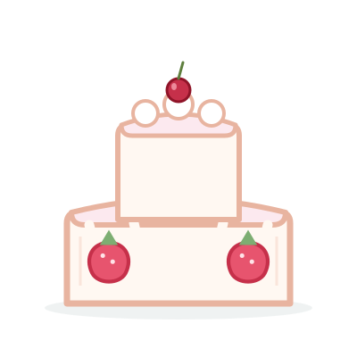
keeki
cake
ke
e
ki

Slide 13

kyaku
customer
kya
ku

Slide 14

kyoo
today
kyo
o

Slide 15

kyookai
church
kyo
o
ka
i

Slide 16

saka
slope
sa
ka

Slide 17

suu
to smoke
su
u

Slide 18

soko
there
so
ko

Slide 19

sukoshi
a little
su
ko
shi

Slide 20

sekai
world
se
ka
i

Slide 21

shako
garage
sha
ko

Slide 22

shuu
state
shu
u

Slide 23

shookai
introduction
sho
o
ka
i

Slide 24
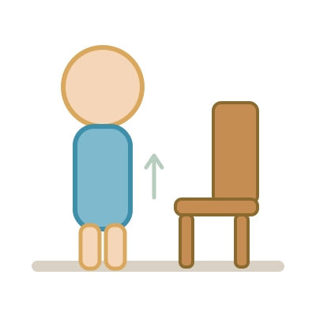
tatsu
to stand
ta
tsu

Slide 25

chiri
dust
chi
ri

Slide 26

tetsu
iron
te
tsu

Slide 27

toki
time
to
ki

Slide 28

chikai
close
chi
ka
i

Slide 29

choo
intestines
cho
o

Slide 30

chakuchi
landing
cha
ku
chi

Slide 31

chuucho
hesitation
chu
u
cho

Slide 32

nani
what
na
ni

Slide 33

niku
meat
ni
ku

Slide 34

nuu
to sew
nu
u

Slide 35

neko
cat
ne
ko

Slide 36
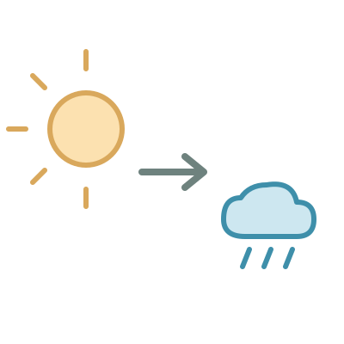
nochi
later
no
chi

Slide 37

nyaa
meow
nya
a

Slide 38

nyuushi
baby tooth
nyu
u
shi

Slide 39
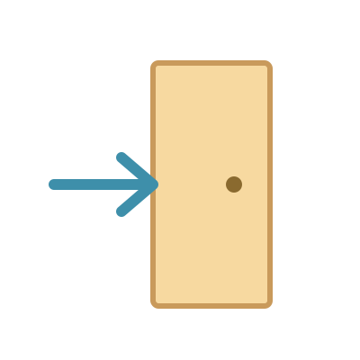
nyuukai
admission
nyu
u
ka
i

Slide 40

hako
box
ha
ko

Slide 41

hifu
skin
hi
fu

Slide 42

fune
ship
fu
ne

Slide 43

heso
navel
he
so

Slide 44

hoshi
star
ho
shi

Slide 45
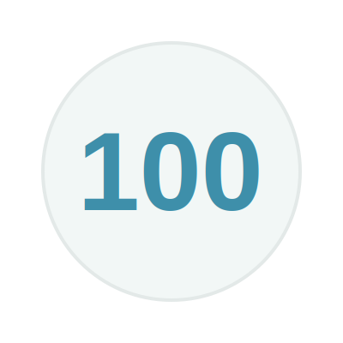
hyaku
hundred
hya
ku

Slide 46

hyuuhyuu
whiz
hyu
u
hyu
u

Slide 47

hyooka
valuation
hyo
o
ka

Slide 48
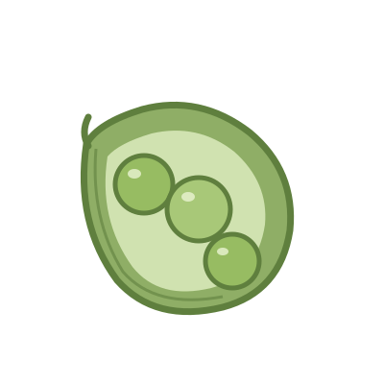
mame
bean
ma
me

Slide 49
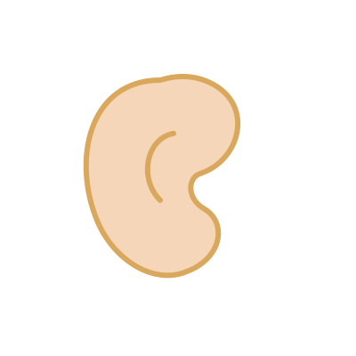
mimi
ear
mi
mi

Slide 50

momo
peach
mo
mo

Slide 51
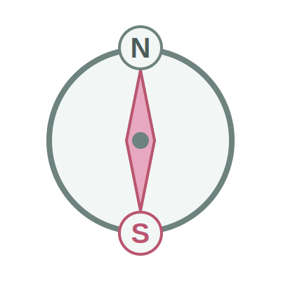
minami
south
mi
na
mi

Slide 52

musume
daughter
mu
su
me

Slide 53

mokuhyoo
aim
mo
ku
hyo
o

Slide 54

myaku
pulse
mya
ku

Slide 55

myoo
odd
myo
o

Slide 56

yama
mountain
ya
ma

Slide 57

yume
dream
yu
me

Slide 58
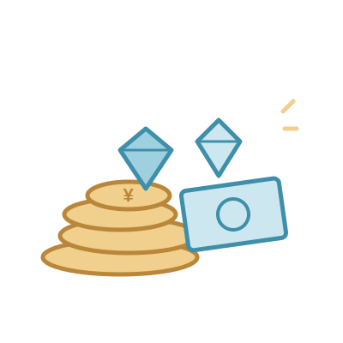
yoku
desire
yo
ku

Slide 59

yatou
to employ
ya
to
u

Slide 60
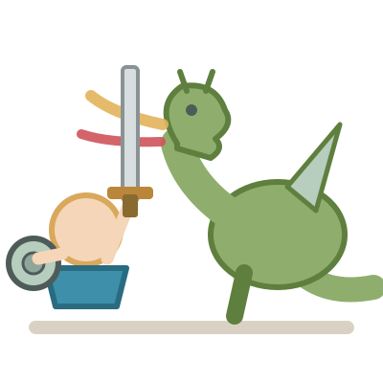
yuuki
bravery
yu
u
ki

Slide 61

yosoku
prediction
yo
so
ku

Slide 62
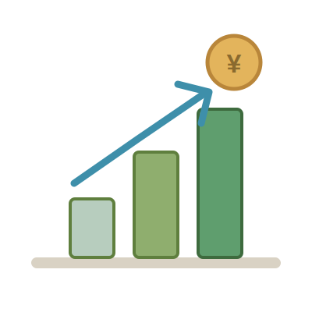
yuueki
profitable
yu
u
e
ki

Slide 63

yookyuu
demand
yo
o
kyu
u

Slide 64

raku
easy
ra
ku

Slide 65

riku
land
ri
ku

Slide 66

rusu
absence
ru
su

Slide 67

retsu
line
re
tsu

Slide 68

roku
six
ro
ku

Slide 69
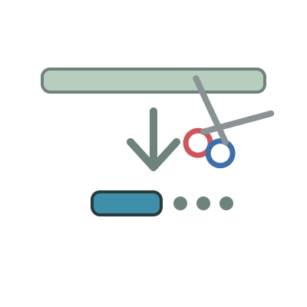
ryaku
omission
rya
ku

Slide 70
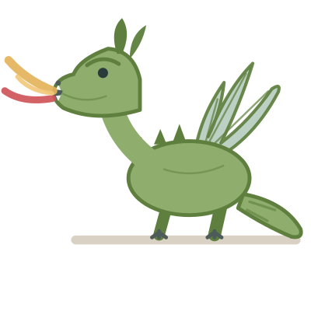
ryuu
dragon
ryu
u

Slide 71

ryoo
amount
ryo
o

Slide 72

washi
eagle
wa
shi

Slide 73

watashi
I (me)
wa
ta
shi

Slide 74

wasureru
to forget
wa
su
re
ru

Slide 75

wariate
assignment
wa
ri
a
te

Slide 76
wariateru
to allot
wa
ri
a
te
ru

Slide 77

wakai
young
wa
ka
i

Slide 78

gai
harm
ga
i

Slide 79

girisha
Greece
gi
ri
sha

Slide 80

guusuu
even number
gu
u
su
u

Slide 81

geki
drama
ge
ki

Slide 82
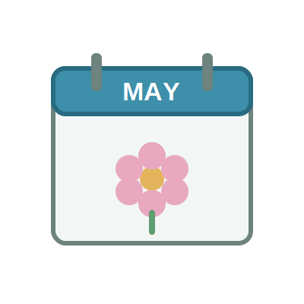
gogatsu
May
go
ga
tsu

Slide 83

gyaku
contrary
gya
ku

Slide 84
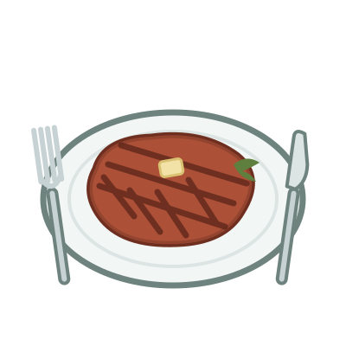
gyuuniku
beef
gyu
u
ni
ku

Slide 85

gyooji
event
gyo
o
ji

Slide 86
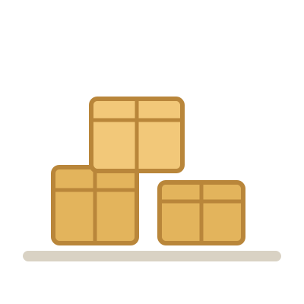
zaiko
stock
za
i
ko

Slide 87

jimusho
office
ji
mu
sho

Slide 88

zurui
sly
zu
ru
i

Slide 89

zeetaku
luxury
ze
e
ta
ku

Slide 90
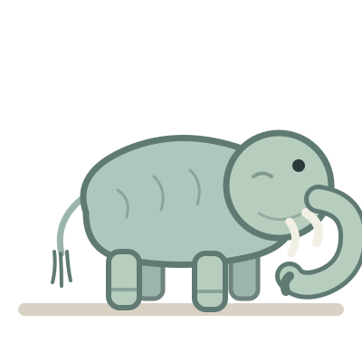
zoo
elephant
zo
o

Slide 91
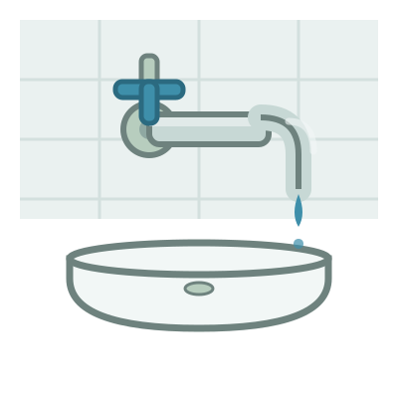
jaguchi
tap
ja
gu
chi

Slide 92

juu
ten
ju
u

Slide 93

joogi
ruler
jo
o
gi

Slide 94

dashi
soup stock
da
shi

Slide 95

deru
to go out
de
ru

Slide 96

doko
where
do
ko

Slide 97

daigaku
university
da
i
ga
ku

Slide 98

detarame
nonsense
de
ta
ra
me

Slide 99

doozo
please
do
o
zo

Slide 100
batsu
punishment
ba
tsu

Slide 101

biiru
beer
bi
i
ru

Slide 102

buta
pig
bu
ta

Slide 103

beni
rouge
be
ni

Slide 104

booshi
hat
bo
o
shi

Slide 105
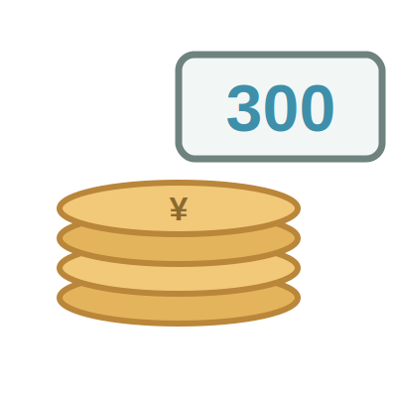
sanbyaku
three hundred
sa
n
bya
ku

Slide 106
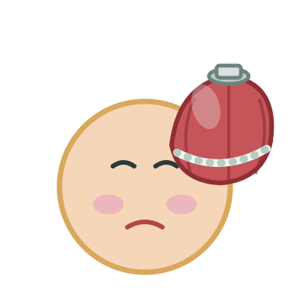
byooki
sickness
byo
o
ki

Slide 107

byoo
a second
byo
o

Slide 108

pan
bread
pa
n

Slide 109

puuru
pool
pu
u
ru

Slide 110

posuto
mailbox
po
su
to

Slide 111

piano
piano
pi
a
no

Slide 112

puragu
plug
pu
ra
gu

Slide 113

pedaru
pedal
pe
da
ru

Slide 114

roppyaku
six hundred
ro
ppya
ku

Slide 115

happyaku
eight hundred
ha
ppya
ku

Slide 116

hantai
opposite
ha
n
ta
i

Slide 117
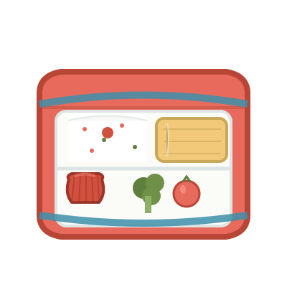
bentoo
lunch box
be
n
to
o

Slide 118

kanri
administration
ka
n
ri

Slide 119

hanzai
crime
ha
n
za
i

Slide 120
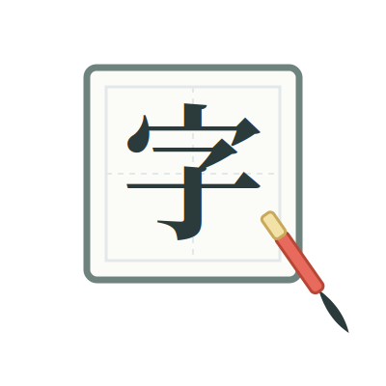
kanji
Chinese character
ka
n
ji

Slide 121
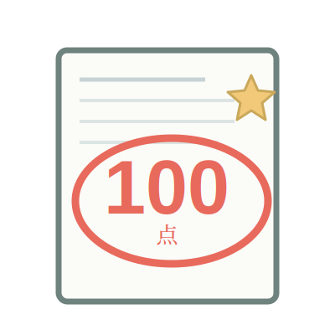
kanpeki
perfect
ka
n
pe
ki

Slide 122

chinmoku
silence
chi
n
mo
ku

Slide 123

shinbun
newspaper
shi
n
bu
n

Slide 124

konban
tonight
ko
n
ba
n

Slide 125
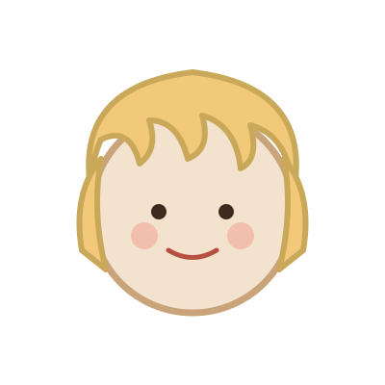
kinpatsu
blond
ki
n
pa
tsu

Slide 126

kankyoo
environment
ka
n
kyo
o

Slide 127

tenki
weather
te
n
ki

Slide 128

mangetsu
full moon
ma
n
ge
tsu

Slide 129

kenshin
devotion
ke
n
shi
n

Slide 130
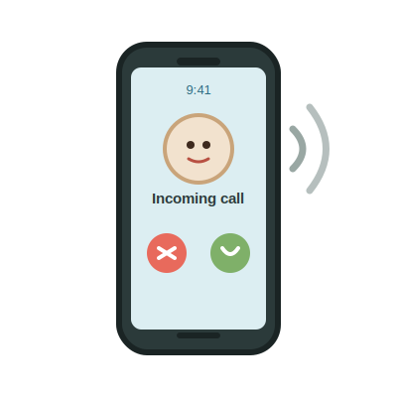
denwa
telephone
de
n
wa

Slide 131

tenin
clerk
te
n
i
n

Slide 132

honya
book store
ho
n
ya

Slide 133

hakkiri
clearly
ha
kki
ri

Slide 134
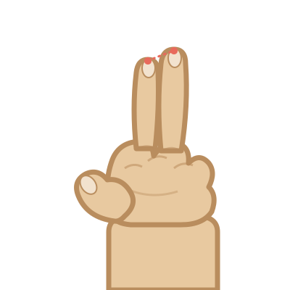
chotto
a little
cho
tto

Slide 135

massugu
straight
ma
ssu
gu

Slide 136
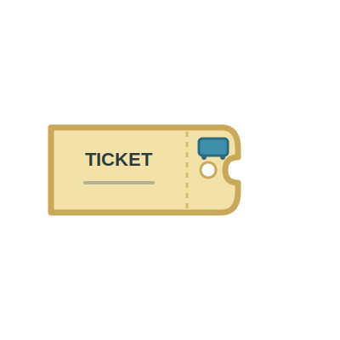
kippu
ticket
ki
ppu

Slide 137

kitte
stamp
ki
tte

Slide 138

ame
rain
a
me

Slide 139

ame
candy
a
me

Slide 140

asa
morning
a
sa

Slide 141

asa
hemp
a
sa

Slide 142

seki
seat
se
ki

Slide 143
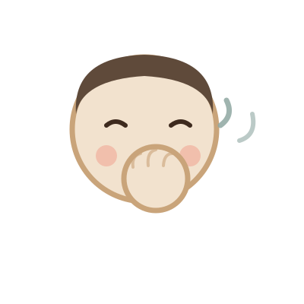
seki
cough
se
ki

Slide 144

atsusa
heat
a
tsu
sa

Slide 145

atsusa
thickness
a
tsu
sa

Slide 146

shujin
husband
shu
ji
n

Slide 147

shuujin
prisoner
shu
u
ji
n

Slide 148

toi
question
to
i

Slide 149

tooi
far
to
o
i

Slide 150
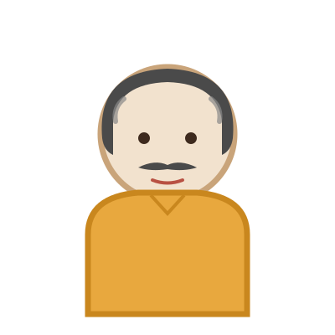
ojisan
uncle
o
ji
sa
n

Slide 151

ojiisan
grandfather
o
ji
i
sa
n

Slide 152

obasan
aunt
o
ba
sa
n

Slide 153

obaasan
grandmother
o
ba
a
sa
n

