Slide 1
Previous Project: Enrollment System New Project: Scheduling Module
both, Betse, Vitek, Ivan

Slide 2
Quality attributes
Scalability, performance, and availability of services [Sereyboth]
Unenrollment [Betsegaw]
Enrollment History [Betsegaw]
Class Material [Vit]
Enrollment Accessibility [Ivan]

Slide 3
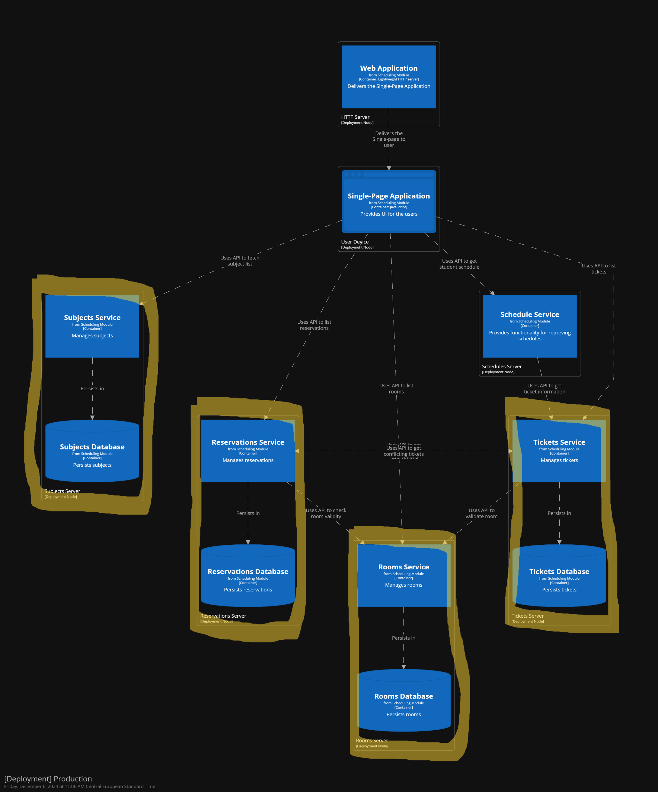
Current Structure of the system:
Author: Sereyboth
Notes:
We want to scale up Tickets Database

Slide 4
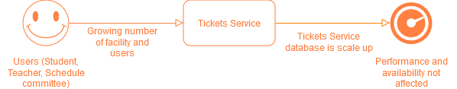
Scenario 1: Scalability
Author: Sereyboth
Notes:
We want to scale up Tickets Database

Slide 5
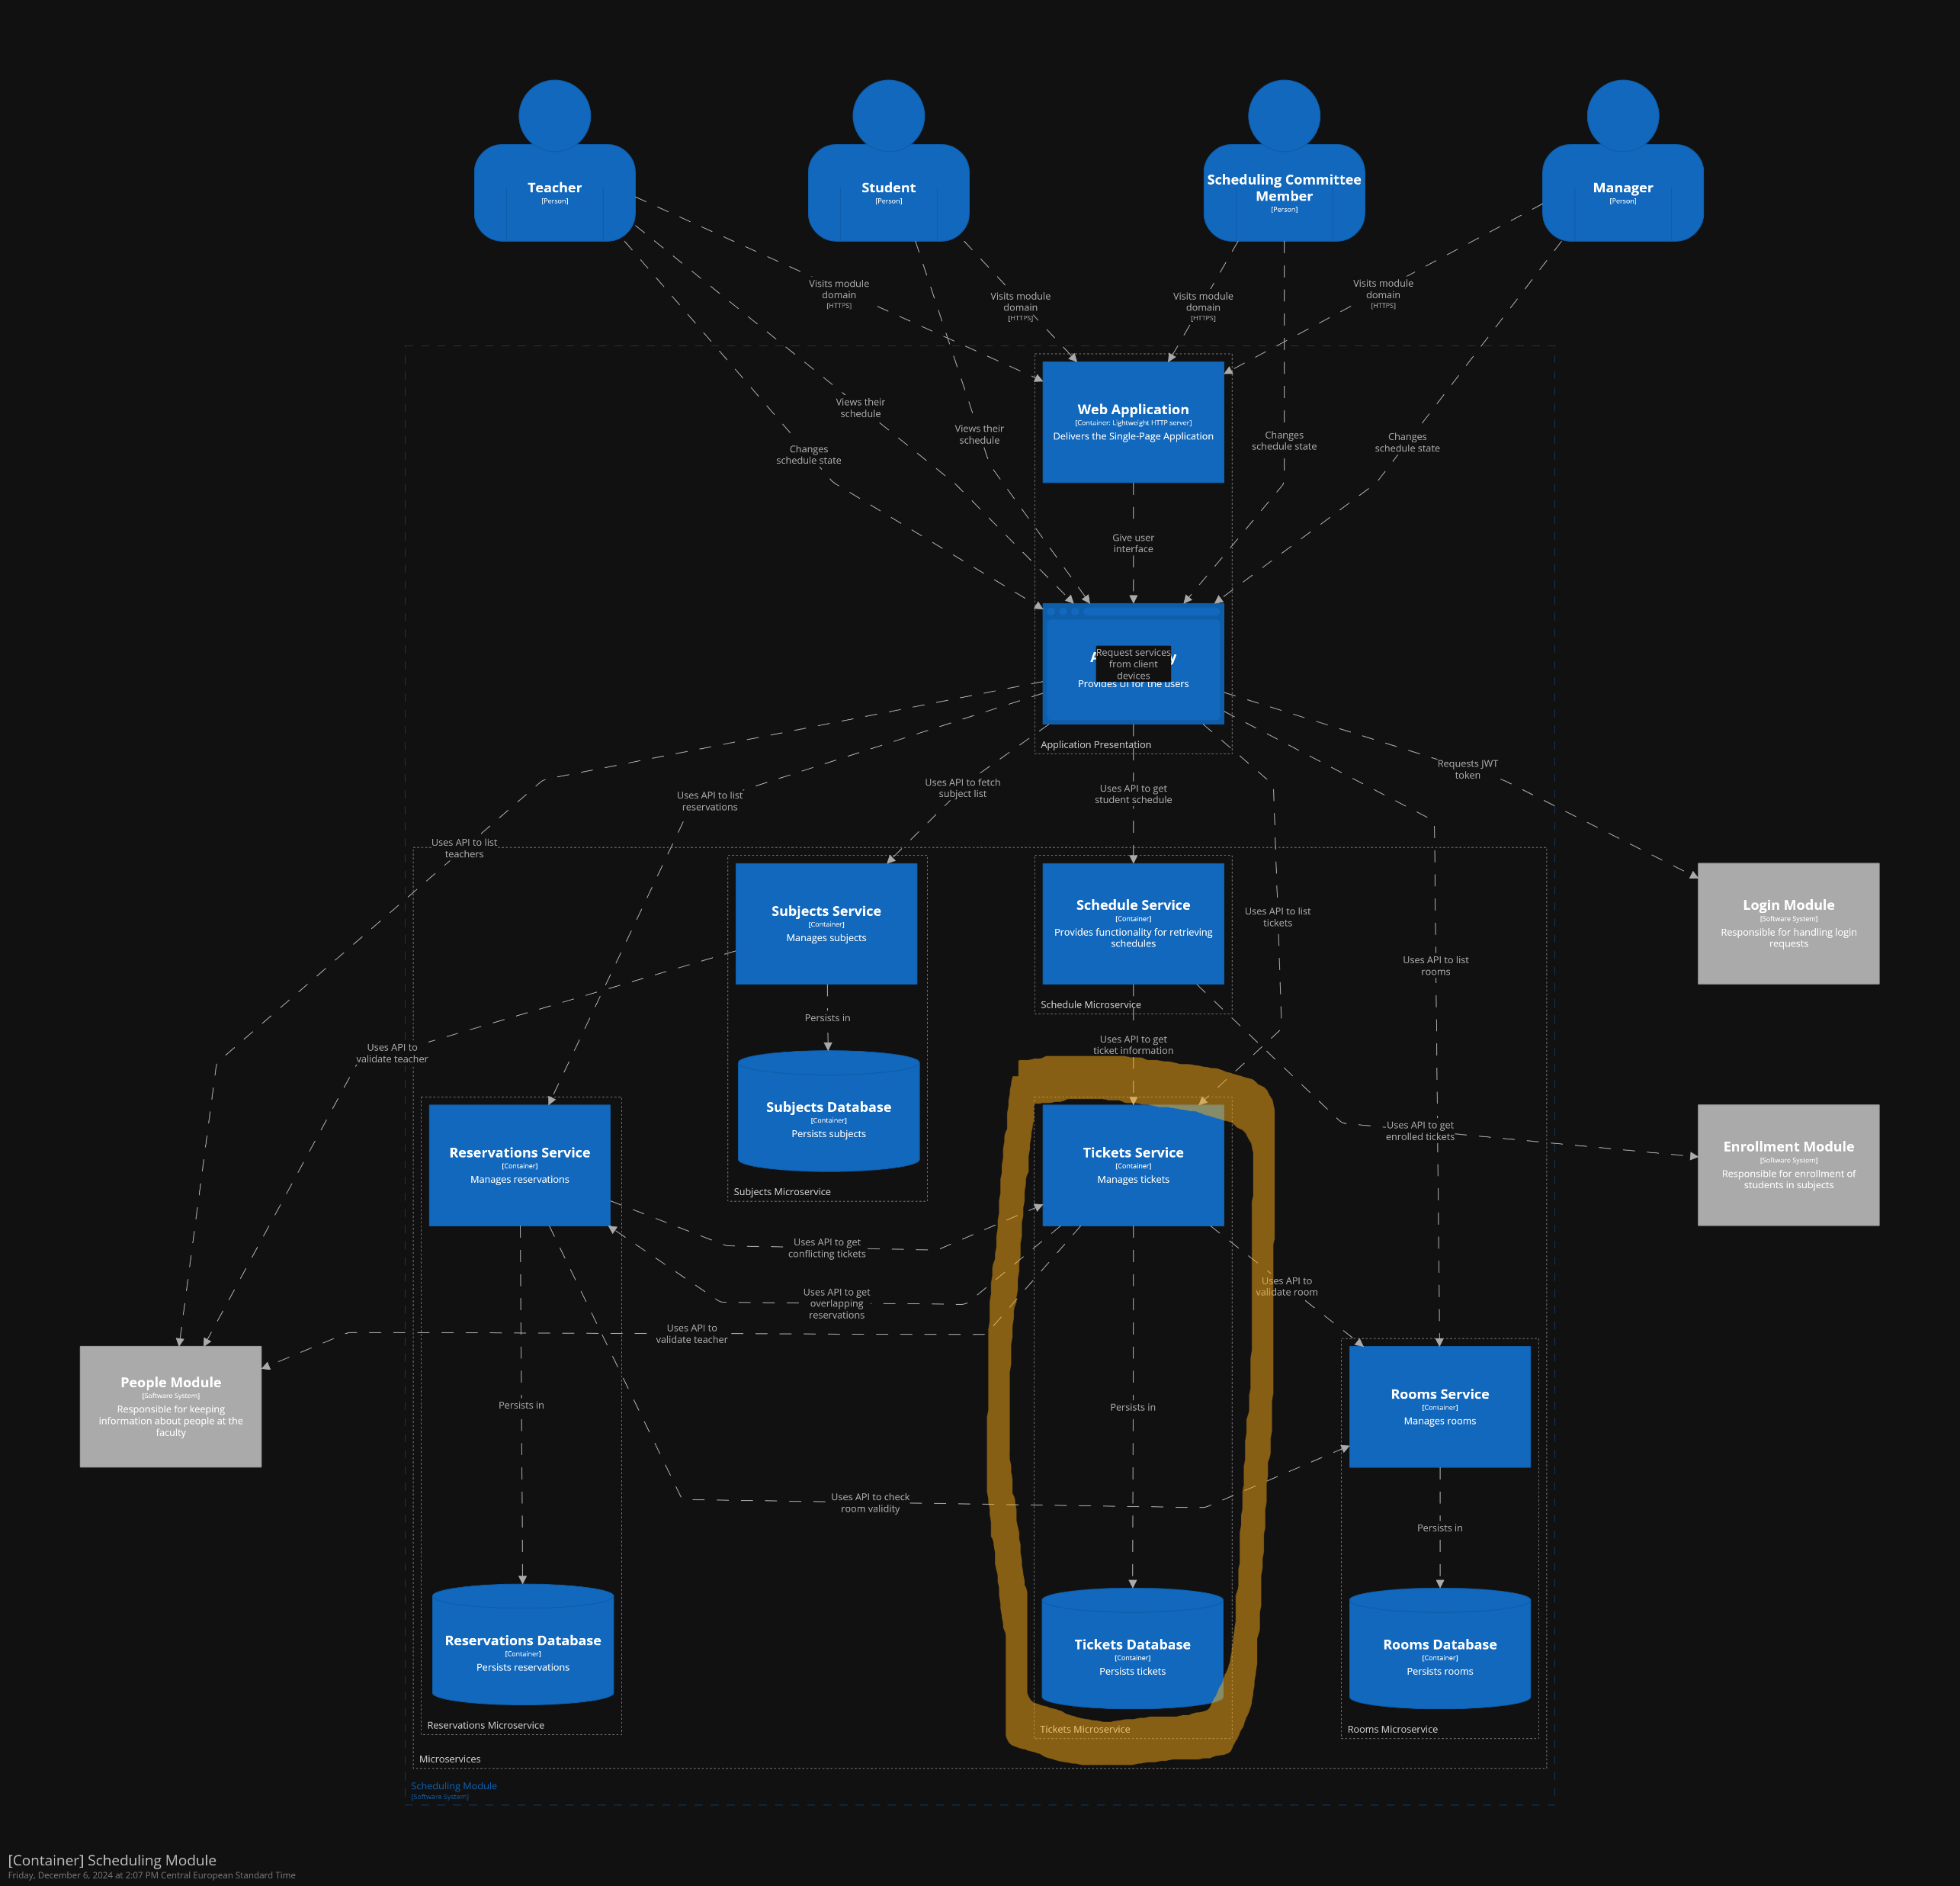
Scenario 1: Scalability
Author: Sereyboth
Notes:
We want to scale up Tickets Database

Slide 6
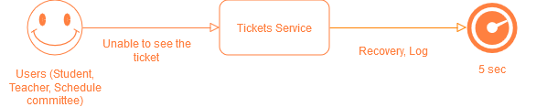
Scenario 2: Availability
Author: Sereyboth
Notes:
we want to keep using the system when the app is updating (Scale up some services)

Slide 7
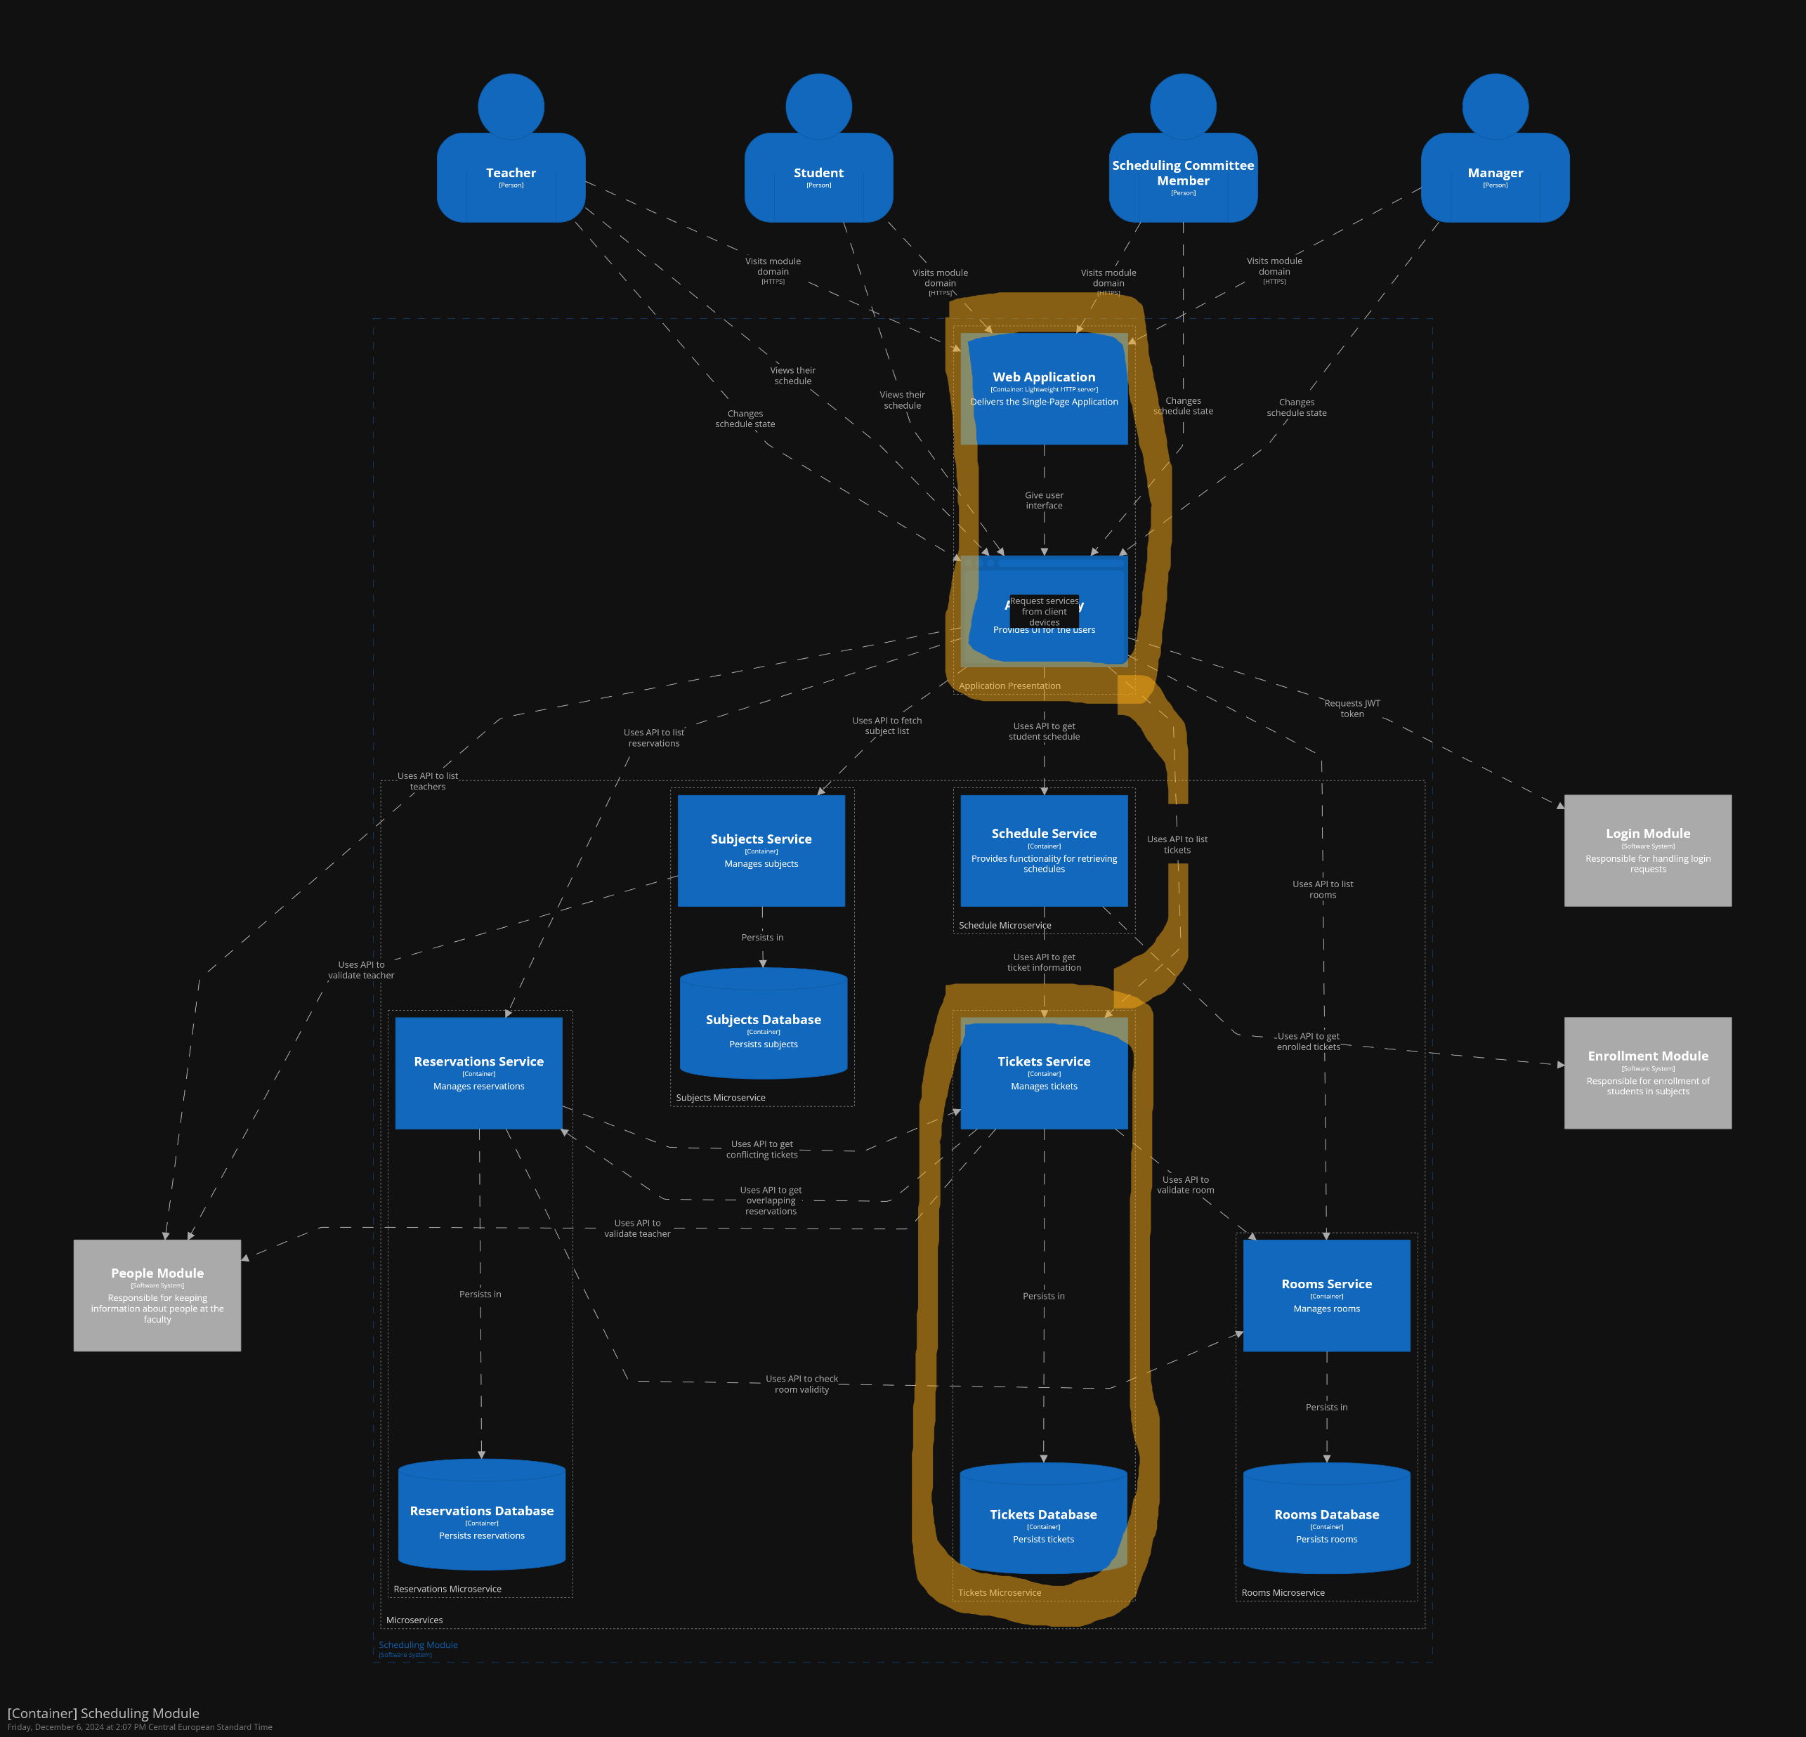
Scenario 2: Availability
Author: Sereyboth
Notes:
we want to keep using the system when the app is updating (Scale up some services)

Slide 8
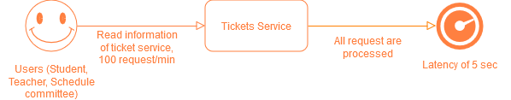
Scenario 3: Performance
Author: Sereyboth
Notes:
User unable to access Ticket Service
Problem 1: it is not possible to just scale a database by itself since it is pair with application server or the other way around with application server scaling. Cause of tight coupling.
Problem 2: downtime on any of the server mean the services and database are both down.

Slide 9
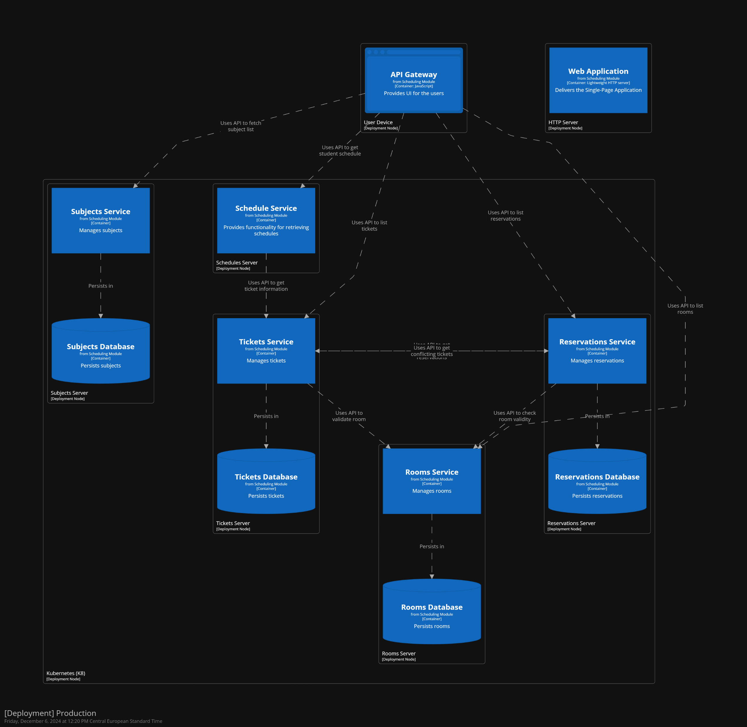
Propose solution 1:
Author: Sereyboth
Notes:
Solution 1: without changing the architecture:
Put Tickets Service on Kubernetes and make multiple replica, synchronization should be handled by Kubernetes
Problem 1 still persist
Problem 2 can be avoided since update some parts of replica while keeping other part running

Slide 10
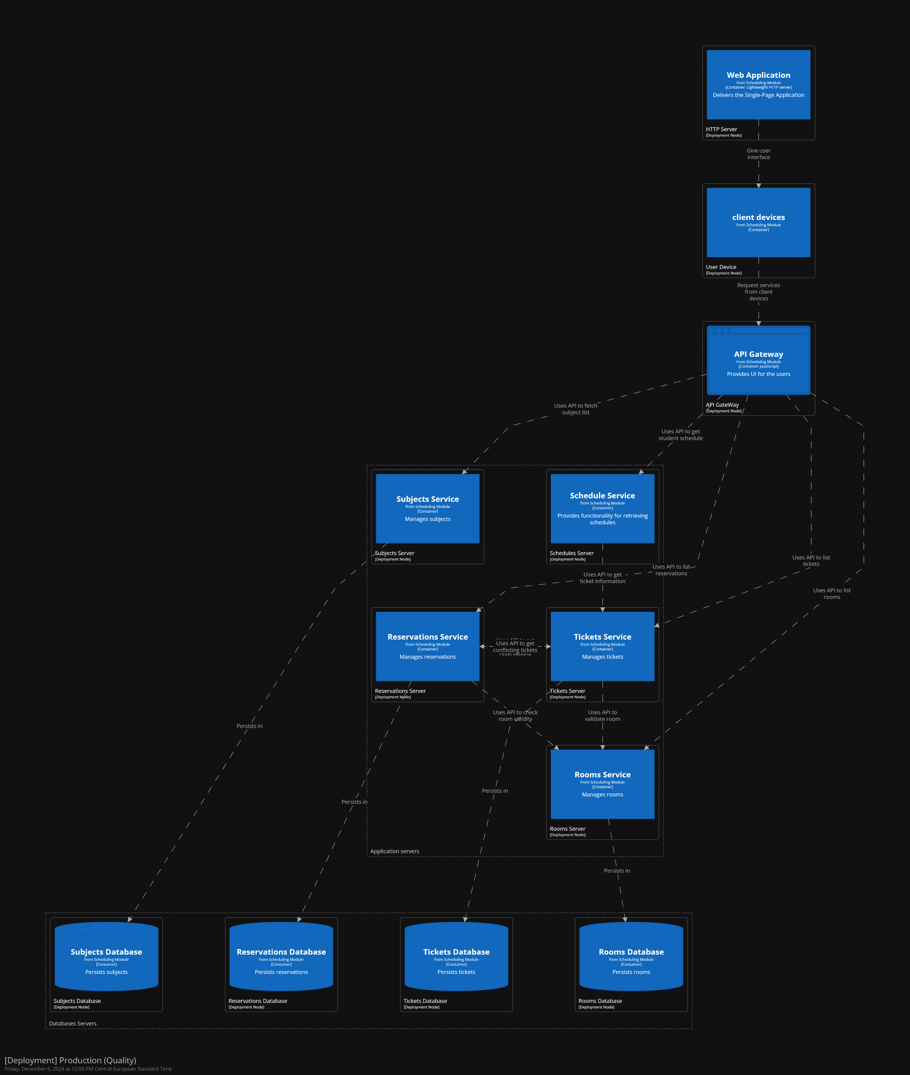
Propose solution 2:
Author: Sereyboth
Notes:
Solution 2(scalability): separate the application services and databases in the structure
By doing this we can scale each service or database without worry about affecting others.
Availability is high since only 1 service is down at a time with database cache service.
Problem 1 and 2 solved

Slide 11
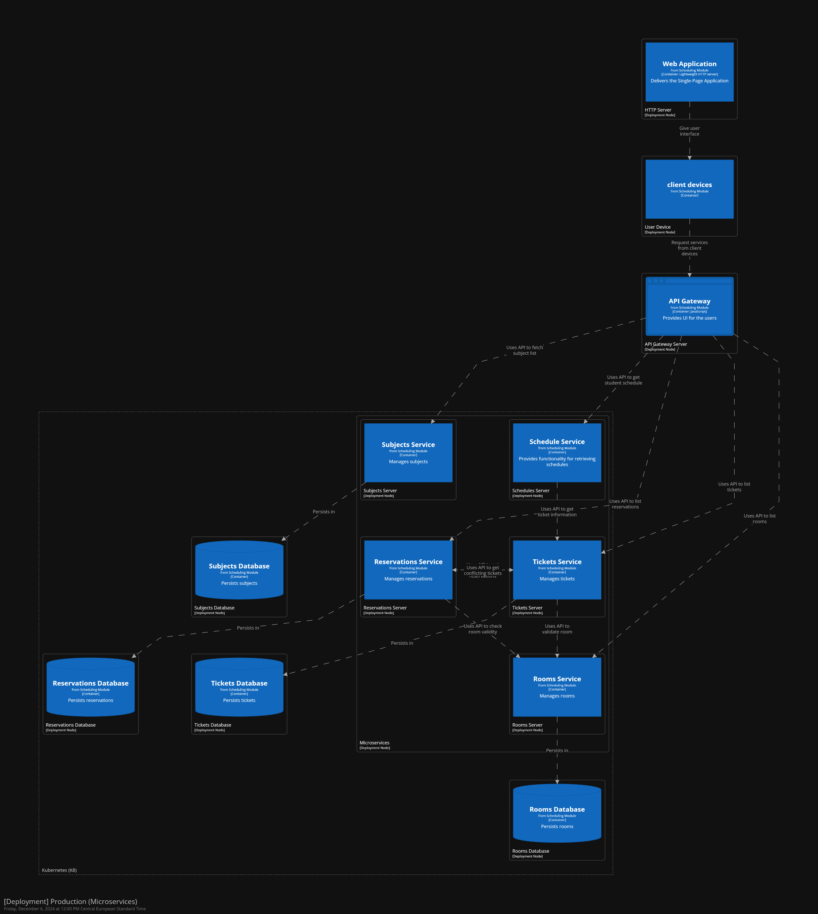
Propose solution 3:
Author: Sereyboth
Notes:
Solution 2.0(Availability & Performance): use solution 2 and put it on Kubernetes
increase the availability of the system with kubernetes loadbalancing. Also reduce stress on server.

Slide 12
Thank you

