Slide 1

ANALYSIS OF PRICES ON REFRIGERATORS
ANITHA KATTA

Slide 2
ANITHA KATTA
I am B-tech graduate in computers in 2019 from KL University.
I have 2.5 years of experience in the IT industry in the SAP BASIS Domain.
I was interested in the field of statistics and where in SAP Basis it involves me in managing SAP system landscapes and ensuring their smooth functioning. Here I can grow technically and analytics.

Slide 3
Agenda
Objective of the project
Data Collection
Raw Data
Data Cleaning
Data Visualization
Univariate Analysis
Bivariate Analysis
Multivariate Analysis
Conclusion

Slide 4
Objective of the project
The objective is to perform web scraping on Flipkart to gather detailed information about various refrigerator brands models and analyzing their properties.
Introduction
Web scraping data is a way to extract information from the website automatically.
With web scraping, you can gather data about different Refrigerators available on Flipkart, such as their prices, brands ,capacity, door types and more.
It's a useful technique to compare refrigerators or gather data for research purposes.

Slide 5
Libraries Used:
Web scraping tools
Python
Beautiful Soup
Requests
Data cleaning & manipulating
NumPy
Pandas
String method
Data Visualization
Matplotlib
Seaborn

Slide 6
Data Collection
Get your flipkart website has the data related to refrigerators.
url="https://www.flipkart.com/search?q=refrigerator&as=on&as-show=on&otracker=AS_Query_OrganicAutoSuggest_3_2_na_na_ps&otracker1=AS_Query_OrganicAutoSuggest_3_2_na_na_ps&as-pos=3&as-type=RECENT&suggestionId=refrigerator&requestId=98da25ba-440d-45d1-a76e-1ac1445f7aaa&as-searchtext=refrigerator&page=1"
We used Beautiful Soup, Requests together to scrape the data from the website

Slide 7
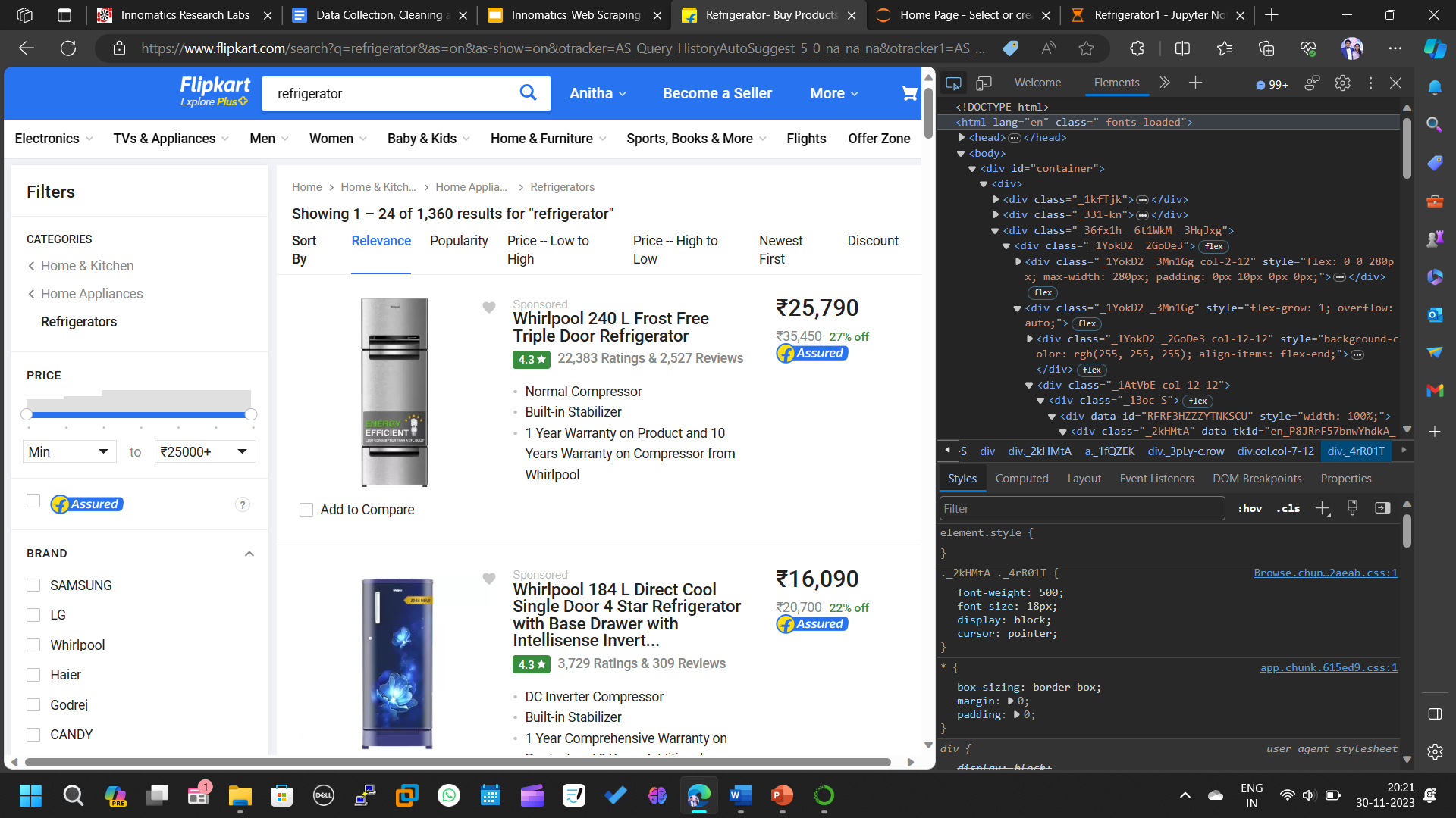
INTERFACE OF THE WEBSITE: :

Slide 8
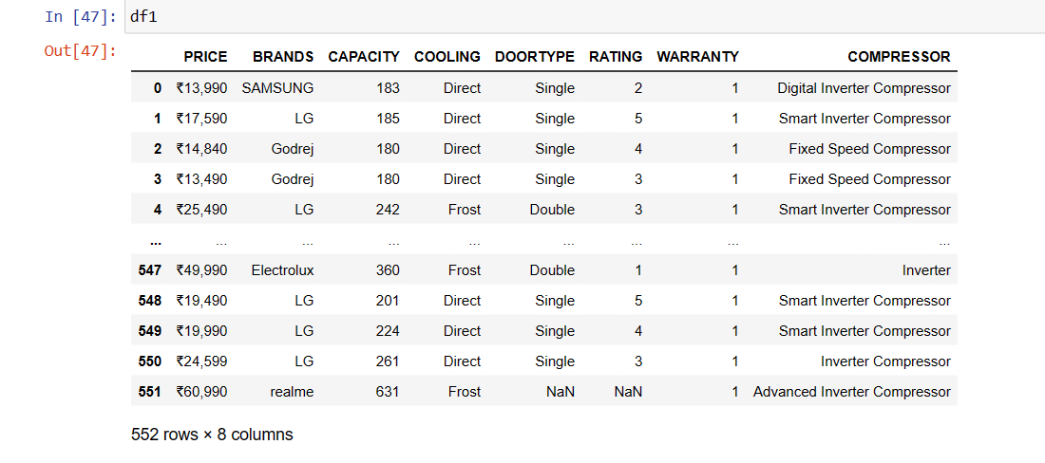
RAW DATA FOR REFRIGERATORS DATA SET :

Slide 9
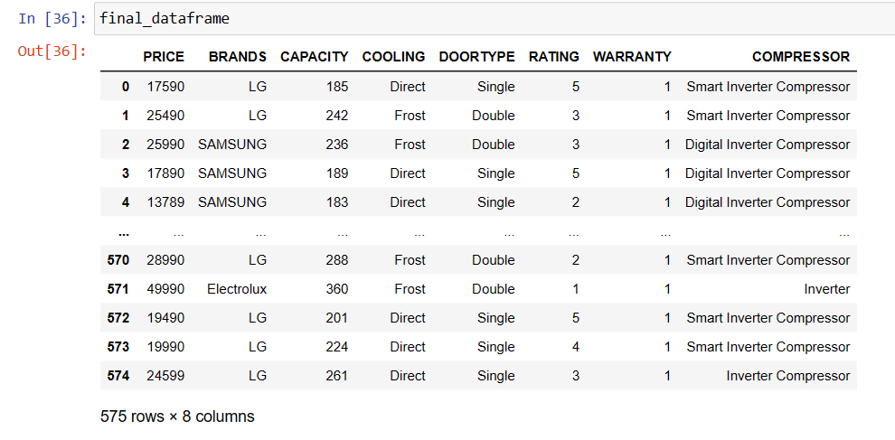
DATA CLEANING:
Identifying Null values.
Removing special symbols.
Treating columns and converting required columns from object to int or float datatype.
Removing the unwanted columns.
CLEANED DATA FRAME:

Slide 10
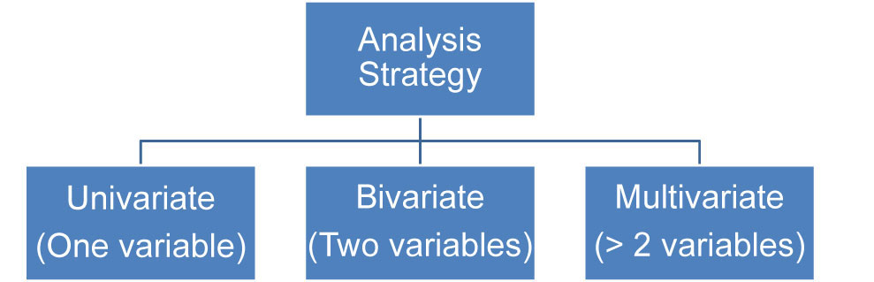
DATA VISUALIZATION :
1. UNI-VARIATE:
1.1 Single categorical
1.2 Single numerical
2. BI-VARIATE:
2.1 Categorical-Numerical
2.2 Numerical-Numerical
2.3 Categorical-Categorical
3. MULTI - VARIATE:
More than two columns we can take
3.1 Categorical-Numerical-Categorical
3.2 Categorical-Numerical-Numerical
3.3 Categorical-Categorical-Categorical
3.4 Numerical-Numerical-Numerical

Slide 11
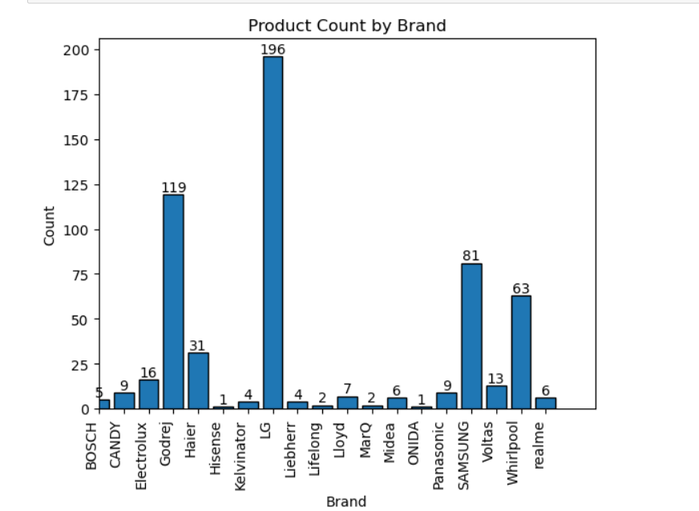
UNIVARIATE ANALYSIS:
Analysis on brands :
LG brand count is high as compared to other brands
Lowest preferred is ONIDA

Slide 12
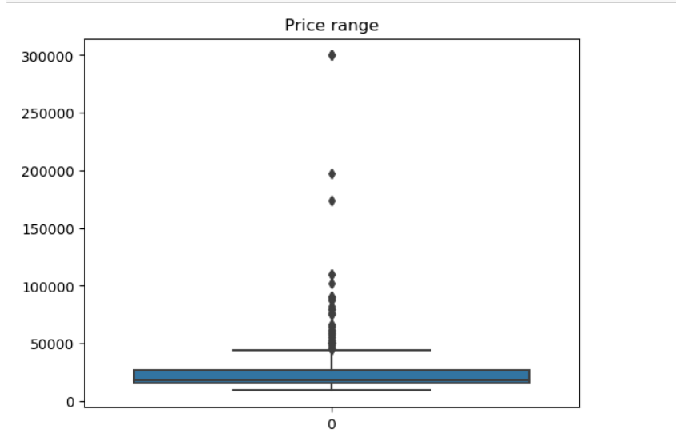
Analysis on Prices:
Most of the brands prices are between 10000 to 25000 rupees .

Slide 13
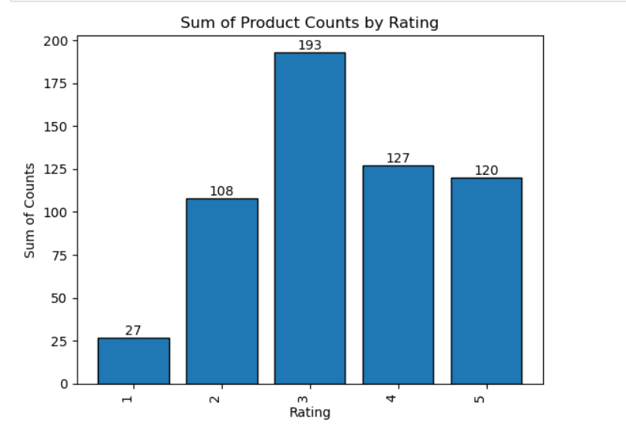
Analysis of rating:
Most of the brands are 3 star rated from the data set

Slide 14
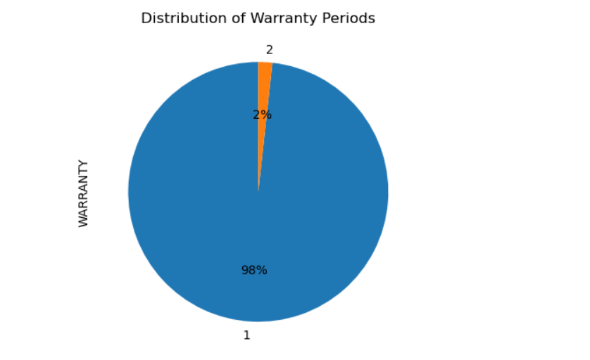
Analysis of warranty :
Most of the brands having the warranty of 1 year.

Slide 15
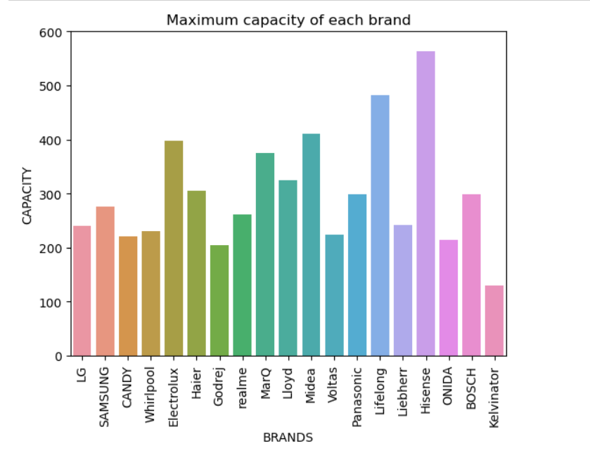
Analysis on brands v/s capacity:
BIVARIATE ANALYSIS:
Hisense is the brand which has the maximum capacity in litres .
Kelvinator has the least capacity .

Slide 16
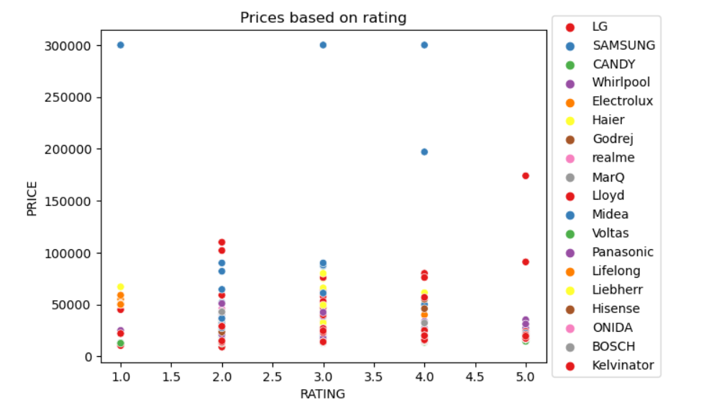
Analysis on prices v/s rating:
Prices are high for Samsung brand where its rating lies between 1 to 5.
Most of the products are 3 star rated .

Slide 17
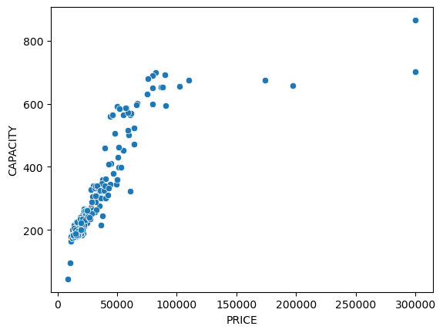
Analysis on prices v/s capacity:
As the capacity of the product is increasing the price is also increasing .

Slide 18
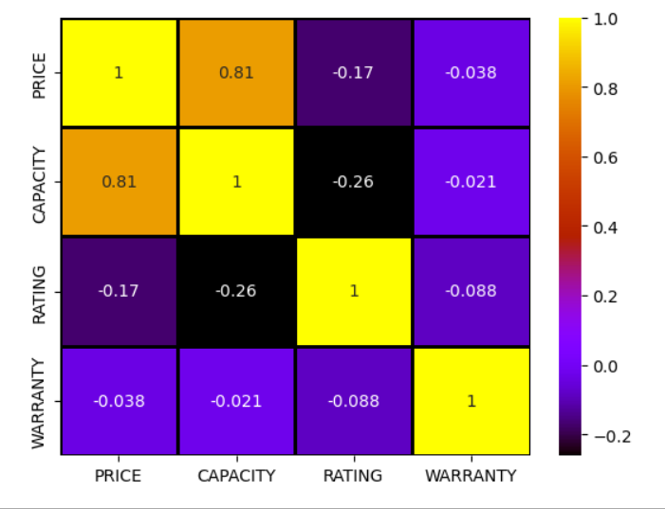
Multivariate Analysis on Numerical Attributes:
Analysis on Refrigerator data set:
Heatmap shows us about the correlation between each numerical attributes among themselves.

Slide 19
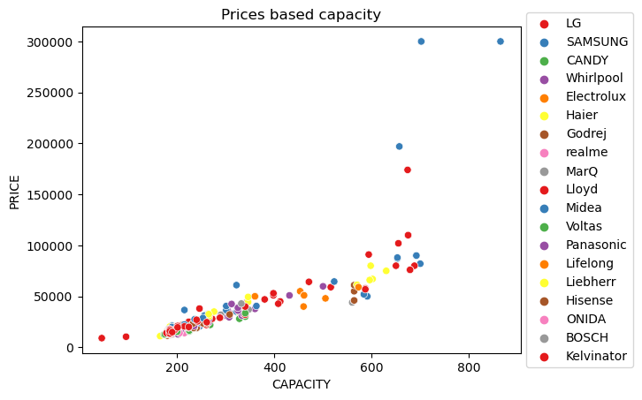
Scatter plot of numerical attributes price , capacity, brands:
Most of the brands capacity ranges between 200 to 300.

Slide 20
Conclusion:
“LG” brand refrigerator has the highest count in market.
Majority of refrigerators are under the Price range of 10000 to 20000.
Most of the refrigerators capacity lies between 200 to 250
“Hisense” Brand has the highest average rating of 40,that means most of the customers are favour to prefer to this Brand.
Most of the brands are 3 star rated from the data set .
Most of the brands having the warranty of 1 year.
Only the Voltas brand had provided 2 years of warranty in the whole data set.
If the affordable price is greater than 250000 then the suggested brand is “SAMSUNG” .
Most of the refrigerator brands contains Smart Inverter compressor.
From our analysis most of the refrigerators are single door.
Kelvinator has the lowest price from the data .

Slide 21

THANK YOU

