Slide 1

Namma Yatri
- Sejal Kanojia, Katta Chandra Sekhar, Archana Dinesh

Slide 2
Problem Statement
The ride-hailing industry grapples with key challenges such as high trip cancellations, demand-supply imbalances, fare volatility, and low adoption of digital payments. This analysis focuses on building interactive Power BI dashboards to drive operational efficiency and improve the overall customer experience through data-driven insights and smarter decision-making.
Objective
Analyze ride-hailing patterns to uncover operational inefficiencies and service gaps.
Leverage data-driven insights to optimize fare pricing strategies for better competitiveness and profitability.
Enhance driver allocation by aligning resources with real-time demand-supply trends.
Promote and increase digital payment adoption through targeted strategies informed by customer behavior data.

Slide 3
Approach Used
Data Cleaning & Transformation
Data Modeling in Power BI
DAX Measures for KPIs
Dashboard Creation & Insights Extraction
Business Recommendations
Methodology
Data Cleaning & Transformation in Power Query.
Data Modeling & Relationship Setup in Power BI.
DAX Measures for KPI Calculations.
Development & Insights Generation.
Business Recommendations & Implementation.

Slide 4
Data Sources
The dataset comprises the following key components:
Trips: Contains core trip-level data such as Trip ID, Fare, Duration, Distance, Driver ID, and Customer ID.
Trip Details: Includes information on customer interactions, trip completions, and cancellations.
Payment Methods: Captures payment preferences, including Cash, UPI, and Debit Card.
Assembly Locations: Provides pickup and drop-off zone details for geographic analysis.

Slide 5
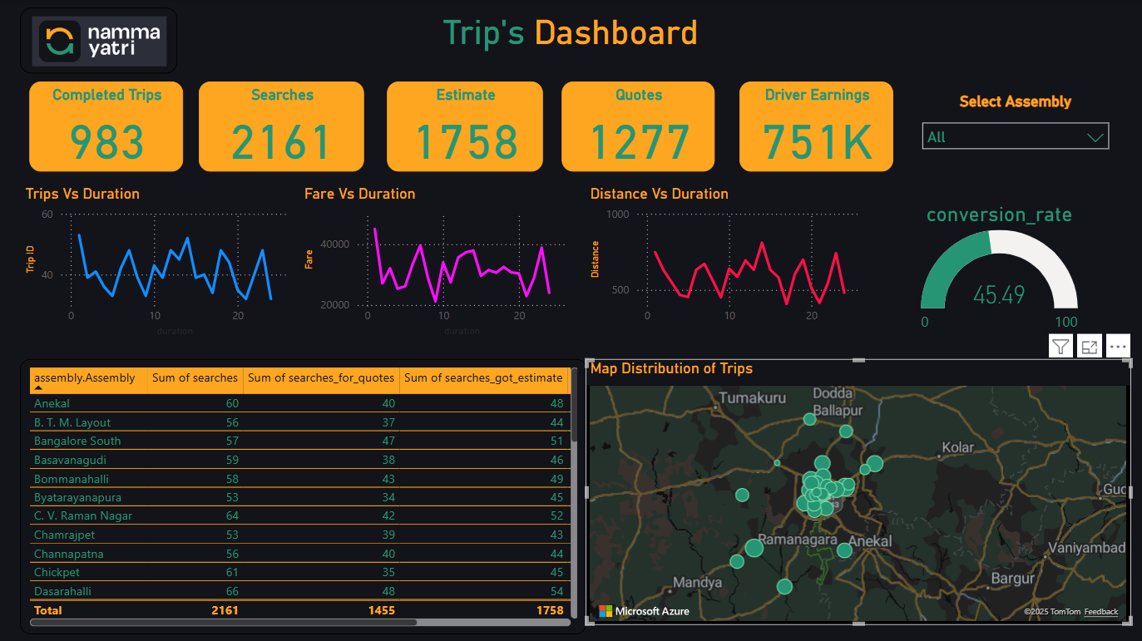
Key DAX Measures
Total Trips = COUNT(Trips[tripid])
Total Revenue = SUM(Trips[fare])
Average Fare = AVERAGE(Fare)
Top Pickup Locations = COUNT(Trips[loc_from])

Slide 6
Editing & Modifications
Removed Duplicates & Handled Missing Values
Created Time-Based Aggregations (Peak Hours, Distance Categories)
Established Relationships Between Tables
Optimized Queries for Performance in Power BI

Slide 7

Business Insights
High drop-off rates during fare estimation indicate the need for a Predictive Pricing model to provide more accurate and acceptable fare quotes.
Demand-supply imbalances in key zones highlight the opportunity to enhance driver allocation through real-time data insights.
Significant fare surges during peak hours suggest a need to refine dynamic pricing strategies to balance profitability with customer retention.
While UPI adoption is on the rise, cash payments still dominate—creating an opportunity to introduce targeted incentives to promote digital payment usage.

Slide 8
Expected Outcomes
Improved demand-supply alignment to minimize rider wait times and enhance service efficiency.
AI-powered fare optimization to strike the right balance between affordability for customers and revenue for the platform.
Boosted digital payment adoption through personalized incentive programs and behavioral insights.
Enhanced driver performance and utilization through data-driven allocation strategies tailored to demand patterns.

Slide 9
Conclusion
Data-driven insights help optimize ride-hailing operations.
Reducing cancellations & improving pricing can boost customer retention.
Smart allocation of drivers increases efficiency & service quality.
Digital transformation strategies will enhance financial performance.

