Slide 1
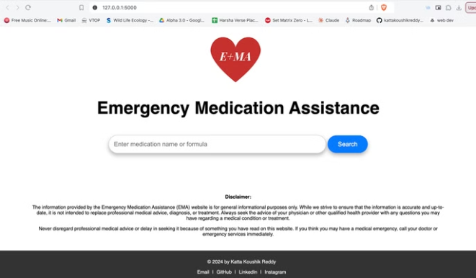

Emergency Medication Assistance Website
This presentation outlines the concept of a user-friendly website designed to provide quick and reliable information on emergency medications. The website aims to address the critical need for accurate medication guidance during urgent situations, empowering individuals to make informed decisions and potentially saving lives.

Slide 2

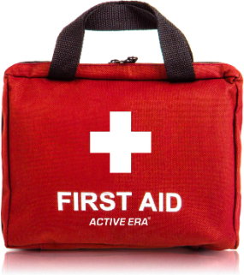
Introduction
1
Problem Statement
Many people face difficulties in choosing the correct medication during emergencies. Incorrect self-medication can lead to adverse effects, complications, or even life-threatening situations.

Slide 3
Real-life Problem Statement
Challenges
Lack of medical knowledge in emergencies. Unavailability of professional medical advice. Risk of taking the wrong medication. Difficulty accessing accurate, trustworthy information quickly.

Slide 4

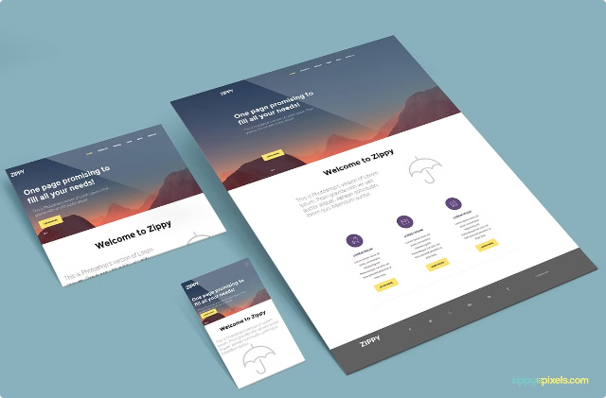
Project Overview
Goal
To provide a user-friendly website that offers quick, reliable information about emergency medications. Users can input a tablet name or formula to get detailed information on usage, dosage, warnings, effects, and alternatives.

Slide 5

How the Idea Solves the Problem
Solution
Provides immediate, accurate information on emergency medication. Reduces the risk of incorrect self-medication. Accessible on both desktop and mobile devices. No login required, ensuring quick access during emergencies.

Slide 6
Key Features
User Input
Tablet or formula name.
Output Information
Uses, Dosage, Warnings, Effects, Alternatives
UI Design
Fixed boxes for consistent information presentation.

Slide 7

Advantages of the Website
1
Pros
Simple and easy to use.
No need to log in, saving crucial time during emergencies.
Compatible with both computers and mobile devices.
Provides vital information that can prevent incorrect medication. Can be a life-saving resource.

Slide 8
Conclusion
Summary
This website addresses a critical need for quick, reliable information on emergency medications. By reducing the risk of taking incorrect medication, it serves as a vital tool in urgent situations. The project can be a significant contribution to public health and safety.

Slide 9
AI-Powered Features
Artificial intelligence can enhance this project's effectiveness.
Integrating image search will allow users to identify medications even if they don't know the exact name or formula.
The AI can analyze uploaded photos of pills, matching them to a database of medications.
This feature will make it easier for individuals to find accurate information during emergencies.
AI-powered chatbots can provide instant support and answer frequently asked questions related to emergency medication.

