Slide 1
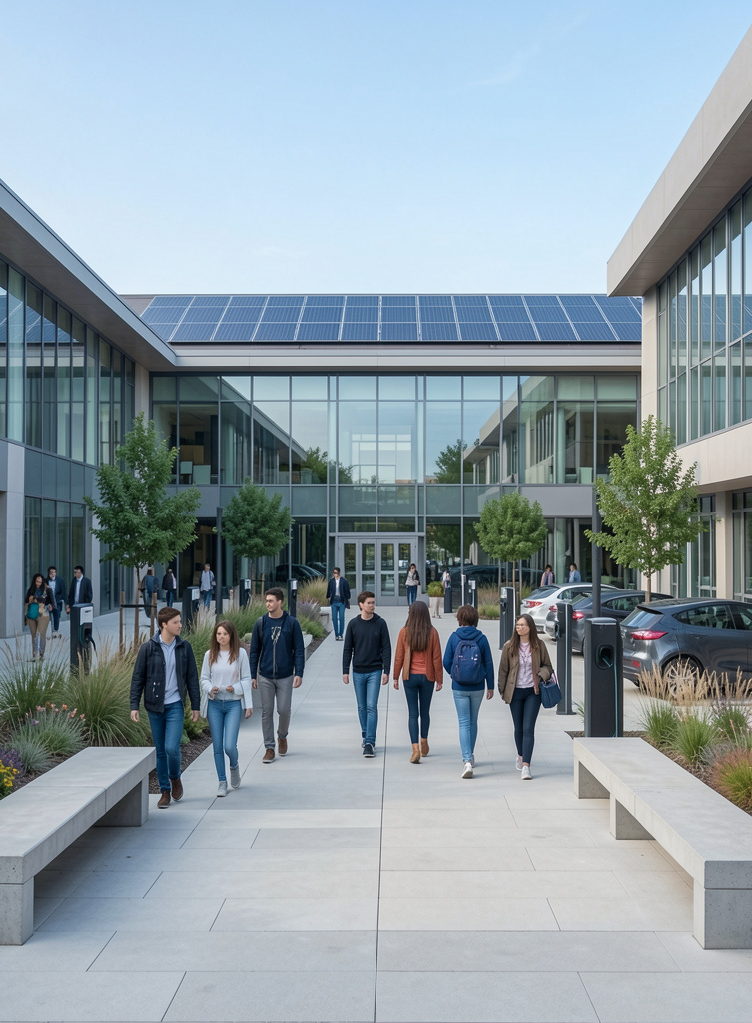
Green Campus AI
Katta Sanvee
Internship Identifier: INTERNSHIP_17828984086a44dee80acf6
AI-Powered Sustainability Management & Decision Support

Slide 2
Data to Action
On campuses, sustainability data lives in silos — energy submeters, IoT water meters, waste audits, and shuttle GPS data all exist, but there's no simple way to bring them together into clear priorities. This makes it hard to decide which building to retrofit first or when to run a water-efficiency campaign, even though the data needed to guide those decisions is already there.

Slide 3
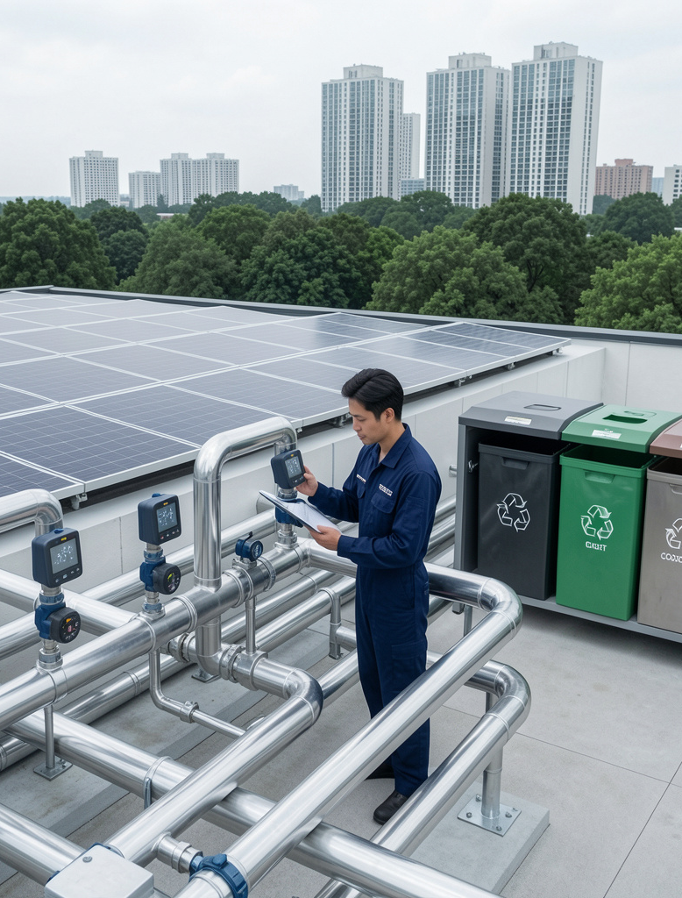
SDG Alignment
Green Campus AI directly supports SDG 11 by helping campuses make data-informed decisions that build sustainable cities and communities. It also contributes to SDG 6, 7, 12, and 13 through water monitoring and leak detection, energy demand management, waste audits, and emissions-informed planning — reinforcing its relevance for universities pursuing resilience and efficiency.

Slide 4
Distinct Needs by User Type
Students need simple, actionable guidance to make sustainable choices. They respond to low-friction, tangible ideas (like locating energy-efficient study spaces) and quick prompts that fit into study routines.
Faculty require curricular tools and classroom-level data to teach sustainability. Campus Administrators need prioritized operational actions with budget-ready recommendations, while Sustainability Teams seek consolidated monitoring, anomaly detection, and campaign management.
Green Campus AI must address four distinct, concrete use cases across Students, Faculty, Campus Administrators, and Sustainability Teams.

Slide 5
Data to Action
Data Ingestion
Normalization & Storage
Analytics & Models
Decision Support
Reporting & Engagement
Connect meters, BMS, ERP, shuttle GPS, and waste-audit uploads.
Time-align metrics and run quality checks to store clean data.
Baseline consumption, anomaly detection, and forecasting to reveal patterns.
Priority scoring, low-cost/high-impact actions, and scenario simulations.
Dashboards, automated reports, and student-facing tips.

Slide 6
Platform Metrics
Data sources integrated
Electricity submeters, BMS, water meters, waste audit spreadsheets, shuttle GPS, weather API.
6
Dashboard KPIs
Five primary tiles: energy kWh, water L, waste kg, transport passenger-km, carbon proxy.
5
Model types deployed
Anomaly detection, short-term forecasting, priority-scoring.
3
Reporting cadence
Daily automated monitoring; monthly action reports.
Daily + 1x

Slide 7
Pilot Roadmap
01
02
03
04
Pilot (0–3m)
Validate (3–6m)
Scale (6–18m)
Institutionalize
Integrate 1–3 buildings, connect 3–4 data sources, deliver initial dashboard; establish weekly review with stakeholders.
Run models, refine decision rules with stakeholders, execute a small behavior campaign to test actions.
Expand to campus-wide data, integrate budgeting and maintenance workflows for sustainable operations.
Embed into campus sustainability operations and curriculum, with ongoing data quality and stakeholder engagement checks.

Slide 8
Actionable Campus Intelligence
- Turns campus data into prioritized, practical actions via AI-backed dashboards and decision workflows.
- Serves students, faculty, administrators, and sustainability teams for faster, informed decisions.
- Aligns with SDG 11 and related SDGs (6, 7, 12, 13); clear architecture and pilot roadmap enable test, learn, scale.

Slide 9
THANK YOU
Do you have any questions?
youremail@freepik.com
+34 654 321 432
yourwebsite.com
Please keep this slide for attribution

