Slide 1















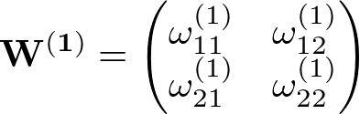
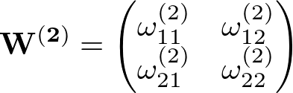




Input
Hidden Layer
Output Layer
x₁
1
1

Slide 2





Input
Hidden Layer
Output Layer
x₁
= Loss Function
1
1

Slide 3
Input
FC
Relu
FC
Relu
FC
SoftMax
Prediction
Hidden
Layer1
Hidden
Layer2
Output

