Slide 1
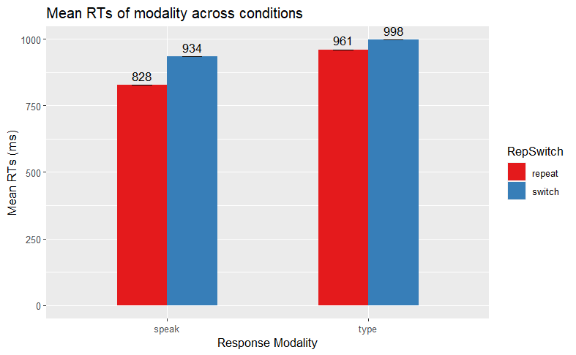
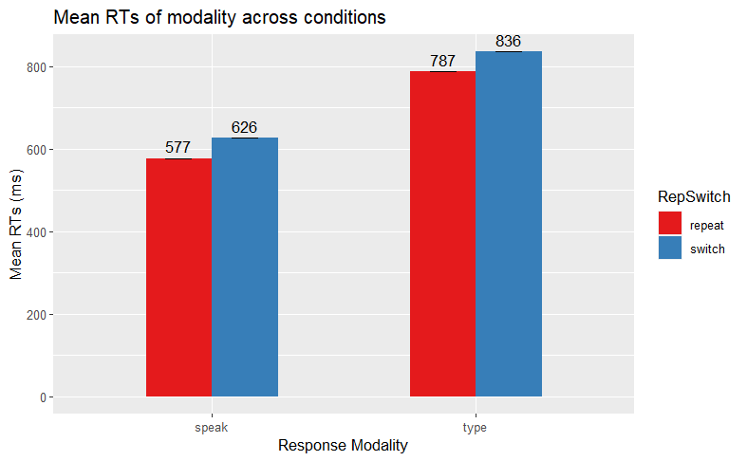
PILOT 1
PILOT 2
Both are faster at Repeat than Switch trials.
Pilot 1 is overall slower than Pilot 2.

Slide 2
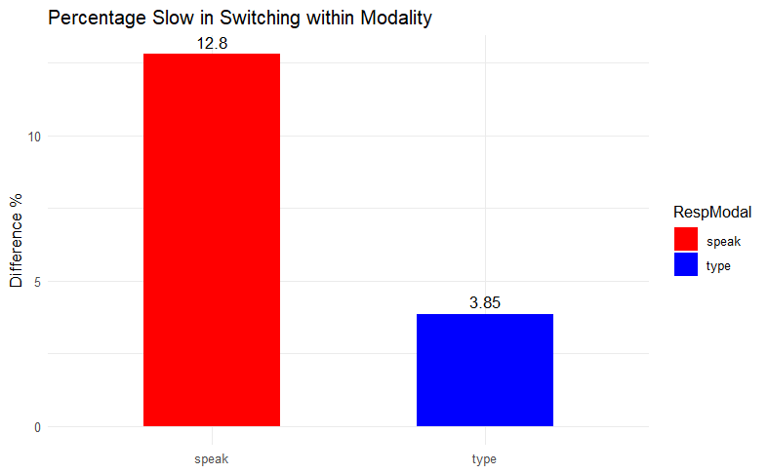
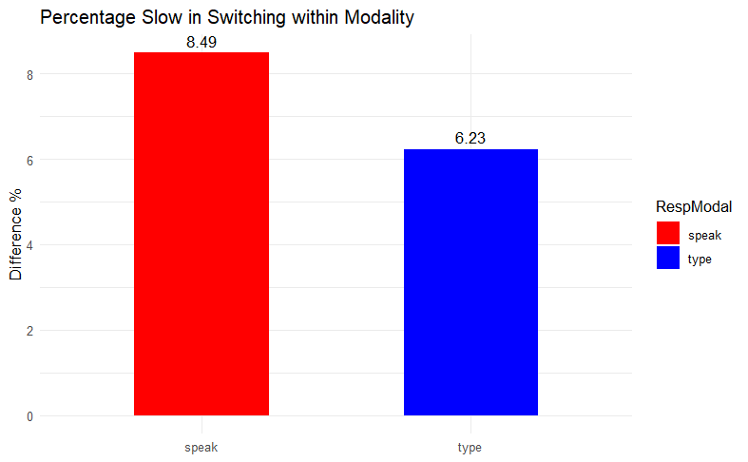
PILOT 1
PILOT 2
Both pilots are slower to switch to Speak than they are to switch to Type.
The difference of the Δ for Speak and for Type is much bigger for Pilot 1 than for Pilot 2.

Slide 3
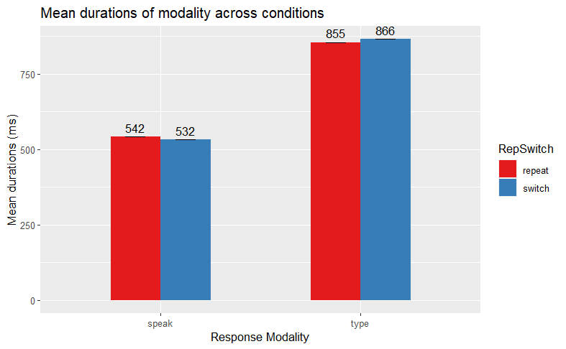
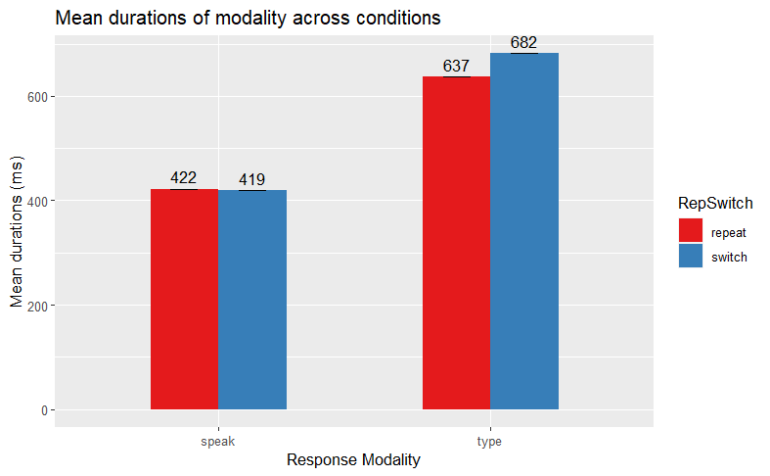
PILOT 1
PILOT 2
Both show longer durations for Type than for Speak.
In Speak, the durations are slightly shorter for Switch than for Repeat trials. The inversed applies to Type.
Pilot 1 shows longer durations than Pilot 2 in all conditions.

Slide 4
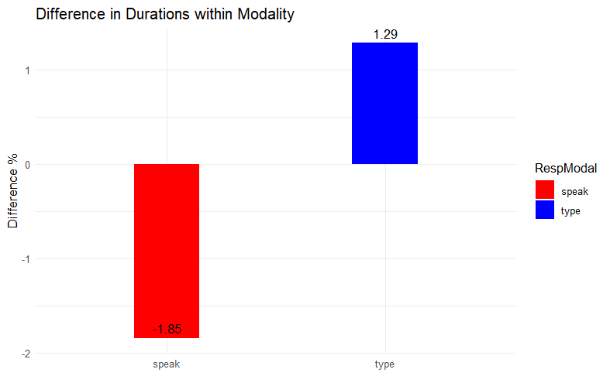
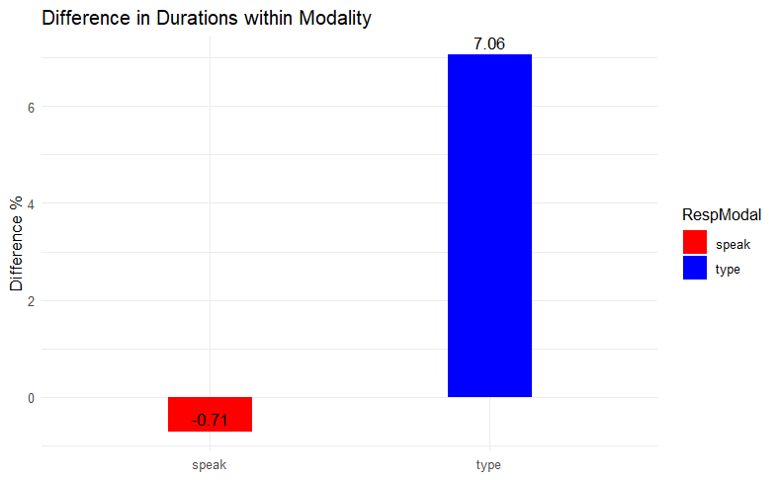
PILOT 1
PILOT 2
Both pilots are faster to Switch to Speak than Repeat Speak. They are both slower to Switch to Type than Repeat Type.
Pilot 1 is slower to Switch to Speak than Pilot 2. Pilot 2 is much slower to Switch to Type than Pilot 2.

Slide 5
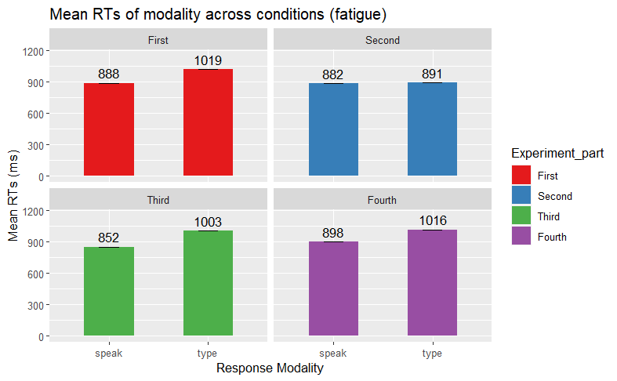
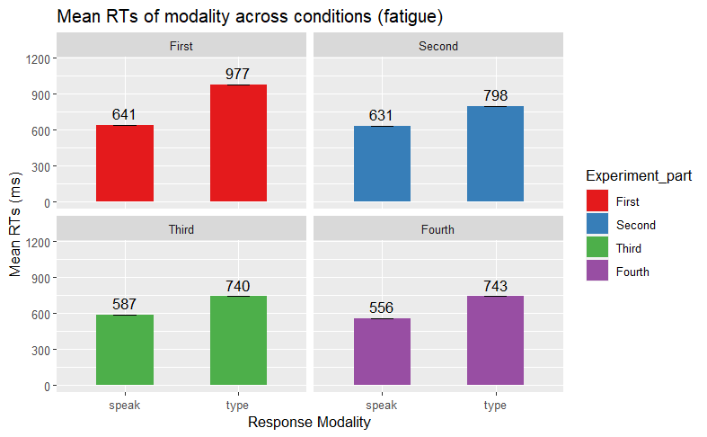
PILOT 1
PILOT 2
Pilot 1 does not show signs of fatigue throughout the experiment: RTs for Speak and Type are very close in the First and Second part of the task, then become faster during the Third part and then we see some signs of fatigue for Type during the Fourth part.
Pilot 2 becomes faster from the First to the Second to the Third part and then more or less preserves the speed of naming throughout the Fourth part. No signs of fatigue.

Slide 6
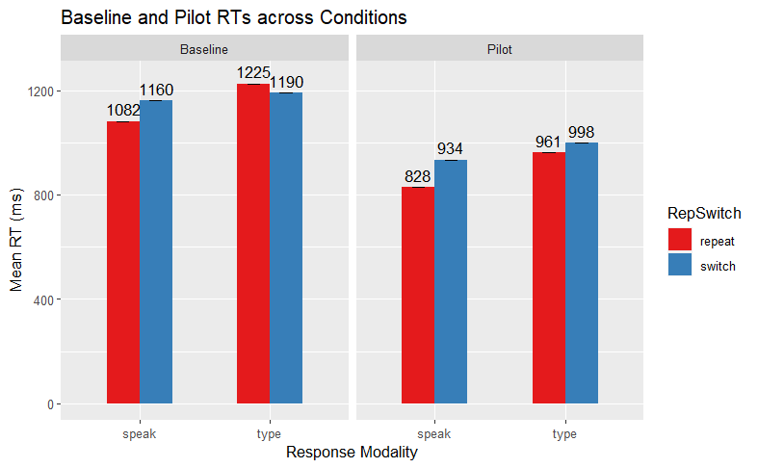
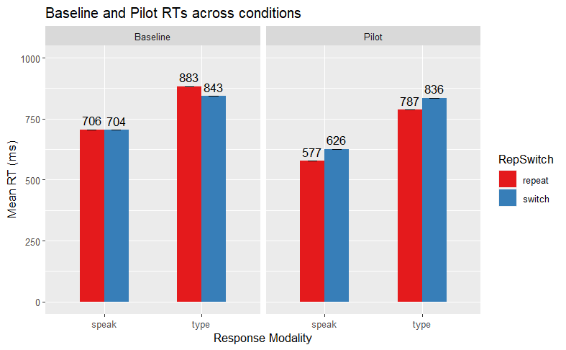
PILOT 1
PILOT 2
Pilot 1: Overall, faster for the target trials (Pilot) than the Baseline trials. Faster in Repeat than Switch apart from Baseline Type. Baseline and Pilot: faster in Speak.
Pilot 2: Baseline: faster in Speak, faster in Switch in Type. Pilot: faster in Speak, faster in Repeat. Overall, faster in both Speak and Type compared to Response modality RTs in the Baseline.
Notes:
They are faster in the Pilot → we force co-activation so this can lead to cross-modality priming plus the fact that this is item-repetition. The representations have already been activated which speeds naming up in contrast to different-item naming in which the phonological and orthographic representations for that item must be activated anew. This tell us that there is a big role of phonology and orthography in typing and speaking respectively.

Slide 7
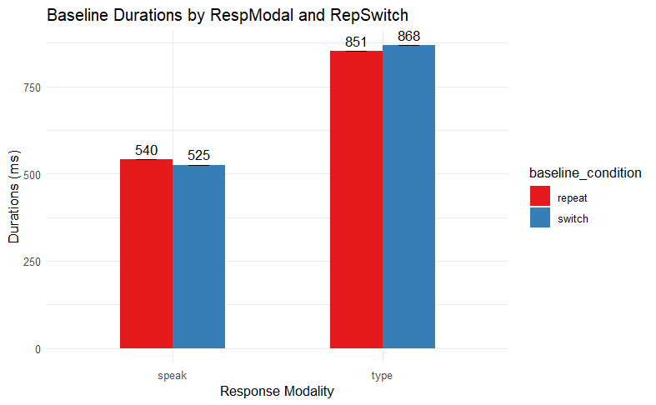
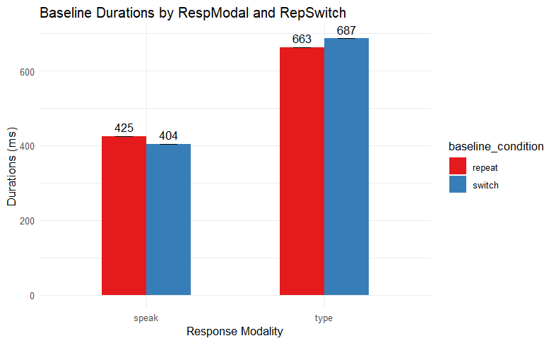
PILOT 1
PILOT 2
Both show longer baseline durations for Type than for Speak. In Type they are faster in Repeat than Switch. In Speak they are faster in Switch than Repeat.
Again, Pilot 1 indicates overall longer durations than Pilot 2.

Slide 8
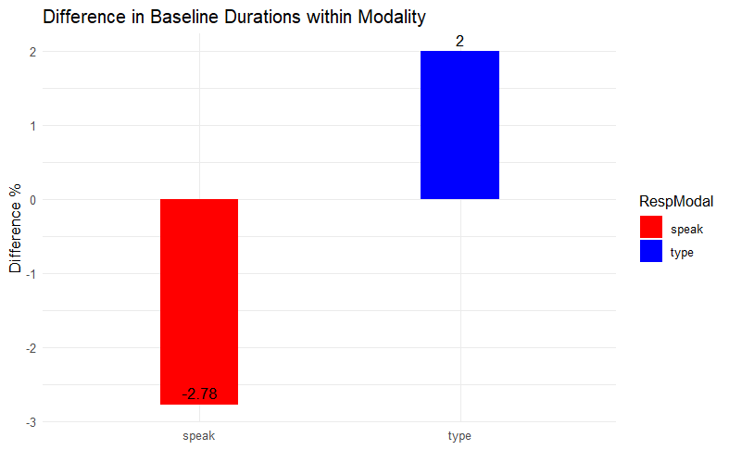

PILOT 1
PILOT 2
Again, they are quicker to Switch to Speak than to Switch to Type (- values). Pilot 1 is slower to Switch to Speak than Pilot 2 but is quicker to Switch to Type than Pilot 2.

Slide 9
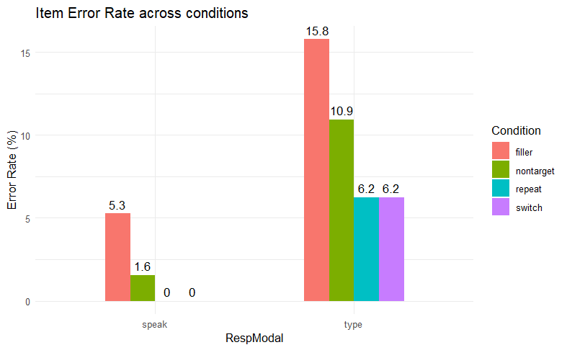
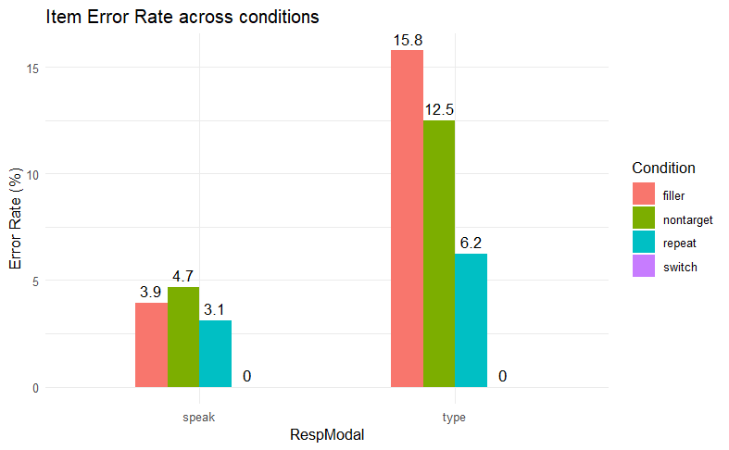
PILOT 1
PILOT 2
Overall, more mistakes in Type for both pilots.
Pilot 2 does not make any mistakes on Switch trials.

Slide 10
Error rates by Response modality
Pilot 1:
Speak:
  1.6% nontarget
Type:
  2.6% filler
  1.6% nontarget
Pilot 2:
Type:
  5.3% filler

