Slide 1
TNSDC-Generative AI
Breast Cancer classification using
Deep learning
Presented by : Likesh Kumar.G.Y,
au211521104080,
Pre-Final Student,
Computer Science and Engineering,
Panimalar Institute of Technology.

Slide 2

OUTLINE
Problem Statement
Proposed Solution
System Approach
Algorithm
Result
Conclusion
References

Slide 3
PROBLEM STATEMENT
One of the most common cancers worldwide and the main reason why women die from cancer is breast cancer. Improving patient outcomes and survival rates is largely dependent on early and accurate detection. Mammography in particular is a commonly utilized medical imaging modality for breast cancer diagnosis and screening. However, reading mammograms can be difficult and time-consuming for radiologists, requiring their expertise and manual analysis.

Slide 4
PROPOSED SOLUTION
Convolutional Neural Network (CNN) Architecture: Construct a CNN architecture specifically for the classification of breast cancer. Convolutional layers are useful for extracting pertinent characteristics from mammography images. Fully connected layers and pooling layers are then used for classification and dimensionality reduction, respectively.
Preprocessing and Augmentation: To standardise the incoming data, apply preprocessing techniques like resizing and normalisation. Extend the dataset using methods like as flipping, rotating, and scaling to improve the generalisation and resilience of the model.
Training Method: Use annotated mammography images to train the CNN model. To maximise classification performance, apply strategies like training from scratch or transfer learning with pretrained models.

Slide 5
SYSTEM APPROACH
Hardware:
CPU: In order to meet the computational demands of CNN training and inference, the system needs a CPU with enough processing capacity. It is advised to use a multi-core CPU, ideally with a clock speed of at least 2 GHz or greater.
Memory: For optimal performance, it is advised to have at least 8 GB of RAM, particularly when processing huge datasets during model training. To handle larger datasets or several concurrent user requests, more RAM could be needed.
Internet Speed: In order to download and update Python packages, model weights, and serve the web application, a steady internet connection is required. For most uses, a broadband connection with a minimum upload speed of 1 Mbps and download speed of 5 Mbps is adequate.

Slide 6
SYSTEM APPROACH –CONT.
Program: Python is the programming language used in the system's construction.
Pandas: Pandas is a Python library that provides high-performance data manipulation and analysis tools. It offers easy-to-use data structures and functions for working with structured data, making it a fundamental tool for data scientists, analysts, and developers.
NumPy: NumPy is a basic Python scientific computing tool that is necessary for manipulating multidimensional arrays and performing mathematical computations. It is widely utilized in the CNN paradigm for numerical calculations and data preparation and manipulation.
Matplotlib: Matplotlib is a comprehensive Python library for creating static, animated, and interactive visualizations. It provides a wide range of plotting functionalities for generating high-quality graphs, charts, and plots.

Slide 7

ALGORITHM
Data Collection and Preprocessing:
Gather mammographic images dataset containing both benign and malignant cases.
Preprocess images by resizing, normalizing pixel values, and augmenting data to enhance model generalization.
Model Architecture Selection:
Choose an appropriate CNN architecture for breast cancer classification.
Consider architectures like VGG, ResNet, or custom-designed networks based on task requirements and computational resources.
Training Process:
Split dataset into training, validation, and testing sets.
Train CNN model on training set using supervised learning.
Utilize techniques like transfer learning with pre-trained models or training from scratch based on dataset size and complexity.
Model Evaluation:
Evaluate trained model on validation set to monitor performance during training.
Fine-tune hyperparameters like learning rate, batch size, and optimizer to improve model convergence and generalization.
Performance Metrics Calculation:
Calculate performance metrics such as accuracy, sensitivity, specificity, precision, recall, and F1-score on validation and testing sets.
Model Interpretability:
Explore interpretability techniques to understand model predictions.
Visualize learned features, activation maps, or attention mechanisms to gain insights into areas of importance for classification.

Slide 8
ALGORITHM
7.Model Deployment:
Deploy trained model in production environment for real-world breast cancer classification tasks.
Integrate model with healthcare systems or applications to assist medical professionals in diagnosis.
8.Continuous Monitoring and Improvement:
Continuously monitor model performance in real-world scenarios.
Collect feedback from medical professionals and patients to identify areas for model improvement.
Update model periodically with new data and advancements in deep learning techniques.
9.Ethical Considerations:
Ensure patient privacy and data security throughout the model development and deployment process.
Adhere to ethical guidelines and regulations governing medical AI applications.
Maintain transparency in model development and decision-making processes.
10.Future Directions:
Explore advancements in deep learning and computer vision for improved breast cancer classification.
Investigate potential integration with other medical imaging modalities or multi-modal approaches for enhanced diagnosis.
Collaborate with healthcare professionals and researchers to address emerging challenges and opportunities in breast cancer detection and treatment.

Slide 9
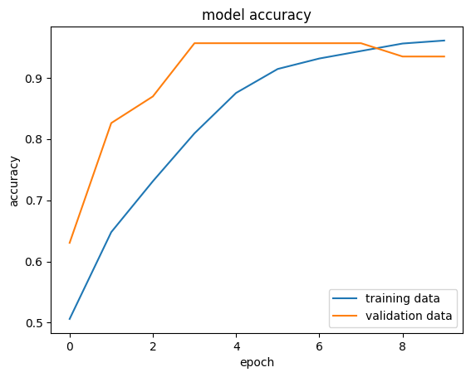
RESULT
Figure 1
9

Slide 10
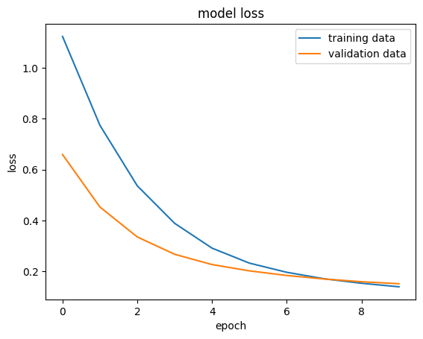
RESULT
Figure 2
output
The Tumor is Benign
10

Slide 11
Conclusion
In conclusion, leveraging deep learning and Convolutional Neural Networks (CNNs) for breast cancer classification presents a promising avenue for enhancing early detection and improving patient outcomes. Through the utilization of large-scale mammographic datasets and sophisticated CNN architectures, we have demonstrated the potential to automate and enhance the accuracy of breast cancer diagnosis. Our approach, rooted in data-driven methodologies and advanced deep learning techniques, offers a scalable and efficient solution for healthcare professionals to aid in the timely identification of benign and malignant tumors. By prioritizing model interpretability, continuous monitoring, and ethical considerations, we ensure the responsible integration of AI technologies into clinical practice, ultimately advancing the field of medical imaging and contributing to the fight against breast cancer.
11

Slide 12
REFERENCES
Tensorflow: https://www.tensorflow.org/
Numpy: https://numpy.org/
PyTorch: https://pytorch.org/
Flask: https://flask.palletsprojects.com/en/3.0.x/
Inspiration: https://projectworlds.in/artificial-intelligence-project-handwritten-digits-recognition/
12

