Slide 1
Image Recognition with IBM Cloud Visual Recognition
MEMBER 1: DURAISARAVANAKKUMAR G
MEMBER 2:GURUPRASATH K
MEMBER 3:DHARANIDHARAN S
MEMBER 4:KATUKURI VASANTHKUMAR
MEMBER 5:KASA VENGATESH

Slide 2
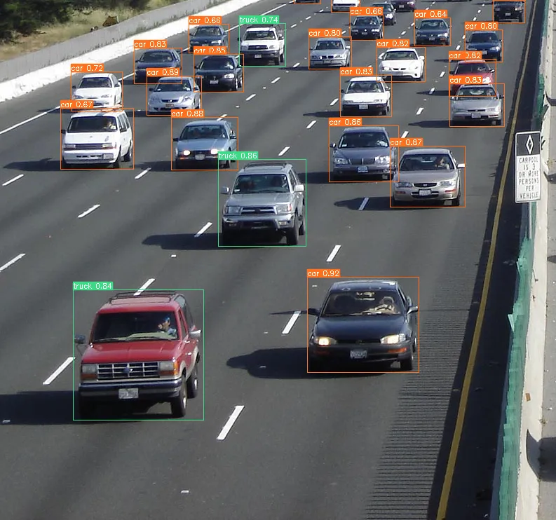
Problem Definition:
The project involves creating an image recognition system using IBM Cloud Visual Recognition. The goal is to develop a platform where users can upload images, and the system accurately classifies and describes the image contents. This will enable users to craft engaging visual stories with the help of AI-generated captions, enhancing their connection with the audience through captivating visuals and compelling narratives.

Slide 3
Image Recognition Setup:
Step 1:In IBM cloud dashboard (Visual Recognition) create a API key for image recognition. After
creating API key copy the URL and paste in the python API directory.
Step 2: Install the IBM Watson SDK using pip
!pip install ibm-Watson
Step 3: Use the IBM Watson SDK for Python to interact with the Visual Recognition service.
Create a Python script that sends images to be recognized by the service using the API key
and service URL.
Step 4: Test the Image and train the model to identify or recognition the object.

Slide 4
User Interface:
1.Image Upload Section:
Upload Button: Place a prominent "Upload Image" button.
Drag-and-Drop Area: Include a drag-and-drop area for users to drop images for recognition.
File Input: Alternatively, allow users to click and select images using a file input field.
Upload Progress: Display a progress bar or loading spinner during image upload.
2.Image Display:
After uploading, display the uploaded image prominently.
Allow users to zoom in/out or view the image in full-screen mode.
3.Recognition Results:
Recognized Objects: List the objects or concepts detected in the image.
Confidence Scores: Include confidence scores indicating the AI's confidence level for each recognition.
4.Action Buttons:
"Recognize" or "Analyze" Button: Trigger the image recognition process.
"Clear" Button: Allow users to remove the uploaded image and recognition results.

Slide 5
Image Classification:
1.Prepare Your Training Data:
If you want to create a custom classifier for specific image recognition tasks, you'll need to prepare a dataset of images. This dataset should include examples of the classes or objects you want the classifier to recognize.
2.Train a Custom Classifier:
Using the IBM Cloud Visual Recognition tools, you can create and train a custom classifier with your prepared dataset. This step is necessary only if you're creating a custom classifier.
3.Error Handling:
Implement error handling to manage situations where the image classification request fails or returns unexpected results.
4.Deployment:
Deploy your application or system with image classification capabilities to your desired environment.
5.Continuous Improvement:
Collect user feedback and use the Visual Recognition tools to continuously improve the custom classifier's accuracy if you're using one.

Slide 6
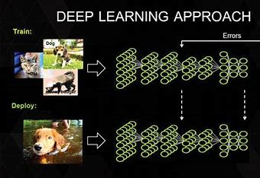
AI-Generated Captions:
In image recognition we use the Deep learning algorithm for detect the object.
Deep learning is a branch of machine Learning. It is an algorithm that attempts to perform high-level abstraction on data using multiple processing layers that contain complex structures or consist of multiple nonlinear transformations.
end-to-end (E2E) object detection can be performed without defining features, usually based on a convolutional neural network (CNN).
Deep learning-based object detection methods can be classified into one-stage methods and two-stage methods, as well as the RefineDet algorithm that inherits the benefits of the former algorithms.

Slide 7
1. Data Collection and Preprocessing:
Collect a labeled dataset of images for training. The dataset should include images of the objects or categories you want to recognize.
Preprocess the images by resizing them to a consistent size, normalizing pixel values, and augmenting the data (e.g., applying random rotations or flips) to increase model robustness.
2. Splitting Data:
Divide the dataset into three subsets: training, validation, and testing.
The training set is used to train the model, the validation set helps in tuning hyperparameters, and the testing set assesses the model's performance.
3. Building a CNN Model:
Design a CNN architecture that consists of layers such as convolutional layers, pooling layers, and fully connected layers.
Convolutional layers apply convolution operations to extract features from the input images.
Pooling layers downsample the feature maps to reduce computational complexity.
Fully connected layers make predictions based on the extracted features.
4. Model Training:
Train the CNN model using the training dataset.
During training, the model learns to recognize patterns and features that distinguish different objects or categories.
Use a loss function (e.g., categorical cross-entropy for multi-class classification) to measure the model's error, and optimize it using backpropagation and gradient descent algorithms.

Slide 8
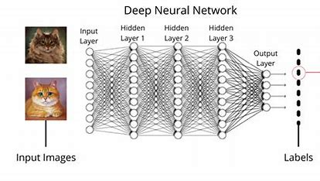
5. Hyperparameter Tuning:
Experiment with different hyperparameters such as learning rate, batch size, and network architecture.
Use the validation set to monitor the model's performance during training and select the best hyperparameters.
6. Model Evaluation:
Evaluate the trained model on the testing dataset to assess its accuracy, precision, recall, and other relevant metrics.
Use techniques like confusion matrices and ROC curves for performance analysis.

Slide 9
User Engagement:
1. Image Metadata:
Allow users to add metadata, such as titles, descriptions, and tags, to their images to help with organization and search.
Automatically capture and display metadata from recognized objects or concepts.
2.Search and Filtering:
Implement a search bar and filtering options to help users quickly locate specific images in their gallery.
Enable filtering by date, tags, or recognized objects.

Slide 10
Conclusion:
Versatile Applications:
Image recognition finds use in a wide range of fields, from healthcare and autonomous vehicles to e-commerce and social media.
Its versatility makes it a transformative technology with the potential to improve various aspects of our lives.
AI Advancements:
Image recognition is closely tied to the advancements in artificial intelligence and deep learning, particularly convolutional neural networks (CNNs).
These technologies have revolutionized the accuracy and capabilities of image recognition systems.
Ongoing Development:
Image recognition continues to evolve, with ongoing research and development efforts aimed at improving accuracy, speed, and adaptability.
Future advancements may open up new possibilities and applications for this technology.

Slide 11
THANK YOU

