Slide 1

Your async code is lying to you.

Slide 2

About Me!
Full Stack Developer 🤡 (Nowadays)
Cat Person
Typescript fanboy
Movie Critic by night
Daniel Denis

Slide 3


Promises are essential
we use them all the time to craft async operations

Slide 4

Promises are essential

Slide 5
Promises are...weird
In this talk we will go through a couple of odd behaviors and important short comings that you may have noticed, or not.

Slide 6
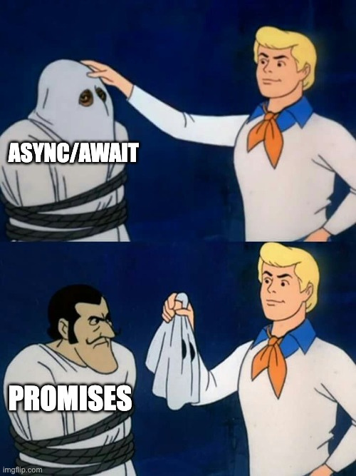
Async/await is just syntactic sugar over promises

Slide 7
Represents an already running computation, that may have completed
Eager Execution
You don’t have to call the promise.
Cannot describe a computation.

Slide 8
  Code is correct
Core Ideas
  Creating this promise causes a side effect.
  We cannot get the value here without running the side effect

Slide 9
  Code is correct
Core Ideas
  Creating this promise causes a side effect.
  We cannot get the value here without running the side effect

Slide 10
Implicit Memoization
Promises run and store the value, and there is nothing you can do about that.

Slide 11
Can’t retry?
There is no native way to actually retry a promise

Slide 12
Floating Promises
It’s not so easy to catch, right? right?

Slide 13
We cannot interrupt a running promise.
Can’t stop,
won’t stop
We had a failed proposal

Slide 14
You have to do all the work
You have to pass the signal through all the layers
Abort Controller
You read the aborted signal, but you have to explicitely stop
Abort appears as an error, which then you have to deal with

Slide 15
e is unknown
This is a JS thing not necessarilly a promises thing.
WTH is e?
Generic Parameter of type Promise<A>
CLANKERS WILL PARSE!!

Slide 16
Honorable Mentions
No control over concurrency
Not that many built-in combinations

Slide 17
So what’s the solution
Sponsor TC39 proposals
Use third party libraries

Slide 18
EFFECT

Slide 19

And we are done 🥳

Slide 20

Follow me on Twitter.
@warriorRapid
The End!

