Slide 1
MURDErer 101 dun...dunN...DunNN
IST 652 Final Project
Kathryn Egan
September 6, 2020

Slide 2



The Crime Scene
Variable | Description | Example
Record ID | unique identifier | 1…2….3...4 etc.
Agency Name | name of responding agency | NYPD
Agency Type | jurisdiction | municipal/state/federal
City | city of crime's occurrence | NYC
State | state of crime's occurrence | NY
Year | year of crime's occurrence | 1980-2020
Month | month of crime's occurrence | January
Crime Type | type of crime committed | Manslaughter by Negligence
Crime Solved | was the crime solved or not | Yes /No
Victim Sex | sex of the victim | Male/ Female
Victim Age | age of victim at time of crime | 37
Victim Race | the race of the victim | Native American
Victim Ethnicity | the ethnicity of the victim | Hispanic/ Not Hispanic/Unknown
Perpetrator Sex | sex of the perpetrator | Male/ Female
Perpetrator Age | ago of the perp at time of crime | 25
Perpetrator Race | the race of the perp | White
Perpetrator Ethnicity | the ethnicity of the perp | Hispanic/ Not Hispanic/Unknown
Relationship | relationship between victim and perp | acquaintance
Weapon | weapon used to commit the crime | handgun
Victim Count | the number of victims during this crime | 4
Perpetrator Count | the number of perps committing the crime | 1
Record Source | where was this crime case obtained from | FBI
24 columns and 638454 rows of US homicide cases
Data spans 1980-2014
From The Murder Accountability Project
FBI and State Agency Reports

Slide 3

Crime Scene Investigation
Removal of Unnecessary Columns
Removal of the Unknown
Creation of new data frames from homicide counts
Conversion of Columns to Dictionary Keys and Values for Correlation Analysis
Scaling Data for Regression Analysis

Slide 4
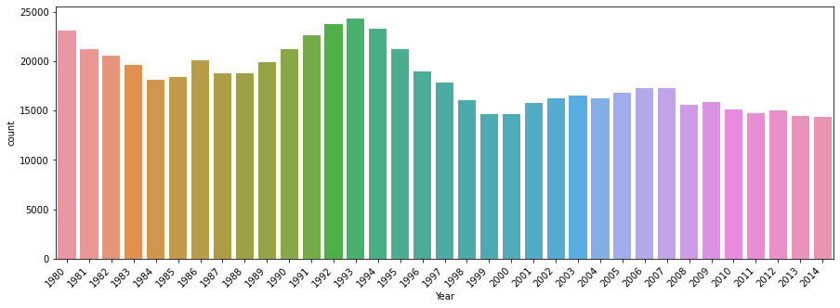
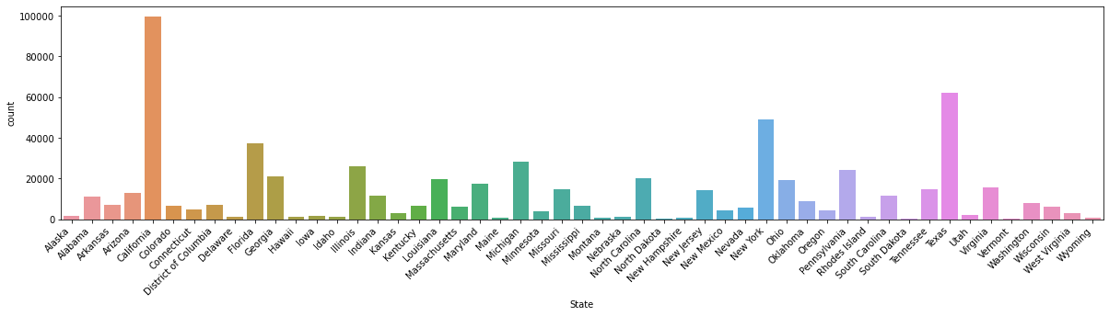
Victim Count
Homicide Counts by Year
year = pd.DataFrame(df, columns = [‘Year'])
year.stack().value_counts()
Avg_num_homicides= sum(homicides)/len(homicides) output[1]18241.54
state = pd.DataFrame(df, columns = ['State'])
state.stack().value_counts()
Homicide Counts by State

Slide 5

Victimology
murder_by_gender = df.groupby(['Victim_Sex', 'Perpetrator_Sex', 'Weapon', 'Relationship']).size()
unsolved = df.groupby(['Crime_Solved','Victim_Age', 'Victim_Race', 'State']).size()
Victim_Sex | Perp_Sex | Weapon | Relationship | Count
Female | Male | Drugs | In-Law | 3
Female | Male | Drugs | Mother | 12
Female | Male | Drugs | Neighbor | 2
Female | Male | Drugs | Sister | 3
Female | Male | Drugs | Son | 2
Female | Male | Drugs | Stepdaughter | 1
Female | Male | Drugs | Stranger | 21
Female | Male | Drugs | Unknown | 66
Female | Male | Drugs | Wife | 72
Female | Male | Explosives | Acquaintance | 17
Female | Male | Explosives | Brother | 2
Female | Male | Explosives | Common-Law Wife | 1
Female | Male | Explosives | Daughter | 12
Female | Male | Explosives | Employee | 1
Female | Male | Explosives | Ex-Wife | 1
Female | Male | Explosives | Family | 2
Female | Male | Explosives | Friend | 2
Female | Male | Explosives | Girlfriend | 3
Female | Male | Explosives | In-Law | 1
Female | Male | Explosives | Mother | 2
Female | Male | Explosives | Neighbor | 1
Female | Male | Explosives | Stranger | 99
Female | Male | Explosives | Unknown | 18
Female | Male | Explosives | Wife | 9
Female | Male | Fall | Acquaintance | 12
Female | Male | Fall | Common-Law Wife | 2
Female | Male | Fall | Daughter | 1
Crime_Solved | Victim_Age | Victim_Race | State | Count
No | 4 | White | Texas | 5
No | 4 | White | Virginia | 1
No | 4 | White | Washington | 2
No | 4 | White | Wisconsin | 1
No | 5 | Asian/Pacific Islander | Hawaii | 1
No | 5 | Asian/Pacific Islander | Washington | 1
No | 5 | Black | Alabama | 1
No | 5 | Black | Arizona | 1
No | 5 | Black | California | 1

Slide 6
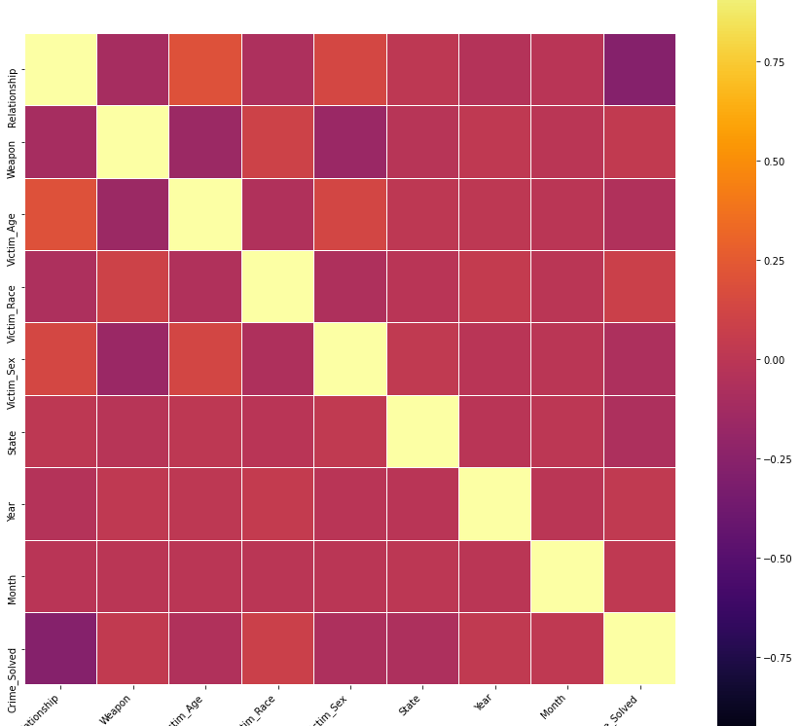
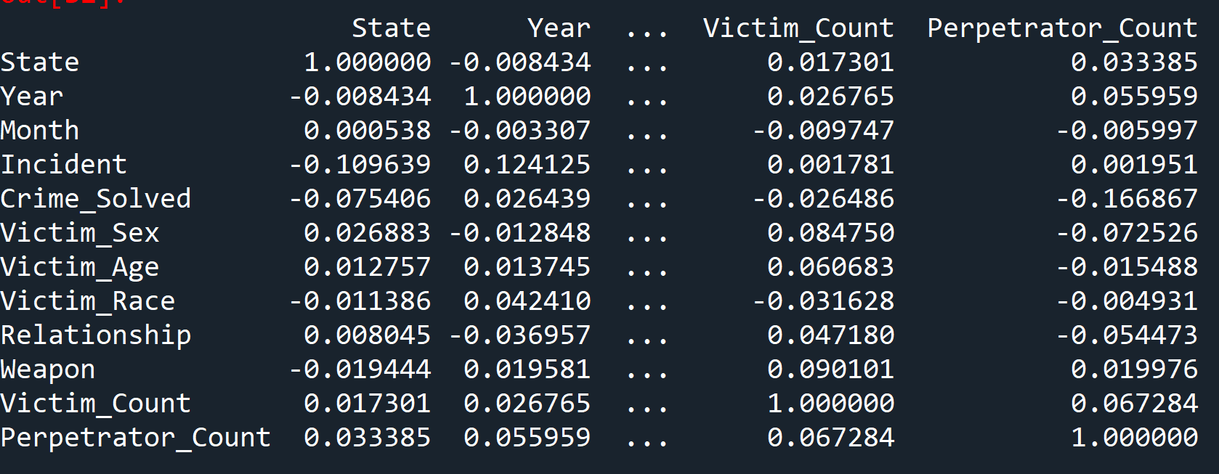
Criminology
dictionary Conversion
df.corr()
sns.heatmap

Slide 7
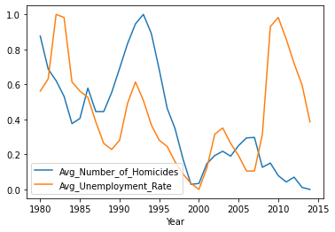
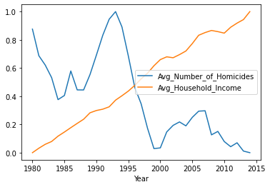
Motive
Unemployment Rates?
Household Income?
Merged annual homicide counts df with df from bls.gov
Merged annual homicide counts df with df created from table scraped from economics website

Slide 8

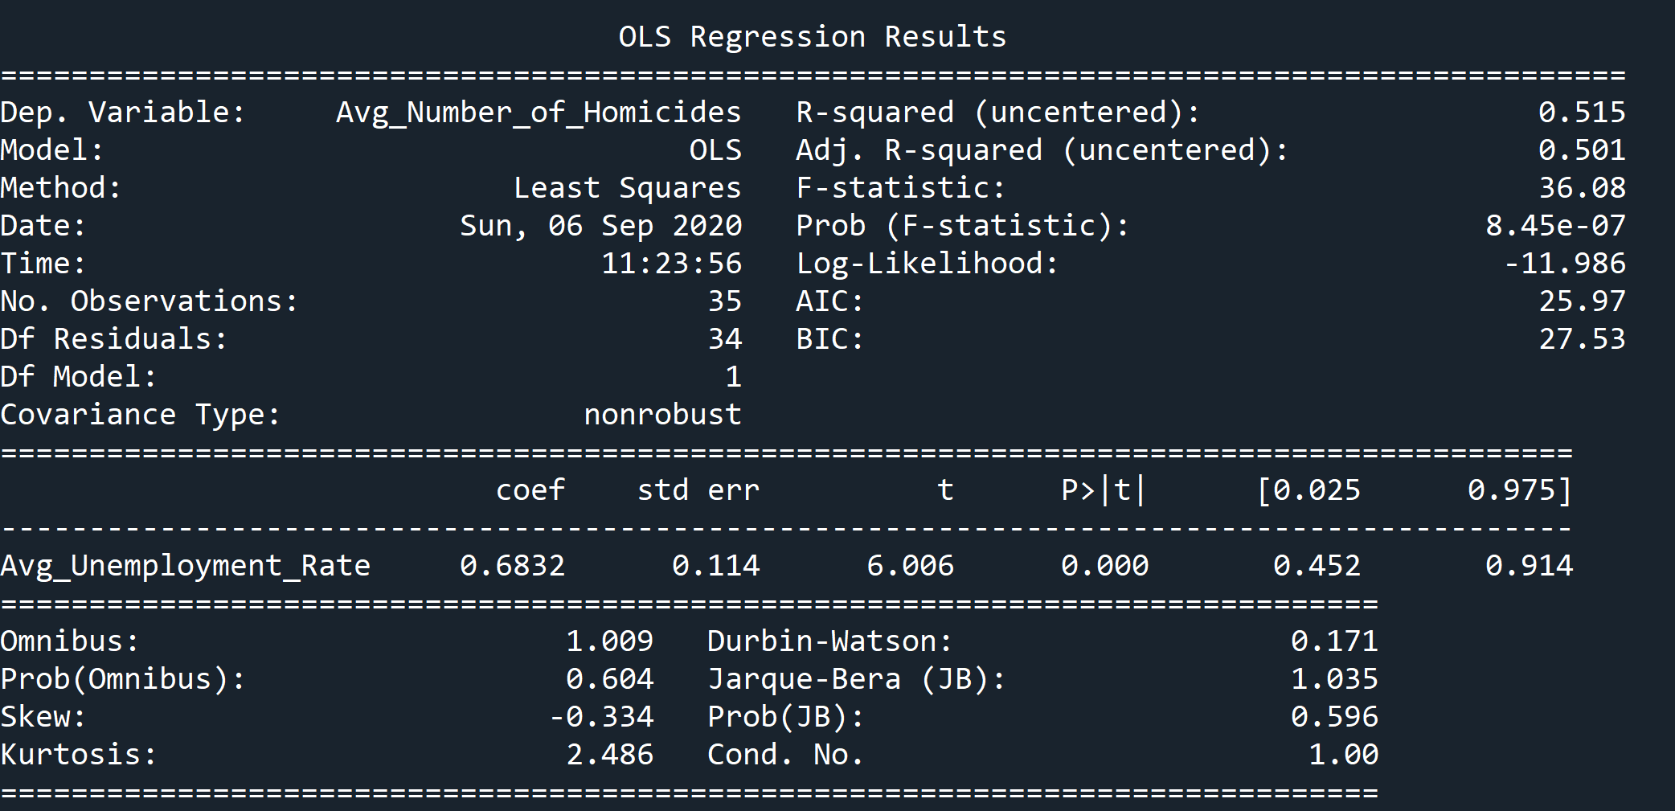
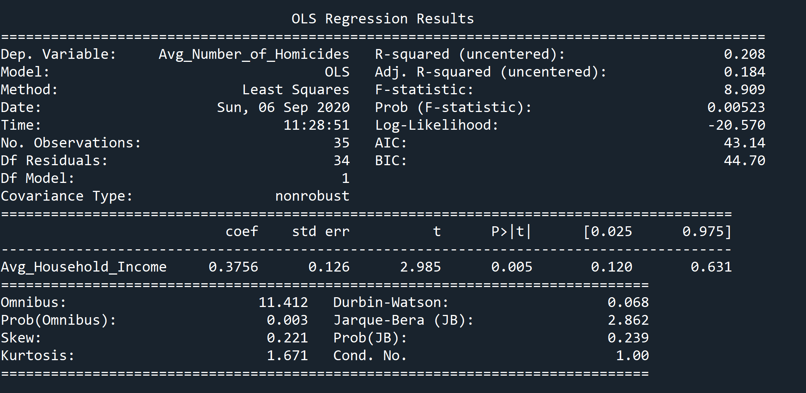
Motive
Unemployment Rates?
Household Income?
Scaled data for linear regression
Dependent Variable: Number of Homicides
Independent Variable: Unemployment Rate
Scaled data for linear regression
Dependent Variable: Number of Homicides
Independent Variable: Household Income

Slide 9
Questions?
Thank You!

