Slide 1

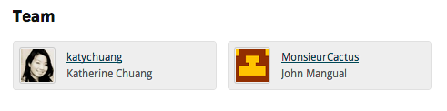
Nuance
“The app you need to help you look up details.”
Tapped NFC Hackathon, New York
October 6 – 7, 2012

Slide 2
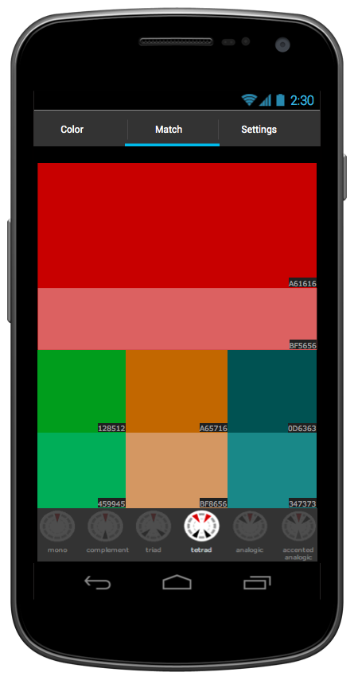
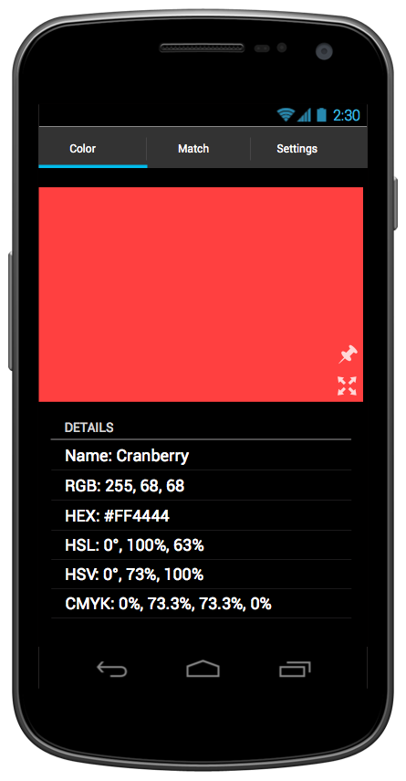
Outline
What does
How it does it
Who it’s for
Next steps

Slide 3
Features
Color Information
Color Schemes

Slide 4
How it works – for user
What color is this?
‘Tap’
Color RGB Value
Which colors match this one?
‘Tap’
Matching Color RGB Values

Slide 5
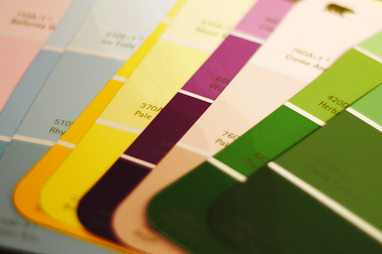
Uses
Paint selection

Slide 6
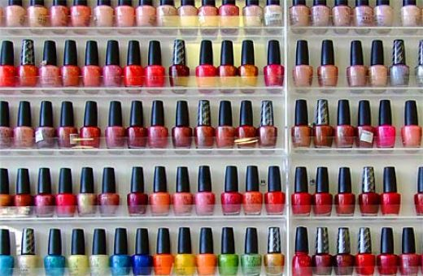
Uses
Nail Polish

Slide 7
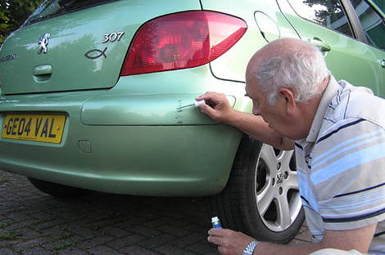
Uses
Car paint touch up

Slide 8
Next Steps
Look up bus schedule quickly
Which bus/train should I take?
When is the next one?
Social integration.. Maybe for online dating
Look up object information
Who made this piece that is on exhibit in museum?
What is the serial number of this gadget?

