Slide 1
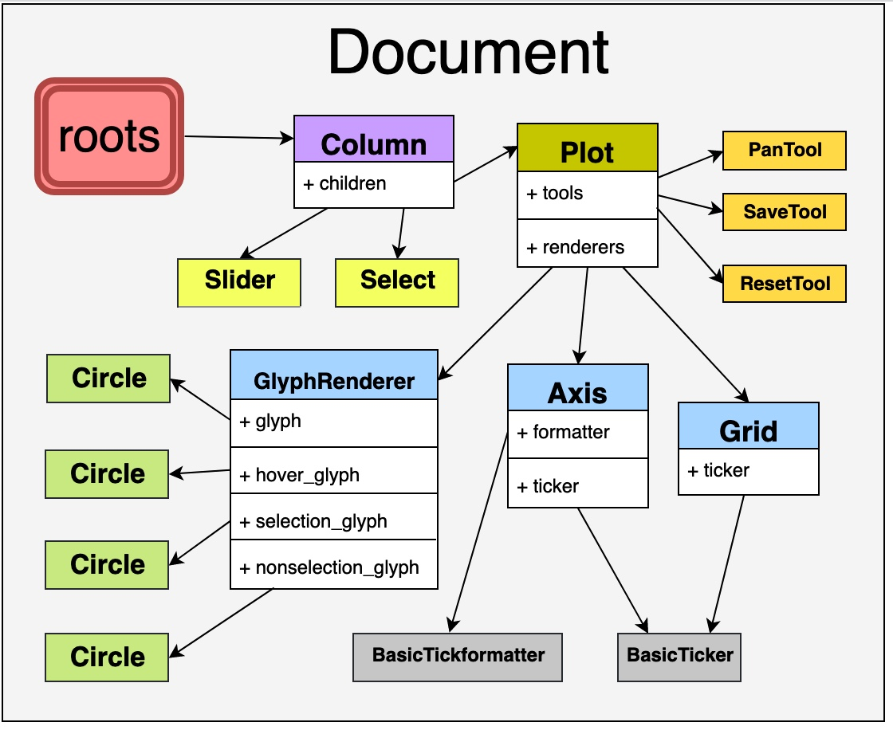
Document
Roots
Tab
Panel
Row
Plot
HoverTool
+ children
+ children
+ children
+ tools
+ formatter
+ renderers
DatetimeFormatter
Column
+ children
CrosshairTool
DatePicker
Spinner
Select
X-Axis
GlyphRenderer
+ formatter
Line
+ glyph
+ ticker
DatetimeFormatter
DatetimeTicker

