Slide 1
K Nearest Neighbors Based Optical Character Recognition
David Katz
Harrison Zhao

Slide 2
Image Dataset
Broke 52k images into a training set of 40k and a test set of 12k
Each image represents a lowercase letter a-z
Initial image 16x8 pixels
Vectorized each image by summing 2x2 blocks

Slide 3

4 | 0 | 0 | 0
2 | 1 | 0 | 0
0 | 2 | 0 | 0
0 | 2 | 0 | 0
2 | 1 | 0 | 0
2 | 3 | 3 | 1
2 | 0 | 0 | 3
1 | 0 | 0 | 1

Slide 4
KNN Machine Learning
To train, simply vectorize each image from the training set.
To test, compute the Euclidean distance between a vectorized image from the test set and each feature vector from the training set.
Use the top K to make a decision as to which letter the test image represents.

Slide 6
Goal: Improve KNN Accuracy
Modification of KNN
Use KNN results as letter likelihoods
Preprocessed KNN on with K=50 training set and stored these results for future use
Letter: | # in top K
h | 40
b | 8
l | 2
P(h|image) = 40/50 = 80%
P(b|image) = 8/50 = 16%
P(l|image) = 2/50 = 4%

Slide 7
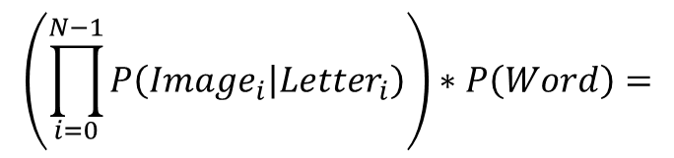

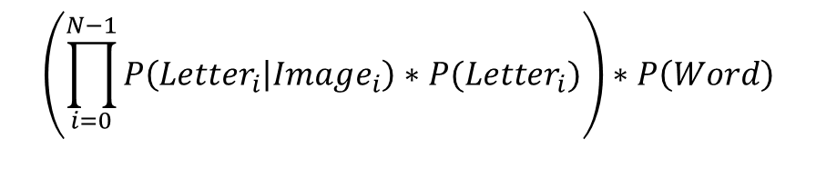
MAP Estimate for Words
Maximize P(Word|Images)
Apply Bayes’ theorem, equivalent to maximizing:
$$P\left(Images | Word\right)∗P\left(Word\right)=$$
$$\left(\prod_{i=0}^{N−1}{P\left(Image_{i} | Letter_{i}\right)}\right)∗P\left(Word\right)=$$
$$\left(\prod_{i=0}^{N−1}{P\left(Letter_{i} | Image_{i}\right)∗P(Letter_{i})}\right)∗P\left(Word\right)$$
Must be computed for every word of sequence length!

Slide 8
Where do we get these probabilities?
P(Letter|Image) approximated from KNN
Smoothing was applied to remove zero probabilities
P(Letter) approximated from training set
P(Word) approximated from all letters of appropriated length from the Brown Corpus

Slide 11
Deliverables
Accepts an input text file containing a sequence of words
Returns an html file with letters taken from training set and predicted word
Benchmarked system performance by testing words randomly chosen from the Brown Corpus
A webpage for users to try drawing their own words

Slide 12
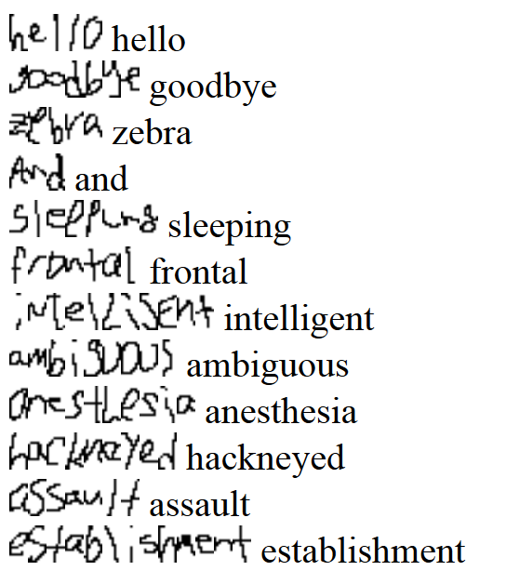
Sample output.html

Slide 15
Spellchecking
Poorly drawn characters may have a significant impact on the resulting word
Attempted single letter spellchecking via thresholding character with minimum weight
Resulted in slight improvement for words with an error, but a significant decrease in performance for words with no errors

Slide 16
No Errors
One Substitution Error

Slide 17
Try it for yourself!
http://199.98.20.118:3000/

