Slide 1
Katzenpost
Claudia Diaz
Moritz Bartl
Panoramix meeting
Athens 24 September 2018

Slide 2
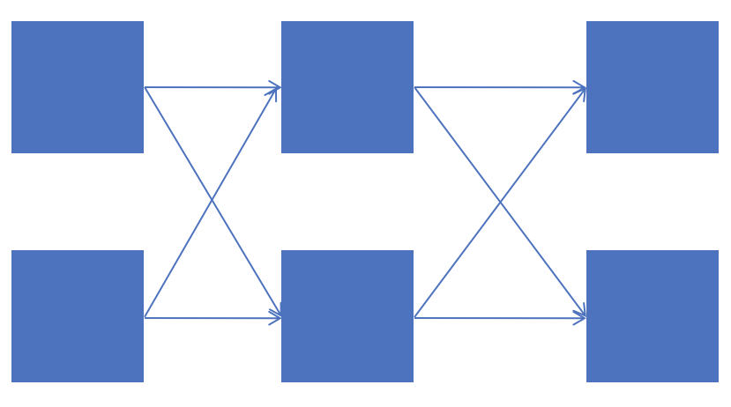
Messaging Mixnet Architecture
Provider
(sender)
Provider
(receiver)
Mixnet
Notes:
Providers authenticate users and maintain email accounts
Acks sent back from Exit Provider (reliable if recipient offline) + retransmissions from the client
existing e-mail programs to interact with a mixnet SMTP submission proxy and a POP3 receive proxy

Slide 3
Reliable transport: SURB-ACKS
Place message to Bob’s inbox
Extract SURB and send back as ACK
Provider
(sender)
Provider
(receiver)
Mixnet
Retransmit (after random delay)
Re-encrypt message from scratch

Slide 4
Dummy traffic: loops
Extract SURB and send back
Provider
(sender)
Provider
(receiver)
Mixnet
Messages are indistinguishable from normal user messages for all entities but responding provider
Client loops
Mix loops
Notes:
Protection against long-term disclosure attacks
Increased anonymity sets per message
Detection of active attacks (n-1)

Slide 5
Mix and provider pipelines
Listeners
Incoming connection workers
Crypto workers
Provider packet workers
User spools
Connector packet dispatcher
Mix delay
AQM
Kaetzchen
workers
External plugin workers
External plugin workers
SURB
loops
key lookups
External plugin workers
Notes:
Kaetzchen services are essentially simple Request/Response services where the response is sent back to the client using a SURB.
ACKS?? Generated in which box
autoresponder agents ("Kaetzchen") that run on Katzenpost provider instances
The use-cases for such agents include, but are not limited to
user identity key lookup, a discard address, and a loop-back responder for the purpose of cover traffic.

Slide 6
PKI mixnet infrastructure
Directory authorities maintain a consensus on the network
Consensus lists participating mixes, their descriptors (addresses, crypto keys) and position in the topology
Published periodically including keys for at least the following 3 epochs
  nr epochs: max round trip, exposure of keys to compromise attacks
All key rotations happen simultaneously
Sphinx key rotation every epoch for forward secrecy and efficient replay protection (mixes & providers)
Network topology
  Randomly assigned (based on unbiased random seed)
  Only refreshed when layers become too unbalanced (splits anonymity sets)
Mix operators may schedule downtime with half empty mix descriptors
Open issues:
  Not byzantine-fault-tolerant, allows for manual intervention upon consensus fault
  PQ crypto signatures for all PKI documents
  Packet loss for full current epoch if mix goes down (consensus not updated), worse if long epochs
  No bandwidth authority to measure actual mix bandwith

Slide 7
PKI Clients
Providers keep the keys (long lived X25519 keypair) of their users associated to their email address
Any client can query the key associated to a user account
  Anonymous lookup over mixnet
  Indistinguishable from normal message (except for responding provider)
  Reply uses SURB (similarly to message acks)
Trust on first use
  Provider could MITM if it provides bad key
  Detection possible via self-lookups (probabilistic catching of cheating)

Slide 8
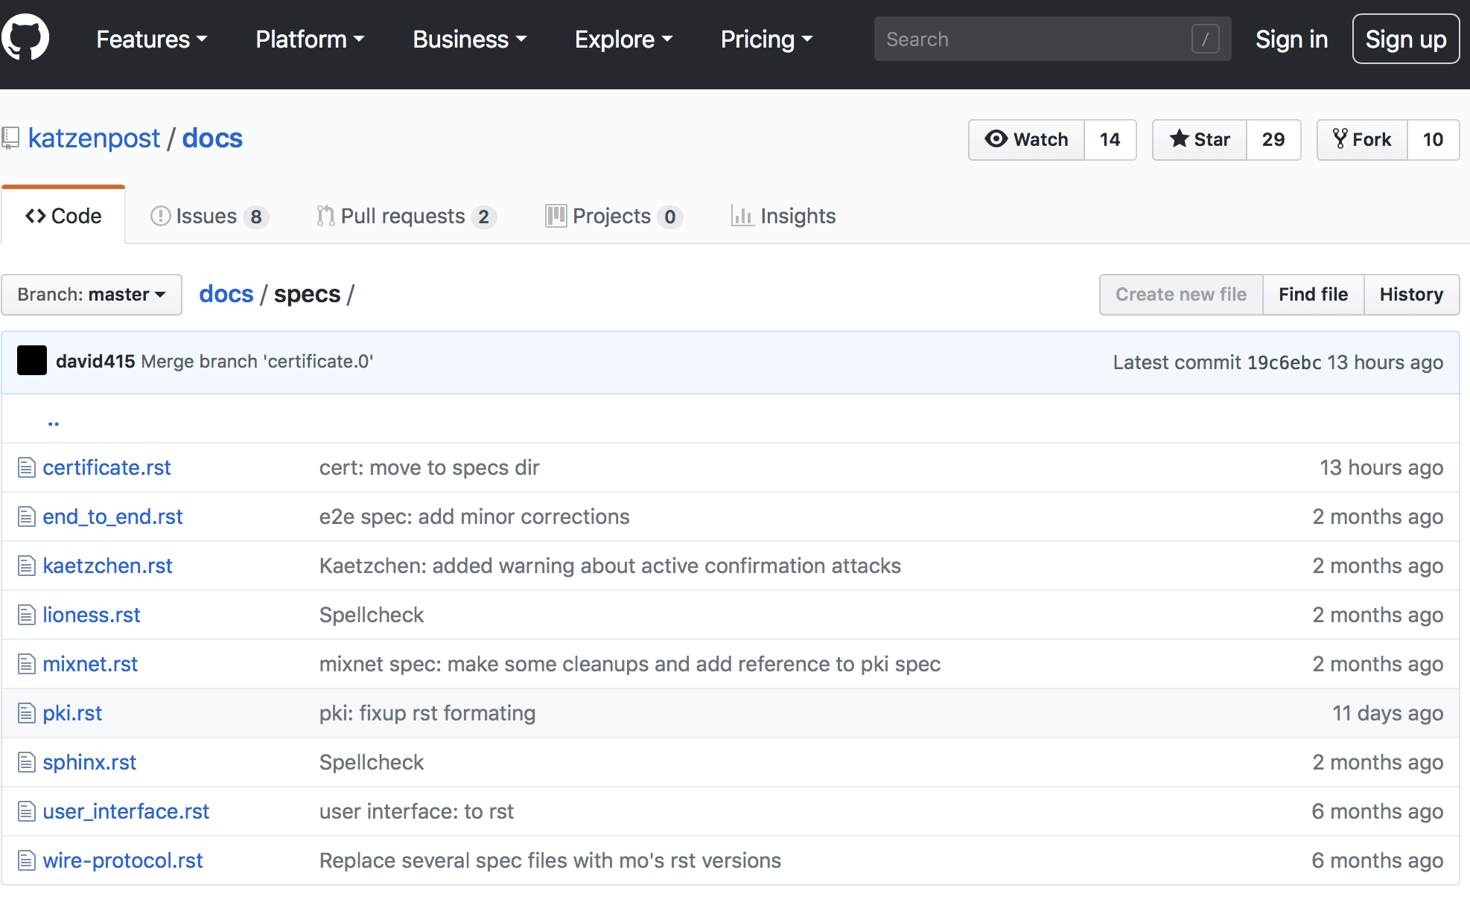
Specs

Slide 9
Katzenpost Mix Network Wire protocol
Fork of Noise crypto library implementation which has the ability to use the New Hope Simple post quantum hybrid key exchange for forward secrecy
  addition of a quantum resistant algorithm will provide forward secrecy even in the event that large scale quantum computers are applied to historical intercepts
Provides
  Mutual authentication
  Link layer encryption and forward secrecy
Used at link layer for ALL communications
  Clients to Providers and Directory Authorities
  Providers, Mixes and Directory Authorities
Notes:
Lioness wide block cipher
Specification of a concrete parameterization based around the BLAKE2b hash algorithm and ChaCha20 stream cipher

Slide 10
Sphinx
Compact and secure packet format
Features:
  per hop bitwise unlinkability
  Single Use Reply Blocks
  indistinguishable replies
  hidden the path length
  hidden the relay position
  tagging attack detection
  replay attack detection

Slide 11
Mixnet spec
Network topology (layered)
Mixing strategy (Poisson)
Sphinx packet processing
  Timestamping
  Authenticate and decrypt
  Replay detection
  Keep for specified delay, then forward to next hop
Scalability
  Active queue management algorithms (AQMs) in ingress mix and egress queues
  Messages are purged from (any of) the queues so that performance degrades gracefully with respect to increased work load

Slide 12
E2E spec
Sending a message
  Fragment message into fixed sized blocks
  Encrypt and authenticate each block
  Choose route and delays at each hop
    Open issue: delays for multi-block messages
  Create the SURB-ACK
  Assemble ciphertext and SURB-ACK in Sphinx packet payload
  … Retransmit if needed (ACK not received)
Receiving a message
  Provider unwraps sphinx packet and extracts
    Message block (to receiver mailbox)
    SURB-ACK (send back to network)
  Clients poll their provider to download received messages and acks of sent messages
    Decrypt blocks with user key
    Reassemble multi-block messages
Notes:
SMTP / POP
Check additional security/anonymity considerations

Slide 13
Downloads
“Playground” Client Release https://katzenpost.mixnetworks.org/downloads.html
  Linux / Mac ( / Windows ?) binaries
  Android integration demo based on K-9 Mail

Slide 14
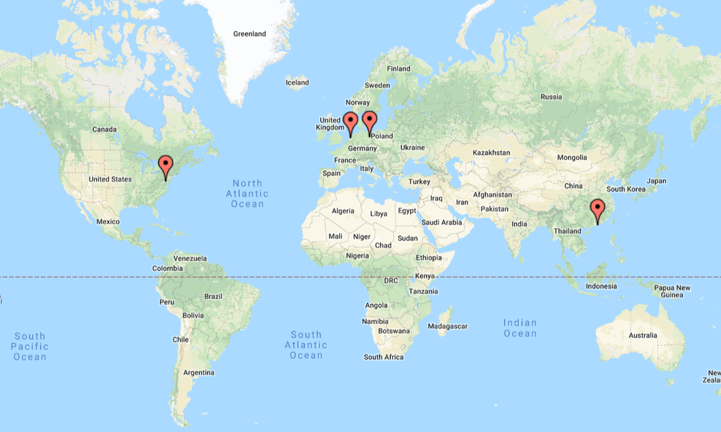
Playground
Provided by CCT & Greenhost
Notes:
Berlin
Washington DC
Amsterdam
Hong Kong

Slide 15
Registration
username@provider
uploads key to provider
    authentication
    keyserver lookups
writes local configuration file for mailproxy
katzenpost_registration -name username

Slide 16
Usage
mailproxy -f ~/.mailproxy/mailproxy.toml
22:17:54.372 NOTI minclient:username@provider: Katzenpost is still pre-alpha. DO NOT DEPEND ON IT FOR STRONG SECURITY OR ANONYMITY.
22:17:54.372 NOTI listener/POP3: Listening on: 127.0.0.1:2524
22:17:54.372 NOTI listener/SMTP: Listening on: 127.0.0.1:2525

Slide 17
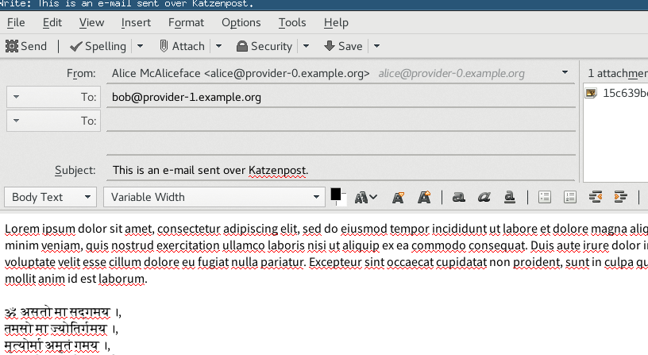
Thunderbird Demo

Slide 18
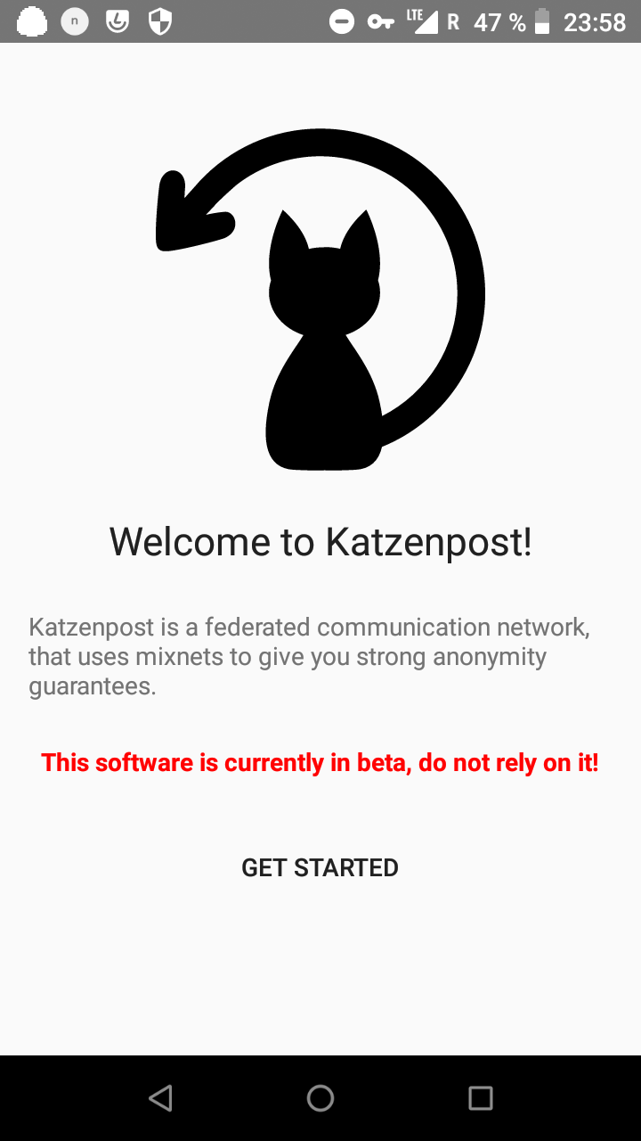
Android

Slide 19
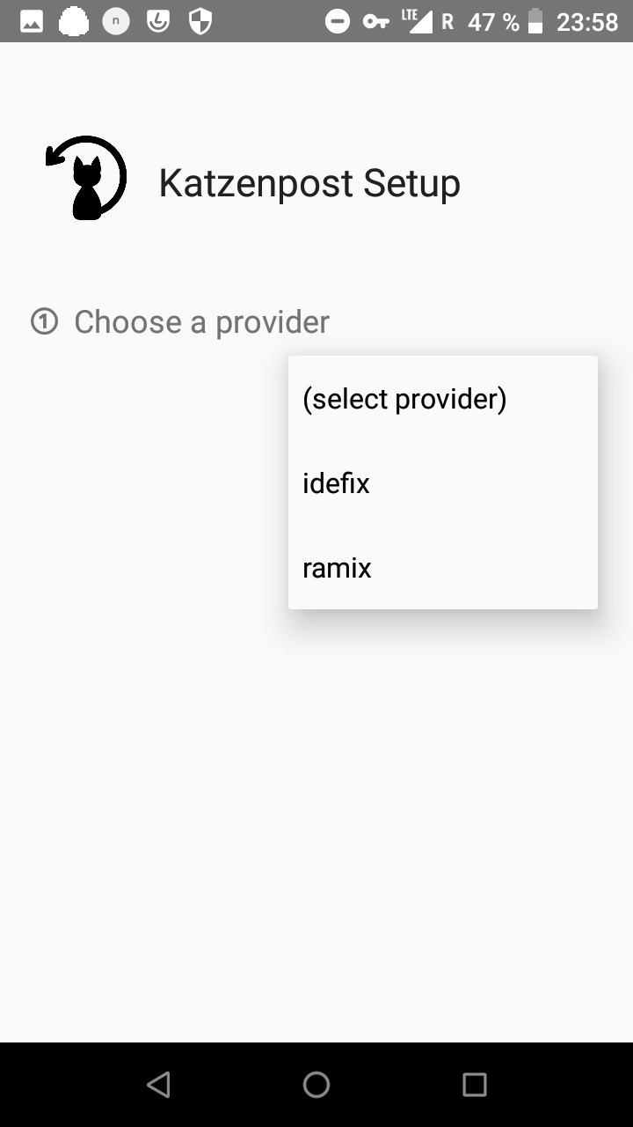

Slide 20
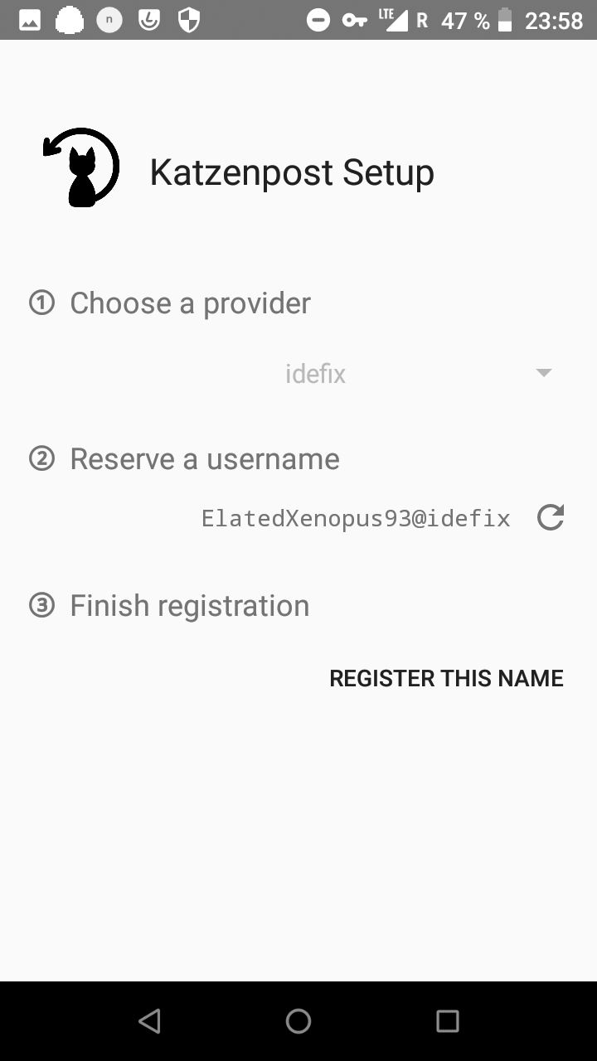

Slide 21


Slide 22
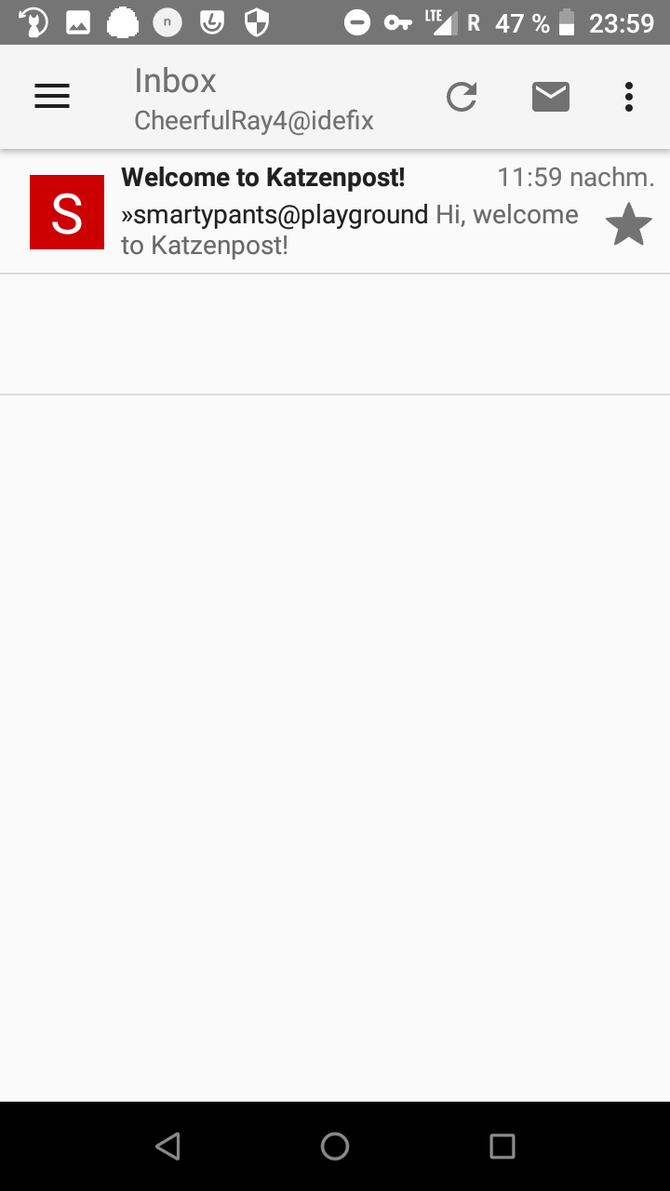

Slide 23
Documentation
“Katzenpost Handbook”
“Getting started in Katzenpost development”
“How to set up your own Katzenpost mixnet”
FAQ
Glossary
Contribution Guidelines

Slide 24
Specifications
End-to-end protocol
Mix network
Public Key Infrastructure (voting/non-voting)
Sphinx packet format/SURBs
Mailproxy (“User Interface”)
Wire Protocol
LIONESS Wide-Block-Cipher
Extensions (Autoresponder/Bot/Echo)

Slide 25
“Proper” Free Software Project
Active Issue tracker (Github)
Continuous Integration (TravisCI)
Mailing lists, Discussion Channel (IRC)

Slide 26
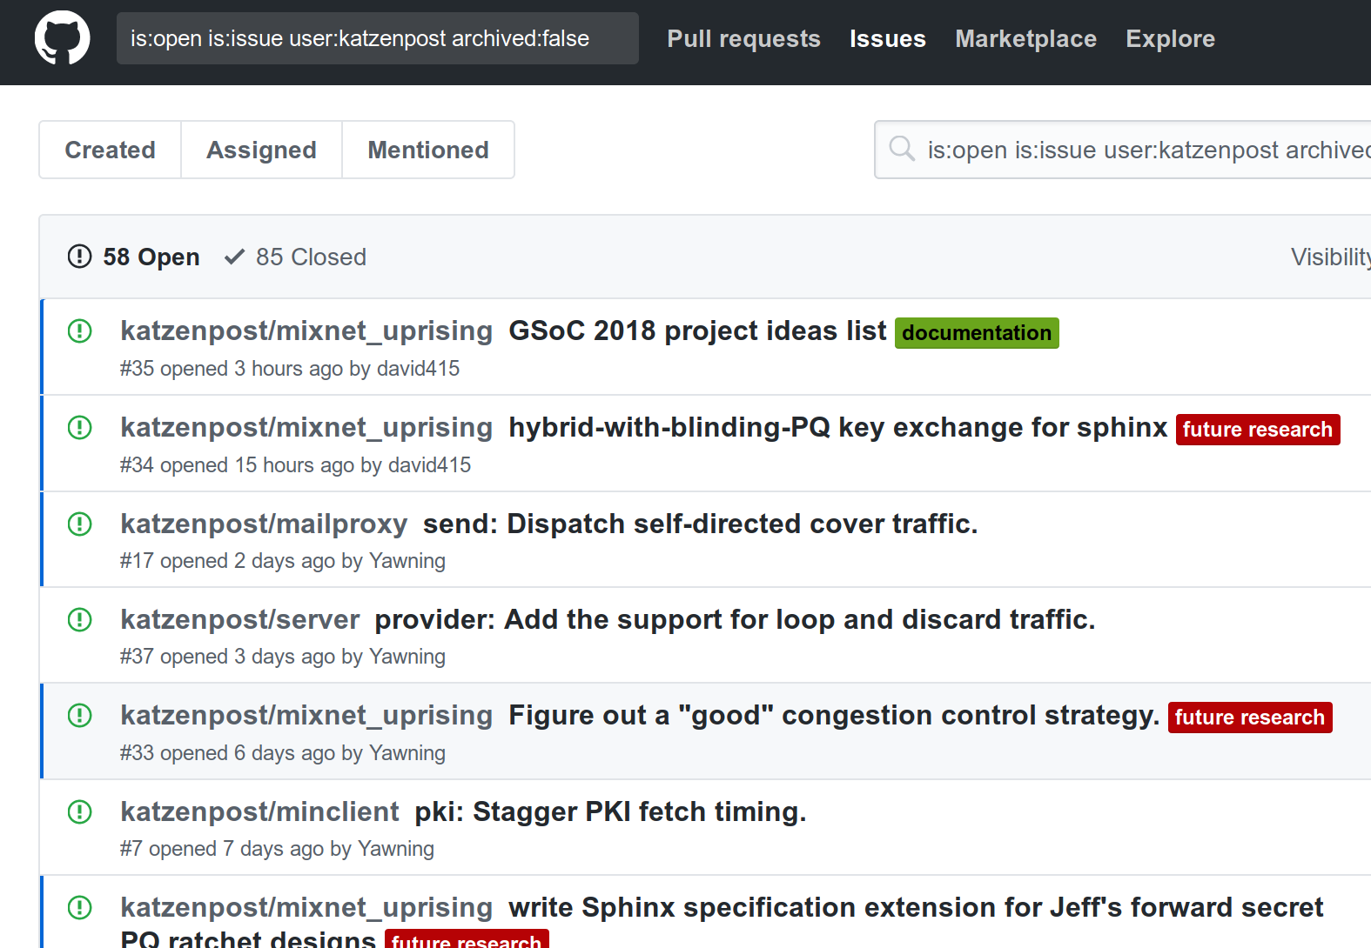

Slide 27
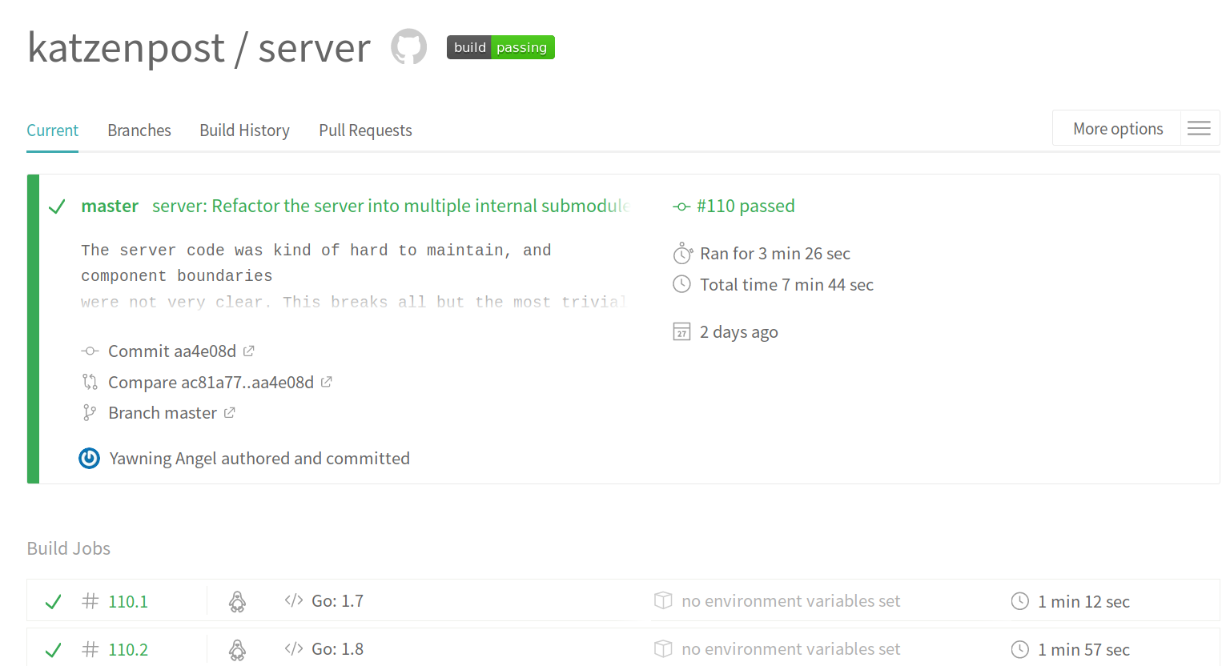

Slide 28
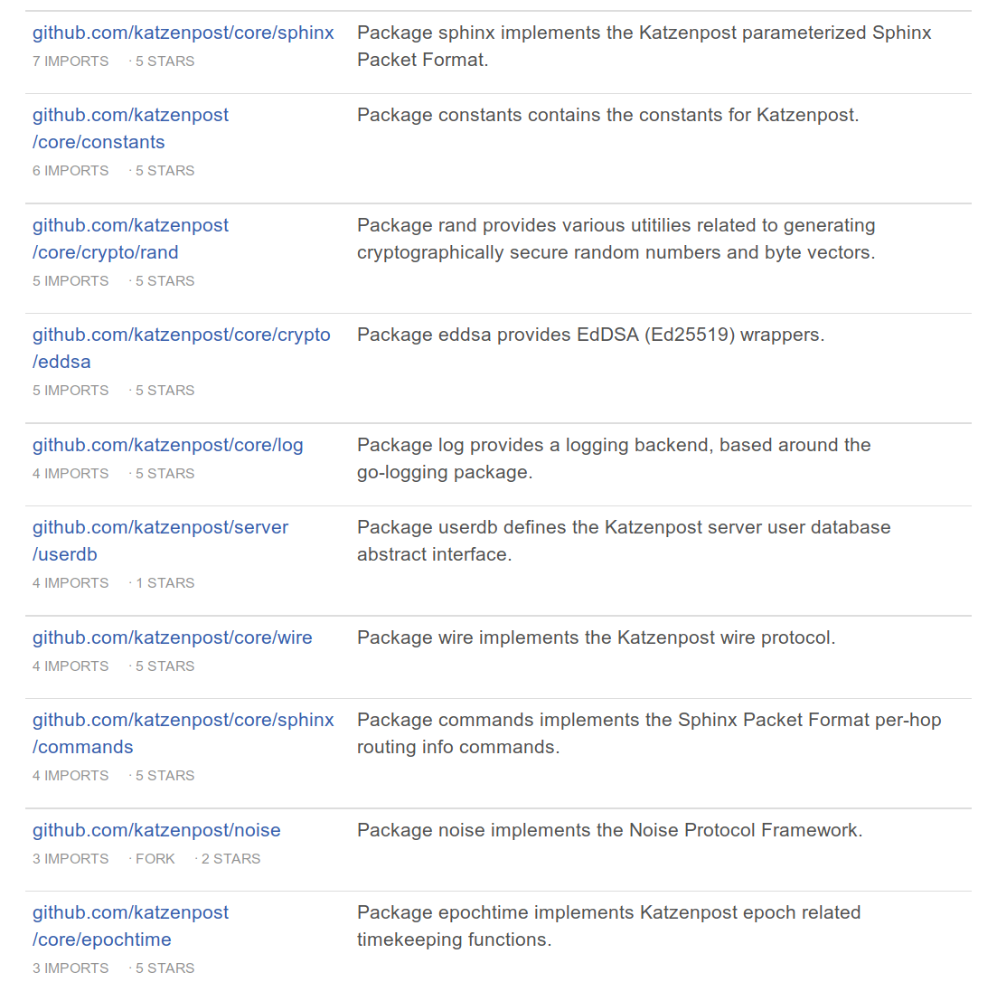

Slide 29
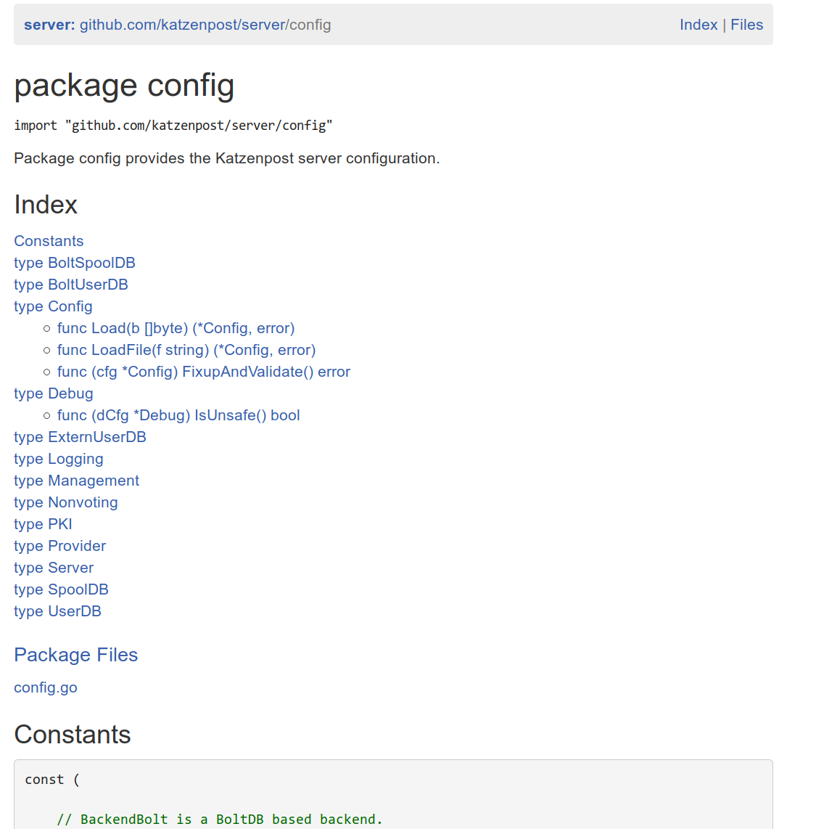

Slide 30
Deployment (server-side)
Configuration file and local testbed generator/test environment (kimchi)
Ansible scripts for provisioning

