Slide 1
MV2Dbased lifting
ENSAI

Slide 2
2D detection
Mask RCNN
Input images (I_v)
Bounding box (B_i_v = x_min, x_max, y_min, y_max)
RPN
RoI Align
Feature maps for each bounding box Ov = RoI-Align(Fv , Bv ),
0 ≤ v < N.
Notes:
Input images: Denoted as I over v cameras.
Mask RCNN is the 2D object detector. It contains the RPN (Region proposal network). RPN is a neural network that generates regions of interest (RoIs) based on the identification of potential objects in the image. Each region of interest is the bounding box and each bounding box is classified.
Inside Mask RCNN there is also the RoI-Align which extracts feature maps from the RoIs. In our case each bounding box corresponds to 7x7 RoI align feature map having 512 channels.

Slide 3
mask_rcnn_r50_fpn.py
1. Backbone
  Resnet
  Depth = 50
  Num_stages = 4 (by default)
  Out_indices (indices for each stage)
  frozen_stages = 1
  norm_cfg = BN (Batch normalization)
2. Neck
  In channel = [256,512,1024,2048]
  out_channel = 256
  num_outs = 5
3. RPN_head
  In channel = 256
  Feature channels = 256
  Anchor generator
  BBOX coder
  Loss classification: Cross entrpy
  Loss bbox = L1 loss
4. ROI head
  Bbox roi extractor
    Roi layer = roi_align, output size = 7
    out_channel = 256
  Bbox head
    in_channel = 256
    fc_out_channel = 1024
    roi_feat_size = 7
    num_class = 10
    Loss classification: Cross entrpy
    Loss bbox = L1 loss

Slide 4
mv2d_r50_single_frame_roi_1408x512.py
Point_cloud_range = given in meters. Need to change to actual dimensions for the data.
post_range = same as above
roi_size = 7 Roi_align resizes each selected region to 7x7 (default from resnet)
roi_stride = downsampling factor between original image and the feature map = 16 (nuscenes)
  This roi_stride needs to be tuned for cancer data.
One STEM + 4 stages in resnet
DCN (deformable convolution networks at last stages of resnet)
grid_mask configuration for training. Can be tuned for cancer data to remove generalisation?
Neck:
  Only uses the 3rd stage feature output. Based on cancer data this needs to be tuned.
ROI head
  ROI_stride = 16 (to be tuned)
  1024*1024→128*128(3rd stage)→ each roi will be 16x16 so we get a 8x8 feature map → downsampled to 7x7
  Output channels = 512

Slide 5
Positional Encoding
Encode 3D positional information into 2D features to get 3D position aware features.
Earlier used to generate high resolution images from low resolution, by encoding HR co-ordinates into LR features.
Type of Implicit neural representation (INR). Maps co-ordinates to visual signal by MLP.
Anchor points in 3D space are transformed to object queries by a MLP.
These further interact with 3D position aware features to predict corresponding 3D objects.
In MV2D the PE is split into 2 parts:
  Camera frustum coordinate positional encoding
  3D coordinate positional encoding

Slide 6
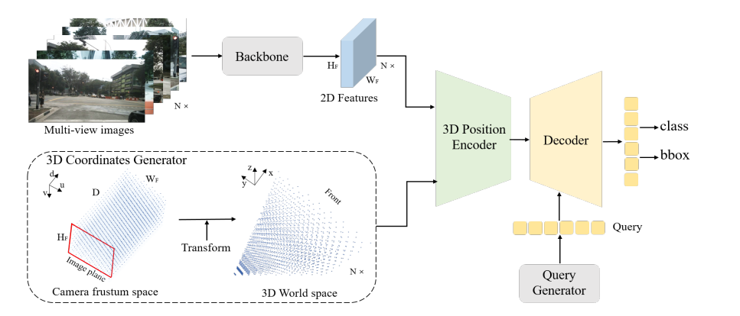
PETR method

Slide 7

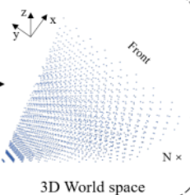

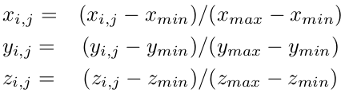
3D coordinate generator PETR
u
j
v
. . .
Discretize the camera frustum space into D planes
d_j = (j/(D-1) * (Zmax – Zmin) + Zmin)
Eg: Z is from -10m to +10m
Notes:
Each feature map represented as u x v, is projected onto the camera frustum space. The equation is as shown in the figure.
The depth discretization value d_j is obtained using varying methods. One of the methods involves smaller resolution of the discretization closer to the camera and larger steps further away. This ensures the

Slide 8
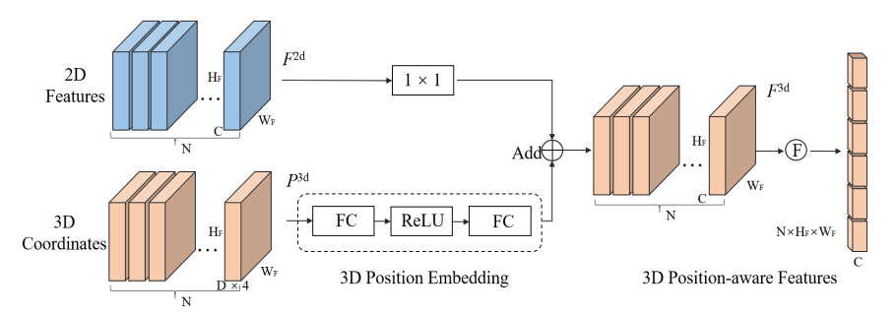
3D position embedding + Position aware features

Slide 9
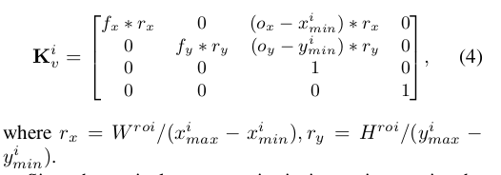
MV2D - Camera frustum co-ord PE
Flat
1D conv
Avg Pool
Linear
ReLu
p_i_v
F_i_v (7x7x512)
K_i_v
Intermediate updated feature map
Notes:
query_generator.py
def get_roi_feat(self, x, extra_feats=dict()):
This step creates an intermediate set of feature maps where the camera intrinsic params are positionally encoded with the RoI feature maps, and we obtain the 3D camera frustum coordinate space.
For each bounding box in an image the NN learns the representation of the object location.
p_i_v is the co-ordinate space that is generated from the co-ordinate space of the intermediate updated feature maps.

Slide 10

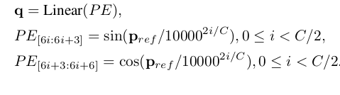
3D co-ordinate position embedding
Pref is normalized as:
Queries are generated as:
Notes:
def center2lidar(self, center_pred, intrinsic, extrinsic)
reference_points, return_feats = self.query_generator(bbox_feats, intrinsics, extrinsics, extra_feats)
reference_points[..., 0:1] = (reference_points[..., 0:1] - self.pc_range[0]) / (
self.pc_range[3] - self.pc_range[0])
reference_points[..., 1:2] = (reference_points[..., 1:2] - self.pc_range[1]) / (
self.pc_range[4] - self.pc_range[1])
reference_points[..., 2:3] = (reference_points[..., 2:3] - self.pc_range[2]) / (
self.pc_range[5] - self.pc_range[2])
reference_points.clamp(min=0, max=1)
SinePositionalEncoding3D

