Slide 1
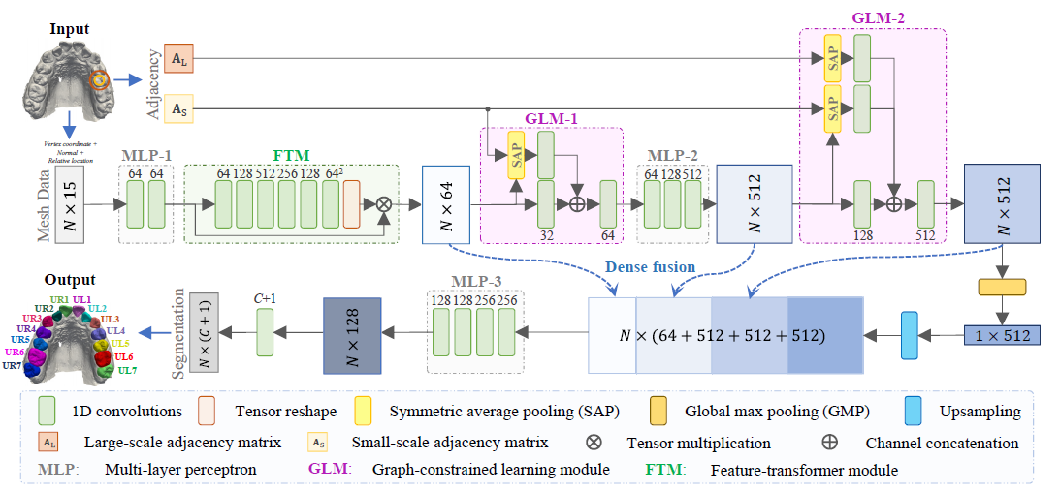
MeshSegNet Study

Slide 2
Model
Input
  Raw mesh surface data with the size of N × 15, where N is the number of mesh cells. Each cell is represented by 15 features:
  ○ Coordinates of the three vertices (9 units)
  ○ Normal vector (3 units)
  ○ Relative position with respect to the whole surface (3 units)

Slide 3
Model
Architecture (similar to pointnet)
  Succesive MLPs to extract increasingly higher level geometric features
  first MLP is followed by a feature-transformer module (FTM) to map inputs into a canonical feature space, creates a transformation invariant representation
  FTM captures cell wise features

Slide 4
Model cont.
Architecture Key points
  GLM (Graph constrained learning)
  Receptive field increases as the layers increase.
    1 hop immediate neighbour or 2 hop or 3 hop for distant neighbour. Done by defining 2 neighbouhood balls that provide adjecency matrices AS and AL to represent graph connections between cells
    Multi scale contextual features are extracted by multiple layers and special pooling
  GLM 1 looks at local features (AS) in small neighbourhood. SAP pooling aggregates neighbourhood features onto current cell
  GLM 2 enlarges receptive field by using AS and AL for SAP (symmetric average pooling)

Slide 5
Model cont.
Dense Fusion
  FTM + GLM1 + GLM2 Local to global feature segmentation are fused
  This is passed through another MLP and 1D convolution layer with softmax to get probabilities of teeth and gingiva

Slide 6
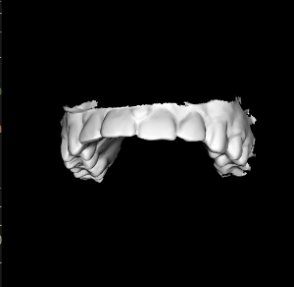
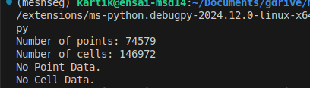
Data Analysis
7 STL files at input
Converted to vtp files for better understanding script: stl2vtp_conv.py
Example of U1JJFQ5H.stl

Slide 7
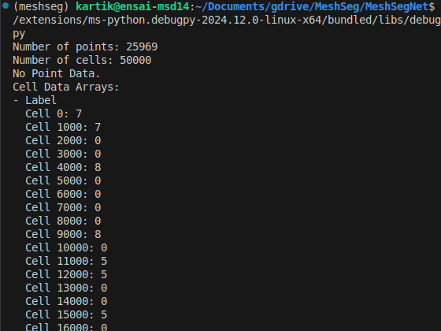
Mesh Segmentation Detection
Script run: step6_predict_with_post_processing_pygco.py
Output obtain as vtp files

Slide 8
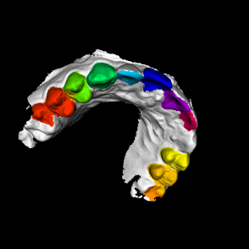
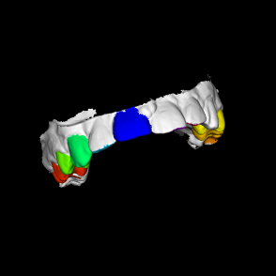
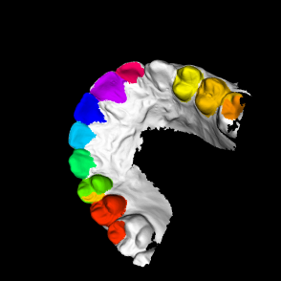
Visualizing the results (U1JJFQ5H)
Script used: visualizeVTP.py
Scripts for visualization and coversion can be found here: https://github.com/katzkid/MeshSegNetStudy

Slide 9
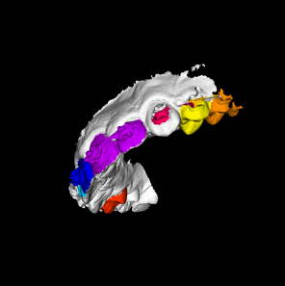
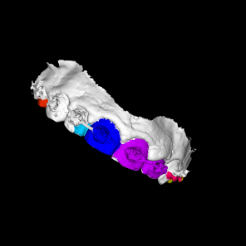
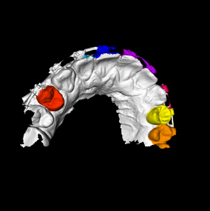
Visualizing (U1CUXHEX.stl)

Slide 10
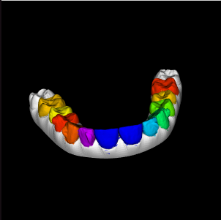
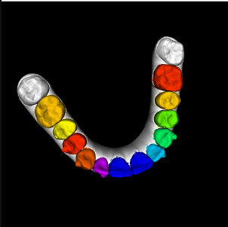

Visualizing (U1K5LD24.stl)

Slide 11
Result analysis
The result in its current state is not able to classify the teeth correctly in our data set.
Possible reasons could be that the study only contained 20 maxillary dental surfaces for training.
Augmentation of the data set was done but it is not clear if it would be representative

Slide 12
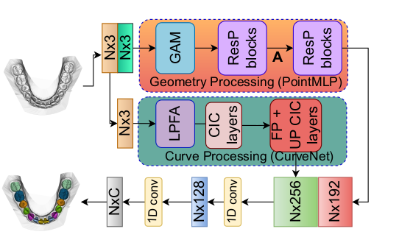
Paper Study: 3D TOOTH MESH SEGMENTATION WITH SIMPLIFIED MESH CELL REPRESENTATION https://arxiv.org/abs/2301.10531

Slide 13
Model
Input: Each mesh cell is represented by 6 features: the 3D coordinates of the barycenter and the 3D components of the normal vector at that barycenter.
Author believes that including mesh cell vertices as features, impose an artificial structural constraint that can hinder learning and prevent the use of multi-resolution mesh data.

Slide 14
Model (cont.)
2 branches of processing:
  Geometric branch
    Point MLP n/w with GAM. Geometric affine module allows the reduced input (only barycenter co_ord and normal). Creates normalized representation of the surface features. This will be less sensitive to variations in scale, orientation or position.
    Capturing mainly the local geometric details

Slide 15
Model (cont.)
2 branches of processing (cont.)
  Curvenet
    Different tooth types exhibit significant variations in shape and size. The curves formed by the barycenter coordinates can capture these differences and enhance the model's representation learning capability
    Inclusion of mesh vertices could introduce noise and confuse the network
    LPFA – Local point feature aggregation
    CIC – Curve intervention convolution (curve grouping (walks), curve aggregation)
    FP + UP – Feature propagation + Upsampling
    Overall this is capturing global geometric features. Long range shape information of the tooth.

Slide 16
Model (cont.)
Feature fusion and classfication
  Geometric branch and Curve branch are concatenated and are processed by convolution networks to generate segmentation scores

Slide 17
Advantages
Only barycenter data is needed. Resolution of the graph is not important I.e multi resolution mesh data can be used
As with MeshSegNet there is complimentary feature leaning and concatenation.
Faster performance, light weight
Results show better performance than MeshSegNet

