Slide 1

House Prices - Advanced Regression Techniques
Barlybay Kaisar (211107009)

Slide 2
Work done
Scraped 40000 advertisements for the sale of apartments in Almaty city from “krisha.kz” website
Visualized and analyzed scraped data using data wrangling techniques
Cleaned and preprocessed data for the training
Trained 6 different regression models and one averaged regression model with various variations of pre-processed data to predict apartment price
Compared obtained results

Slide 3
Table of contents
Data observation – columns, correlations
Feature Engineering – missing data, transformations, preprocessing
Regression models
Evaluation metrics
Results

Slide 4
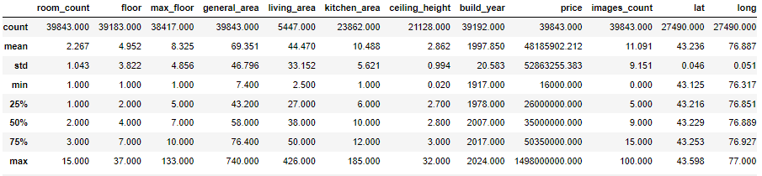
Data observation
Df size = 39843
Other features:
['room_count', 'neighborhood', 'street', 'house_number', 'intersection', 'district', 'floor', 'residential_complex', 'max_floor', 'general_area', 'bathroom', 'living_area', 'kitchen_area', 'condition', 'internet', 'furniture', 'ceiling_height', 'floor_type', 'telephone', 'door', 'balcony', 'parking', 'is_balcony_glazed', 'bars_on_the_window', 'security', 'entry_phone', 'code_lock', 'alarm', 'video_security', 'video_entry_phone', 'concierge', 'plastic_windows', 'non_angular', 'improved', 'rooms_isolated', 'studio_kitchen', 'kitchen_builtin', 'new_plumbing', 'pantry', 'counters', 'quiet_courtyard', 'air_conditioning', 'commercial_convenient', 'installment', 'mortgage', 'building_type', 'build_year', 'price', 'mortgaged', 'images_count', 'private_hostel', 'city', 'text', 'address', 'lat', 'long']

Slide 5
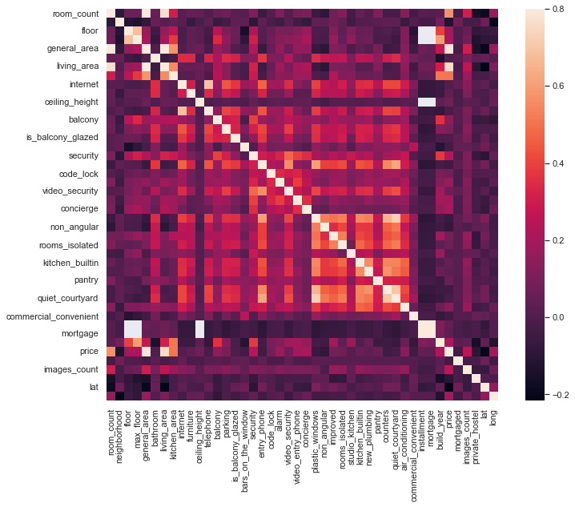
Feature correlation
Price has:
strong correlation with general_area, living_area
moderate correlation with kitchen_area, room_count
Obviously:
general area correlates with room_count, living_area, kitchen_area
etc

Slide 6
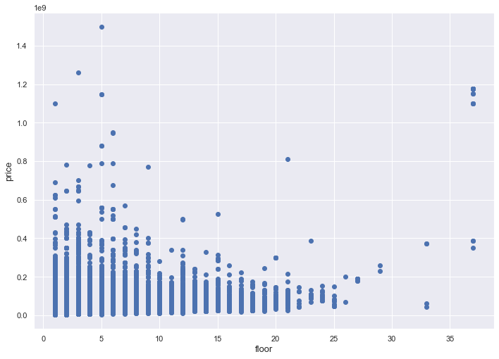
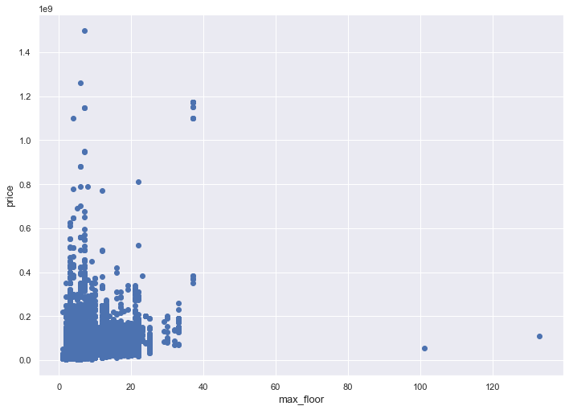
Correlation between price and Floor / max floor
Extremely expensive apartments are not usually built in high-rise buildings.

Slide 7
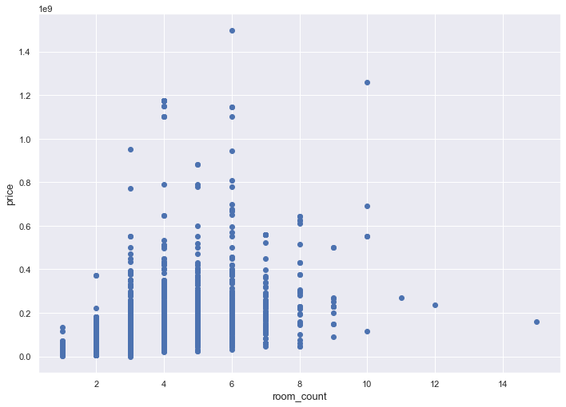
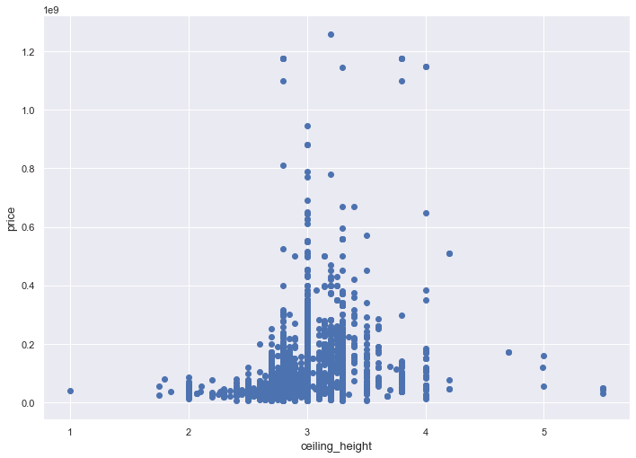
Correlation between price and room count / ceiling height
Expensive apartments have high ceilings(3-4 meter) and 4 to 6 rooms

Slide 8
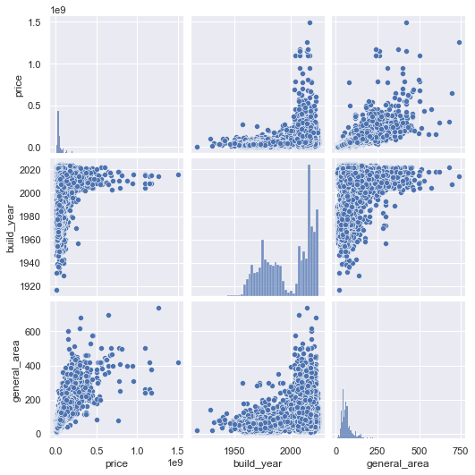
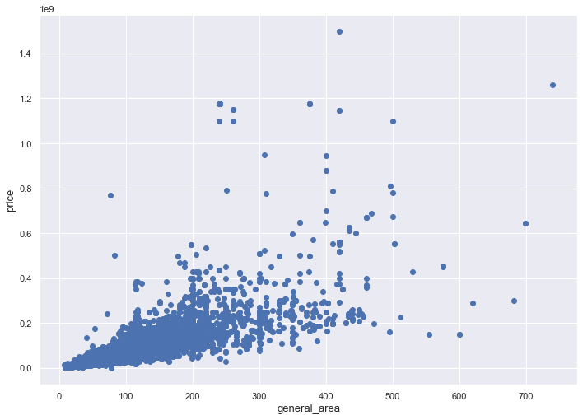
Price vs general area /build year
Strong correlation between general area and price. Expensive apartments are built 2000-2023 years.

Slide 9
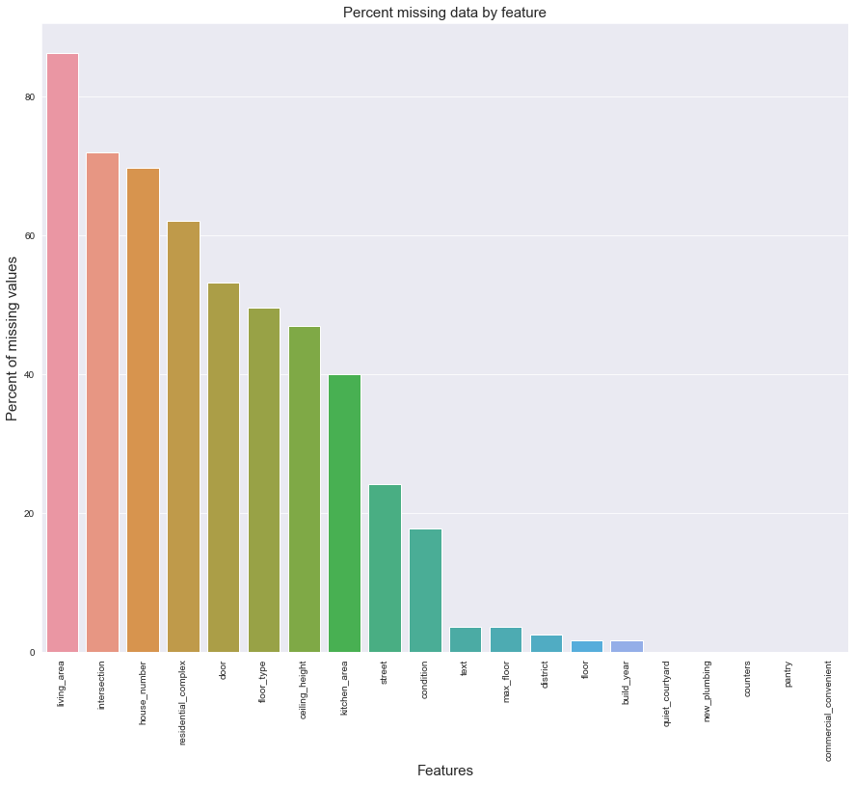
Feature Engineering: missing data
Text => text_len
Drop columns: 'living_area', 'ceiling_height', 'kitchen_area’ text, city
Drop rows with null cells on columns: 'max_floor', 'floor', 'build_year', 'lat', 'long’.
Dropped rows with price <= 100000
Replaced None values of 'residential_complex’, 'door', 'floor_type', 'condition’ with string 'None’

Slide 10
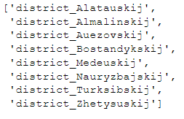
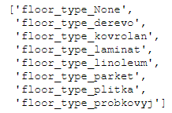
Feature engineering: transformation
Encoded category columns
Transliteration of column names: 'residential_complex', 'condition', 'floor_type', 'door', 'building_type’
Dataframe shape before was: (39843, 56)
Dataframe shape after is : (25559, 474)

Slide 11
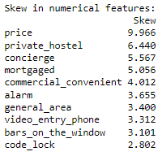
Skewness of other features
For normally distributed data, the skewness should be about zero. For unimodal continuous distributions, a skewness value greater than zero means that there is more weight in the right tail of the distribution. The function `skewtest` can be used to determine if the skewness value is close enough to zero, statistically speaking.
There are 43 (abs(skewness) > 0.75) skewed numerical features to Box Cox transform

Slide 12
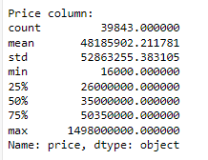
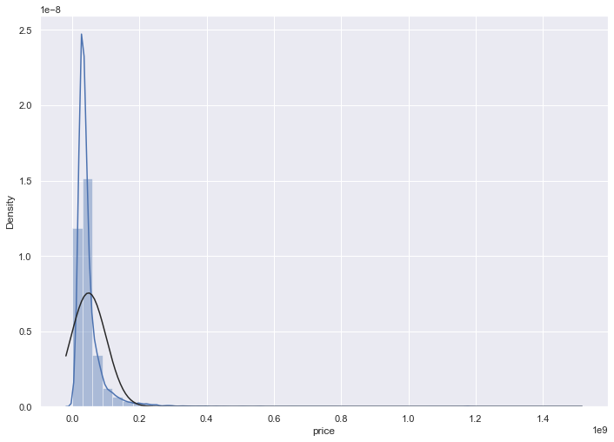
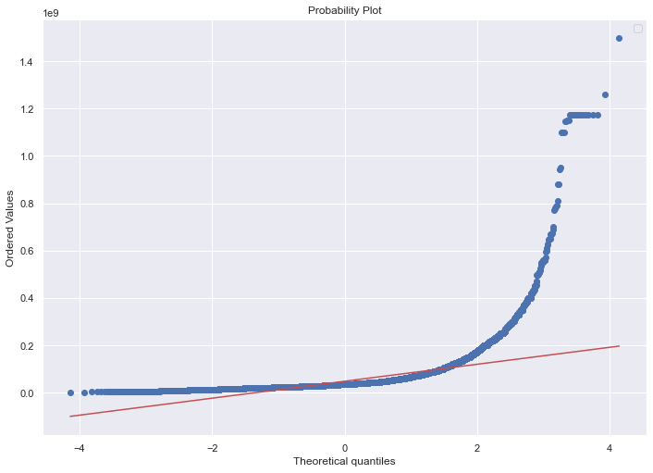
Skewness of price before Box Cox transform
Skewness: 9.061531926502054 Kurtosis: 147.49564850562925
(calculates a best-fit line for the data)

Slide 13
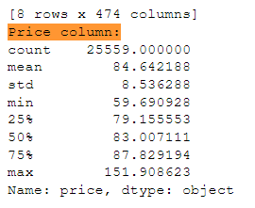
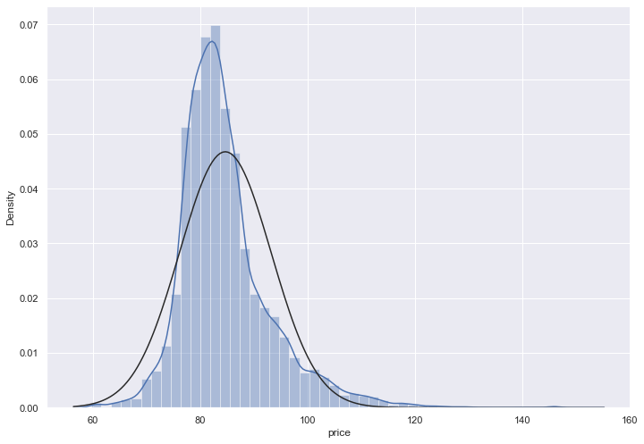
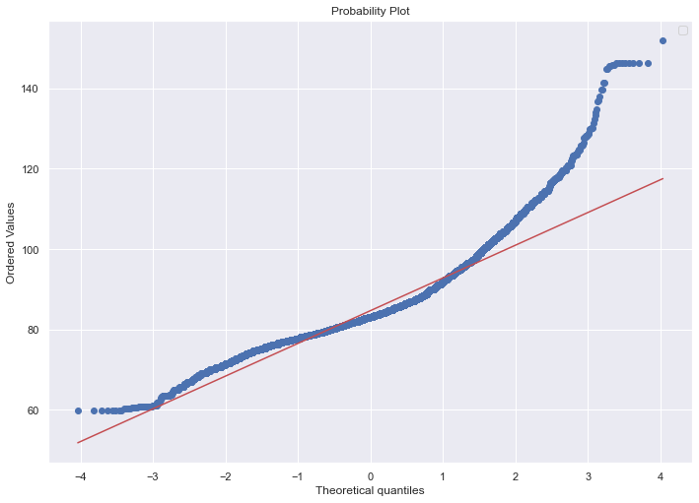
Skewness of price after Box Cox transform
Skewness: 1.4100743880542594
Kurtosis: 4.277300066748374
log(1 + x)

Slide 14
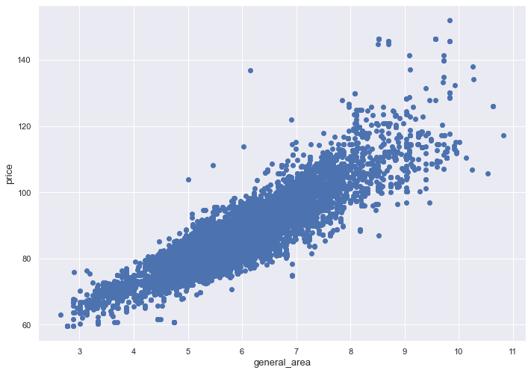
General area vs price before and after skeweness was resolved

Slide 15
Single Models Averaged model
Kernel Ridge Regression(KRR)
Elastic Net Regression
Lasso Regression
Gradient Boosting Regression
XGBoost(Extreme Gradient Boosting) Regression
LightGBM Regression
Kernel Ridge Regression(KRR)
Elastic Net Regression
Lasso Regression
Gradient Boosting Regression

Slide 16
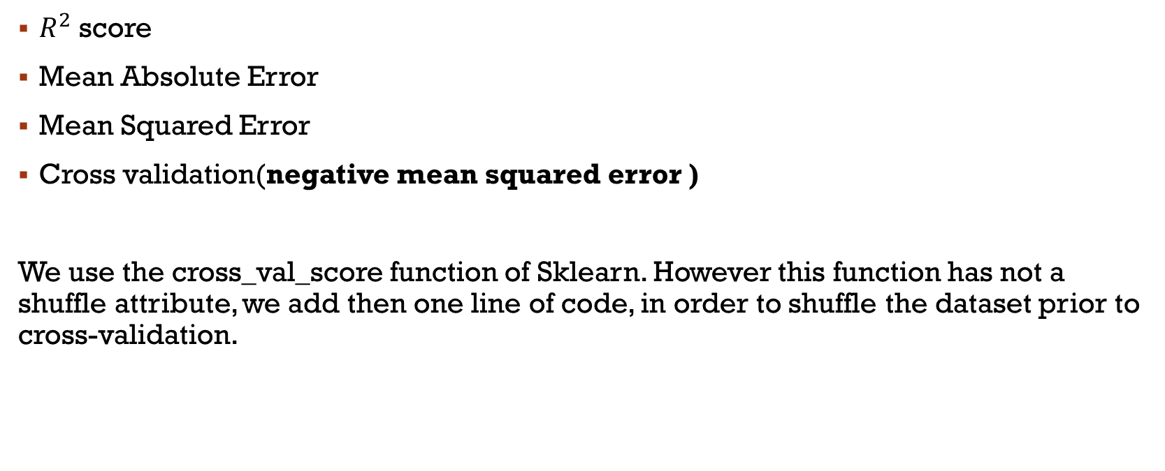
Validation: measures and metrics
$R^{2}$ score
Mean Absolute Error
Mean Squared Error
Cross validation(negative mean squared error )
We use the cross_val_score function of Sklearn. However this function has not a shuffle attribute, we add then one line of code, in order to shuffle the dataset prior to cross-validation.

Slide 17



Validation: $R^{2}$ score
$R^{2}$(coefficient of determination) regression score function. Best possible score is 1.0. It represents the proportion of variance (of y) that has been explained by the independent variables in the model. It provides an indication of goodness of fit and therefore a measure of how well unseen samples are likely to be predicted by the model, through the proportion of explained variance. If $\hat{y_{i}}$ is the predicted value of the $i$-th sample and $y_{i}$ is the corresponding true value for total $n$ samples, the estimated R² is defined as:

Slide 18

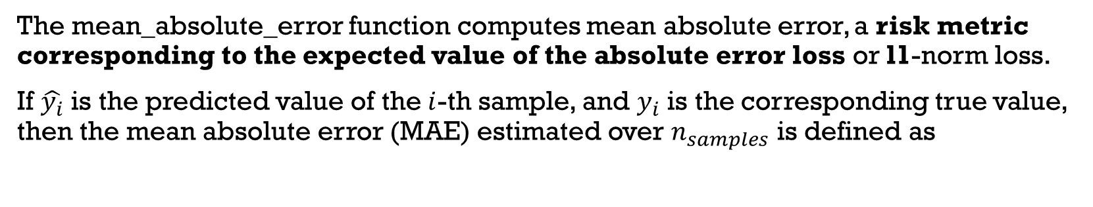
Validation: Mean absolute error
The mean_absolute_error function computes mean absolute error, a risk metric corresponding to the expected value of the absolute error loss or l1-norm loss.
If $\hat{y_{i}}$ is the predicted value of the $i$-th sample, and $y_{i}$ is the corresponding true value, then the mean absolute error (MAE) estimated over $n_{samples}$ is defined as

Slide 19


Validation: Mean squared error
The mean_squared_error function computes mean square error, a risk metric corresponding to the expected value of the squared (quadratic) error or loss.
If $\hat{y_{i}}$is the predicted value of the $i$-th sample, and $y_{i}$ is the corresponding true value, then the mean squared error (MSE) estimated over $n_{samples}$ is defined as

Slide 20

Cross-validation
A test set should still be held out for final evaluation, but the validation set is no longer needed when doing CV. In the basic approach, called k-fold CV, the training set is split into k smaller sets (other approaches are described below, but generally follow the same principles). The following procedure is followed for each of the k “folds”:
a model is trained using of the folds as training data;
the resulting model is validated on the remaining part of the data (i.e., it is used as a test set to compute a performance measure such as accuracy).
In our case negative mean squared error is the performance measure.

Slide 21
Results predict col: price_log1p, skeweness resolved
 | R-square Accuracy | Mean absolute Error | Mean squared Error | Cross-Validation negative mean squared error | Cross-validation standard deviation
Kernel Ridge Regression | 0.92 | 0.0192 | 0.000698 | 0.0016 | 0.0003
Elastic Net | 0.89 | 0.0228 | 0.000968 | 0.0007 | 0
Lasso Regression | 0.89 | 0.0229 | 0.000976 | 0.0007 | 0
Gradient Boosting Regression | 0.95 | 0.0151 | 0.000474 | 0.0066 | 0.0009
XGBoost | 0.92 | 0.0195 | 0.000716 | 0.0076 | 0.0004
LightGBM | 0.93 | 0.0176 | 0.000579 | 0.009 | 0.0008
Averaged model | 0.92 | 0.0189 | 0.000676 | 0.0018 | 0.0003

Slide 22
Results predict col: price, skeweness resolved
 | R-square Accuracy | Mean absolute Error | Mean squared Error | Cross-Validation negative mean squared error | Cross-validation standard deviation
Kernel Ridge Regression | 0.91 | 1.7061 | 6.849177 | 0.0092 | 0.0003
Elastic Net | 0.92 | 1.5649 | 5.785951 | 0.0005 | 0
Lasso Regression | 0.92 | 1.5545 | 5.70355 | 0.0005 | 0
Gradient Boosting Regression | 0.93 | 1.3463 | 5.108386 | 0.632 | 0.0423
XGBoost | 0.95 | 1.2839 | 3.849731 | 0.0938 | 0.0243
LightGBM | 0.92 | 1.564 | 5.588255 | 0.8845 | 0.0821
Averaged model | 0.93 | 1.4802 | 5.316861 | 0.158 | 0.0105

Slide 23
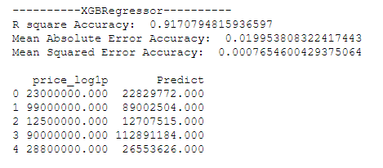
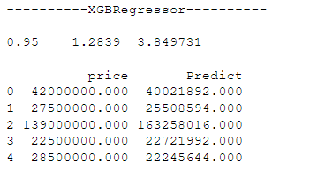
data skewed and prediction example
 | R-square Accuracy
Kernel Ridge Regression | 0.87
Elastic Net | 0.81
Lasso Regression | 0.79
Gradient Boosting Regression | 0.75
XGBoost | 0.92
LightGBM | 0.88
Averaged model | 0.88

Slide 24

Thank you for attention!

Slide 25
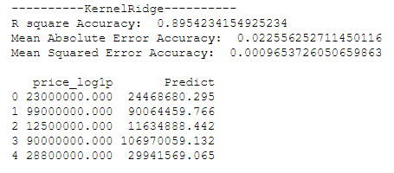
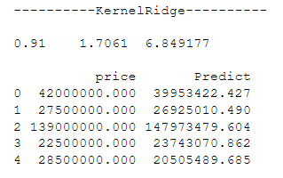
Kernel Ridge Regression :
Kernel ridge regression (KRR) combines ridge regression (linear least squares with l2-norm regularization) with the kernel trick. It thus learns a linear function in the space induced by the respective kernel and the data. For non-linear kernels, this corresponds to a non-linear function in the original space.
KernelRidge score: mean=0.0016 std=(0.0002)

Slide 26
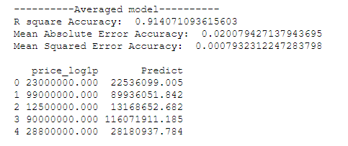
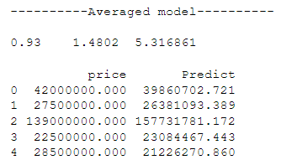
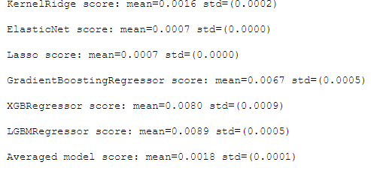
Averaged model
['ElasticNet', 'GradientBoostingRegressor', 'KernelRidge', 'Lasso’]
Averaged model score: mean=0.0018 std=(0.0001)

Slide 27
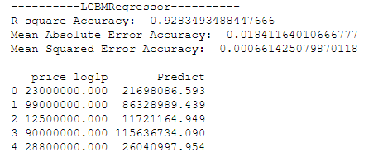
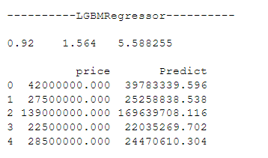
LightGBM :
LGBMRegressor score: mean=0.0089 std=(0.0005)

Slide 28
XGBoost :
Extreme Gradient Boosting (XGBoost) is an open-source library that provides an efficient and effective implementation of the gradient boosting algorithm.
XGBRegressor score: mean=0.0080 std=(0.0009)

Slide 29
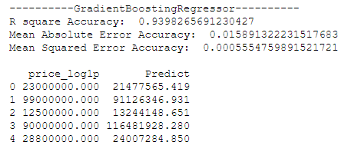
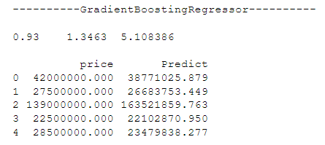
Gradient Boosting Regression
GB builds an additive model in a forward stage-wise fashion; it allows for the optimization of arbitrary differentiable loss functions. In each stage a regression tree is fit on the negative gradient of the given loss function.
GradientBoostingRegressor score: mean=0.0067 std=(0.0005)

Slide 30
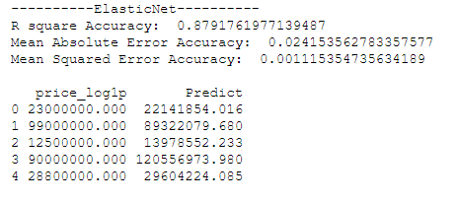
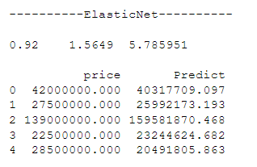
Elastic Net Regression
Linear regression with combined L1 and L2 priors as regularizer.
ElasticNet score: mean=0.0007 std=(0.0000)

Slide 31
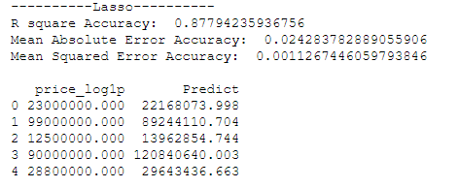
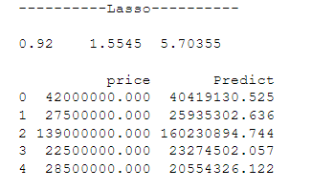
LASSO Regression
This model may be very sensitive to outliers. So we need to made it more robust on them. For that we use the sklearn's Robustscaler() method on pipeline.
Linear Model trained with L1 prior as regularizer (aka the Lasso).
Lasso score: mean=0.0007 std=(0.0000)

