Slide 1


Predicting the ultimate customer in Portuguese bank marketing
Kimberly Kaufman
Springboard: Foundations of Data Science Workshop

Slide 2
Background
This project uses the Bank Marketing Data Set from the UCI Machine Learning Repository. It was originally obtained and condensed for a published study in the June 2014 issue of Decision Support Systems that analyzed the success of telemarketing calls for selling bank long-term deposits.

Slide 3
Problem Setup
2.5 years’ worth of demographic, marketing, social, and economic data
How can we use this to predict which clients are most likely to purchase the product in question?

Slide 4
Possible Solution
Take a supervised machine learning approach
Build a logistic regression model
Use model to predict a binary yes/no target variable on future clients

Slide 5
Data Set
Direct marketing campaign data from an unnamed Portuguese banking institution
Obtained to analyze success of telemarketing calls for selling bank long-term deposits.
Contains 41,188 observations of 21 variables
Each observation represents a unique client

Slide 6
Data Attributes
7 customer demographic attributes
Age, job, marital status, education, default, housing, loan (categorical)
8 marketing campaign attributes
Contact method, month, day of week, previous outcome (categorical)
Duration, campaign, days since last contact, # of previous contacts (continuous; numeric)
5 social and economic context attributes
Employment variation rate, consumer price index, consumer confidence index, Euribor 3 month rate, # of employees (continuous; numeric)
1 output variable / target
Y (categorical; binary)

Slide 7
Data Wrangling
Outlier handling
Capping/flooring approach at 5th/95th percentiles
Categorical handling
Grouped less significant values into a single value; converted all categoricals to factors
High Correlation
3 highly correlated variables removed from dataset
Zero & Near Zero Variance
1 variable with zero variance removed from dataset

Slide 8
Data Partitioning
Full dataset partitioned as follows:
90% training set
10% test set

Slide 9
Predictive Model Creation
Generalized linear model (simplest logistic regression in the Caret package)
Fitted on a “ROC” metric using a cross-validation setup
Trained model on the training set
Made predictions on the test set
Provided outputs in the form of probabilities.

Slide 10
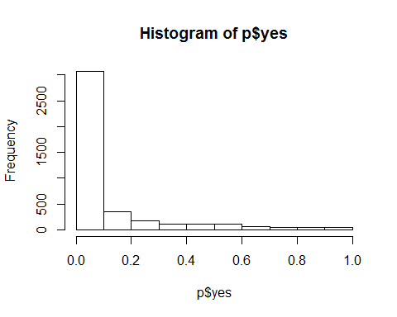
Prediction Results
Initial distribution of y = yes as expected
Next step: determine threshold value

Slide 11
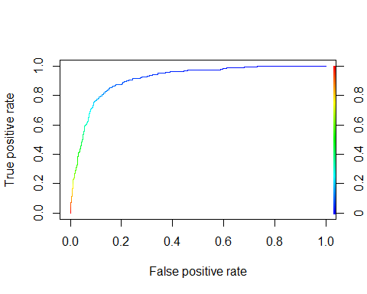
Model Evaluation #1
ROC Curve
Optimal balance of true positives & false positives at threshold value of 0.2
AUC value = .9114

Slide 12
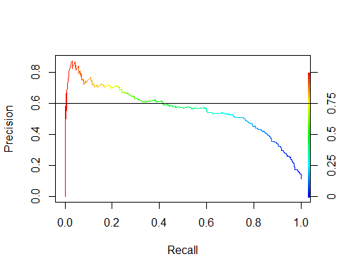
Model Evaluation #2
Precision/Recall Curve
Optimal balance of 0.6 precision & 0.4 recall at threshold value of 0.5

Slide 13
Final results
Use ROC curve & threshold value of 0.2
Compute confusion matrix on predictions vs test set
Sensitivity rate: 24.4%
Specificity rate: 90.4%
Total accuracy rate: 83.0%
Confusion Matrix
y | False | True
no | 347 | 3307
yes | 352 | 112

Slide 14
Conclusion & Recommendations
Use logistic regression model to achieve 83% accuracy rate in predicting customers who will subscribe to a term deposit
Rule out all “no” predictions from y variable and focus marketing efforts on the remaining subset of customers
In future research, compare additional & more complex types of logistic regression models on this dataset

