Slide 1
Does Investor Fear Travel?
VIX Spillovers and Equity Return Predictability in Central European Markets
Herman Kaufman (Konzultant: Urban Kovac)
ŠVOČ – Študentská vedecko-odborná činnosť
Dátum 20.05.2026
Univerzita Komenského v Bratislave, Fakulta managementu
Odbojárov 10, 820 18 Bratislava 218, SLOVENSKO

Slide 2
Obsah
Motivation and research question
Data and methodology
Empirical results across five specifications
Main findings and implications
Questions
Dátum 20.05.2026
Študentská vedecko-odborná činnosť 2026

Slide 3
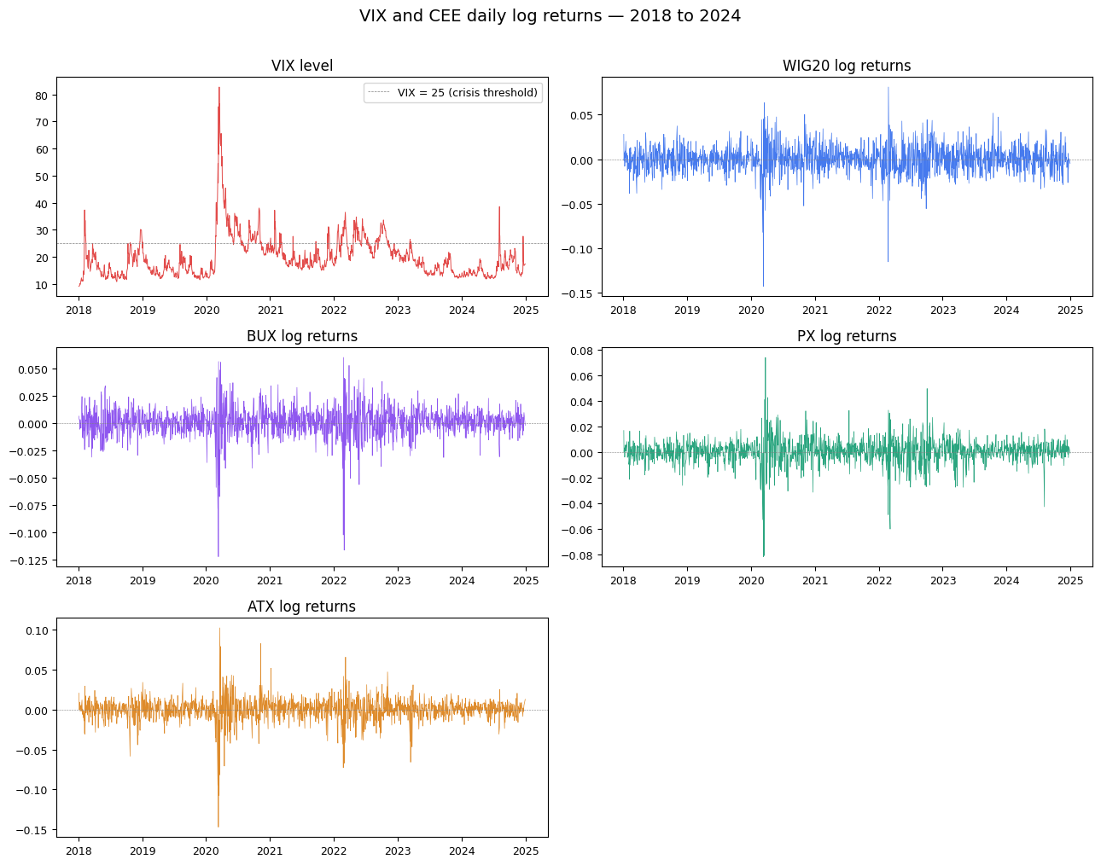
Motivation
16 March 2020: VIX hits 82.69
CEE markets crashed in near-synchrony:
WIG20 −14%, BUX −12%, ATX −15%
Faster than economic linkages can explain
Does global fear predict next-day CEE returns?
Dátum 20.05.2026
Študentská vedecko-odborná činnosť 2026

Slide 5
Research question
Does the VIX, as a measure of US implied volatility, predict next-day returns in Central European equity markets?
Three testable hypotheses:
H1: VIX changes negatively predict next-day CEE returns
H2: Predictability is stronger for globally integrated markets
H3: Predictability intensifies during crisis regimes
Dátum 20.05.2026
Študentská vedecko-odborná činnosť 2026

Slide 6
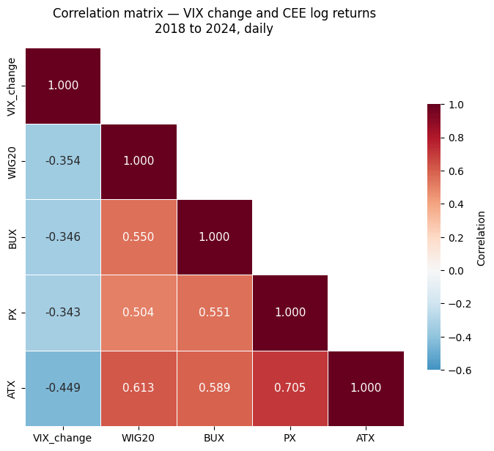
Data and sample
Four CEE indices + VIX
WIG20, BUX, PX (Stooq)
ATX (Wiener Börse)
VIX (CBOE via Yahoo)
Daily, 2018 to 2024
1,637 aligned trading days
VIX–CEE: - 0.34 to -0.45
CEE–CEE: 0.50 to 0.71
Dátum 20.05.2026
Študentská vedecko-odborná činnosť 2026

Slide 8
Methodology: five specifications
Baseline: OLS with Newey-West HAC standard errors
Rolling 252-day windows: stability of the coefficient over time
Regime split: interaction term for VIX > 25 versus calm regime
GARCH(1,1) standardization: returns scaled by conditional volatility
Subperiod analysis: pre-COVID versus post-COVID samples
Dátum 20.05.2026
Študentská vedecko-odborná činnosť 2026

Slide 9
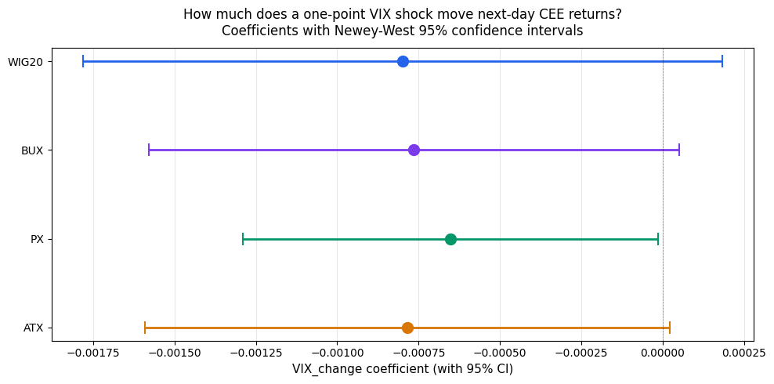
Baseline result
VIX change coefficient negative in all 4 markets
Point estimates ≈ -0.0008 per VIX point
Significant at 5% for PX, 10% for BUX & ATX
R² range: 1.27% to 2.50%
Dátum 20.05.2026
Študentská vedecko-odborná činnosť 2026

Slide 11
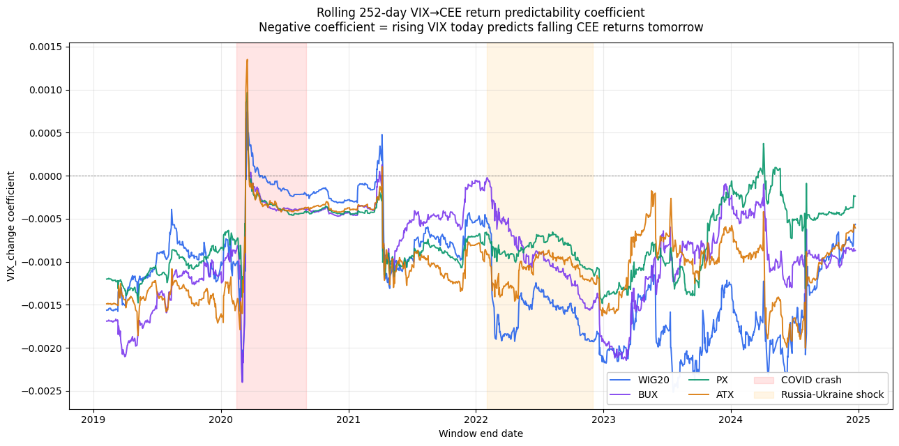
Rolling window
1,384 rolling 252-day windows per market
Coefficient negative in 97 to 99% of windows
Deepens during COVID-19 (2020)
Deepens during Russia-Ukraine (2022)
Sign almost never flips
Dátum 20.05.2026
Študentská vedecko-odborná činnosť 2026

Slide 13
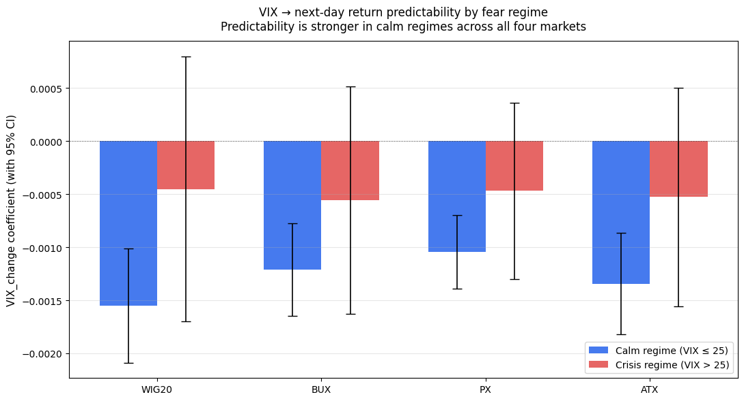
Regime: predictability weakens in crises
Crisis = VIX > 25 (304 days, 18.6%)
Calm effect is 2 to 3× stronger than crisis
Contradicts contagion-amplification (H3)
Why? Signal-to-noise during crises
Dátum 20.05.2026
Študentská vedecko-odborná činnosť 2026

Slide 15
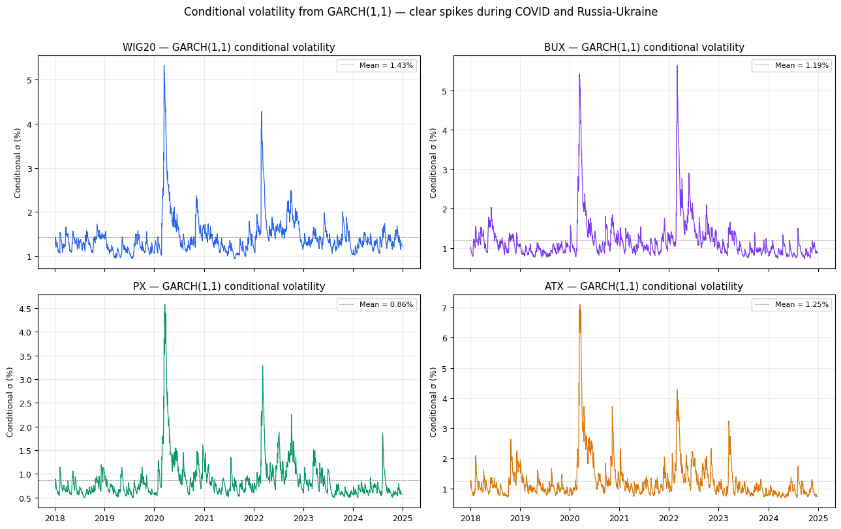
GARCH(1,1) robustness
Fit GARCH(1,1) to each market
Standardize returns by σ_t
Persistence: α+β = 0.95 to 0.96
After standardization: 1% significance
in all 4 markets
Heteroskedasticity attenuated the baseline
Dátum 20.05.2026
Študentská vedecko-odborná činnosť 2026

Slide 17
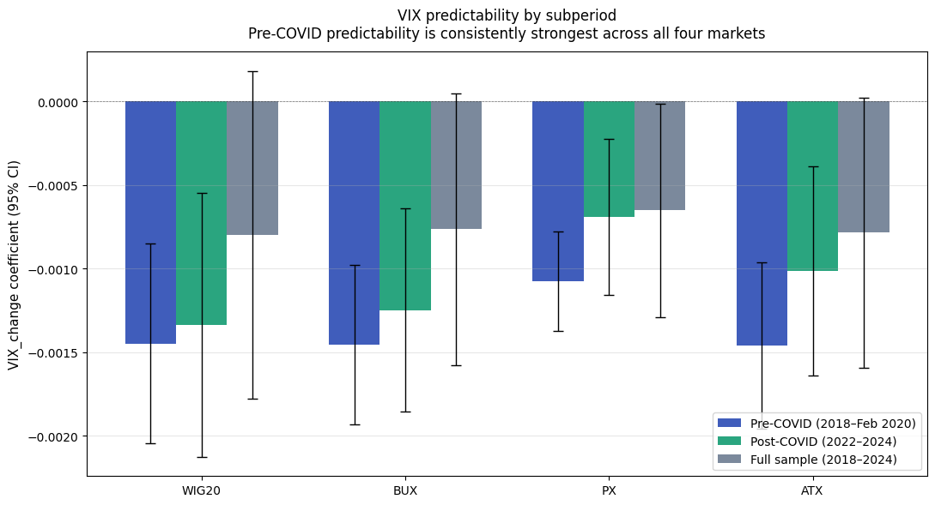
Subperiod analysis
Pre-COVID (488 obs):
β ≈ −0.0015 across markets
Post-COVID (702 obs):
β ≈ −0.0010
All 12 regressions significant at 1%
Pre-COVID R²:
WIG20 5.1%, BUX 6.3%
ATX 6.1%, PX 9.4%
Dátum 20.05.2026
Študentská vedecko-odborná činnosť 2026

Slide 19
Main findings
VIX changes negatively predict next-day CEE returns in every market
Effect holds at 1% significance in 4 of 5 specifications
Strongest in calm regimes, weakens in crisis periods
Strongest in the pre-COVID period (PX R² reaches 9.4%)
Persistence: 97-99% of rolling windows show negative coefficient
Dátum 20.05.2026
Študentská vedecko-odborná činnosť 2026

Slide 20
Two takeaways & Further Analysis
Investors: long VIX positions offer partial CEE hedge in calm markets
Regulators: contemporaneous co-movement does not extrapolate to predictive transmission during crises
Extensions: higher-frequency data, quantile regression, local volatility indices (V2X), Markov-switching regimes
Dátum 20.05.2026
Študentská vedecko-odborná činnosť 2026

Slide 21
Otázky
ŠVOČ
2026 FMUK

