Slide 1
Using Topological Machine Learning to Explore Cosmic Voids
Nihar Gupte

Slide 2
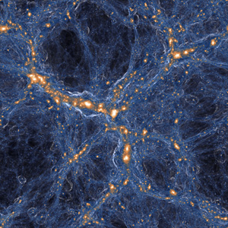
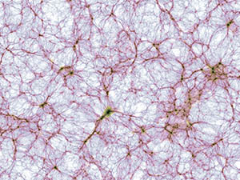
What is the Data?
Galaxy Distribution of long winded Hydrodynamic simulations. This galaxy distribution can be used to find “Cosmic Voids” and “Filament Loops”
One such simulation (Illustrius-TNG):

Slide 3
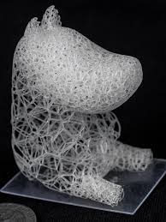
Voronoi Foam
Problem with Hydrodynamic simulation is as a first pass it can be difficult to work with
Galaxy distribution tends to follow a “Voronoi Foam Distribution”.
Credit: Martinez et al.

Slide 4

2D Kinematic Voronoi Foam Simulation
What is an interesting feature we can predict using the topology of voids and filament loops? Time (Epoch)
Because a void is effectively a region of negative density in a uniform background, the voids expand as the superdense regions collapse while slight aspherities decrease as the voids become larger
Galaxies move away from the void centers until they encounter similar matter flowing in an adjacent void
Galaxy Path Follows:

Slide 6
What is Topological Machine Learning?
Topological Data Analysis (TDA) way of expressing topological features of data in a computational form
Relies on Homology of simplicial complexes

Slide 7
References
Martínez, Jonàs, Jérémie Dumas, and Sylvain Lefebvre. "Procedural voronoi foams for additive manufacturing." ACM Transactions on Graphics (TOG) 35.4 (2016): 1-12.

