Slide 1
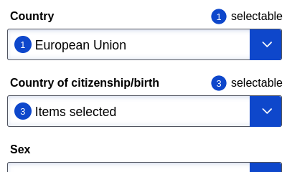





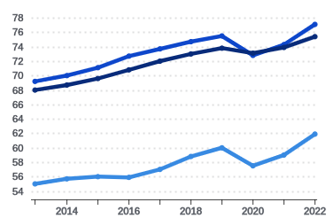






Overview
Wide
Narrow
<-- Back
Row 1
Row 2
Row 3
Title
Title
Title
Subtitle
Subtitle
Subtitle
Row 4
Country
Row 5
Row 6
Row 7

Slide 2

Narrow (alt. 2)
<-- Back
SelectBoxes
Overlay
Starting at Row 1
Row 1
Row 2
Row 3
Title
Subtitle
Row 4
Row 5
Row 6
Row 7

