Slide 1

How will the rise of the number of obese people in New York City affect the business of insurance companies under the ObamaCare?
Notes:
BUSINESS PROBLEM: Start of by defining what we are looking at.
Newrepublic.com - Another major goal of Obamacare is to make sure all people can get coverage at uniform prices, regardless of pre-existing conditions. This is known as “guaranteed issue” and “community rating.” Today insurers frequently charge higher premiums or deny coverage altogether to people with pre-existing conditions. This allows them to keep prices low for the young and the healthy. Obamacare will force insurers to abandon these practices. But if the old and the sick get to pay less, the young and the healthy will have to pay more.
According to The Wall Street Journal, “Healthy consumers could see insurance rates double or even triple when they look for individual coverage under the federal health law later this year …” - See more at: http://www.bankruptingamerica.org/the-top-5-negative-impacts-of-obamacare/#.VbXdfs64nVp
Higher Prices For Younger Workers. Young, healthy Americans are the most likely to be uninsured. Being young and healthy, they risk going without insurance. Now, they will have to get insurance or pay a hefty fine. And if they choose to buy insurance, they’re going to pay higher prices than if they had bought insurance before Obamacare took effect. - See more at: http://www.bankruptingamerica.org/the-top-5-negative-impacts-of-obamacare/#.VbXdfs64nVp
The individual mandate of the Affordable Care Act requires citizens to have health insurance. If you are without insurance and do not qualify for an exemption, you will be subject to a fee, also referred to as the ACA penalty, which will be assessed on your taxes. How much you pay for going without coverage depends on your income, household size and the year, but as time goes on, this penalty will grow in an effort to convince the uninsured to sign up.

Slide 2
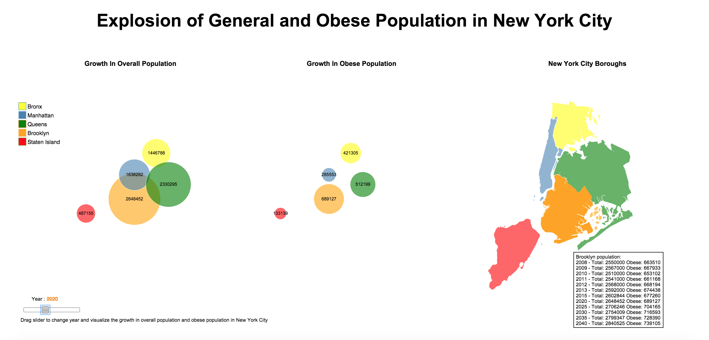
Notes:
Viz explaining the constant growth in population and obesity in the state of new york supporting the business problem statement

Slide 3
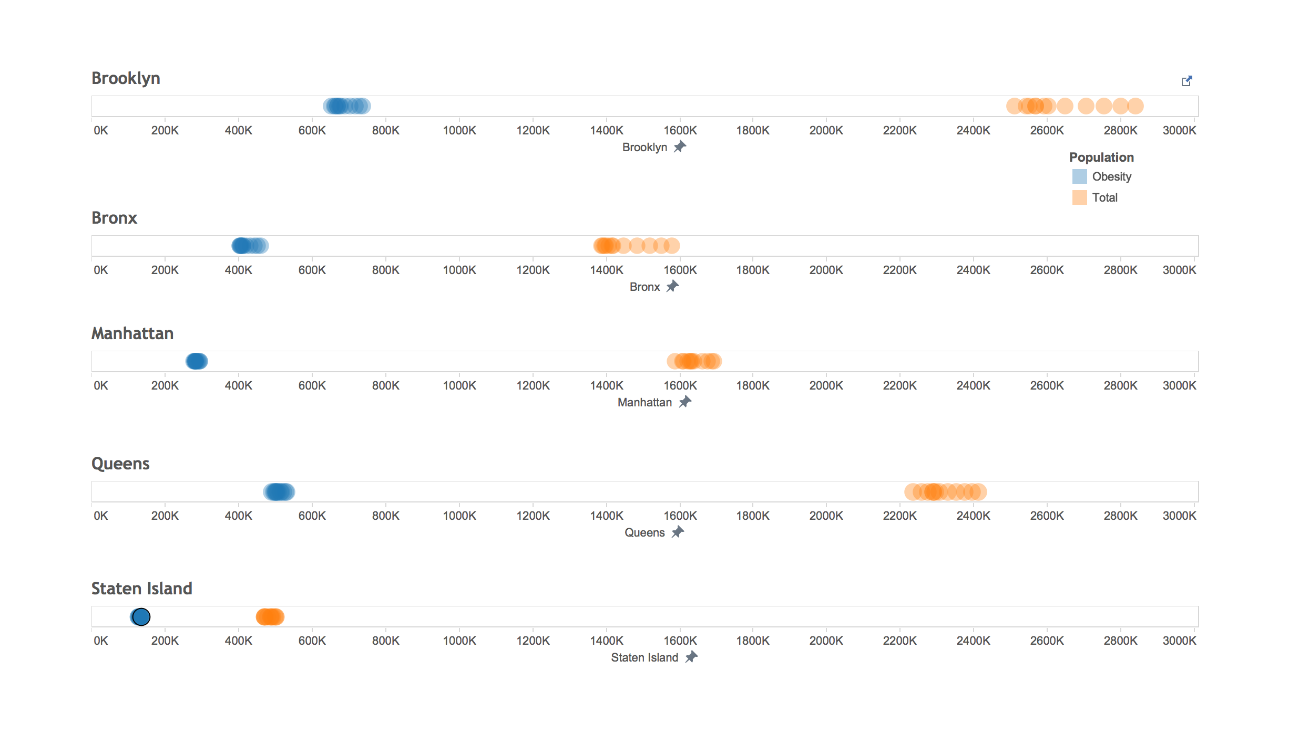
Notes:
Static viz supporting the aforementioned

Slide 4
Current Major Health Issues
Obesity contributes to 4 of the top 10 causes of Death in the United States:
Heart Disease
Stroke
Type 2 Diabetes
Cancer
Notes:
Causes of obesity which are harmful foe health and hence for the insurance companies.
How do I state that the increase in death rates due to the above causes is bad for the insuracne companies? How does their business suffer?
Top 10 leading causes of death in the states – medical news today
The above 4 diseases are related to obesity as stated in obesity in america.org and national heart, lung and blood institute

Slide 5
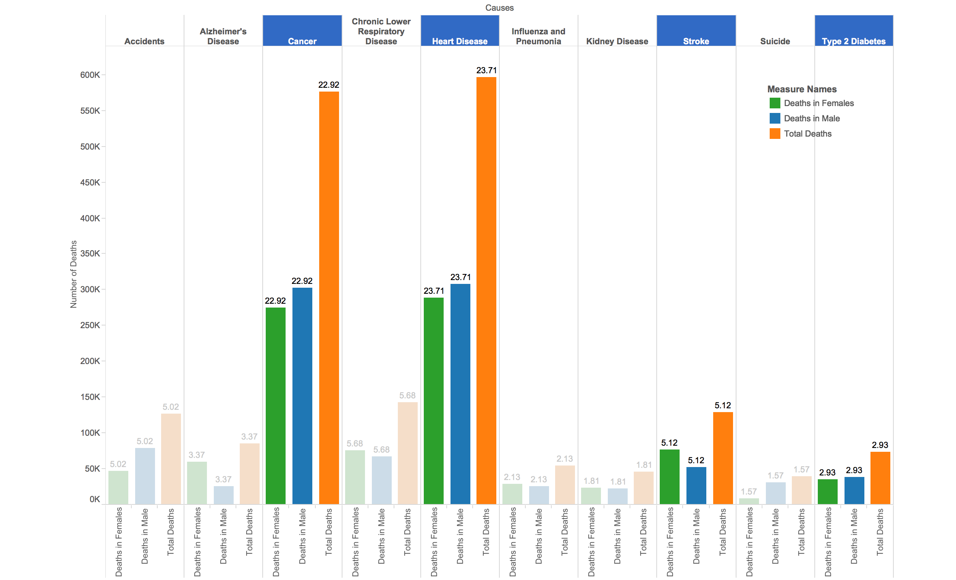
Notes:
Viz showing the deaths due to the 4 major causes that are related to obesity

Slide 6
Healthcare Disruptions
Regulations
Pharmaceuticals
Technology
New Delivery Models
Notes:
Need some points to explain these.
I have no clue what to talk about with regards to these
Regulations/Affordable Care Act – catalyzed most disruptions by lowering the barriers and changing the overall framework of the industry by changing the criteria of monetary reimbursements for Medicare/Medicaid and other insurances companies. It also changed the criteria by which a Hospital is rated by and given government aid.
Technology – Has been integrated at all levels of healthcare as regulations impose more important on tracking information with the healthcare providers’ capability to leveraging that information into meaningful value for their patients.
Two Major Health-Tech initiatives:
Operations: This primary includes EMR systems like Cerner and Epic and many other smaller EMR systems used at clinics, ERs, and other specialty facilities. The biggest opportunities for professional services here is in integration.
Mobile: This includes mobile apps like MyFitnessPal and the HealthVault that count your calories and enable the potential patient to run basic diagnostics with out seeing a Healthcare professional. This also includes Wearables that measure daily activity like physical exertion and sleep cycle to name a few and provide concrete data to the patient and doctor.
Pharma: Besides the major acquisitions on pharmacies of all sizes and histories, there are many other trends in the pharmaceutical space. The two major trends we have identified are –
Specialty Compounding Pharmacy: These are small pharmacies with deep understanding of certain medications used in high margin services. These pharmacies have the capability to cater each medication to its’ patient according to his/her’s DNA and patient history to have the maximum impact in the shortest amount of time.
Delivery Services: These are small pharmacies that operate on a small locality to cater to clinics, doctors’ offices that can outsource pharmaceuticals; along with patients that prefer same day delivery.
New Delivery Models: This includes a series of delivery evolutions the industry is seeing everyday
CVS/Walgreens: are proving more healthcare services than every before, vaccinations, eye, ear and basic heart tests, and so on

Slide 7
UnitedHealth: Pioneering the New Health Mindset
Notes:
Now that we have set the tone we mention our client – an insurance company – united health

Slide 8
In the midst of the largest industry transformation in the United States, we recommend that UnitedHealth Group should initiate a Partnership with other organizations to manage the growing obesity problem in New York City.
Notes:
Our proposed solution explained in brief

Slide 9
A New Prospective On Wellness
Changing a cure centric healthcare industry to become a more preventative healthcare industry
Notes:
This slide shows how the proposed solution is different

Slide 10
The First Healthcare Ecosystem
United Health Network
Mobile
Microsoft
Fitbit
Electronic Health Records
Walgreens/CVS
Incubate Startups
Pharma
Cerner
Epic
Healthcare Delivery Centers
Kaiser Permanente
Others
Notes:
PwC Proposes UnitedHealth Group to create a UnitedNetwork® that plays the role of the first ever ecosystem of its kind
A single platfrom to collaborate with other Healthcare players and potential disruptors
Share data cross functionally with optimal integration to add value to the overall patient experience
Better insight for healthcare provider, potential for more impactful analysis
A more robust process to initiate partnerships with new and old entrants and have a patient and cure centric culture.
Segment patients and develop more granular bundled products to cater to different needs

Slide 11
Solving obesity via the United Network
Leverage data experts
Share insights from data with partners
Raise awareness and provide incentives to customers
Notes:
How do we solve the obesity problem with this Network?
Is this where we can talk about the young and fit having to pay extra as a result of obamacare and how the insurance companies can attract them to continue living a healthy lifestyle by sharing fidbits with them etc. and also try to encourage the unhealthy people to live a similar lifestyle in an attempt to change their unhealthy living ways?
UHG can leverage it’s actuarial and data science expertise in its insurance and optum acquisition to create incentivize and inform it’s customers to make healthier choices
UHG can share the insights from the aggregated data from the UnitedNetwork with the same partners so they can make more impactful offers to their customers (e.g. nike can make appreal offer, WholeFoods can recommend specific fruits). Motivating the potential future “patient” to opt a more healthy lifestyle
UnitedNetwork can help its’ partners build and eventually perfect a scalable micro strategy in New York City to battle obesity by raising awareness and incentivizing their customers to live healthier lives to take all other medium to large size city in the US.

Slide 12
Opportunity For UnitedHealth
Become an Innovative Brand
Lower long-term health risks
Segment Customer Base
Maintain Influence in the Health Industry
Notes:
Can you support each of these points with a one line explanation for each of them?
No other insurance company is proactively making technology investments in the healthcare industry. Championing this strategy will make UHG an innovative brand
By bringing down obesity UHG will have a direct impact on 4 of the top 10 causes of death in the US, hence lowering risks
By aggregating data from so many sources, we can have variables when segmenting our customer base actuarial point of view
By successfully executing the UnitedNetwork, UHG will be able to maintain influence over industry since it will be seen as the organization for having foresight in the industry based of history in Healthcare

Slide 13
The UnitedNetwork
Potential Value add from the Healthcare Ecosystem
Access to Data across all platforms
Long-term Strategic Alliances
Contribute and Manage Disruptions
Notes:
A one line explanation for each of these would be good too
Healthcare professionals and researchers will be able to create long term value by having more of reliable data to analyze.
Companies will be able to add more considerably more value if they set appropriate processes in place to analyze data from multiple sources and give insights to healthcare professionals and patients with enough time to take the right actions.
By collaborating on existing products it is safe it infer that companies are highly likely to continue disrupting with innovating by collaborating and doing joint ventures.

Slide 14
Thank You!
Raza Agha
Chen Tang
Aditya Kaul
Angelica Nunez
Mary Pipenhagen

Slide 15
Appendix
New Delivery/ Treatment Models
Electronic Health Records
DIY Healthcare Apps
Lifestyle Apps/Data

Slide 16
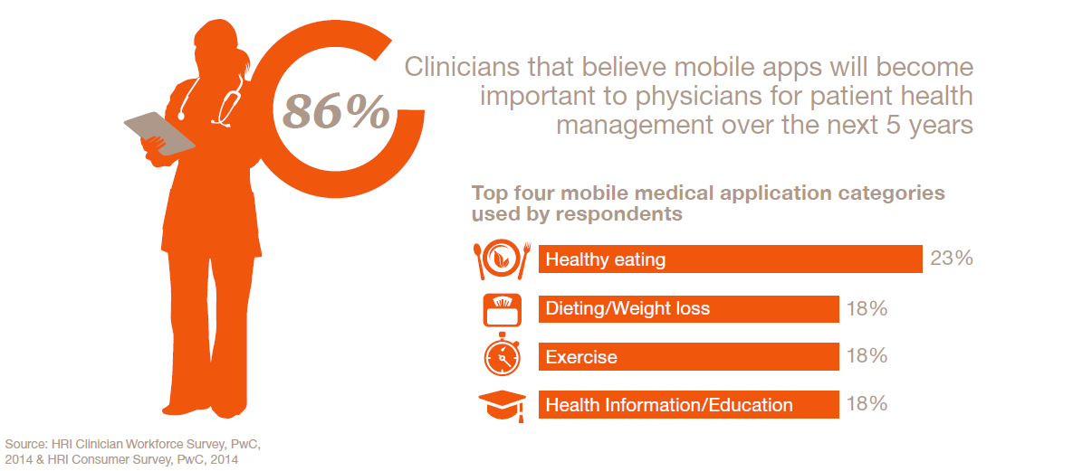
Appendix

Slide 17
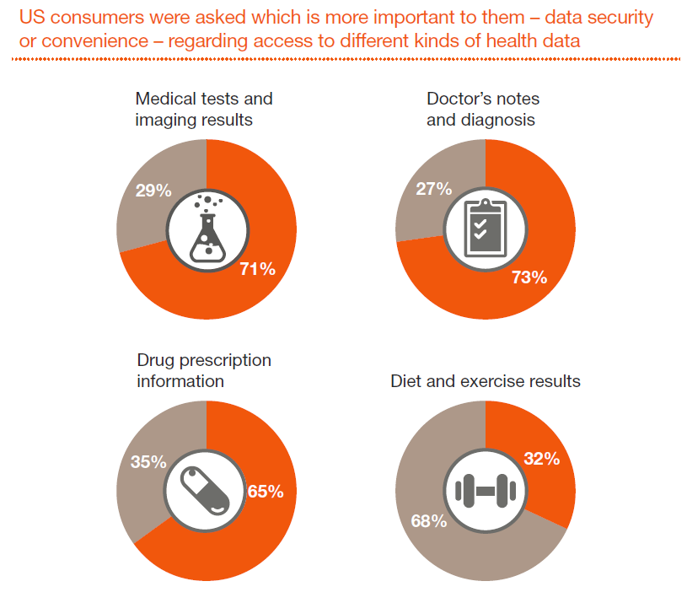
Appendix

