Slide 1
RayDF: Neural Ray-Surface Distance Fields with Multi-view Consistency (NeurIPS 2023)
MCA Final Presentation

Slide 2
Contents
Background
3D Representations
Related Work and Gaps
Proposed Model
Results
Code-Base Set-up & Execution

Slide 3
Background
General Problem Statement - Learning accurate and efficient 3D shape representations
Use cases - Computer-Aided design, Augmented reality, Virtual Reality, Robotics etc
Different tasks in 3D realm - Shape reconstruction, Novel View Synthesis, Scene Understanding, Obtaining 3D shapes or 2D views from trained networks

Slide 4
3D Representations
Coordinate based - Example Occupancy fields, Un/Signed fields, Radiance Fields
Ray based - 3D shapes represented in terms of rays of light that interact with them

Slide 5
Recent Work
Different models have been developed using both representations.
Coordinate based models work well on downstream tasks but fail to perform on obtaining 3D shapes or 2D views
Ray based models - (LFN, NeuLF, PRIF, DDF) - Perform better in obtaining 3D shapes and 2D views. But learned shapes are imperfect (lack of Multi-View Consistency)

Slide 6
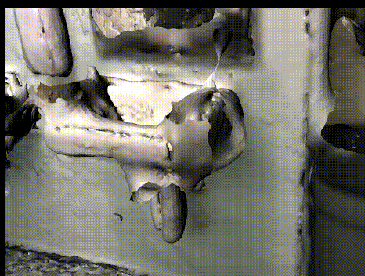
Model is trying to learn a 3D object but there is no consistency when viewed from different angles 🥲

Slide 7
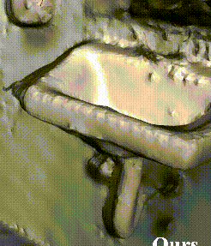
This re-generation is Multi-View Consistent!🤩

Slide 8
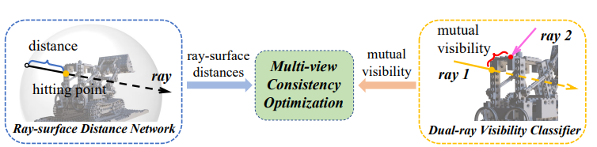
Proposed Solution

Slide 9
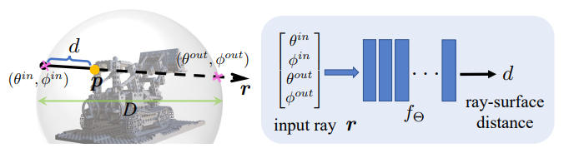
Ray-Surface Distance Field
Taking spherical parameterized ray ( radial distance, Polar angle and azimuthal angle) as input
Regressed distance between ray starting point and surface hitting point

Slide 10
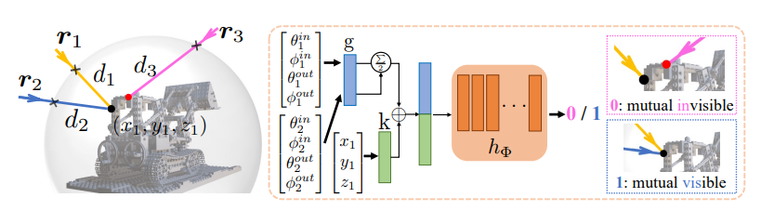
Dual Ray Visibility Classifier

Slide 11
Multi-View Consistency Optimizer
Used to train both the Models
Given - K posed depth images (H X W) of static 3D scenes
Training module consists of 2 stages : - Stage 1 - Training Dual-ray Visibility Classifier Stage 2 - Training Ray-Surface Distance Network
Ultimate goal - optimize main Ray-surface Network and drive it to be Multi-View Consistent

Slide 12



Training Steps
Converting depth images to ray-surface distance - We get K*H*W training ray-distance pairs for a specific 3D scene
For 1 training ray(r,d) we sample M rays in a ball centering at surface point p
Calculate distances between p and the M sampled rays
Generate M ray pairs, feed them to Classifier and get Visibility Scores

Slide 13

Training Steps
Feed primary ray and M sampled rays to Ray-surface distance network and estimate the surface distances
Use the following Multi-View Consistent Loss Function to optimize the ray-surface distance until convergence: -

Slide 14
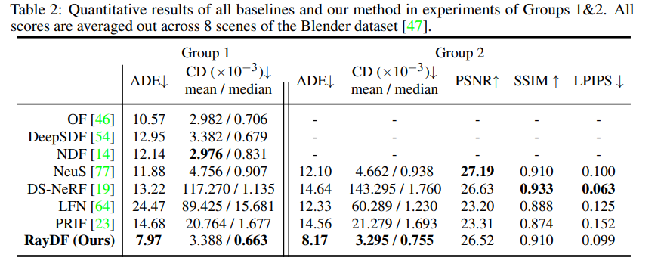
Results
Evaluation on Blender Dataset: -
Group 1 - Testing on depth images
Group 2 - Testing on RGB and RGBD images

Slide 15
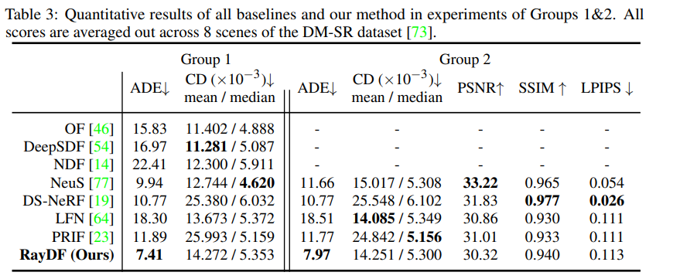
Results
On DM-SR dataset: -

Slide 16
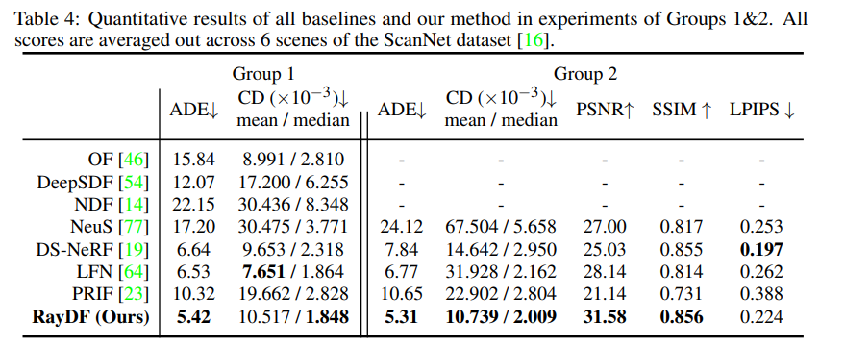
Results
On ScanNet dataset: -

Slide 17
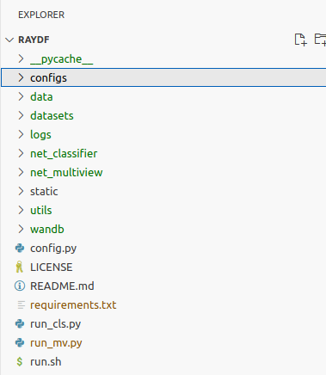
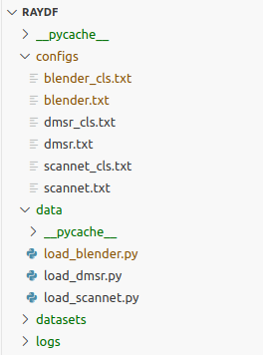
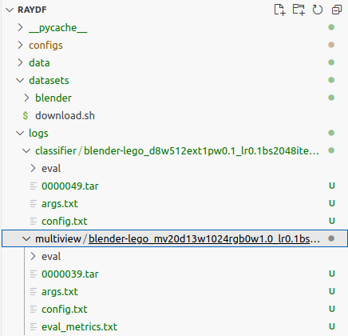
Code-Base

Slide 18
Commands to set-up code-base and train model
pip install -r requirements.txt
sh datasets/download.sh blender
CUDA_VISIBLE_DEVICES=0 python run_cls.py --config configs/blender_cls.txt --scene lego
CUDA_VISIBLE_DEVICES=0 python run_mv.py --config configs/blender.txt --scene lego
CUDA_VISIBLE_DEVICES=0 python run_mv.py --config configs/blender.txt --scene lego --eval_only

Slide 19
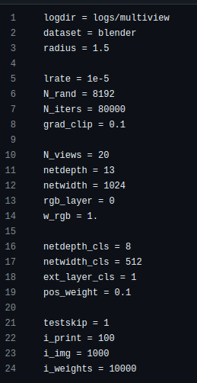
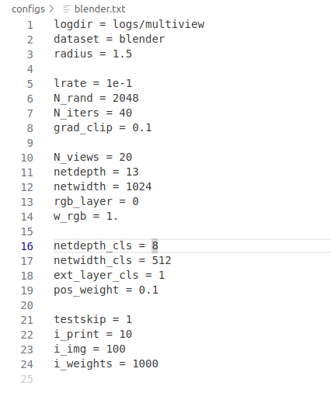
Changes made in Params (blender.txt)
Local: -
Original: -

Slide 20
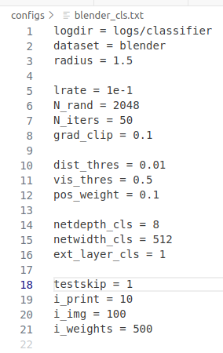
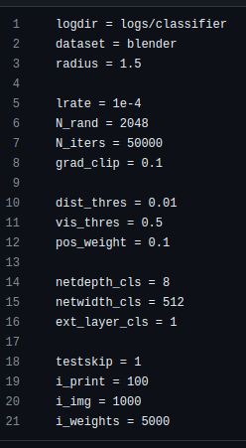
Changes made in Params (blender_cls.txt)
Local: -
Original: -

Slide 21
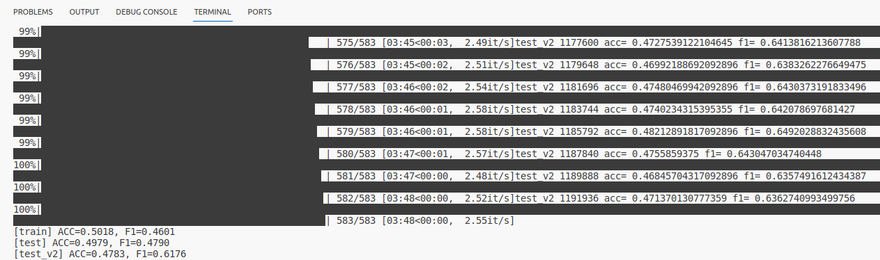
Execution Results

Slide 22
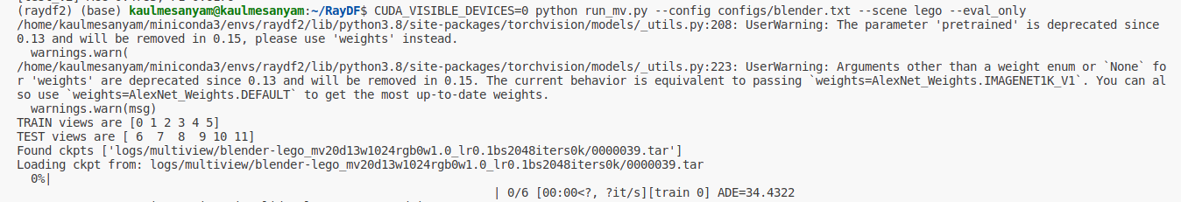
Execution Results

