Slide 1
RayDF: Neural Ray-Surface Distance Fields with Multi-view Consistency
NeurIPS 2023

Slide 2
Contents
Background
3D Representations
Related Work and Gaps
Proposed Model
Results

Slide 3
Background
General Problem Statement - Learning accurate and efficient 3D shape representations
Use cases - Computer-Aided design, Augmented reality, Virtual Reality, Robotics etc
Different tasks in 3D realm - Shape reconstruction, Novel View Synthesis, Scene Understanding, Obtaining 3D shapes or 2D views from trained networks

Slide 4
3D Representations
Coordinate based - Example Occupancy fields, Un/Signed fields, Radiance Fields
Ray based - 3D shapes represented in terms of rays of light that interact with them

Slide 5
Recent work
Different models have been developed using both representations.
Coordinate based models work well on downstream tasks but fail to perform on obtaining 3D shapes or 2D views
Ray based models - (LFN, NeuLF, PRIF, DDF) - Perform better in obtaining 3D shapes and 2D views. But learned shapes are imperfect (lack of Multi-View Consistency)

Slide 6
MileStone
Explicit 3D representation models - Too much memory and dataset requirement
Implicit Coordinate based Models - MLP based models. Work well with limited data and memory. 3D/2D re-generation is weak due to excessive computation requirement
Ray-Based Models - Only 1 network computation is required but lacks multi-view consistency.

Slide 7
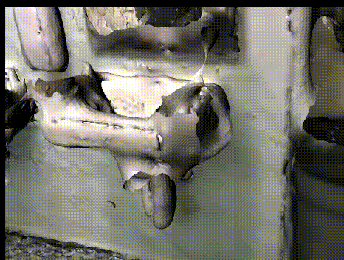
Model is trying to learn a 3D object but there is no consistency when viewed from different angles

Slide 8
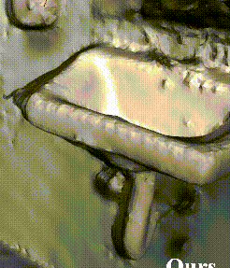
This re-generation is Multi-View Consistent

Slide 9
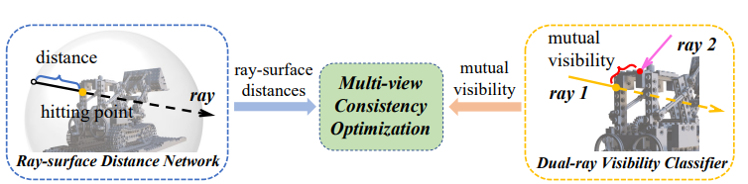
Proposed Solution

Slide 10
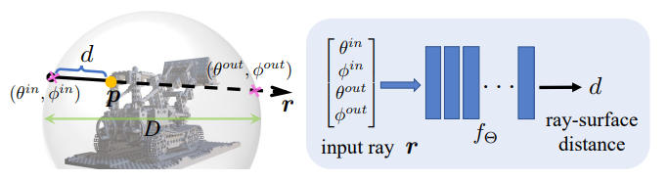
Ray-Surface Distance Field
Taking spherical parameterized ray ( radial distance, Polar angle and azimuthal angle) as input
Regressed distance between ray starting point and surface hitting point

Slide 11
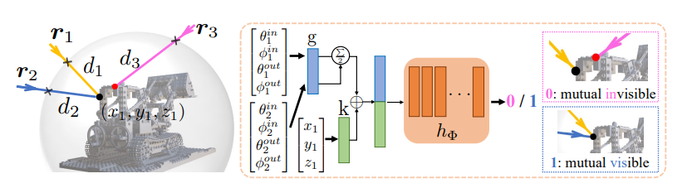
Dual-Ray Visibility Classifier
Model: -

Slide 12
Multi-View Consistency Optimizer
Used to train both the Models
Given - K posed depth images (H X W) of static 3D scenes
Training module consists of 2 stages : - Stage 1 - Training Dual-ray Visibility Classifier Stage 2 - Training Ray-Surface Distance Network
Ultimate goal - optimize main Ray-surface Network and drive it to be Multi-View Consistent

Slide 13


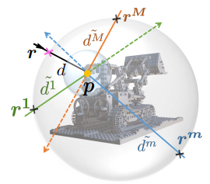

Training Steps
Converting depth images to ray-surface distance - We get K*H*W training ray-distance pairs for a specific 3D scene
For 1 training ray(r,d) we sample M rays in a ball centering at surface point p
Calculate distances between p and the M sampled rays
Generate M ray pairs, feed them to Classifier and get Visibility Scores

Slide 14

Training Steps
Feed primary ray and M sampled rays to Ray-surface distance network and estimate the surface distances
Use the following Multi-View Consistent Loss Function to optimize the ray-surface distance until convergence: -

Slide 15
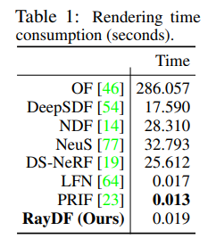
Results

Slide 16
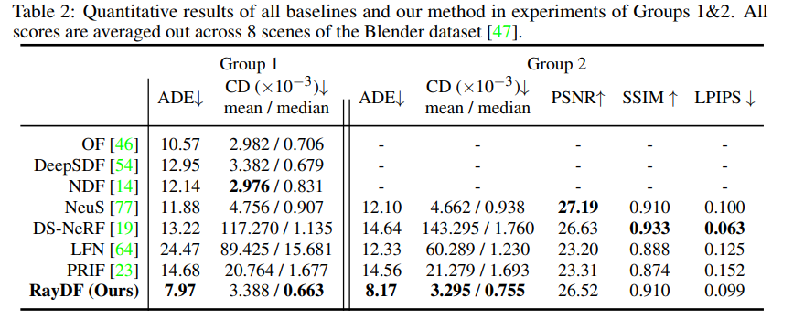
Results
Evaluation on Blender Dataset: -
Group 1 - Testing on depth images
Group 2 - Testing on RGB and RGBD images

Slide 17
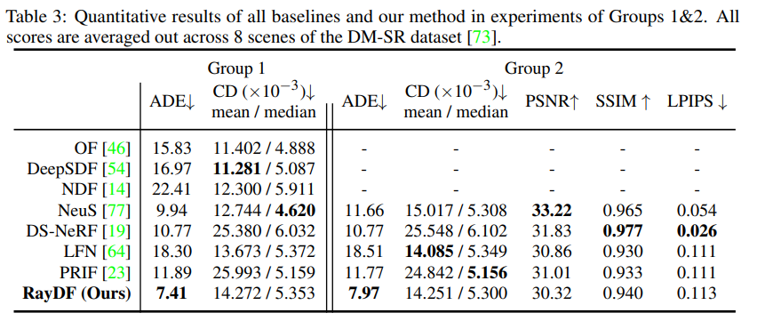
Results
On DM-SR dataset: -

Slide 18
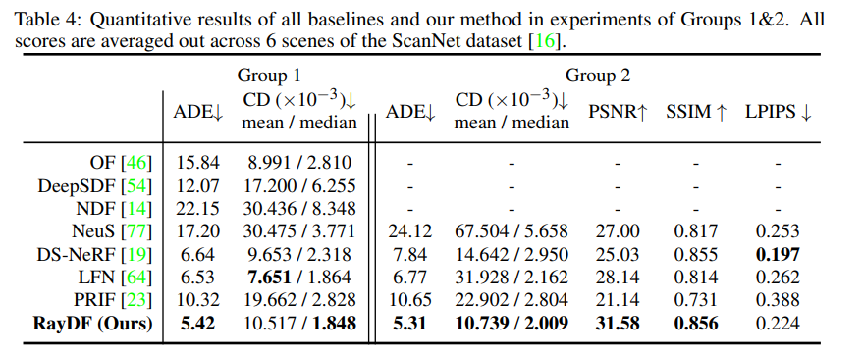
Results
On ScanNet dataset: -

Slide 19
Thank You!

