Slide 1
JAVASCRIPT
Instructor: Kaumarjya Banerjee

Slide 2
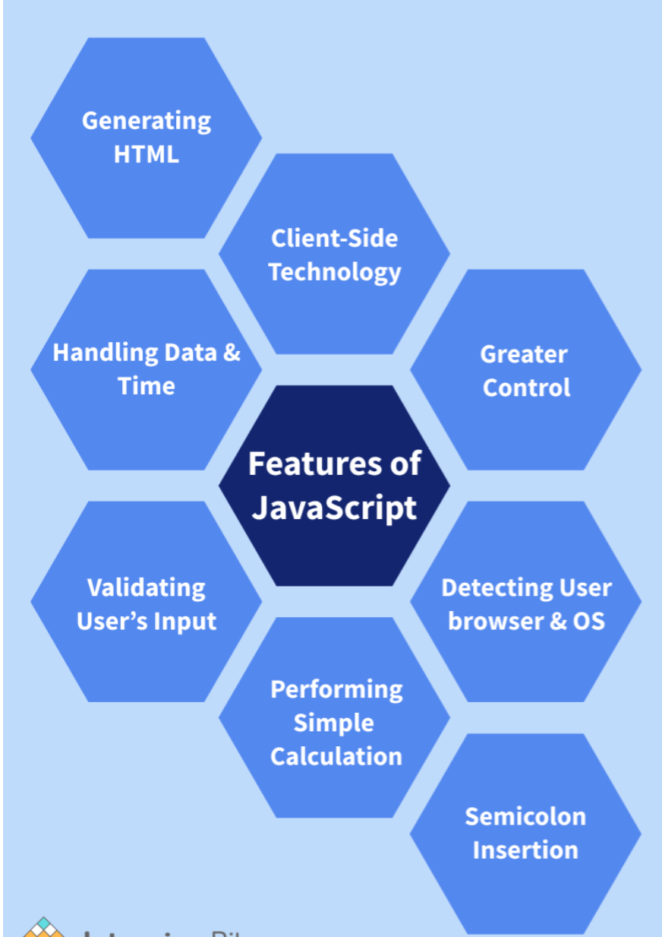
JavaScript is the world's most popular programming language.
JavaScript is the programming language of the Web.
JavaScript is easy to learn.
This tutorial will teach you JavaScript from basic to advanced.

Slide 3
JavaScript Statements
let x, y, z; // Statement 1 x = 5; // Statement 2 y = 6; // Statement 3 z = x + y; // Statement 4
JavaScript Values
The JavaScript syntax defines two types of values:
Fixed values
Variable values
Fixed values are called Literals.
Variable values are called Variables.
JavaScript Let
The let keyword was introduced in ES6 (2015).
Variables defined with let can not be redeclared.
Variables defined with let must be declared before use.
Variables defined with let have block scope.

Slide 4
JavaScript Const
The const keyword was introduced in ES6 (2015).
Variables defined with const cannot be Redeclared.
Variables defined with const cannot be Reassigned.
Variables defined with const have Block Scope.
When to use JavaScript const?
Always declare a variable with const when you know that the value should not be changed.
Use const when you declare:
A new Object
A new Function
A new RegExp
A new Array
s

Slide 5
JavaScript Assignment
Types of JavaScript Operators
There are different types of JavaScript operators:
Arithmetic Operators
Assignment Operators
Comparison Operators
String Operators
Logical Operators
Bitwise Operators
Ternary Operators
Type Operators
= | X=y
+= | X+=y
-= | X-=y
*= | X*=y
/+ | X/=y
++ | X=x+1
-- | X=x-1

Slide 6
JavaScript Comparison Operators
== | equal to
=== | equal value and equal type
!= | Not equal
!== | not equal value or not equal type
> | Greater than
< | Less than
>= | Greater than or equal to
<= | less than or equal to
? | Ternary operator

Slide 7
JavaScript Data Type
JavaScript has 8 Datatypes
1. String 2. Number 3. Bigint 4. Boolean 5. Undefined 6. Null 7. Symbol 8. Object
The Object Datatype
The object data type can contain:
1. An object 2. An array 3. A date

Slide 8
JavaScript String Methods
String length String slice() String substring() String substr() String replace() String replaceAll() String toUpperCase() String toLowerCase() String concat() | String trim() String trimStart() String trimEnd() String padStart() String padEnd() String charAt() String charCodeAt() String split()
String indexOf()
String lastIndexOf()
String search()
String match()
String matchAll()
String includes()
String startsWith()
String endsWith()
String Search Methods

Slide 9
JavaScript Array
An array is a special variable, which can hold more than one value.
Array methods
Pop
Push
Shift
unshift
Slice
Splice
Delete
concat
Splicing and Slicing Arrays
The splice() method adds new items to an array.
The slice() method slices out a piece of an array.

Slide 10
JavaScript IF-Else
Conditional Statements
Very often when you write code, you want to perform different actions for different decisions.
You can use conditional statements in your code to do this.
In JavaScript we have the following conditional statements:
Use if to specify a block of code to be executed, if a specified condition is true
Use else to specify a block of code to be executed, if the same condition is false
Use else if to specify a new condition to test, if the first condition is false
Use switch to specify many alternative blocks of code to be executed

Slide 11
JavaScript For Loop
Different Kinds of Loops
JavaScript supports different kinds of loops:
for - loops through a block of code a number of times
for/in - loops through the properties of an object
for/of - loops through the values of an iterable object
while - loops through a block of code while a specified condition is true
do/while - also loops through a block of code while a specified condition is true
for (let i = 0; i < 5; i++) {
text += "The number is " + i + "<br>";
}
const person = {fname:"John", lname:"Doe", age:25};
let text = "";
for (let x in person) {
text += person[x];
}
const numbers = [45, 4, 9, 16, 25];
let txt = "";
for (let x in numbers) {
txt += numbers[x];
}

Slide 12
JavaScript For Loop
const cars = ["BMW", "Volvo", "Mini"];
let text = "";
for (let x of cars) {
text += x;
}
The While Loop
The while loop loops through a block of code as long as a specified condition is true.
while (i < 10) {
text += "The number is " + i;
i++;
}
uses a do while loop. The loop will always be executed at least once, even if the condition is false, because the code block is executed before the condition is tested:
do {
text += "The number is " + i;
i++;
}
while (i < 10);

Slide 13
JavaScript Classes
ECMAScript 2015, also known as ES6, introduced JavaScript Classes.
JavaScript Classes are templates for JavaScript Objects.
JavaScript Class Syntax
Use the keyword class to create a class.
Always add a method named constructor():
class Car {
constructor(name, year) {
this.name = name;
this.year = year;
}
}
const myCar1 = new Car("Ford", 2014);
const myCar2 = new Car("Audi", 2019);
A JavaScript class is not an object.
It is a template for JavaScript objects.

Slide 14
JavaScript Modules
Modules
JavaScript modules allow you to break up your code into separate files.
This makes it easier to maintain a code-base.
Modules are imported from external files with the import statement.
Modules also rely on type="module" in the <script> tag.
<script type="module">
import message from "./message.js";
</script>
Import
You can import modules into a file in two ways, based on if they are named exports or default exports.
Named exports are constructed using curly braces. Default exports are not.
<!DOCTYPE html>
<html>
<body>
<h1>JavaScript Modules</h1>
<p id="demo"></p>
<script type="module">
import { name, age } from "./person.js";
let text = "My name is " + name + ", I am " + age + ".";
document.getElementById("demo").innerHTML = text;
</script>
</body>
</html>

Slide 15
JavaScript CallBack Function
In JavaScript, you can also pass a function as an argument to a function. This function that is passed as an argument inside of another function is called a callback function.
// function
function greet(name, callback) {
console.log('Hi' + ' ' + name);
callback();
}
// callback function
function callMe() {
console.log('I am callback function');
}
// passing function as an argument
greet('Peter', callMe);

Slide 16
Destructuring
Destructuring makes it easy to extract only what is needed. into another array or object.

Slide 17
ES6 Spread Operator
The JavaScript spread operator (...) allows us to quickly copy all or part of an existing array or object into another array or object.

Slide 18
Promise
A promise is simply a placeholder for an asynchronous task which is yet to be completed. When you define a promise object in your script, instead of returning a value immediately, it returns a promise.
const myPromise = new Promise((resolve, reject) => {
setTimeout(() => {
resolve('this is the eventual value the promise will return');
}, 300);
});
console.log(myPromise);
When the promise finally returns a value, you will typically want to do something with that return value.

Slide 19
Async/await
"async and await make promises easier to write"
async makes a function return a Promise
await makes a function wait for a Promise
There’s a special syntax to work with promises in a more comfortable fashion, called “async/await”. It’s surprisingly easy to understand and use.
async function f() {
let promise = new Promise((resolve, reject) => {
setTimeout(() => resolve("done!"), 1000)
});
let result = await promise; // wait until the promise resolves (*)
alert(result); // "done!"
}
f();

