Slide 1
CSS3
Instructor: Kaumarjya Banerjee

Slide 2
CSS is the language we use to style an HTML document.
CSS describes how HTML elements should be displayed.
This tutorial will teach you CSS from basic to advanced.
What is CSS?
CSS stands for Cascading Style Sheets
CSS describes how HTML elements are to be displayed on screen, paper, or in other media
CSS saves a lot of work. It can control the layout of multiple web pages all at once
External stylesheets are stored in CSS files

Slide 3

The CSS Box Model
In CSS, the term "box model" is used when talking about design and layout.
The CSS box model is essentially a box that wraps around every HTML element. It consists of: margins, borders, padding, and the actual content. The image below illustrates the box model:

Slide 4
CSS units
Unit | Description
px | pixels (1px = 1/96th of 1in)
Rem = 1rem = 16px | Relative to font-size of the root element
em= 1em = 16px | Relative to the font-size of the element (2em means 2 times the size of the current font)
vw | Relative to 1% of the width of the viewport*
vh | Relative to 1% of the height of the viewport*

Slide 5
CSS functions
Functions | Description
Calc() | Allows you to perform calculations to determine CSS property values
linear-gradient() | Creates a linear gradient
Max() | Uses the largest value, from a comma-separated list of values, as the property value
Min() | Uses the smallest value, from a comma-separated list of values, as the property value
Rgba() | Defines colors using the Red-Green-Blue-Alpha model (RGBA)
Var() | Inserts the value of a custom property

Slide 6
Flexbox
The flex container properties are:
flex-direction
flex-wrap
flex-flow
justify-content
align-items
align-content
The flex item properties are:
order
flex-grow
flex-shrink
flex-basis
flex
align-self
Links:
https://flexbox.tech/
https://flexiting.com/playground/

Slide 7
Position-
The position property specifies the type of positioning method used for an element (static, relative, fixed, absolute or sticky).
The position Property
The position property specifies the type of positioning method used for an element.
There are five different position values:
static
relative
fixed
absolute
Sticky
Elements are then positioned using the top, bottom, left, and right properties. However, these properties will not work unless the position property is set first. They also work differently depending on the position value.

Slide 8
Position-
Static: Default value. Elements render in order, as they appear in the document flow.
absolute:The element is positioned relative to its first positioned (not static) ancestor element
fixed:The element is positioned relative to the browser window
relative:The element is positioned relative to its normal position, so "left:20px" adds 20 pixels to the element's LEFT position
sticky:The element is positioned based on the user's scroll position
A sticky element toggles between relative and fixed, depending on the scroll position. It is positioned relative until a given offset position is met in the viewport - then it "sticks" in place (like position:fixed).

Slide 9
Animation:
CSS Animations
CSS allows animation of HTML elements without using JavaScript or Flash!
following properties:
@keyframes
animation-name
animation-duration
animation-delay
animation-iteration-count
animation-direction
animation-timing-function
animation-fill-mode
animation
The @keyframes Rule
When you specify CSS styles inside the @keyframes rule, the animation will gradually change from the current style to the new style at certain times.

Slide 10
Shadow:
With CSS you can add shadow to text and to elements.
Text-shadow
Box-shadow

Slide 11
JAVSCRIPT

Slide 12
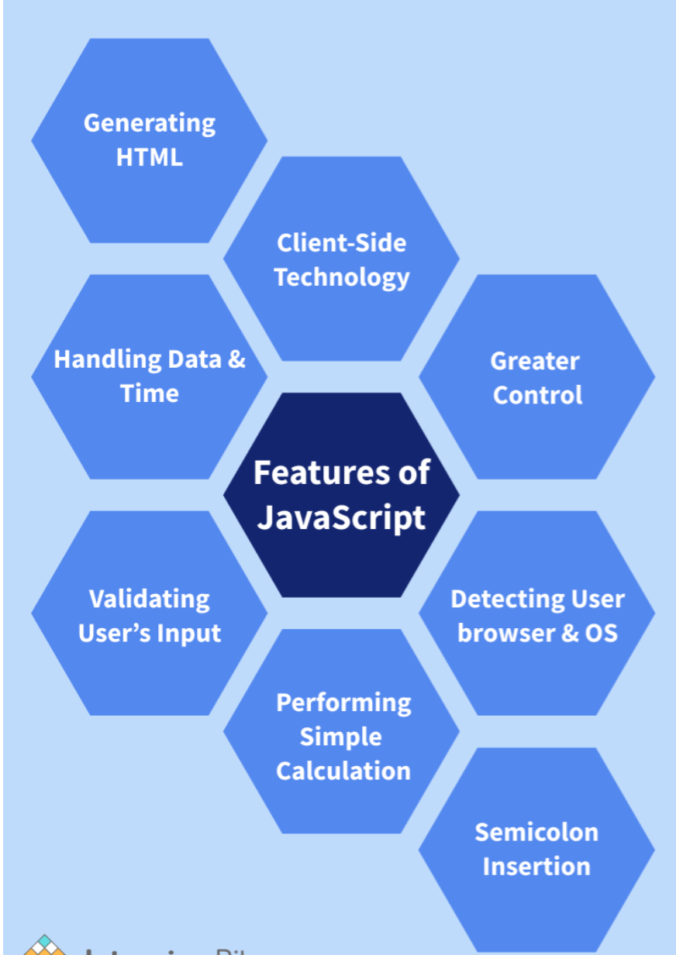
JavaScript is the world's most popular programming language.
JavaScript is the programming language of the Web.
JavaScript is easy to learn.
This tutorial will teach you JavaScript from basic to advanced.

Slide 13
JavaScript Statements
let x, y, z; // Statement 1 x = 5; // Statement 2 y = 6; // Statement 3 z = x + y; // Statement 4
JavaScript Values
The JavaScript syntax defines two types of values:
Fixed values
Variable values
Fixed values are called Literals.
Variable values are called Variables.
JavaScript Let
The let keyword was introduced in ES6 (2015).
Variables defined with let can not be redeclared.
Variables defined with let must be declared before use.
Variables defined with let have block scope.

Slide 14
JavaScript Const
The const keyword was introduced in ES6 (2015).
Variables defined with const cannot be Redeclared.
Variables defined with const cannot be Reassigned.
Variables defined with const have Block Scope.
When to use JavaScript const?
Always declare a variable with const when you know that the value should not be changed.
Use const when you declare:
A new Object
A new Function
A new RegExp
A new Array

Slide 15
JavaScript Assignment
Types of JavaScript Operators
There are different types of JavaScript operators:
Arithmetic Operators
Assignment Operators
Comparison Operators
String Operators
Logical Operators
Bitwise Operators
Ternary Operators
Type Operators
= | X=y
+= | X+=y
-= | X-=y
*= | X*=y
/+ | X/=y
++ | X=x+1
-- | X=x-1

Slide 16
JavaScript Comparison Operators
== | equal to
=== | equal value and equal type
!= | Not equal
!== | not equal value or not equal type
> | Greater than
< | Less than
>= | Greater than or equal to
<= | less than or equal to
? | Ternary operator

Slide 17
JavaScript Data Type
JavaScript has 8 Datatypes
1. String 2. Number 3. Bigint 4. Boolean 5. Undefined 6. Null 7. Symbol 8. Object
The Object Datatype
The object data type can contain:
1. An object 2. An array 3. A date

Slide 18
JavaScript String Methods
String length String slice() String substring() String substr() String replace() String replaceAll() String toUpperCase() String toLowerCase() String concat() | String trim() String trimStart() String trimEnd() String padStart() String padEnd() String charAt() String charCodeAt() String split()
String indexOf()
String lastIndexOf()
String search()
String match()
String matchAll()
String includes()
String startsWith()
String endsWith()
String Search Methods

Slide 19
JavaScript Array
An array is a special variable, which can hold more than one value.
Array methods
Pop
Push
Shift
unshift
Slice
Splice
Delete
concat
Splicing and Slicing Arrays
The splice() method adds new items to an array.
The slice() method slices out a piece of an array.

Slide 20
JavaScript IF-Else
Conditional Statements
Very often when you write code, you want to perform different actions for different decisions.
You can use conditional statements in your code to do this.
In JavaScript we have the following conditional statements:
Use if to specify a block of code to be executed, if a specified condition is true
Use else to specify a block of code to be executed, if the same condition is false
Use else if to specify a new condition to test, if the first condition is false
Use switch to specify many alternative blocks of code to be executed

