Slide 1
JAVASCRIPT
Instructor: Kaumarjya Banerjee

Slide 2
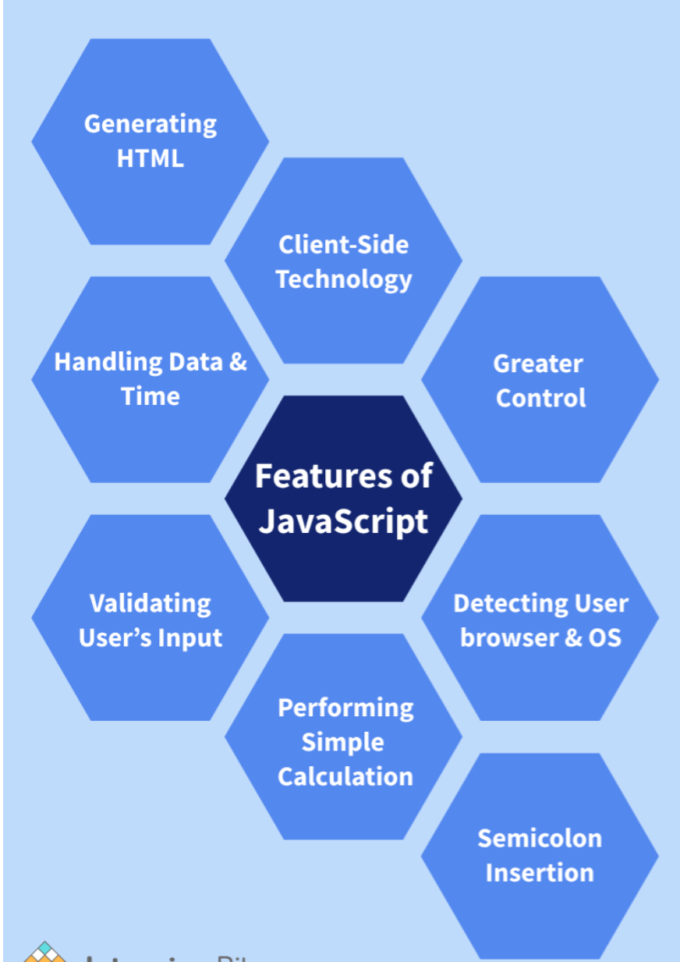
JavaScript is the world's most popular programming language.
JavaScript is the programming language of the Web.
JavaScript is easy to learn.
This tutorial will teach you JavaScript from basic to advanced.

Slide 3
JavaScript Statements
let x, y, z; // Statement 1 x = 5; // Statement 2 y = 6; // Statement 3 z = x + y; // Statement 4
JavaScript Values
The JavaScript syntax defines two types of values:
Fixed values
Variable values
Fixed values are called Literals.
Variable values are called Variables.
JavaScript Let
The let keyword was introduced in ES6 (2015).
Variables defined with let can not be redeclared.
Variables defined with let must be declared before use.
Variables defined with let have block scope.

Slide 4
JavaScript Const
The const keyword was introduced in ES6 (2015).
Variables defined with const cannot be Redeclared.
Variables defined with const cannot be Reassigned.
Variables defined with const have Block Scope.
When to use JavaScript const?
Always declare a variable with const when you know that the value should not be changed.
Use const when you declare:
A new Object
A new Function
A new RegExp
A new Array
s

Slide 5
JavaScript Assignment
Types of JavaScript Operators
There are different types of JavaScript operators:
Arithmetic Operators
Assignment Operators
Comparison Operators
String Operators
Logical Operators
Bitwise Operators
Ternary Operators
Type Operators
= | X=y
+= | X+=y
-= | X-=y
*= | X*=y
/+ | X/=y
++ | X=x+1
-- | X=x-1

Slide 6
JavaScript Comparison Operators
== | equal to
=== | equal value and equal type
!= | Not equal
!== | not equal value or not equal type
> | Greater than
< | Less than
>= | Greater than or equal to
<= | less than or equal to
? | Ternary operator

Slide 7
JavaScript Data Type
JavaScript has 8 Datatypes
1. String 2. Number 3. Bigint 4. Boolean 5. Undefined 6. Null 7. Symbol 8. Object
The Object Datatype
The object data type can contain:
1. An object 2. An array 3. A date

Slide 8
JavaScript String Methods
String length String slice() String substring() String substr() String replace() String replaceAll() String toUpperCase() String toLowerCase() String concat() | String trim() String trimStart() String trimEnd() String padStart() String padEnd() String charAt() String charCodeAt() String split()
String indexOf()
String lastIndexOf()
String search()
String match()
String matchAll()
String includes()
String startsWith()
String endsWith()
String Search Methods

Slide 9
JavaScript Array
An array is a special variable, which can hold more than one value.
Array methods
Pop
Push
Shift
unshift
Slice
Splice
Delete
concat
Splicing and Slicing Arrays
The splice() method adds new items to an array.
The slice() method slices out a piece of an array.

Slide 10
JavaScript IF-Else
Conditional Statements
Very often when you write code, you want to perform different actions for different decisions.
You can use conditional statements in your code to do this.
In JavaScript we have the following conditional statements:
Use if to specify a block of code to be executed, if a specified condition is true
Use else to specify a block of code to be executed, if the same condition is false
Use else if to specify a new condition to test, if the first condition is false
Use switch to specify many alternative blocks of code to be executed

