Slide 1
Anomaly and Misuse based Network Intrusion Detection System
-Sumedha Khurana (RA1411003010478)
-Kaumudi Gupta (RA1411003010474)
Guided by: Mr. G. Manoj Kumar
Assistant Professor(O.G)

Slide 2
ABSTRACT
The use of information and technology by different types of devices generates a large quantity of data packets that contains confidential and personal information. The packets are used to send data over an network. Hackers try to manipulate our data or gain illegal access to the files. Due to this reason, it is necessary to use computer security tools, such as Intrusion Detection Systems (IDS). This work presents an IDS that can perform the packet-based analysis. The flows are organized to be processed by machine learning methods. We design a network intrusion detection system that alarms the admin in case of any kind of intrusion or misuse of data. We are implementing this system using Support vector machine(SVM) algorithm, Weka and Java in various stages to overcome the challenges. Various shortcomings like Misuse of data, port scanning, denial of services will be dealt with in this system. Training data will be used to train the network and perform the testing of the system.

Slide 3
Introduction
Intrusion: Attempting to break into or misuse of system.
Intruders maybe from outside or within the network.
Cyber attacks are actions aimed at compromise the pillars of information security such as integrity, confidentiality and availability of a resource
Different ways of classifying IDS
- anomaly detection
- signature based misuse
- host based
- network based

Slide 4
More about IDS
This IDS possess an attacked
description that can be matched to sensed attack manifestations.
Near real-time detection and response to malicious attack.
Security of confidential data
Attack verification
Plays the role of informant rather than police officer

Slide 5
Challenges
Malicious Activites (smurf, satan, buffer overflow ,rootkit, nmap etc)
Best algorithm for detection and classification
Complexity
Accuracy

Slide 6
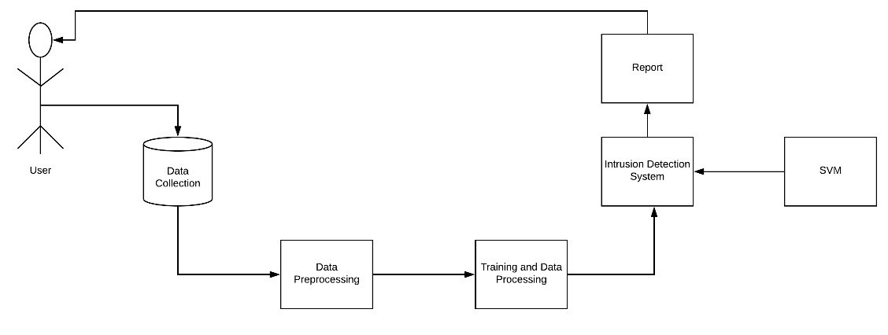
Proposed Architecture
(Represents Network)
Testing Data

Slide 7
Dataset
We are using NSL-KDD dataset divided into two parts, one for training and other for testing.
There are total 42 features in the dataset including Protocol_type, Service, Flag, Source bytes, Destination bytes etc.
The last column contains the output denoting a normal activity or an attack.
Different types of attacks are included like satan, rootkit, portsweep , buffer overflow.

Slide 8
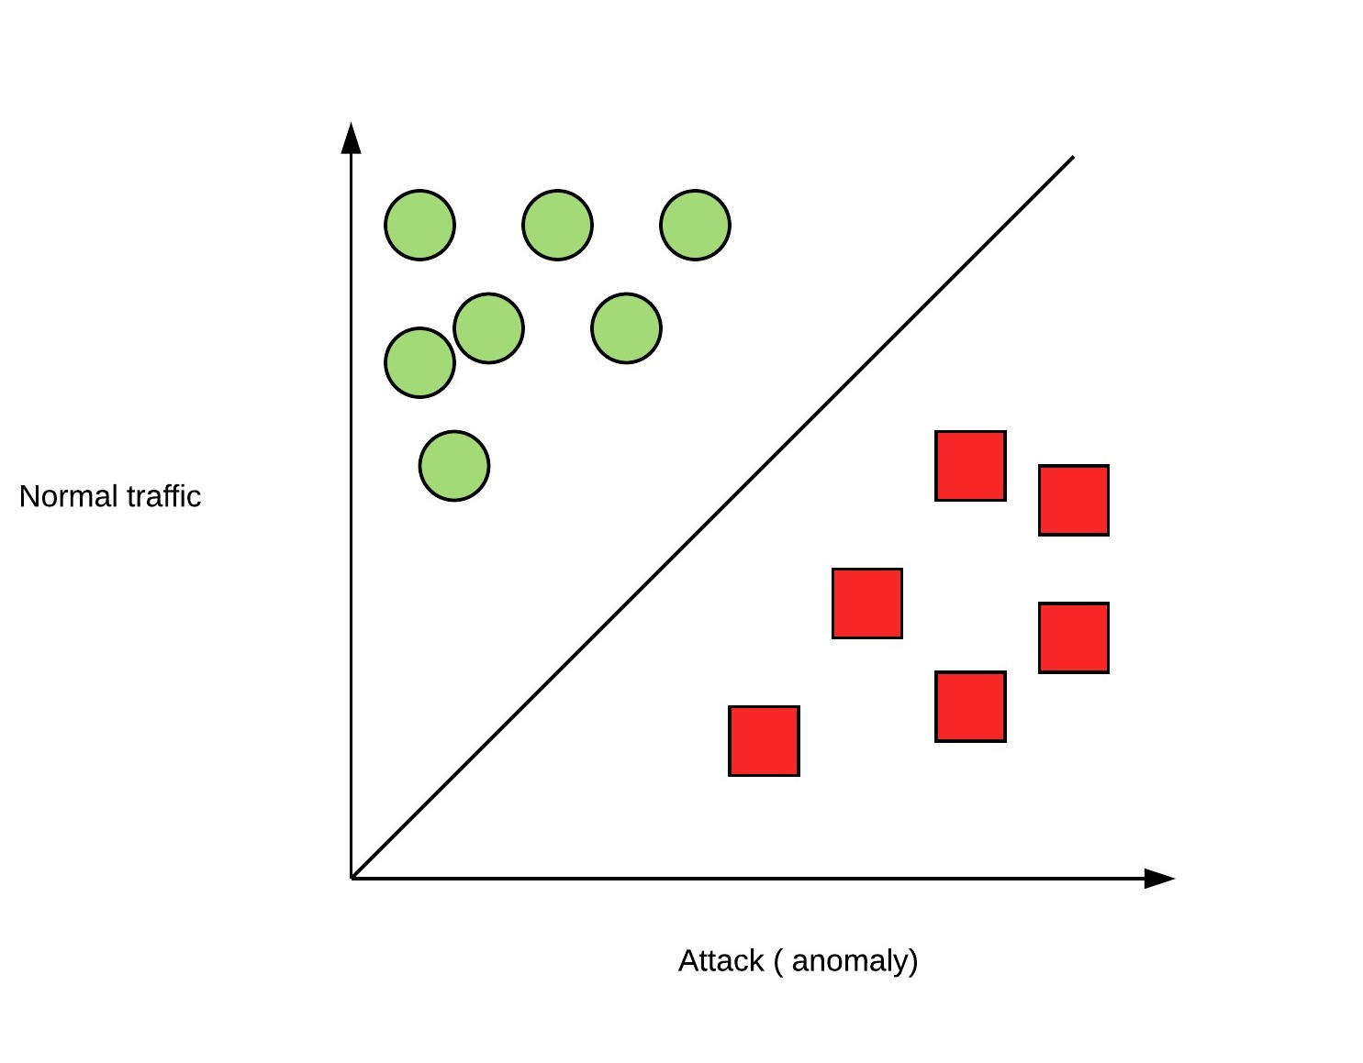
Algorithm :- Support Vector Machine
Support Vector Machine (SVM) is a supervised machine learning algorithm
used for both classification or regression challenges.
Best known algorithm for classification

Slide 9
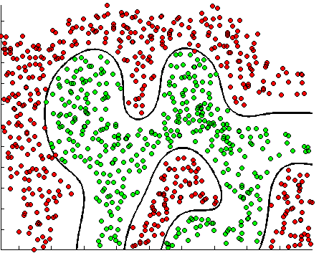
KSVM
Most of the datasets available have non linear decision boundary. So the kernal function is used for converting the feature space.
The kernal function is chosen in such a way that dataset becomes linearly separable in new feature space.
The most commonly used kernal functions are polynomial and radial basis function.
Kernal Trick which means the kernel function transform the data into a higher dimensional feature space to make it possible to perform the linear separation.

Slide 10
Packages Used
Caret
It is a package in R
Its function is to streamline the model training process for complex regression and classification problems.
Kernlab
It provides basic kernal functionality like computing a kernel matrix using a particular kernel and modern kernel-based algorithms.
a R package available from CRAN under the GPL license.

Slide 11
Proposed System
Implementing and learning how our IDS will perform when intrusion is detected in the system
Testing how SVM will differentiate different kinds of attacks from normal behaviour
Design and implementation of misuse detection system that can identify between different types of attacks.
We will test our system of training data

Slide 12
Steps Involved
Preparing Datasets for anomaly detection
Using weka to remove useless attributes
Writing code to remove attributes
Preparing datasets for Misuse detection
Using R for applying SVM and training the system
Dataset for distinguishing between attack and not an attack

Slide 13
Advantages of Proposed System
It detects various types of attacks.
We aim at achieving high accuracy.
The system is trained to detect any new type of attack which is not known.
It is independent of the performance of the operating system

Slide 14
Conclusion
Our system shows accuracy of 98.59% and 98.79% for Misuse and Anomaly based Intrusion detection system respectively which is commendable. As future work, it is suggested to carry out the detection of other types of threats, such as arbitrary code execution in Internet pages (cross-site scripting) and poisoning the DNS memory (obfuscation of DNS). We also suggest to apply multiple algorithms with SVM to improve the time complexity.

Slide 15
References
E. M. Kakihata, H. M. Sapia, R. T. Oikawa, D. R. Pereira, J. P. Papa,V. H. C. Alburquerque and F. A. Silva :’Intrusion Detection System Based on Flows using Machine Learning Algorithms’,IEEE TRANSACTIONS, VOL. 15,NO.10, OCTOBER 2017
Heba F. Eid, Ashraf Darwish, Aboul Ella Hassanien, andAjith Abraham,(2010) Principle Components Analysis and Support Vector Machine based Intrusion Detection System,IEEE.
J.F Joseph,A. Das,B.C. Seet, (2011) Cross-Layer Detection of Sinking Behavior in Wireless Ad Hoc Networks Using SVM and FDA. IEEE Transaction on dependable and secure computing, Vol. 8, No. 2, April 2011.
Abhaya,Kaushal Kumar : An efficient network intrusion detection system based on fuzzy C-means and support vector machine,IEEE 2017
S. Latha, Sinthu Janita Prakash :A Survey on Network Attacks and Intrusion Detection Systems ,2017 International Conference on Advanced Computing and Communication Systems (ICACCS -2017)
BATISTA, Maira Lambort. Analysis of Security Events in Networks
of Computers Using Novelty Detection. Dissertation of
BATISTA, Maira Lambort. Analysis of Security Events in Networks
Master of Science in Computer Science, Paulista State University
of Computers Using Novelty Detection. Dissertation of
"Júlio de Mesquita Filho", São José do Rio Preto, São José do Rio Preto
Master of Science in Computer Science, Paulista State University
- SP, 2012.
"Júlio de Mesquita Filho", São José do Rio Preto, São José do Rio Preto
[2] CERQUEIRA, Pedro H. Ramos. A Study on the Recognition of
- SP, 2012
Standards: A Supervised Learning with Bayesian Classifier.
Master's Dissertation in Sciences, University of São Paulo Escola
Superior of Agriculture "Luiz de Queiroz", Piracicaba - SP, 2010.
[3] CORRÊA, Jorge Luiz. A Network Event Detection Model
Based on Flow Tracking. Master's Dissertation in Science
of Computer Science, Paulista State University "Júlio de Mesquita
Son ", São José do Rio Preto - SP, 2009.
[4] DUDA, RO et. al. Patters Classification - 2nd edition, Wiley-
Interscience Publication, 2000.
[5] HALL, Peter et al. Choice of neighbor in nearest neighbor
classification. The Annals of Statistics, 2008

Slide 16
Jayshree Jha, Leena Ragha : Intrusion Detection System using Support Vector Machine, International Journal of Applied Information Systems (IJAIS) ISSN : 2249-0868, Foundation of Computer Science FCS, New York, USA , International Conference and workshop on Advanced Computing 2013
Preeti Aggarwal, Sudhir Kumar Sharma, "Analysis of KDD DatasetAttributes : Class wise For Intrusion Detection", 3rd International Conference on Recent Trends in Computing 2015 (ICRTC-2015)
R. Vijayanand, D. Devaraj, B. Kannapiran : Support Vector Machine Based Intrusion Detection System with Reduced Input Features for Advanced Metering Infrastructure of Smart Grid,2017,International Conference on Advanced Computing and Communication Systems (ICACCS -2017)
Dr.M.Amutha Prabakar,M.Karthikeyan :“An efficient technique for preventing SQL injection attack using pattern matching algorithm", 2013 IEEE International Conference on Emerging Trends in Computing, Communication and Nanotechnology (ICECCN 2013)

