Slide 1
RISC-V Microcontroller using Arrow DECA
Design of Microcontroller using RISC-V ISA on Arrow DECA Board

Slide 2
Why use RISC-V?
1. Open-Source Nature
2. Customization and Scalability
3. Community

Slide 3
Why?
There exists many open-source and proprietary microcontrollers using RISC-V ISA such as RocketChip, Open-V, etc
Two flaws for students
Lack of proper documentation and source code
Approachable source code for customization

Slide 4
Aims and Objectives
1. To design a simple microcontroller using RISC-V ISA
2. Use VHDL
3. Test the system using sample programs
4. Provide Modularity
5. Provide proper documentation for the system

Slide 5
Methodology
Two Parts
1. CPU Design
2. Peripheral Design

Slide 6

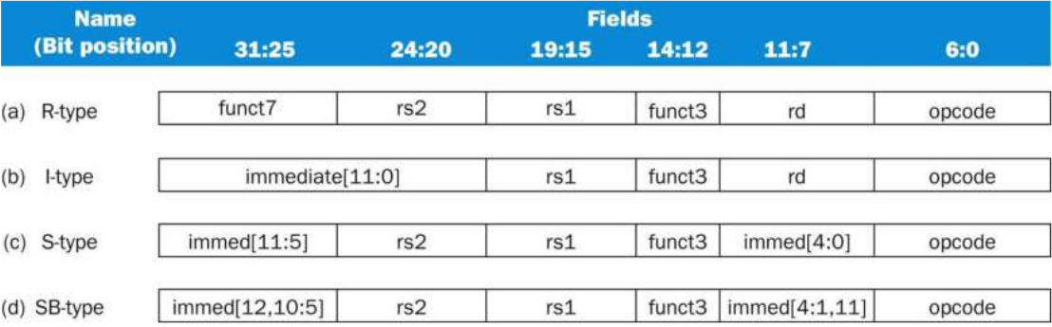
CPU Design
Supported Instructions
Instruction | Description
add | reg=reg+reg
sub | reg=reg-reg
and | reg=reg&reg
or | reg=reg|reg
addi | reg=reg+constant
andi | reg=reg&constant
ori | reg=reg|constant
ld | reg=mem(address)
sd | mem(address)=reg
beq | Jump if reg=reg
bne | Jump if reg!=reg
RV32I ISA variant
Instruction Format

Slide 7
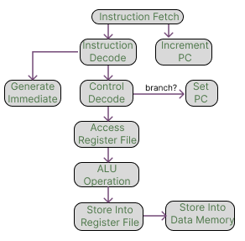
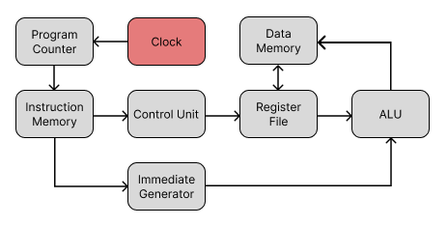
CPU Design (Non-pipelined)
1. Clock
2. Program Counter
3. Instruction Memory
4. Control Unit
5. Register File
6. ALU
7. Data Memory
8. Immediate Generator
Detail Implementations are described in Chapter 3 of the report

Slide 8
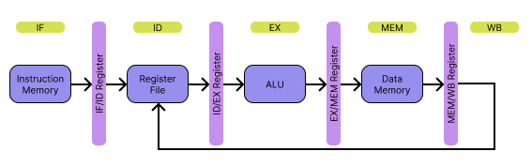
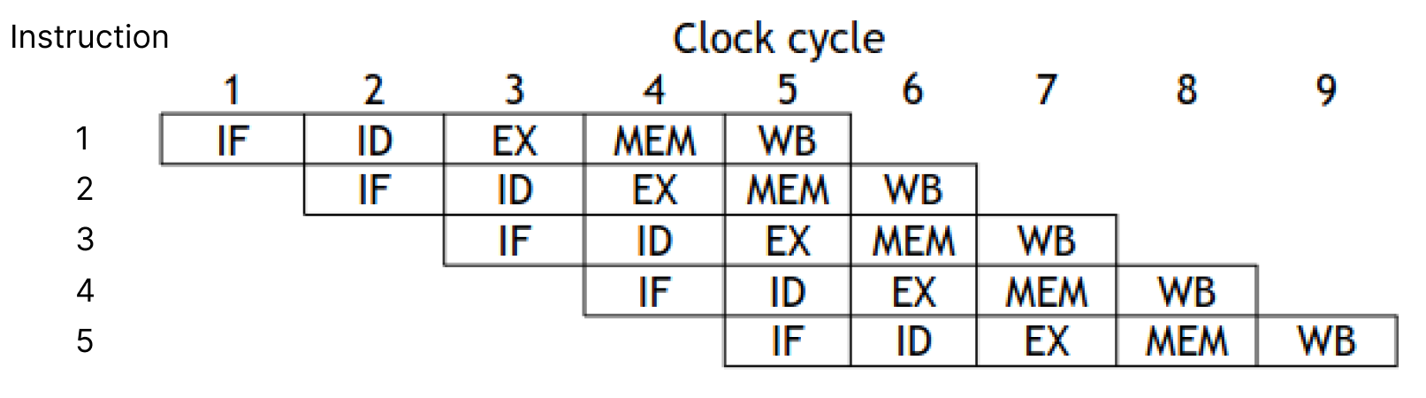
CPU Design (Pipeline)
Stages
1. Instruction Fetch (IF)
2. Instruction Decode (ID)
3. Execution (EX)
4. Memory (MEM)
5. Write Back (WB)

Slide 9
CPU Design (Pipeline Hazards)
Pipeline Hazards
1. Data Hazard
2. Control Hazard
3. Structural Hazard
Mitigation
----------------> Data Forwarding
----------------> Data Forwarding
Detail Implementation can be found in Section 14 of Chapter 3 in the report

Slide 10
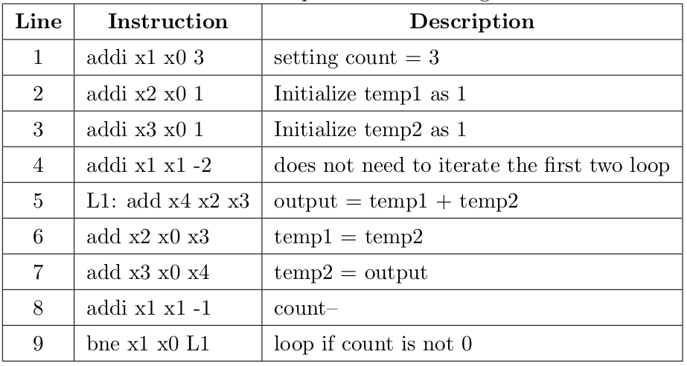
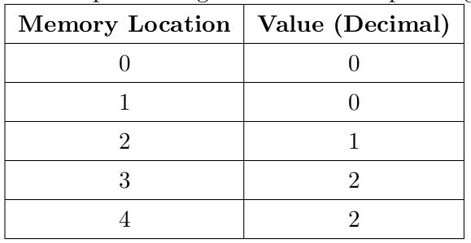
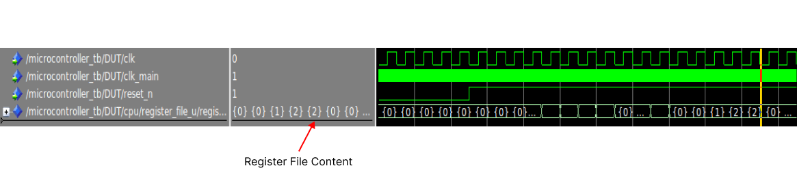
Simulation Testings
Count(x1) | temp1(x2) | temp2(x3) | output(x4)
3 | 1 | 1 | 0
1 | 1 | 2 | 2
0 | 1 | 2 | 2

Slide 11
Peripheral Designs
Microcontrollers require peripherals
Implemented Peripherals
1. UART – Universal Asynchronous Receiver Transmitter
2. SPI – Serial Parallel Interface
3. I2C – Inter-Integrated Circuit
4. I/O – Input/Output

Slide 12
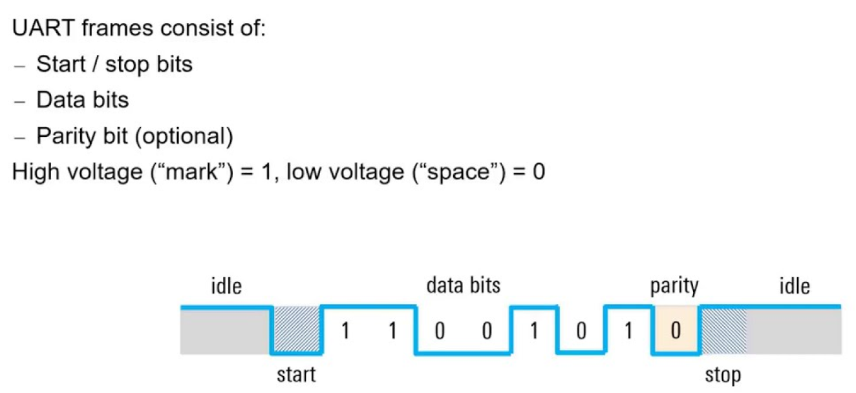
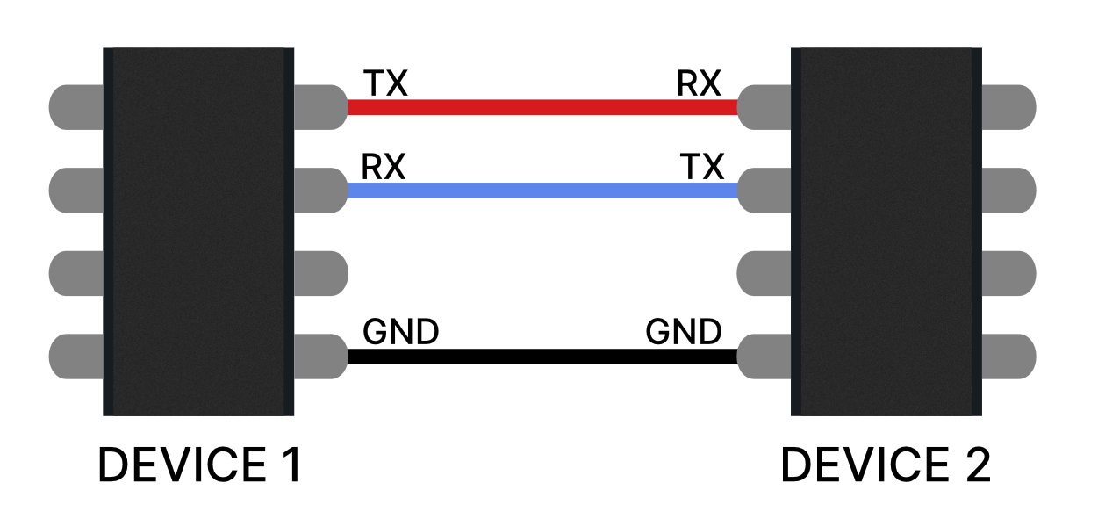
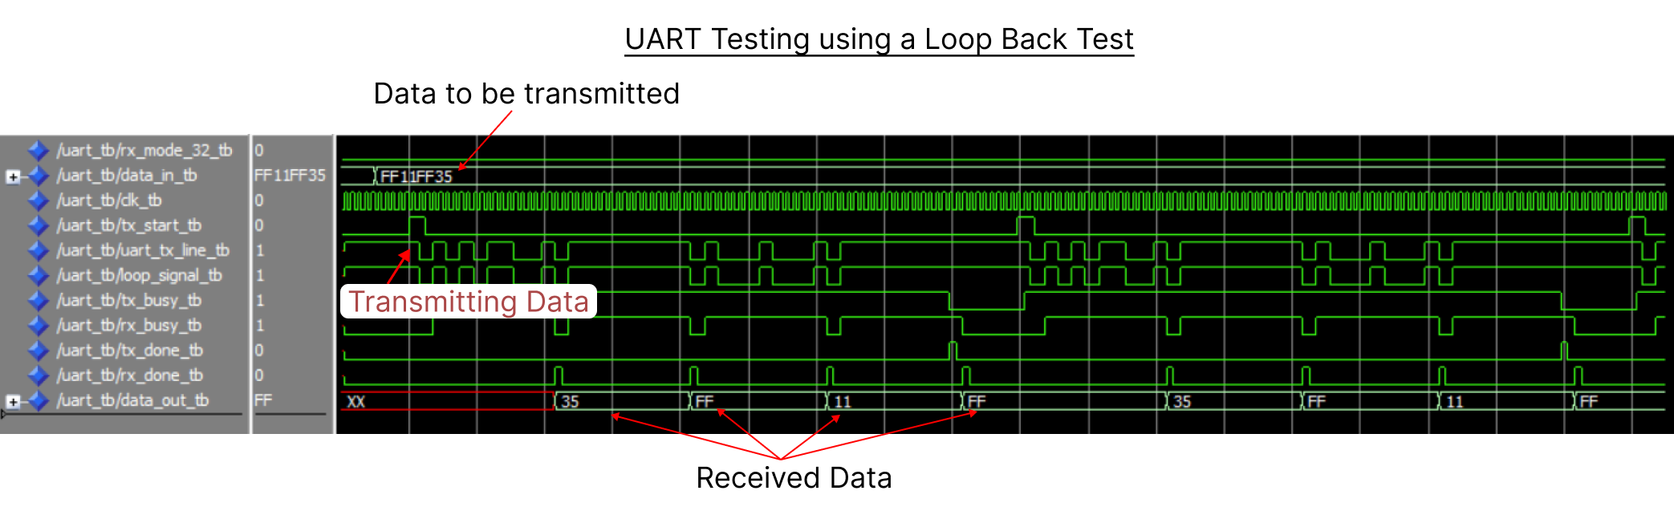
UART Design

Slide 13
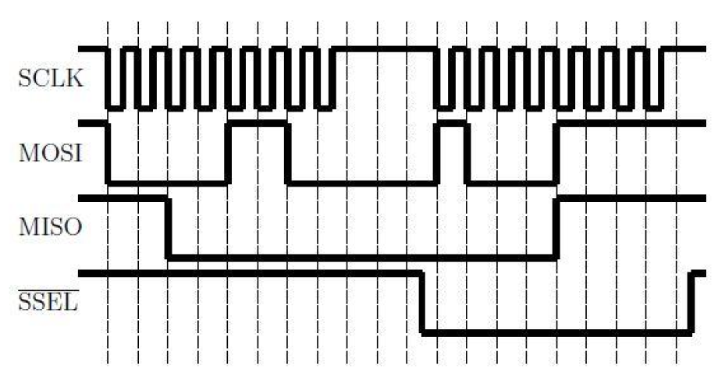
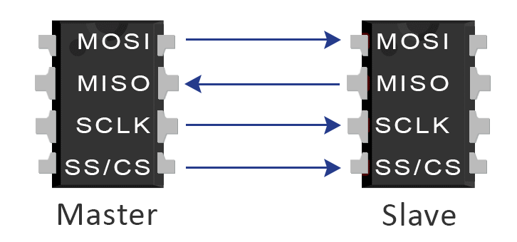
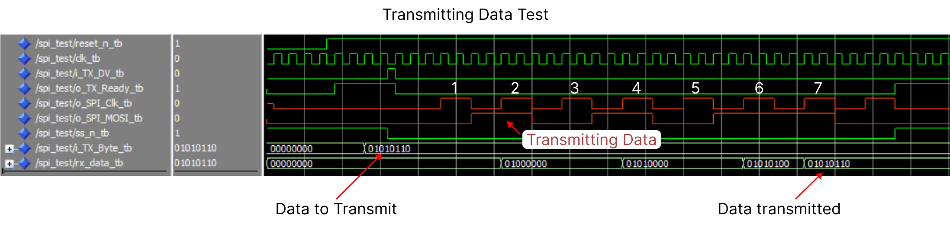
SPI Design

Slide 14
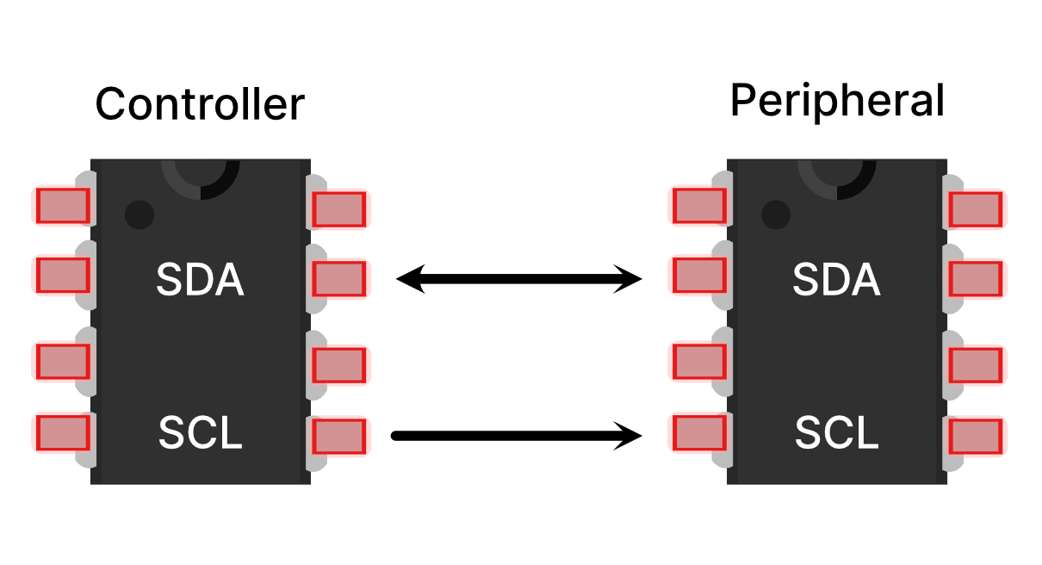
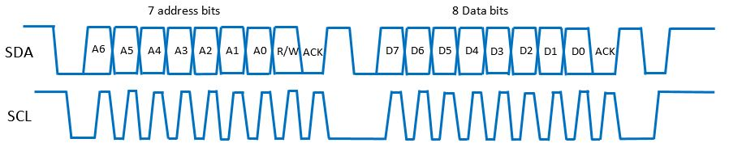
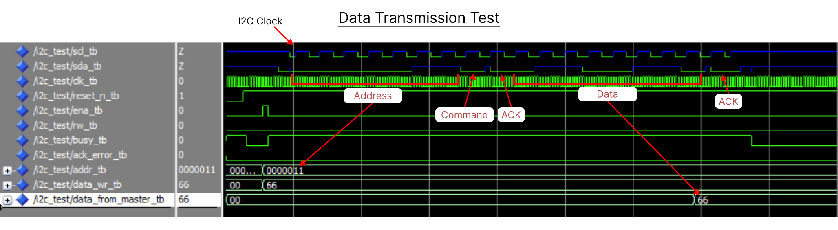
I2C Design

Slide 15
General I/O
General I/O wraps all other I/O related modules
1. General I/O
2. UART
3. SPI
4. I2C
All of the detail implementations and more testings have been documented in Chapter 4 of report

Slide 16
Hardware Testings
Counting from 0 to 6 in Binary

Slide 17
Hardware Testings
Input Testings

Slide 18
Hardware Testings
Transmitting on UART1

Slide 19

Thank You

