Slide 1
Data Analysis
Dr. Kaung Myat Khant

Slide 2
Let’s see what we should do with the data we acquired
Here is simulated data from dataing apps such as tinder, match ,etc.

Slide 3
But the data is really messy
id | age_female | age_male | match_age_female | match_age_male
1 | 28 | 99 | 25 | 99
2 | 99 | 28 | 99 | 21
3 | 20 | 99 | 19 | 99
4 | 99 | 22 | 99 | 18
5 | 19 | 99 | 18 | 99

Slide 4
So we run a few codes to tidy up
data %\>% pivot_wider(id_cols = id, names_from = gender, values_from = c(age, match_age), values_fill = 99) %\>% pivot_longer(cols = -id, names_to = c(".value", "gender"), names_pattern = "(age\|match_age)\_(female\|male)") %\>% mutate(across(c(age, match_age), \~ na_if(., 99))) %\>% filter(complete.cases(.))

Slide 5
And we get this tidy data and our data has meaning
# A tibble: 5 × 4 id gender age match_age <int> <chr> <int> <dbl> 1 1 female 28 25 2 2 male 28 21 3 3 female 20 19 4 4 male 22 18 5 5 female 19 18

Slide 6
We use statistics to see what we could know from our data
$matched_age=α+β_{1}×age+β_{2}×gender$

Slide 7
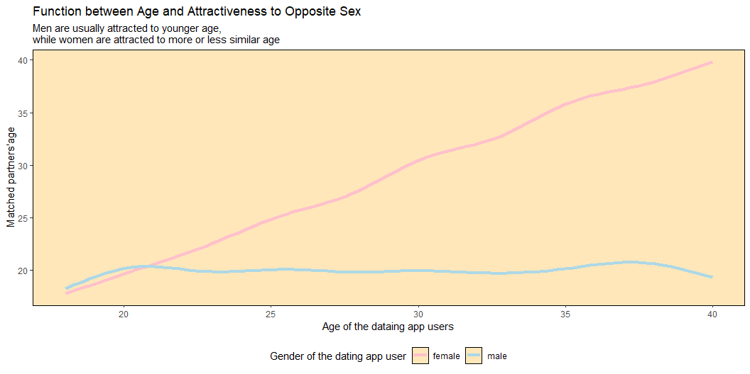
And here is what we got

