Slide 1







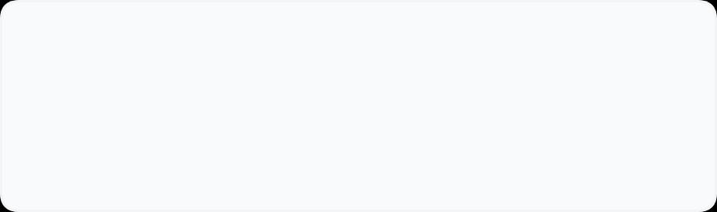




KHIT ZAY
Parent Company Context
Blazon MM Group
Strategic Expansion Plan
Multi-Vendor
Marketplace
Expansion
Strategy
30-Year Legacy
17 Int'l Brands
1M+ Active Users
"From a single-vendor powerhouse to Myanmar’s premier curated marketplace—connecting lifestyle seekers with trusted sellers."
Complement, Don't Compete
Quality-First
Filling portfolio gaps with non-competing categories.
Rigorous vetting to maintain premium positioning.
Transforming Myanmar's e-commerce landscape by leveraging a 30-year legacy.
Phased Scale
Data-Driven Ops
Controlled expansion from pilot to full launch.
Leveraging analytics for inventory and fulfillment.
Prepared By
KHIT ZAY Strategy Team
March 10, 2026

Slide 2












Executive Summary
Strategy Overview
Expansion Roadmap
Starting Position
12-Month Success Metrics
Active Customer Base
1,000,000+
Marketplace Scale
Product Volume
60-80
6,000+
International Brand Portfolio
17 Brands
Quality Sellers
Active SKUs
Operational Legacy
30 Years
Financial Target
Customer Experience
6.75B
4.5/5
Projected GMV (MMK)
CSAT Score
Building on a solid foundation of trusted logistics and customer service infrastructure established by Blazon MM Group.
Seller Value Proposition
Go-To-Market Phases
Strategic Vision
Immediate Access: Direct reach to 1M+ active user base
1
2
3
4
Zero Risk: No upfront fees, commission-based model
Foundation
Pilot
Expand
Full Launch
"To build Myanmar's premier curated marketplace by extending fashion & beauty leadership into complementary lifestyle categories."
M 1-2
M 3-4
M 5-7
M 8-12
Full Support: End-to-end logistics & customer service
Marketing Power: Integrated into established digital campaigns

Slide 3


















Seller Acquisition Strategy
Phased Expansion
"Complement, Don't Compete"
12-Month Roadmap
Target Categories (Yangon-Based)
Focus: Lifestyle Extension
Qualification Standards
PRIORITY
LUXURY
TECH
Physical Presence
Yangon warehouse/office mandatory
Watches
Fragrances
Authenticity Guarantee
Casio, Seiko, Fossil. Premium authorized dealers.
Niche & designer perfumes above mass market.
Gadgets
100% original with documentation
Earbuds, smartwatches, power banks (<2kg).
Fulfillment Capacity
Min. 50 orders/month capability
Liability Insurance
Required for items > 500k MMK
Accessories
Home & Wellness
More categories in
Phase 4
Strict Vetting Process
Sunglasses, jewelry, belts, wallets.
Aromatherapy, candles, small decor.
Execution Timeline & Milestones
MONTH 1-2
MONTH 3-4
MONTH 5-7
MONTH 8-12
PHASE 1: FOUNDATION
PHASE 2: PILOT
PHASE 3: EXPANSION
PHASE 4: FULL SCALE
"Building the Rails"
"Proof of Concept"
"Controlled Growth"
"Market Leadership"
Key Actions
Targets
8% Comm.
Targets
Year 1 Goal
Legal framework (SLAs)
10-15
300
Sellers:
30-50
80
4k
Shopify Multi-vendor setup
Sellers
Orders/Mo
Products:
1.5k - 3k
Sellers
Orders/Mo
Fulfillment:
≥ 96%
Shortlist 50-100 sellers

Slide 4





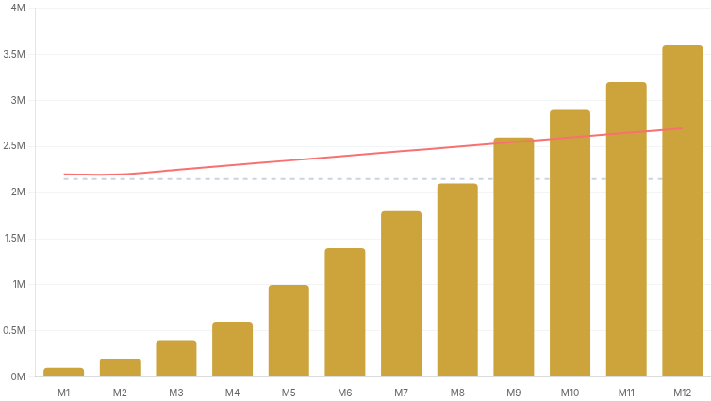








Financial Model
Monthly Break-Even
Year 1 GMV Target
Path to Profitability & Unit Economics
~215 Orders
MMK 6.75B
Fixed Monthly Costs
MMK 2.15M
12-Month Profitability Projection
Revenue
Fixed Costs
Total Costs
Platform & Tech Stack
690,000
Comparing Commission Revenue vs. Total Operational Costs
Personnel (Mgmt + CS)
1,140,000
Ops & Marketing
315,000
Variable per Order
Avg. MMK 10,500
Delivery
Processing
2,250 - 3,750
2.9% + 450
Packaging
Insurance
450
1.5% (>150k)
Commission Strategy
8%
Pilot Phase (M 1-4)
Profitability Scenarios
Incentivize early adoption
Standard Rate (M 5+)
Break-Even Point
12%
Base platform fee
215
Premium Watch
+ MMK 311k
orders / month
Price: 225k | Vol: 25
Net Profit
Requires approx. 4 orders per seller (at 60 sellers)
Volume Incentives (Month 9+)
Bronze
Silver
Gold
Avg. Gross Profit
Target Month
Cheap Gadget
- MMK 270k
12%
10%
8%
MMK 10,000
Month 9
Price: 37.5k | Vol: 100
Net Loss

Slide 5























Operational Framework
Fulfillment Target
CSAT Goal
End-to-End Workflow & Service Standards
98% Success
4.5 / 5.0
Core Operational Workflow
1
2
3
4
Seller Onboarding
Product Management
Order Fulfillment
CS & Returns
Application & Doc Submission
Standardized Listing Upload
Auto-routing to Seller
Omni-channel Support
Business & Authenticity Vetting
QA Review (Image 1200px+)
Seller Confirm (< 24h)
Centralized RMA Portal
Platform Training (Mandatory)
Real-time Inventory Sync
KHIT ZAY Standard Pack
Seller Inspection (48h)
Portal & API Credentials
Low Stock Auto-Alerts
Pickup & Real-time Track
Refund Credit (3-5 Days)
Delivery Service Level Agreement (SLA)
Benchmark: 95% On-Time
Logistics Partners
J&T
J&T Express
Primary Partner (Nationwide)
Yangon Region
Major Cities
Nationwide
1-2 Days
2-3 Days
3-7 Days
DHL
DHL eCommerce
Same-day express available
High-Value / Premium
Mandalay, Naypyidaw
Rural Townships
EMS
Myanmar Post
Rural Reach

Slide 6





















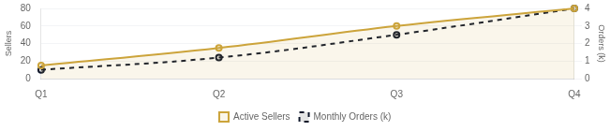
Implementation Roadmap
Year 1 Status
Active Sellers
Risk Mitigation & Success Metrics
Full Launch
Target: 80+
Critical Success Factors
Strict Seller SLA Requirements
Non-compliance leads to account review
Quality Over Quantity
Strict vetting ensures premium positioning and avoids "flea market" perception.
24h
48h
98%
<5%
Leverage Infrastructure
Order Confirmation
Max Dispatch Time
Fulfillment Rate
Return Rate Cap
Utilize Blazon's established logistics to lower barrier to entry for sellers.
Phased Growth Gates
Go/No-Go decisions at each phase based on strict financial & operational KPIs.
Year 1 Success Metrics Dashboard
Risk Mitigation Strategy
CSAT Score
Annual GMV Target
4.5 / 5.0
Risk: Seller Quality Drop
High
6.75 Billion MMK
Probationary pilot periods, "Mystery Shopper" audits, and performance reserves.
Target Achieved @ Month 12
Seller Retention
85%
Risk: Logistics Failure
Med
Multi-carrier redundancy (J&T + EMS) and automated tracking integration.
Risk: Cash Flow
Med
Conservative commission modeling and phased marketing spend.

