Slide 1
Skills for Computing
Topic 6:
Creative Thinking
Notes:
NCC Education - Title Master

Slide 2
Learning Outcomes for this Topic
By the end of this topic, students should be able to:
  Understand types of thinking activities
  Understand the background to the TASC and Six Hats models

Slide 3
Brainstorms and Mind-maps
  Brain-storming: writing down as many connected ideas as you can possibly generate on a given subject
  Mind-mapping (sometimes a ‘spider’ or ‘web’ diagram): A similar process, but arranged to show connections and interconnections from a central point

Slide 4
Whole-Brain Thinking - 1
  The typical human brain has two hemispheres, each of which is dominant during certain activities.
    It is worth noting that, though one half of the brain may be dominant, the other half is never inactive, so every activity is a combination of the two
  We refer to these as ‘right brain’ and ‘left brain’
    ...though in a significant minority of people the two are reversed.

Slide 5
Whole-Brain Thinking - 2
  Many of the most creative people in history have been credited as being ‘whole-brain thinkers’ – i.e. people who can harness the strengths of both left- and right-brain thinking.
  Often-cited examples include Albert Einstein, Pablo Picasso and Leonardo da Vinci

Slide 6
Whole-Brain Thinking - 3
  In the 1960s and 1970s, scientists Roger Sperry and Robert Ornstein made the first discoveries about the specialisations of each side of the brain:
Left - ‘logical’ ‘critical’
Right - ‘intuitive’ ‘creative’

Slide 7
The Right Hemisphere: ‘Blue Sky Thinking’
  Our right hemisphere is predominant for many creative activities, including any performance arts, using the imagination, daydreaming and recognising colours
  We often here about ‘Blue Sky Thinking’ – this means generating many ideas without any barriers, doubts or objections
  This is a perfect example of right-brained thinking

Slide 8
The Left Hemisphere: Logical and Critical Thinking
  Our left hemisphere is dominant when we are using logic – for example, making a list, following a step-by-step process, proof-reading a document or working out simple algebra.
  You may be familiar with the term Critical Thinking; this involves questioning assertions, trying to find the flaws in a position, and testing an argument in as harsh a manner as possible.
  This is an excellent example of left-brained thinking.

Slide 9
TASC - Introduction
  Thinking
  Actively in a
  Social
  Context

Slide 10
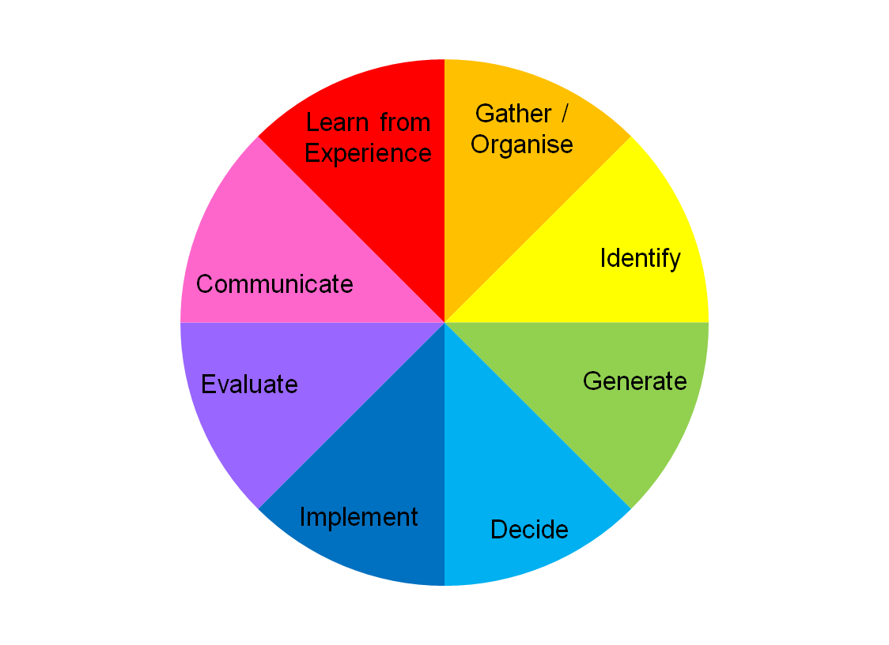
The TASC Wheel
[based on the TASC wheel
© Belle Wallace – www.tascwheel.com]

Slide 11
TASC and the Whole Brain
  TASC promotes whole-brain thinking through a balance of left/right:
    Phase one and two identify and organise known information (combined)
    Phase three – extreme creativity (right-brain)
    Phase four – extreme criticality (left-brain)
    Phase five – implementation (combined)
    Phase six – evaluation (critical; left-brain)
    Phase seven – communication (creative; right-brain)
    Phase eight – learn from experience (combined)

Slide 12
Six Hats – Introduction
  Argument vs Parallel Thinking
    History of dialectical problem-solving dates back to the ancient Greeks.
    This involves establishing a thesis and antithesis, then evaluating them against each other
    Parallel thinking means looking at all aspects together, alongside each other
  Argument: Opposition, disagreement
  Parallel: Possibilities

Slide 13
Six Hats Overview
  White - Objective
  Red - Emotional
  Yellow - Optimistic
  Black - Critical
  Green - Creative
  Blue – Control and Overview

Slide 14
Using the 6 Hats
Individual...
... or in a Group
Sequential...
... or in Parallel

Slide 15
Seminars
  The rest of this topic is made up of creative thinking seminars
  Before the seminars begin, make sure you have read the worksheets on TASC and Six Hats which are in your student guide – these will explain the main principles in more detail

Slide 16
References and Further Reading
  Wallace B and Maker J, et al (2004) Thinking Skills and Problem-Solving: An Inclusive Approach. London, David Fulton Publishers
  De Bono, Edward (1999): Six Thinking Hats. London, Penguin

Slide 17
Topic 6 – Creative Thinking
Any questions?
Notes:
NCC Education - End Slide Master

