Slide 1
Skills for Computing
Topic 9:
Charts and Estimates
Notes:
NCC Education - Title Master

Slide 2
Learning Outcomes for this Topic
By the end of this topic students should be able to:
  Be able to use charts
  Understand what distributions represent
  Be able to estimate values

Slide 3
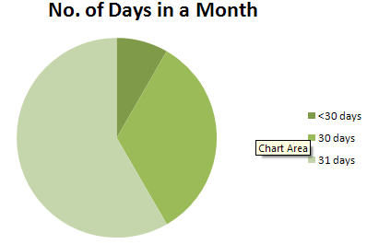
Pie Charts
  Information is easier to understand when it is shown in a picture.
  An example pie chart:
    Days in a month:
    <30 : 8.3%
    30 : 33.3%
    31 : 58.3%

Slide 4
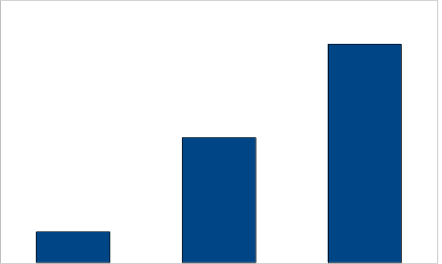
Bar Charts
  Whether we show the proportions for one year or ten years, we obtain the same chart. The proportions, or the relative frequencies, don't change with the number of values.
  One year Ten years

Slide 5
Relative Frequencies
  When the bars in bar chart represent the number of items in each range, we call it a histogram.
  A bar chart shows values of a quantity; a histogram shows the relative frequencies of values of a quantity.
  Relative frequencies are useful for representing data that changes with each measurement.

Slide 6
Measurements - 1
  Any measurement is affected by many factors. If we use a ruler to measure a piece of string, the result will depend on:
    How much we stretch the string
    Whether we look at the markings on the ruler from an angle
    Whether the string is wet or dry
    How good our eyesight is
    Where we hold the ends of the string

Slide 7
Measurements - 2
  The same measurement gives a different result when it is repeated.
  We cannot predict this variation, so we call it “random”.
  The net effect of many random variations we call noise

Slide 8
Distributions - 1
  We cannot predict randomly varying values, but we can measure how often they fall within a given range. This process is called binning.
  We do this by separating our range of samples into smaller ranges, called bins, and count how many values fall into each bin. Then, it is easy to see the relative frequency of values in each range.

Slide 9
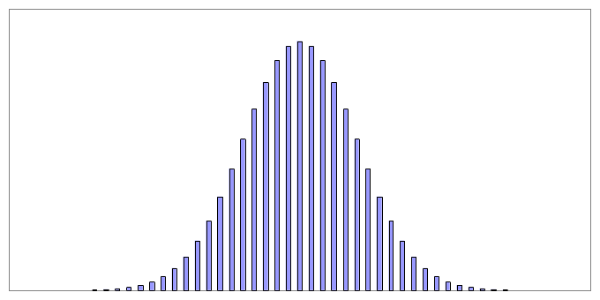
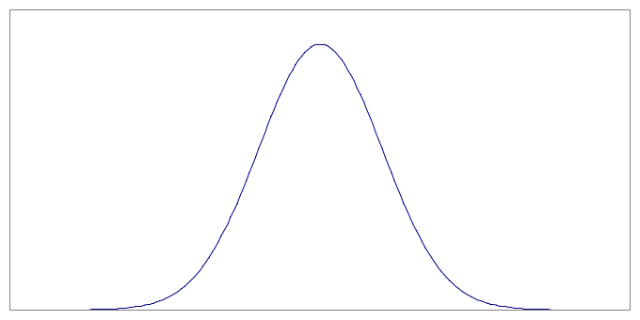
Distributions - 2
  If we have many values, we can make the bins more narrow and get a smoother curve. The histogram represents data from a large number of measurements. As the number of measurements increases, it begins to look like a distribution.

Slide 10
Distributions - 3
  A distribution shows how often we obtain data close to some value.
  A distribution tells us how values vary.
  It does not tell us what the values are.

Slide 11
Normal Distributions - 1
  Measurements are affected by many factors, some of which partially cancel. The net result is that we generally get values with a small error more often than values with a large error. The corresponding distribution is shaped like a hill, also sometimes called bell-shaped.
  The main example of this is called the normal distribution.

Slide 12
Normal Distributions - 2
  The normal distribution is important because it occurs very often in practice.
    We get values from the central region more often. We can see this from the fact that the height of the distribution, which shows the relative frequency, is greater near the centre.
    The extreme left and right of the distribution, called the tails, represent values which occur rarely.

Slide 13
Central Value
  We can summarise a collection of values with one number, the central value.
  This gives us a typical value for the distribution, in the sense that most of the measurements are usually not far from the central value.

Slide 14
The Median
  A simple way to find the central value:
    Put the values in order from smallest to largest, then find the point where half the values are smaller and half larger. This is called the median.
  The median is useful because it does not depend on the details of the shape of the distribution.
    Even if a distribution is very different from a normal distribution, the median will give a good estimate of the central region.

Slide 15
The Mean - 1
  Most measurements have a normal distribution.
    The best way to find the central value of a normal distribution is to find the average of the values. This is called the mean value.
    This method usually works for other distributions as well.

Slide 16
The Mean - 2
  For example:
    Number of children in each family in a small village of 12 families:
    3,5,1,0,4,2,0,0,4,5,3,3
    (3+5+1+0+4+2+0+0+4+5+3+3)/12 = 30/12 = 2.5 children.
    The mean number of children per family is 2.5

Slide 17
Accuracy of the Mean
  As the number of values in the dataset increases, the accuracy of the mean improves. In general in statistics we assume that we have a large dataset.
  The mean is a bit more accurate than the median, for estimating the centre of a normal distribution.
  The median may be more accurate than the mean if the tails of the distribution cover a significant area compared to the central region.

Slide 18
Distribution of the Mean
  If we repeatedly make estimates of the mean for separate datasets from the same distribution, we obtain a set of different estimates for the mean.
  For a normal distribution, the distribution of estimates of the mean has a distribution which is approximately normal.
  This distribution becomes more narrow with more samples in the original dataset.

Slide 19
Uniform Distribution (discrete)
Suppose we have six-sided, perfect dice.
When throwing the dice there are 1 of 6 likely outcomes.
The probability density function is shown on the next slide.

Slide 20
Uniform Distribution (discrete)
f(x))
1/6
x
1
2
3
4
5
6
0

Slide 21
Uniform Distribution (continuous)
Suppose that your college is due to have a fire alarm sometime between 12:00 and 14:00 today.
If the time at which the fire alarm starts is measured as minutes after 12:00, the probability density function on the next slide results.

Slide 22
Uniform Distribution
f(x))
Area = 1
x
0
120

Slide 23
Uniform Distribution
The alarm can ring at any time between 0 and 120 minutes, so at any point in time the probability of it occurring is equal.
Outside the range 12:00 to 14:00, it will not ring so the probability is zero.
Think about the mean for this distribution

Slide 24
Topic 9 – Charts and Estimates
Any questions?
Notes:
NCC Education - End Slide Master

