Slide 1

MARKET EXPANSION STRATEGY
Zomato Expansion Strategy
Data-Driven Recommendations for Identifying the Next High-Potential Markets
Strategy & Analytics Team | 2026

Slide 2





THE CHALLENGE
Where Should Zomato Expand Next?
Zomato operates in dense, mature markets where competition is fierce and growth is slowing. To sustain momentum, the business needs to identify new geographies that combine low competitive saturation with strong potential for high ratings, pricing power, and customer engagement.
Market Saturation
Restaurant density per country
Customer Ratings
Average rating & satisfaction
Guiding Question
Spending Power
Which countries offer the best balance of low competition, high ratings, and strong commercial potential?
Average cost for two
Service Adoption
Delivery & table booking impact
Zomato Expansion Strategy
2

Slide 3



THE FOUNDATION
Data Overview
The analysis is built on a cleaned, standardized, and enriched restaurant dataset spanning multiple countries, capturing pricing, ratings, cuisine, and service-adoption signals.
9,551
15
20
Restaurants Analyzed
Countries Covered
Attributes per Record
Dataset cleaned, de-duplicated, and standardized across currencies and rating scales — enriched with delivery, booking, and cuisine indicators for comparative analysis.
Zomato Expansion Strategy
3

Slide 4
ANALYSIS 1 OF 6
Restaurant Count by Country
India dominates the dataset with 8,652 listings — the market is saturated and highly competitive.
Philippines, Turkey & New Zealand show very low restaurant density, signaling open white space.
Low listing counts in these markets point to a strong first-mover expansion opportunity.
Zomato Expansion Strategy
4

Slide 5
ANALYSIS 2 OF 6
Ratings in Recommended Countries
Philippines posts the highest average rating (4.5) among all candidate markets.
Turkey and New Zealand both rate above the global average of 3.7.
Consistently high ratings indicate strong existing customer satisfaction in these regions.
Zomato Expansion Strategy
5

Slide 6
ANALYSIS 3 OF 6
Average Cost for Two (INR)
Turkey is the most cost-efficient market at roughly ₹950 average spend for two.
Philippines sits in a moderate spend bracket — affordable yet sustainable for margins.
New Zealand commands premium pricing (~₹2,300), suiting a higher-margin positioning.
Zomato Expansion Strategy
6

Slide 7
ANALYSIS 4 OF 6
Online Delivery Impact on Ratings
Restaurants offering online delivery average a 0.7-point higher rating than those without.
Delivery availability is strongly linked to greater customer convenience and satisfaction.
Recommended as a standard offering across all newly launched outlets.
Zomato Expansion Strategy
7

Slide 8
ANALYSIS 5 OF 6
Table Booking Impact on Ratings
Outlets with table booking enabled average 4.3 vs. 3.55 for those without.
Table booking acts as a signal of a premium, planned dining experience.
Improves customer perception and is worth prioritizing in flagship locations.
Zomato Expansion Strategy
8

Slide 9
ANALYSIS 6 OF 6
Cuisine Performance
Continental, Italian, and Cafe cuisines post the highest average ratings.
North Indian cuisine is highly saturated and shows comparatively lower average ratings.
New outlets should prioritize high-rated, less-saturated cuisine categories.
Zomato Expansion Strategy
9

Slide 10

CONCLUSION
Conclusion
A phased entry into Philippines, Turkey, and New Zealand — backed by delivery, booking, and the right cuisine mix — offers the strongest risk-adjusted growth path.
Philippines
Turkey
New Zealand

Slide 11
RECOMMENDATIONS
Recommendations
Prioritize Three Markets
Enable Delivery & Booking
Focus on Winning Cuisines
Philippines, Turkey, and New Zealand combine low competition with strong ratings and pricing potential.
Both services correlate strongly with higher customer ratings — make them standard at launch.
Lead with Continental, Italian, and Cafe formats; avoid oversaturated categories like North Indian.
Together, these three actions form the launch playbook for entering each new market with confidence.

Slide 12
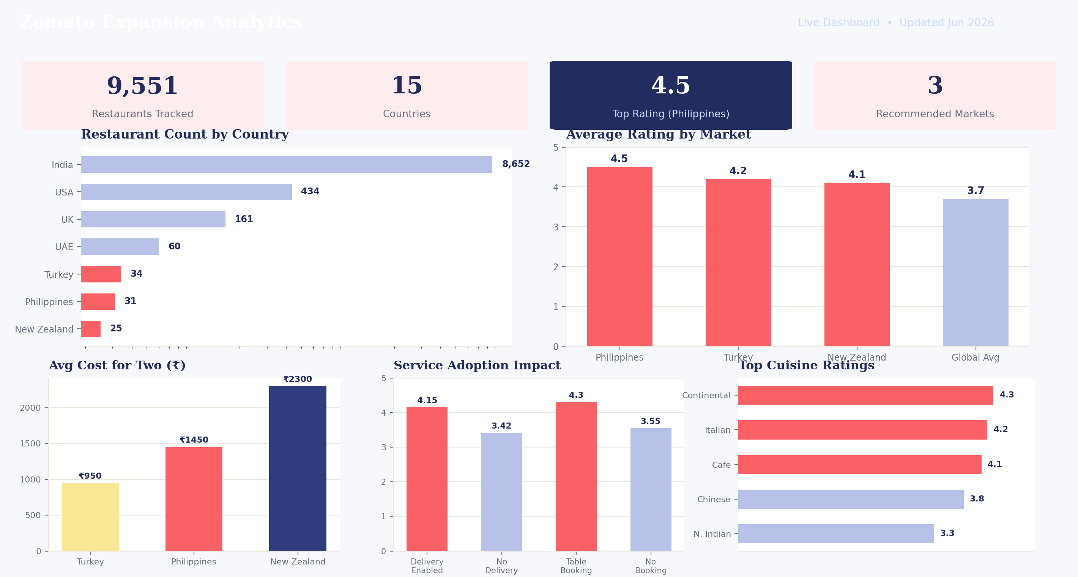
SUPPORTING DETAIL
Expansion Analytics Dashboard
Interactive dashboard summarizing market scores, ratings, and pricing benchmarks across all candidate countries.
Zomato Expansion Strategy
11

