Slide 1
WHISHEXT
-Gursimran Kaur

Slide 2
IDEA
Helps to schedule the messages for a given occasion
Uses the phone SMS service instead of third party messaging app’s and hence gives a personalized touch to the messages
Can be used as a reminder service also

Slide 3
Requirements
It uses phone’s contacts and hence, it is necessary that the message being sent is saved in the device
Simple and easily understandable UI
A main screen is provided where all the data is consolidated.

Slide 4
Backend Integration
Uses Firebase to save the recent chat data.

Slide 5
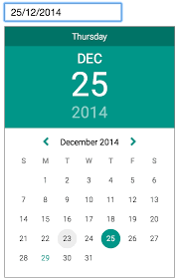
Third Party Tools
Uses material Date-Picker for choosing date.
Butter Knife
Joda DateTime

Slide 6
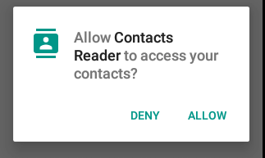
Privacy Concerns
It access contact data and hence as per android’s build version ( after 23), It asks for a run-time permission to allow contacts and messaging service when it is installed on a new device.

