Slide 1

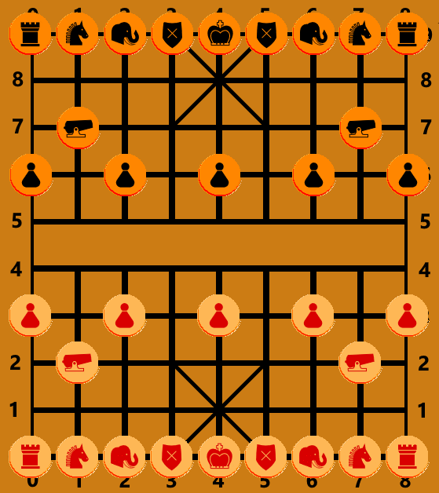

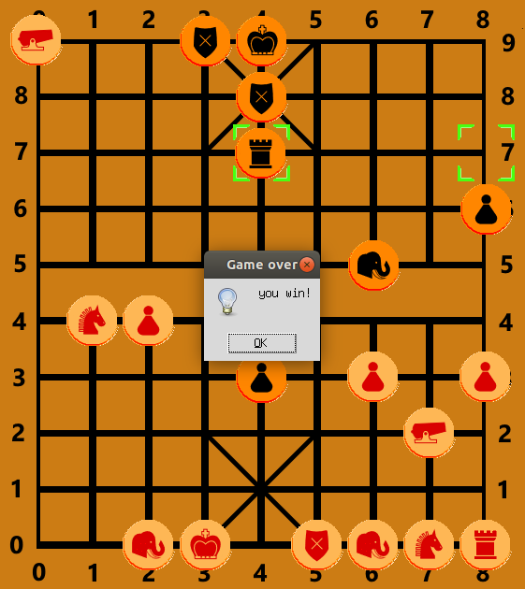









Heuristic AI for XiangQi
Kaur Karus, Mari Liis Velner
Institute of Computer Science, University of Tartu
Computer Science, MSc
Introduction
XiangQi or Chinese Chess is a two-player strategic board game similar to Western Chess. It is played on a 9-by-10 table with 16 pieces for each player and a river in the middle to divide the board. With pieces divided into defensive and offensive units, some movement restrictions and a larger board, it requires more strategy than common chess and is deemed to be more complex for machines. Checkmate is achieved when a player has no legal moves left to play. Stalemate is achieved when the game lasts for over 300 moves or neither player has any offensive (that can cross the river) pieces remaining.
We created multiple heuristic models that can play and successfully win against casual human players as well as a randomly playing model. We also evaluated their performance against each other.
Advisor
Figure 1. Initial table state
Can only move one step diagonally within the Palace (3x3 area marked by diagonal lines)
Elephant
Can only move 2 steps diagonally. Cannot cross the River (clear section in the middle of the board)
Horse (Knight)
Similarly to the Knight in Western Chess, can only move 2 steps forward, 1 step sideways in any direction. Can be blocked by pieces placed directly adjacent in the moving path.
Chariot (Rook)
Similar to the Rook in Western Chess, can move on any unblocked vertical or horizontal path.
Cannon
Similar to the Chariot in movement, but can only take an opposing piece if it has to jump over a single other piece.
Figure 2. Example winning state – opponent is in inescapable check from Cannon (top-left)
Soldier (Pawn)
Created models
Can move one step forward until crossing the river. Once the river can be crossed, the Soldier can also move one step to either side. Does not get promoted.
MoveMaxxer (2) – try to maximize the number of available moves while minimizing the number of possible opponent moves. Can prioritize more “valuable”/powerful pieces.
SingleFocus – try to opportunistically take and threaten “valuable” opponent pieces while defending own “valuable” pieces.
TriTac – three-stage model that changes its tactic depending on the board state.
Annealing – uses simulated annealing to balance move availability, pieces threatened and friendly pieces being defended.
Governor (King)
Can only move one step horizontally or vertically inside the Palace. Can never be on the same vertical line as the opposing Governor with no pieces between them (“Flying Governor rule”).
Conclusions
The decision tree complexity of XiangQi is estimated at 10¹⁵⁰, while the complexity of Western chess is only 10¹²³. This makes creating an effective, but simple AI a daunting task.
Creating heuristic AI for an uncommon strategy-rich board game is deceptively simple. However, creating effective heuristics to use for move evaluation while on limited processing power is a notable challenge, as evidenced by a failed AlphaBeta model, which in essence aims to speed up minimax, but was unbearably slow. For Chinese Chess, heuristics based on simulated annealing or maximizing possible moves proved to work most efficiently. To a subjective evaluator, the SingleFocus model was found to be most interesting to play against due to unexpected acts of aggression.
https://github.com/kaurix02/XiangQiAI

