Slide 1
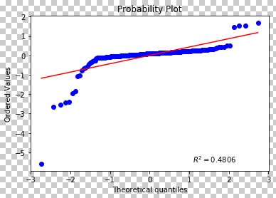
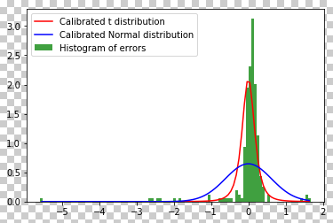
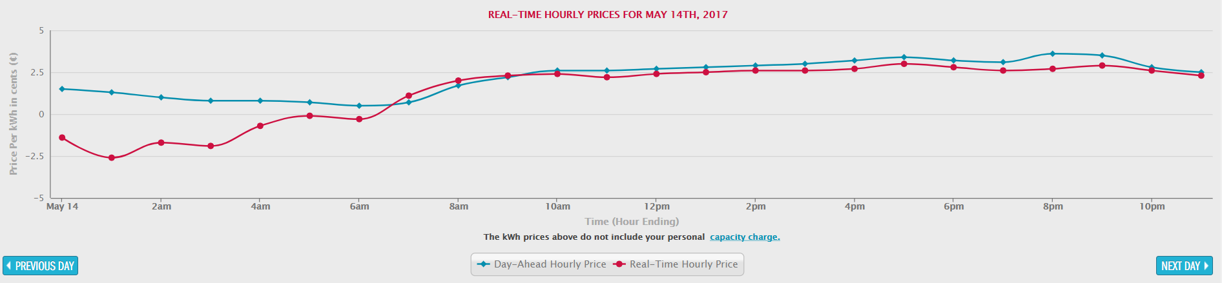
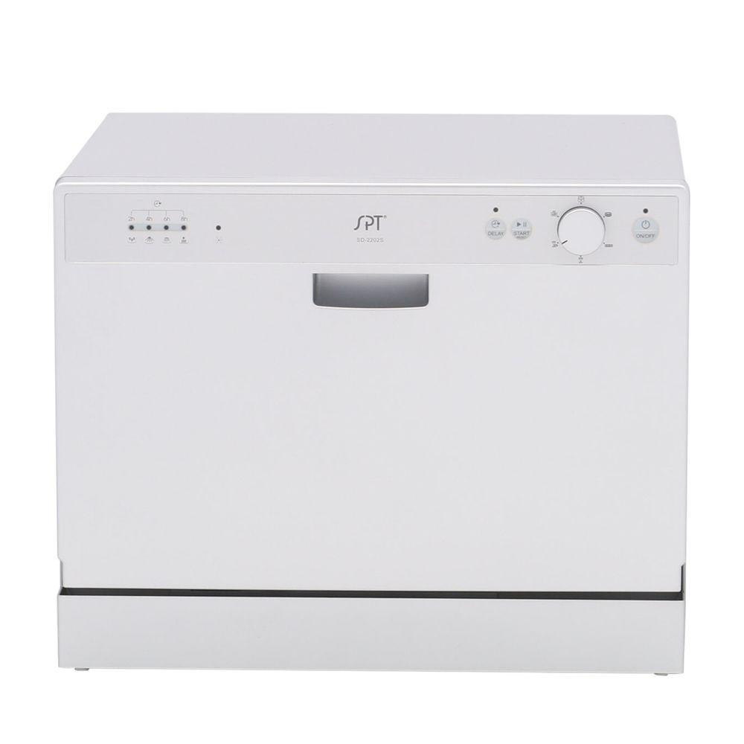
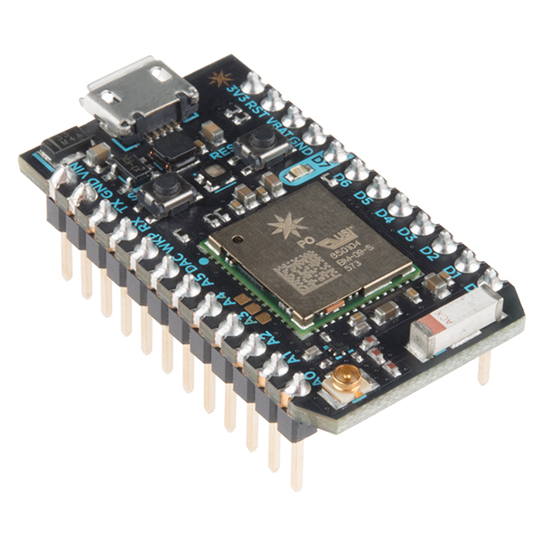

IoT for Power Consumption
RACHNEET KAUR, JOHN NGUYEN, CLARA SCHAYE, DANIEL YEE, RACHEL ZILZ, DANIEL BLOCK, R. S. SREENIVAS, KEVIN THOMPSON, AND RICHARD B. SOWERS
Motivation
Better energy management and production methods are creating “smart” electric grids, which allow electric companies to more closely manage everything about the electric grid. As a result, some companies are offering incentives for more energy use during lower demand times. This research is focused on predicting optimal start/stop time in order to minimize the cost of energy consumption. We are also implementing a physical system in order to demonstrate the effectiveness of our predictive model.
Accomplishments
Constructing a reliable algorithm from our pricing models requires a decision rule to determine which model to use.
Good and Bad Days
Good Days - Days where the improved regression is accurate, i.e. the error on regression below a threshold
Bad Days – Days when the models are inaccurate
Algorithm
We predict which kind of day we have by analyzing the accuracy of the models as prices start to drop
In practice, this has a 10% false positive rate and a 25% false negative rate, though better decision rules are being explored.
After determining the kind of day it is, we just need to apply the most appropriate model to minimize expected costs:
On Good Days, use the improved regression model to determine the optimal starting time
On Bad Days, use the coarse regression to select starting time
Results
In practice, these models achieve about 25% of the total savings possible per customer per day, and it is believed that up to 45% is possible, with just these two pricing models. This translates to saving ~10% on the cost of running your dishwasher each night
Figure 5. QQ plot for errors on the regressed prices indicate a heavy tailed distribution
Figure 6. Calibrated t-distribution to the error
Importance
Our modern society is continually becoming more and more dependent on electronics in our day to day lives. As we continue to use more electricity, it is necessary to try and minimize the risk of blackouts and the hazards that come with them. The implementation of this research would more evenly distribute power consumption, which puts less stress on power grids.
Proposed Research Approach
This project is a combination of energy price modeling and predictions, as well as a physical model that demonstrates the potential for implementation into modern homes.
Price Modeling
The data used to generate our pricing model was collected from Commonwealth Edison (ComEd). The “Live Pricing” API allows us to test our predictive models in real time against real energy prices.
The two main pricing models we are currently using are:
Coarse Regression – This model simply uses the average prices from the past few days to model expected prices
Improved Regression – This is obtained from regressing on historical averages as well as the current price
IoT Dishwasher
The physical model is designed around an SPT Countertop Dishwasher. An onboard Particle Photon microcontroller allows for remote activation. Amazon’s Echo Dot was chosen as the user interface, since it can interact with Amazon Web Services (AWS) with ease.
This system is designed with modularity in mind, so any one part can easily be replaced with another make or model.
Future Directions
We are exploring new models which regress on prices from the same day of the week over the previous month instead of just the previous few days
We plan to look at ComEd’s predicted day ahead pricing, which we can also regress on while modeling the prices.
Figure 1.
ComEd Live Pricing over 24 hours
Benefits and Applications
Consumers save money on power usage for:
  Charging electric vehicles, cell phones laptops, etc.
  Laundry Machines
  Water heaters
Limit potential failure of backup generators for hospitals, water treatment facilities, etc. in the case of a blackout
Less energy lost from having to restart the power grid after blackout
Figure 2.
SPT Countertop Dishwasher
Figure 3.
Particle Photon
Figure 4.
Amazon Echo Dot

