Slide 1
Digital Financial Literacy AI Agent
CAPSTONE PROJECT
Presented By:
Student name : Kaushal Saha
College Name & Department : Malla Reddy University, Btech CSE(Data Science)

Slide 2
OUTLINE
Problem Statement
Technology used
Wow factor
End users
Result
Conclusion
Git-hub Link
Future scope
IBM Certifications

Slide 3
PROBLEM STATEMENT
Many people in India lack understanding of digital finance, including how to use UPI, credit cards, debit cards, and how to stay safe online.
This leads to fear, misuse, or financial fraud.
Proposed Solution:
An AI Agent for Digital Financial Literacy that answers common questions using IBM Watsonx.ai foundation models.
It educates users on topics like digital payments, online banking, and safety tips in simple language.

Slide 4
TECHNOLOGY USED
1.IBM Watsonx.ai Studio
2.IBM Cloud Lite Account
3.IBM Granite Foundation Model (e.g., granite-3-3-8b-instruct)
4.Python Notebook (Watsonx)
5.Natural Language Processing (NLP)

Slide 5
IBM CLOUD SERVICES USED
IBM Watsonx.ai Studio
IBM Watsonx.ai Runtime
IBM Granite Model
IBM Cloud Object Storage (for notebook/project files)

Slide 6
WOW FACTORS
1.Simple, trustworthy answers to financial questions
2.Explains UPI, online fraud, credit vs debit cards, etc.
3.Works 24x7 — anytime access for learning
4.Empowers people with digital financial knowledge
5.Can be expanded into multilingual and voice assistant later

Slide 7
END USERS
General Public (all ages)
Students learning finance basics
NGOs and Rural Awareness Programs
Schools and Colleges
Government Digital Literacy Campaigns

Slide 8
RESULTS
Successfully built AI agent on IBM Watsonx.ai
Granite model answers questions like:
What is UPI?
What is the difference between credit and debit cards?
How to stay safe during online payments?
Responses generated directly from IBM Foundation Model using notebook
Project hosted and submitted via GitHub

Slide 9
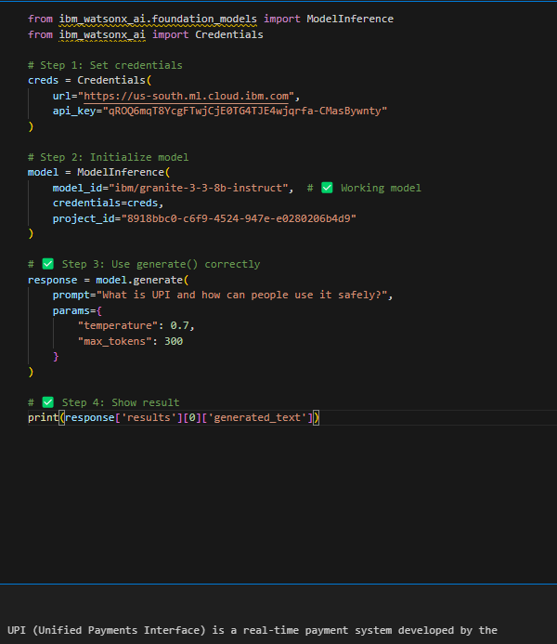
RESULTS

Slide 10
CONCLUSION
AI Agent helps reduce digital illiteracy in finance
People can make better and safer financial decisions
The agent can grow into a mobile app, chatbot, or voice assistant
It shows how AI can solve real-life problems for common people

Slide 11
FUTURE SCOPE
Multilingual support (Hindi, Telugu, etc.)
Voice-activated assistant
Integration with WhatsApp or Mobile App
Add fraud detection examples or scenario-based learning
Real-time alerts or reminders on financial tips

Slide 12
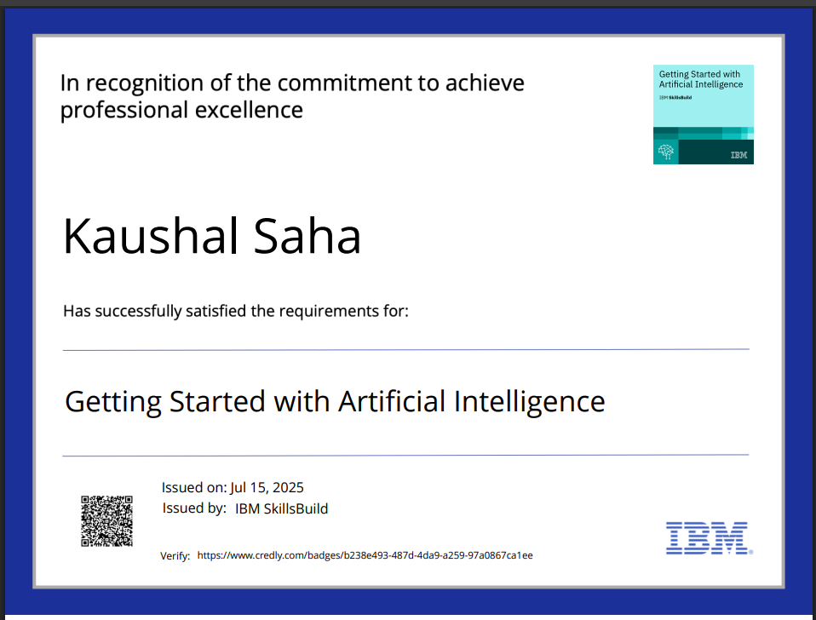
IBM CERTIFICATIONS

Slide 13
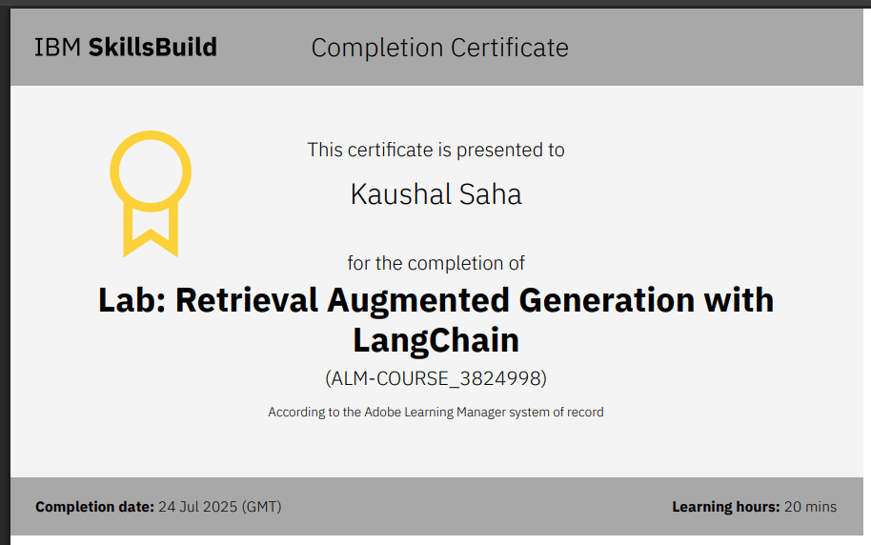

Slide 14
GITHUB LINK
https://github.com/kaus-ship/Digital-Financial-Literacy-Agent

Slide 15
THANK YOU

