Slide 1
Online Course Recommendation System
Group -5

Slide 2
Table of Contents
INTRODUCTION
DATASET OVERVIEW
DATA PREPROCESSING
RECOMMENDATION METHOD
MODEL OPTIMISATION
STREAMLIT APP FEATURES
RESULT
ADVANTAGES
CHALLENGES
FUTURE ENHANCEMENTS
CONCLUSION

Slide 3
Introduction
Problem: Learners struggle to find the right courses due to information overload
Objective: Provide personalized course recommendations based on user similarity
Approach: User-Based Collaborative Filtering + Streamlit web interface

Slide 4
Dataset Overview
Dataset: online_course_recommendation_v2.xlsx
Key Columns: user_id , course_id , course_name, instructor, rating (1–5), certification_offered, study_material_available, difficulty_level, course_duration_hours
Structured data for collaborative filtering model

Slide 5
Data Preprocessing
Dropped irrelevant columns for training
Encoded categorical values: Yes/No → Binary, Difficulty → Ordinal encoding
Removed missing values
Created 'high_rating' column (rating ≥ 4 = 1, else 0)

Slide 6
Recommendation Method
User-Based Collaborative Filtering steps:
1. Build user-course rating matrix
2. Compute cosine similarity between users
3. Find top-N similar users
4. Recommend courses highly rated by similar users
Formula: Predicted Rating = Σ(similarity × rating) / Σ(similarity)

Slide 7
Model Optimization
Filtered to active users (≥ 5 ratings) to reduce sparsity
Used sparse matrix optimizations to prevent memory overload
Selected top-N recommendations for display

Slide 8
Streamlit App Features
Sidebar user selection & recommendations count slider
HTML/CSS styling for recommendation cards
Displays: 📘 Course Name, 👨‍🏫 Instructor, ⭐ Predicted Rating, ⏱️ Duration

Slide 9
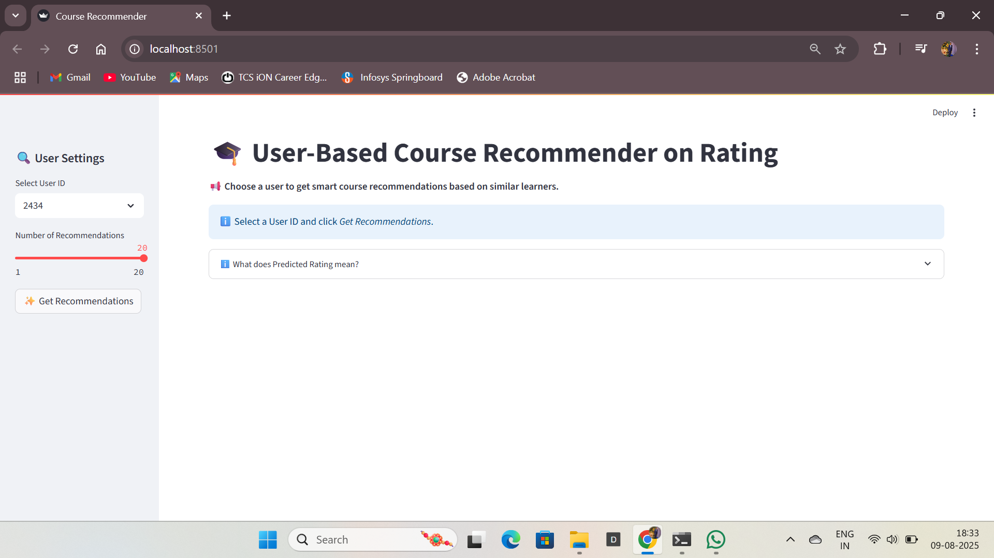
RESULT

Slide 10
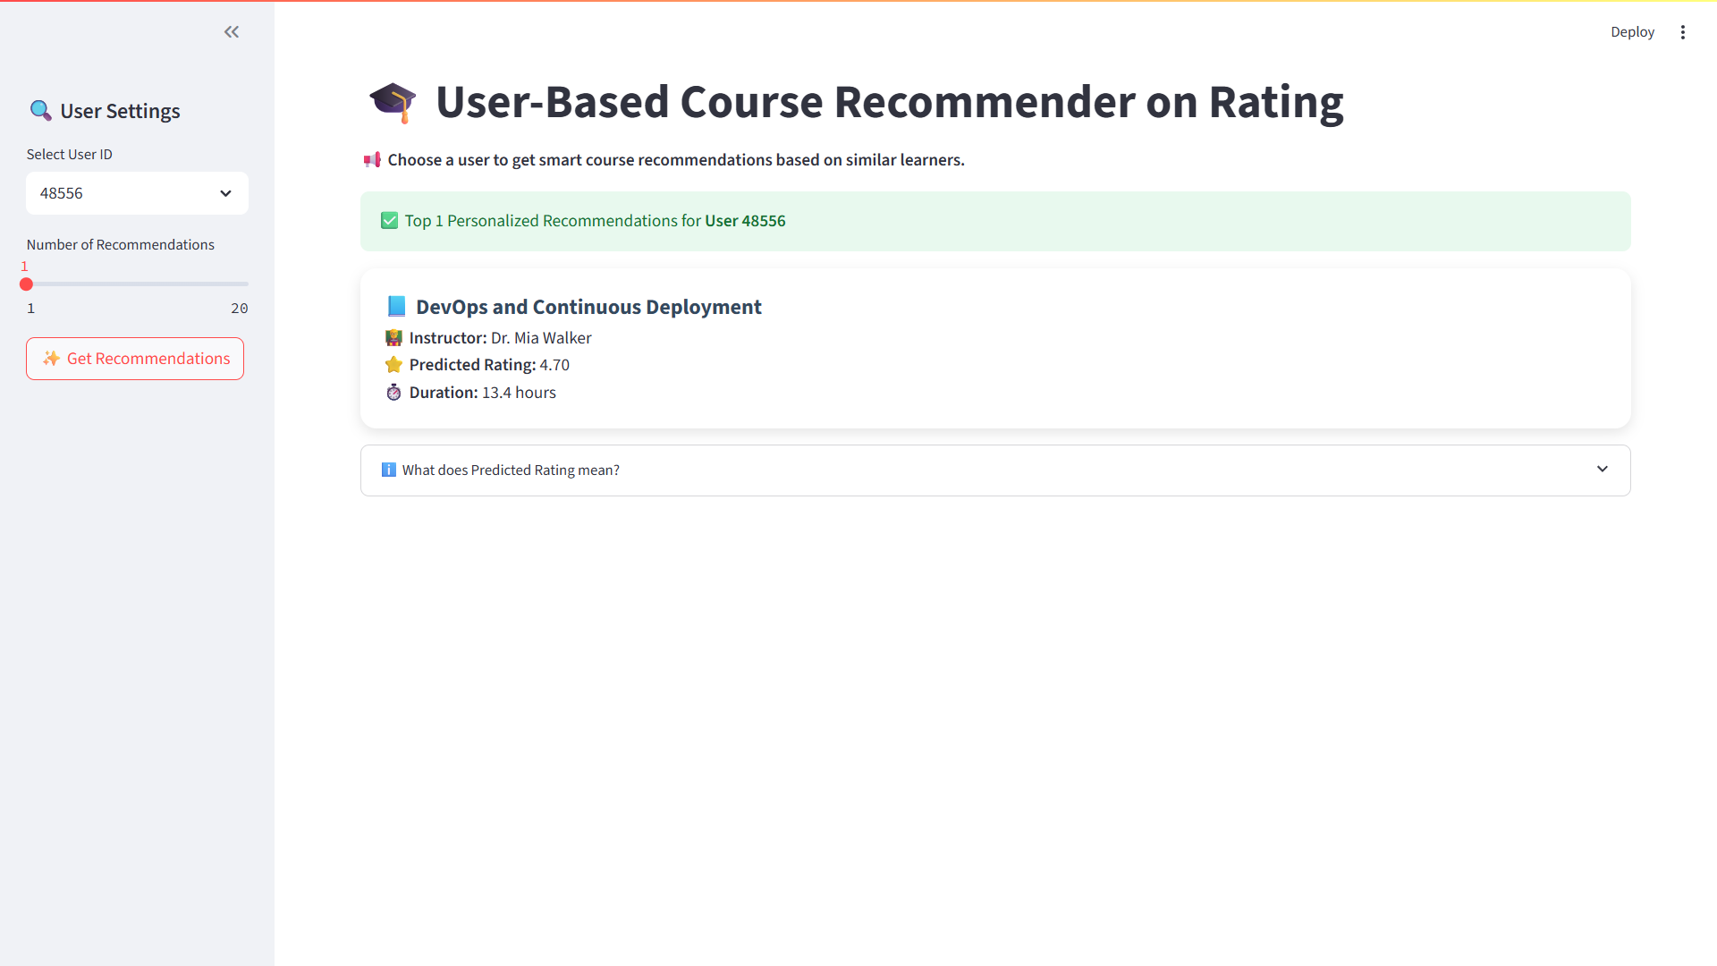
RESULT

Slide 11
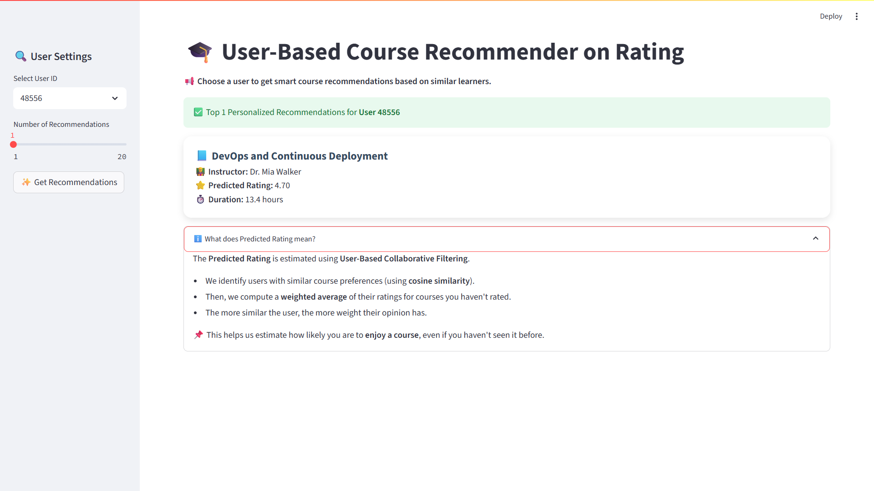
RESULT

Slide 12
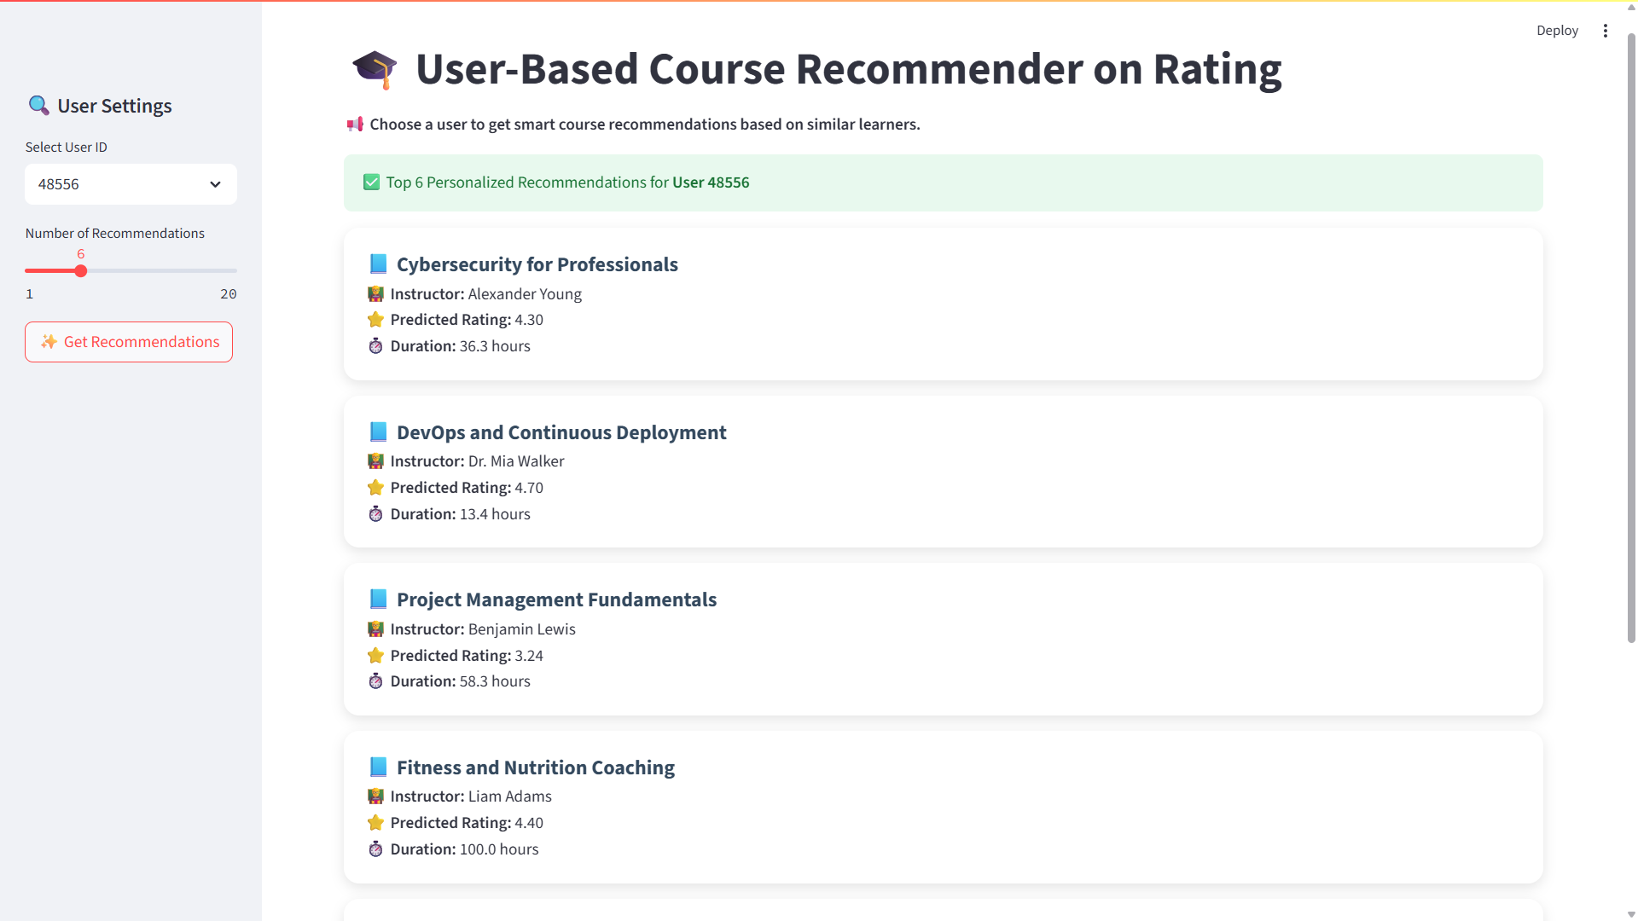
RESULT

Slide 13
Advantages
Personalized recommendations improve learner engagement
Simple, interactive interface
Scalable to large datasets with optimization

Slide 14
CHALLENGES
Data Sparsity: Many users rated only a few courses → sparse user-course matrix, harder to find strong similarities.
Cold Start Problem: New users with no ratings or new courses with no reviews cannot be recommended effectively.
Memory Limitations: Large similarity matrix computation for thousands of users can be resource-intensive.
Scalability: Increasing dataset size slows down similarity calculations without optimizations.
Bias in Recommendations: Highly popular courses tend to dominate, reducing diversity in suggestions.
Limited Context Awareness: Recommendations are based only on ratings, ignoring user goals or session behavior.

Slide 15
Future Enhancements
Add content-based filtering for cold-start users
Enable real-time feedback loop
Implement session-based recommendations
Enhance UI with animations, tabs, sorting options

Slide 16
Conclusion
Developed a complete end-to-end pipeline — from data preprocessing to model building and Stream lit deployment.
Implemented User-Based Collaborative Filtering to provide personalized course recommendations.
Achieved a user-friendly interface with clear course details: title, instructor, predicted rating, and duration.
Optimizations like active user filtering and sparse matrix handling improved performance.
The system demonstrates practical applicability for e-learning platforms to enhance learner engagement.

Slide 17
THANK YOU

