Slide 1
RETAIL ANALYTICS
Customer Shopping Behavior Analysis
Turning transaction data into insights for marketing, retention, and product strategy
Python • PostgreSQL • Power BI
Prepared for Stakeholder Review

Slide 2
Project Snapshot
Analysis of 3,900 retail transactions to uncover purchasing patterns and customer segments
3,900
18
$59.76
3.75 / 5
Customers Analyzed
Data Attributes
Avg. Purchase Amount
Avg. Review Rating
Approach
1
Clean & Prepare
2
Query & Analyze
3
Visualize
Handled missing values, engineered features in Python
Answered business questions with PostgreSQL / SQL
Built an interactive Power BI dashboard for stakeholders

Slide 3
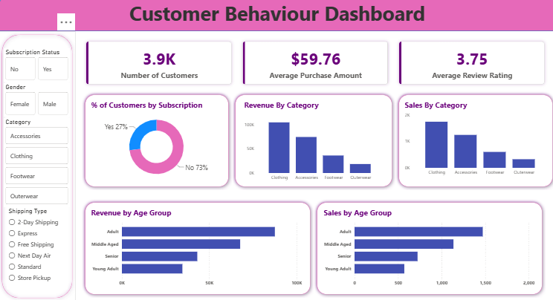
Live in Power BI
A single interactive dashboard tracks these KPIs for the whole team
3.9K
$59.76
3.75
27%
Customers
Avg. Purchase Amount
Avg. Review Rating
Subscribed Customers
Filterable by subscription status, gender, category, and shipping type

Slide 4
Where the Revenue Comes From
Revenue is concentrated in one category and one customer group
45%
of total revenue comes from Clothing
$104,262 — the top category, more than Accessories, Footwear and Outerwear combined with the next tier
Revenue by Gender
68%
of revenue comes from male customers
$157,890 vs. $75,191 from female customers
$18,524
Outerwear — the lowest-revenue category
Signals an opportunity to diversify beyond Clothing

Slide 5
Loyalty Runs Deep, Subscriptions Don't
Repeat customers drive the business, but most high spenders aren't subscribed
80%
of customers are Loyal repeat buyers
3,116 of 3,900 customers have placed more than 10 orders
Customers by Segment
73%
of revenue comes from non-subscribers
$170,436 vs. $62,645 from subscribers — subscription isn't capturing top spenders
$60.48
avg. order value for Express shipping
Higher than Standard shipping ($58.46) — faster delivery correlates with bigger baskets

Slide 6
Recommendations
Five actions to grow revenue, engagement, and retention
1
Diversify beyond Clothing
2
Fix underperforming products
Expand Clothing while building targeted promotions for Outerwear to reduce reliance on one category.
Investigate low Shirt sales and ratings; protect Blouse and Gloves demand with inventory and promotion.
3
Rebuild the subscription offer
4
Reward loyal customers
Promote exclusive subscriber benefits — non-subscribers currently drive 73% of revenue.
Launch loyalty points and personalized offers for the 80% of customers who are repeat buyers.
5
Nudge customers to Express shipping
Offer free Express shipping above a spend threshold to lift average order value.

Slide 7
Next Steps
Review recommendations, prioritize with the marketing and product teams, and track impact via the Power BI dashboard.
Full analysis: Python (EDA) • PostgreSQL (SQL queries) • Power BI (dashboard) • GitHub (documentation)
Thank You

