Slide 1

CLASSIFICATION OF OVARIAN CANCER SUBTYPES USING RESNET 50
Presented By
Kauser Nissar TP
P03PE22S019033
Guided By
Prof. Deepalakshmi R
Asst. Professor

Slide 2
01
02
03
04
AREA AND OBJECTIVES
LITERATURE REVIEW
RESULTS
METHODS INVOLVED

Slide 3
AREA OF THE PROJECT
Image analysis
Deep learning
OBJECTIVES
Utilization of fine-tuned variants of DENSENET for the classification of ovarian cancer subtypes.
Conducting benchmarking and comparative analysis of variants employed in the classification task.

Slide 4
LITERATURE REVIEW
Sl. No. | Title | Dataset | Algorithm | Accuracy | Research Gap
1. | Deep learning-based ovarian cancer subtypes identification using multi-omics data Year - 2020 | The Cancer Genome Atlas (TCGA) | Denoising Auto Encoder, K-means Clustering, Logistic Regression | Without any dimensionality reduction method, K-means achieved lowest Silhouette score(0.165). Auto Encoder and K-means obtained a silhouette score of 0.549 Denoising Auto Encoder and K-means obtained a silhouette score of 0.583 | Purity and Heterogeneity of TCGA Samples Need for Inclusion of Additional Clinical Factors Challenges Related to Sample Size Integration of Mult omics Expression Data and Cancer Images
2. | Deep learning-enabled pelvic ultrasound images for accurate diagnosis of ovarian cancer in China: a retrospective, multicenter, diagnostic study Year - 2021 | Ultrasound images from Tongji Hospital, Tongji Medical College, Huazhong University of Science and Technology | Dense Convolutional Network of 121 layers (DENSENET-121) | The accuracy achieved was 78.8% | The DCNN model is developed on static images and could not visualize lesions from multiple perspectives in a real-time scenario, which might deteriorate model performance

Slide 5
LITERATURE REVIEW
Sl.No. | Title | Dataset | Algorithm | Accuracy | Research Gap
3. | A New Deep Learning method for Automatic Ovarian Cancer Prediction & Subtype classification Year - 2021 | TCGA-OV | ALEXNET having eight convolutional layers, four max-pooling layers, and four dense layers with ELU activation after each convolutional layer. | Achieved accuracy of 72%. | Limited dataset size.
4. | Early-Stage Detection of Ovarian Cancer Based on Clinical Data Using Machine Learning Approaches Year - 2022 | The dataset of 349 patients was collected from the Third Affiliated Hospital of Soochow University | Classification algorithms combined with grid search to tune the parameters | RF, GBM, and LGBM showed the maximum accuracy of 88.0%, AUC of 87%. | The main limitation of this research was the amount of data. Utilize more data to explore ovarian cancer including the control group of patients.

Slide 6
LITERATURE REVIEW
Sl. No. | Title | Dataset | Algorithm | Accuracy | Research Gap
5. | Ovarian tumor diagnosis using deep convolutional neural networks and a denoising convolutional autoencoder Year - 2022 | 1613 Ultra Sound images from St. Mary's hospital | DENSENET121DENSENET201 | In determining tumor malignancy, the DenseNet121 model showed an accuracy of 90.49% with an AUC of 0.9395 and the DenseNet201 model showed an accuracy of 88.7% with an AUC of 0.9419 | Still ultrasound images were used. Therefore, the multi-focal images that can be extracted from the ultrasound video were not fully utilized.
6. | Prediction of Ovarian Cancer Response to Therapy Based on Deep Learning Analysis of Histopathology Images Year - 2023 | TCGA | INCEPTION V3 | The deep learning classifier achieved a mean ROC AUC of 0.846 ± 0.009 with an accuracy of 85% in correctly classifying tumors. | The dataset comprises only high-grade serous carcinomas and predominantly advanced-stage tumors that do not fully represent the diversity and clinical heterogeneity of ovarian cancers.

Slide 7
BLOCK DIAGRAM
Microscope Images of Biopsy Samples
Data Organization
Exploratory Data Analysis
Data preprocessing (resizing and normalization)
Comparative analysis
Fine tuning
Evaluation
Classification using DENSENET121 and RESNET 50
Figure 1. Block diagram of the proposed method for classification of ovarian cancer subtypes.

Slide 8
TOOLS REQUIRED
Python’s pandas module for organizing the dataset.
Visualizations using Matplotlib and Seaborn.
Scikit learn library, keras, TensorFlow, PyTorch.
Kaggle for interactive python notebooks and access to GPU

Slide 9
DATA DESCRIPTION
UBC-OCEAN Dataset
It includes whole slide images (WSI) and tissue microarray (TMA) images.
Total dataset size is approximately 500 GB.
The dataset comprises a total of 538 WSI images and 513 TMA images.
Histopathology acquired from Mendeley’s Data
It contains histopathology images of five subtypes of ovarian cancer along with non-cancerous histopathological images.
The dataset has a size of 83 MB.

Slide 10
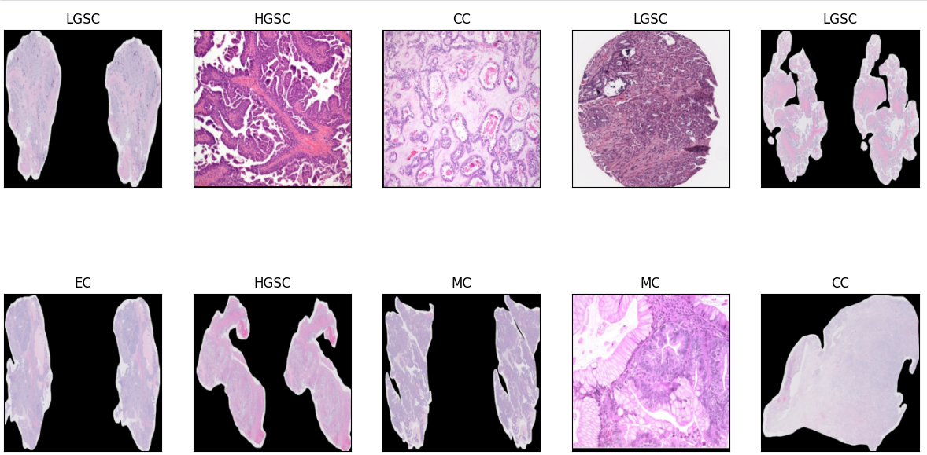
DATA DESCRIPTION
Abbreviation | Subtype
LGSC | Low Grade Serous Carcinoma
HGSC | High Grade Serous Carcinoma
EC | Endometrioid Carcinoma
MC | Mucinous Carcinoma
CC | Clear Cell Carcinoma

Slide 11
METHODS
EXPLORATORY DATA ANALYSIS
DATA ORGANIZATION
EVALUATION
PREDICTIONS
MODEL TRAINING
DATA PREPROCESSING

Slide 12
DATA ORGANIZATION
Initially, the CSV file provided for the UBC Ocean dataset contained pertinent information such as image_id, height, width, and labels.
Paths to the whole slide images (WSI) were appended as a new column.
A separate data frame was created to incorporate the additional histopathology image dataset, which included six labels: EC, MC, HGSC, CC, LGSC, and non-cancerous.
Given the focus on ovarian cancer subtypes, the non-cancerous label was omitted as it was deemed irrelevant.

Slide 13
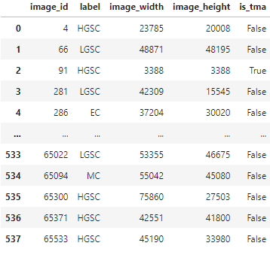
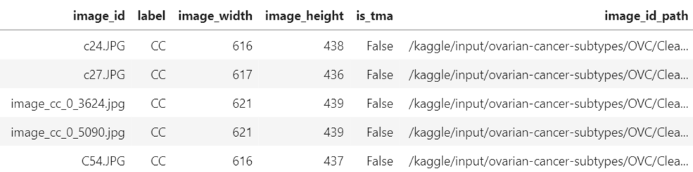
DATASET BEFORE AND AFTER ORGANIZATION
BEFORE
AFTER

Slide 14
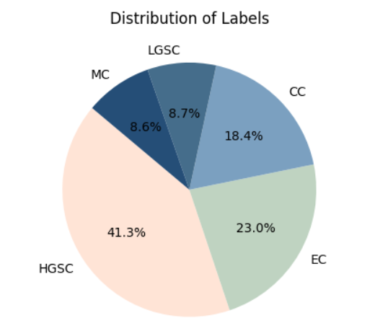
EXPLORATORY DATA ANALYSIS
Figure 3. Pie charts representing the distribution of labels

Slide 15
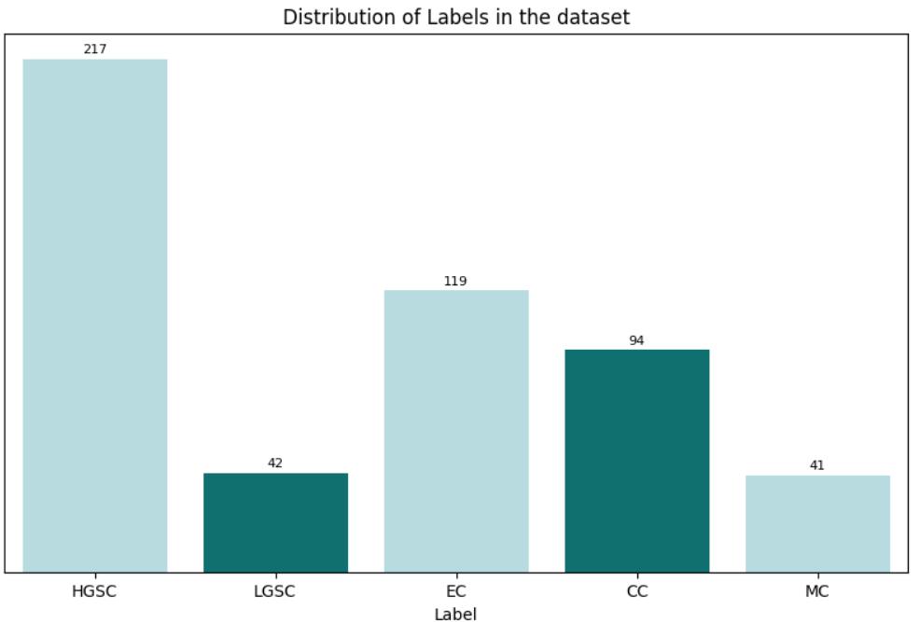
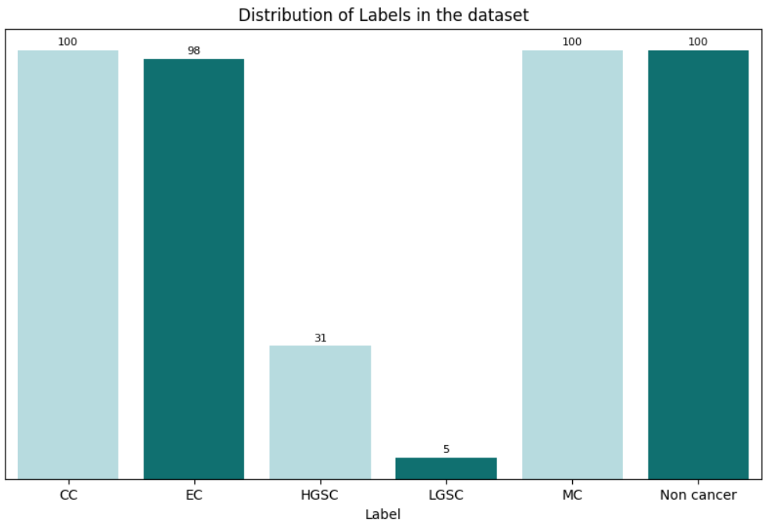
EXPLORATORY DATA ANALYSIS
Figure 4. A count plot that visualizes the distribution of labels in the UBC-OCEAN dataset
Figure 5. A count plot that visualizes the distribution of labels in the Mendeley’s dataset.

Slide 16
DATA PREPROCESSING
Label encoding : 'CC' (0), 'EC' (1), 'HGSC' (2), 'LGSC' (3), and 'MC' (4).
Image Transformation and Normalization:
Resizing to (224, 224)
Normalization using the specified mean and standard deviation:
The mean [0.485, 0.456, 0.406] and standard deviation [0.229, 0.224, 0.225] correspond to the mean and standard deviation values used for the ImageNet dataset, from which the pre-trained ResNet50 model was trained.

Slide 17
TRAINING USING DENSENET 121
DenseNet121 model utilized for ovarian cancer subtype classification.
Persistent overfitting issue despite mitigation efforts.
Validation loss: 2.7998, Validation accuracy: 0.4865 after 10 epochs.
Training accuracy: 90%, indicating severe overfitting.
Experiment details: Test size, random state, rescaling, target size, batch size, class mode, weight initialization, activation function, learning rate, and epoch count.
Notes:
Dense Layers
Bottleneck – 1X1 convolutional layers to reduce the input channel to each dense blocl
Dense blocks- series of cnn – relu and batch normalization
Global Average Pooling and Classifier: Towards the end of the network, global average pooling is applied to reduce the spatial dimensions of the feature maps to 1x1. This is followed by a fully connected layer and a softmax classifier for making predictions

Slide 18
DENSENET 121 PERFORMANCE
Test Size | Batch Size | Activation | Learning Rate (lr) | Epochs | Patience | Train Accuracy | Validation Accuracy | Dropout
0.2 | 16 | 'relu' | 0.0001 | 10 | - | 90.4% | 48.65% | -
0.2 | 32 | 'relu' | 0.0001 | 30 | 3 | 84% | 38.74% | -
0.2 | 32 | 'relu' | 0.0001 | 30 | 3 | 40% | 29.52% | 0.5
Table 1. Performance of the model with different hyper parameters.

Slide 19
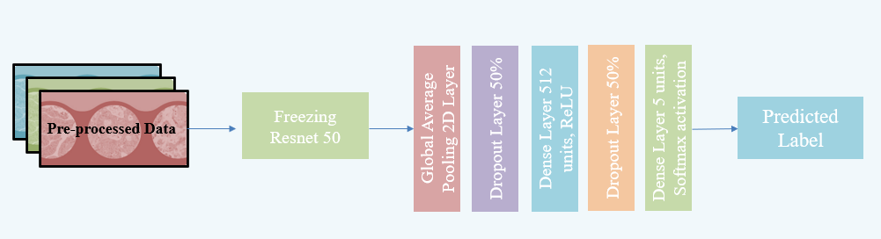
ARCHITECTURE OF RESNET 50
Figure 7. Architecture of the model used for training the dataset.
Notes:
Residual blocks – each block – 2 CNNs + Batch Normalization
Pooling layers
Fully connected layer

Slide 20
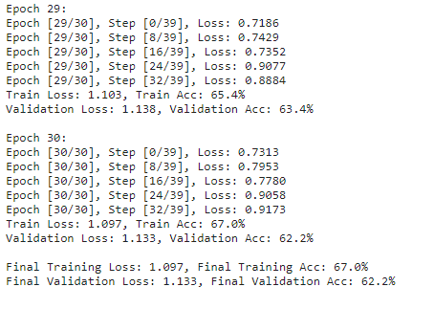
TRAINING USING RESNET 50
ResNet50 in PyTorch for efficiency.
Initial: Training loss 1.175, accuracy 62.3%; some classes had poor precision, recall, F1-score (Validation accuracy: 0.50).
After fine-tuning: Training loss 1.036, accuracy 46.5%; Validation loss 1.277, accuracy 49.1%.
Further fine-tuning: Training loss 0.897, accuracy 67.2%; Validation loss 0.987, accuracy 62.2%.
Enhanced precision, recall, F1-score in updated classification report.
Figure 6. Screenshot of output.

Slide 21
RESNET 50 PERFORMANCE
Epochs | Optimizer | Learning Rate | Momentum | Batch size | Weight Decay | Dropout | Training Accuracy | Validation Accuracy
30 | SGD | 0.0005 | 0.8 | 16 | - | - | 62.80% | 50.00%
29 | ADAM | 0.0006 | - | 32 | - | - | 69.80% | 53.70%
29 | ADAMW | 0.0001 | - | 32 | 0.01 | - | 67.2% | 62.20%
30 | ADAMW | 0.0003 | - | 32 |  | 0.5 | 49.50% | 44.40%
30 | ADAMW | 0.00001 | - | 32 | 1.00E-05 | 0.2 | 56.51% | 51.85%
Table 2. Performance of the model with different hyper parameters.

Slide 22
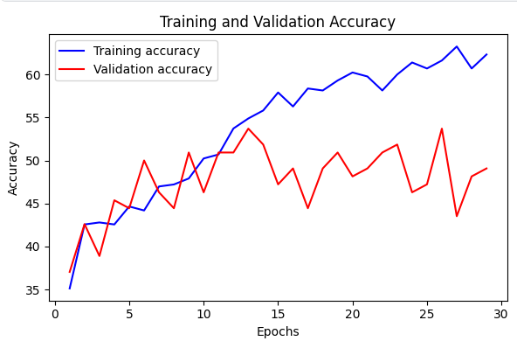
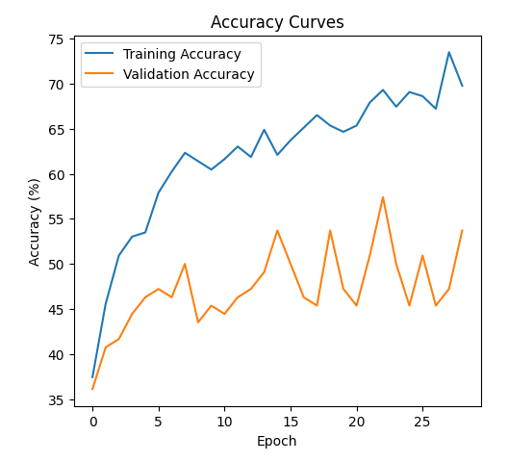
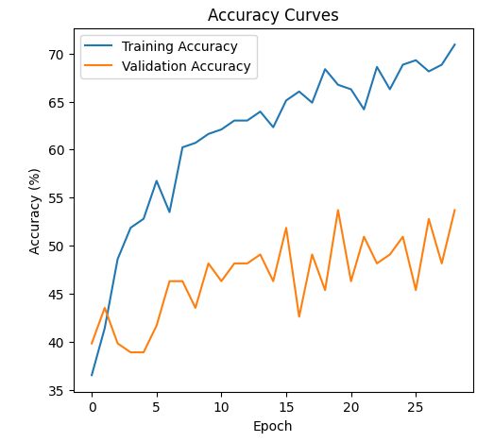
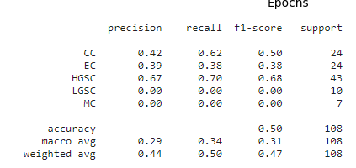
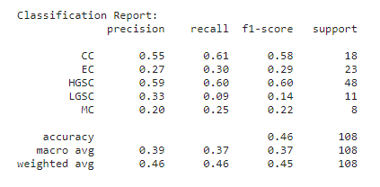
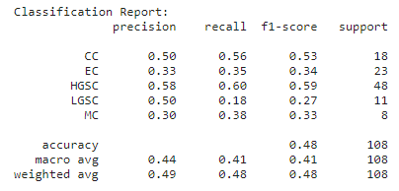
COMPARATIVE ANALYSIS
Epochs: 30
SGD
Lr: 0.0005
Momentum: 0.8
Epochs: 29
AdamW
Lr: 0.0006
weight_decay: 0.01
Epochs: 29
AdamW
Lr: 0.0001
Batch size: 32

Slide 23
CLASSIFICATION REPORT FOR RESNET 50
Current model: 30 epochs, ADAMW optimizer, learning rate - 0.0001, batch size - 32.
Achieved 67.2% training accuracy after fine-tuning, demonstrating enhanced performance and generalization compared to previous models.
Updated classification report: Shows notable improvements in precision, recall, and F1-score across most classes, highlighting the effectiveness of fine-tuning.
Class | Precision | Recall | F1-Score | Support
CC | 0.71 | 0.66 | 0.68 | 41
EC | 0.80 | 0.64 | 0.71 | 44
HGSC | 0.62 | 0.78 | 0.69 | 49
LGSC | 0.33 | 0.18 | 0.14 | 11
MC | 0.68 | 0.87 | 0.76 | 30
Table 3. Classification report of RESNET 50

Slide 24
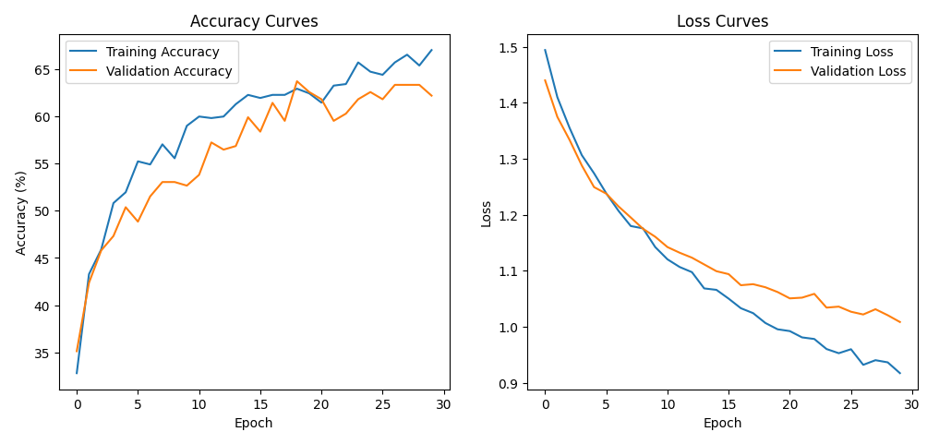
ACCURACY AND LOSS PLOTS
Figure 8. Accuracy and loss plots plotted against epochs.

Slide 25
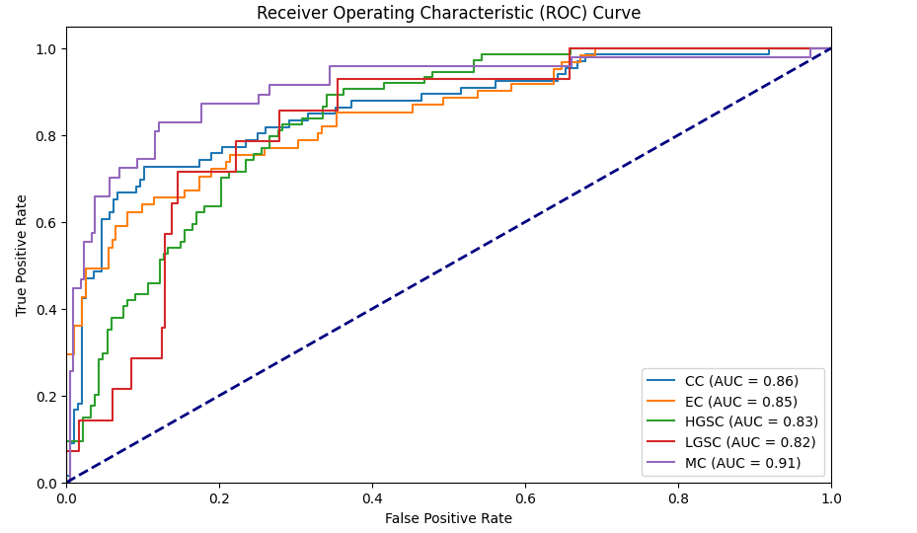
ROC CURVE FOR RESNET 50
Figure 9. ROC Curve obtained for the model.

Slide 26
PREDICTIONS USING THE TRAINED MODEL
Image ID | Ground Truth Label | Predicted Label
532 | HGSC | HGSC
466 | HGSC | HGSC
157 | EC | EC
22 | LGSC | HGSC
456 | HGSC | HGSC
156 | HGSC | HGSC
128 | HGSC | EC
479 | HGSC | HGSC
12 | HGSC | HGSC
133 | EC | EC
Table 4. Predictions made using the model

Slide 27
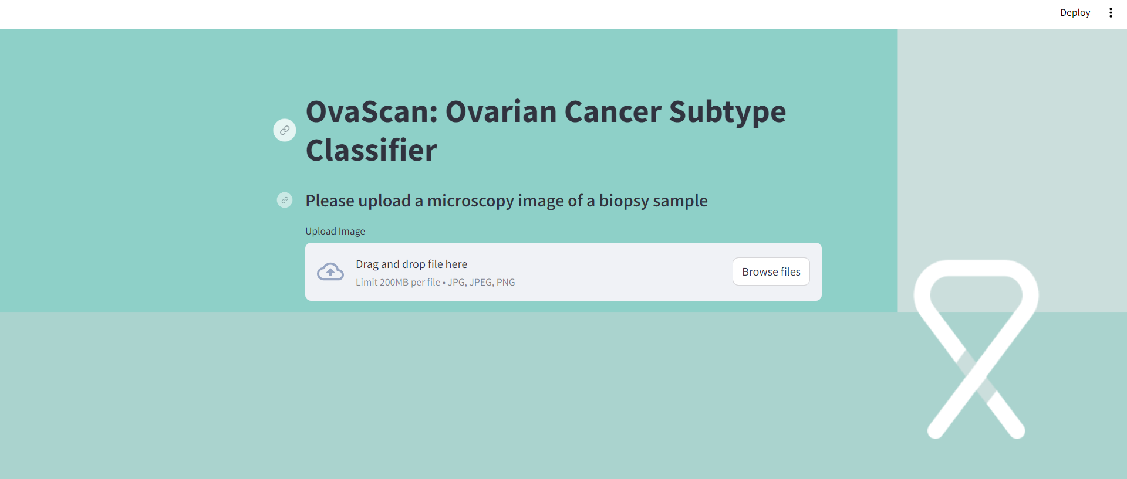
WEBAPP FOR CLASSIFICATION

Slide 28
FUTURE SCOPE AND CHALLENGES
Incorporating supplemental masks for segmentation can provide valuable insights into identifying cancerous regions within images, enhancing the model's interpretability.
Addressing the scarcity of LGSC images in training data is crucial for enhancing the ovarian cancer subtype classification model. Strategies like data augmentation and synthetic image generation offer potential solutions.

Slide 29
CONCLUSION
Transitioning from the initial DenseNet121 architecture to a customized ResNet50 model marks a dedication to continuous improvement.
Implementing the AdamW optimizer with weight decay for L2 regularization has been crucial in guiding parameter updates smoothly while addressing overfitting concerns.
Meticulously selecting and monitoring hyperparameters over 30 epochs resulted in a notable training accuracy of 67.2% and validation accuracy of 62.2%, showcasing the model's performance and the delicate balance between complexity and generalization.
67.2%
Training Accuracy
62.2%
Validation Accuracy

Slide 30
LIST OF REFERENCES
Baușic, A., Coroleucă, C. "Transvaginal Ultrasound vs. Magnetic Resonance Imaging (MRI) Value in Endometriosis Diagnosis.", Diagnostics (Basel), 2023.
Kasture, K. R., Shah, D. D., Matte, P. N., "Deep learning-based ovarian cancer subtypes identification using multi-omics data.", Diagnostics (Basel), 2020.
Ziyambe, B., Yahya, "A Deep Learning Framework for the Prediction and Diagnosis of Ovarian Cancer in Pre- and Post-Menopausal Women.", Diagnostics (Basel), 2023.
Kasture, K. R., Shah, D. D., Matte, P. N, "A New Deep Learning method for Automatic Ovarian Cancer Prediction & Subtype classification." International Journal of Emerging Technology and Advanced Engineering (IJETAE), 2021.
Yue, Z.,Sun, C.,Chen, F.,Zhang, Y.,Xu,W.,Shabbir, S., "Machine learning-based LIBS spectrum analysis of human blood plasma allows ovarian cancer diagnosis", Biomed. Opt. Express, 2021.
Ghoniem, R. M., Algarni, A. D., Refky, B., Ewees, "Multi-Modal Evolutionary Deep Learning Model for Ovarian Cancer Diagnosis.", International Journal of Emerging Technology and Advanced Engineering (IJETAE), 2021.
Kasture, K. R., Choudhari, D., Matte, P. N, "Prediction and Classification of Ovarian Cancer using Enhanced Deep Convolutional Neural Network.", International Journal of Emerging Technology and Advanced Engineering (IJETAE), 2022.

