Slide 1

Exploring and Modeling with the IMDB Movie Dataset

Slide 2



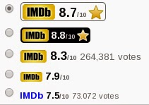



Motivation

Slide 3
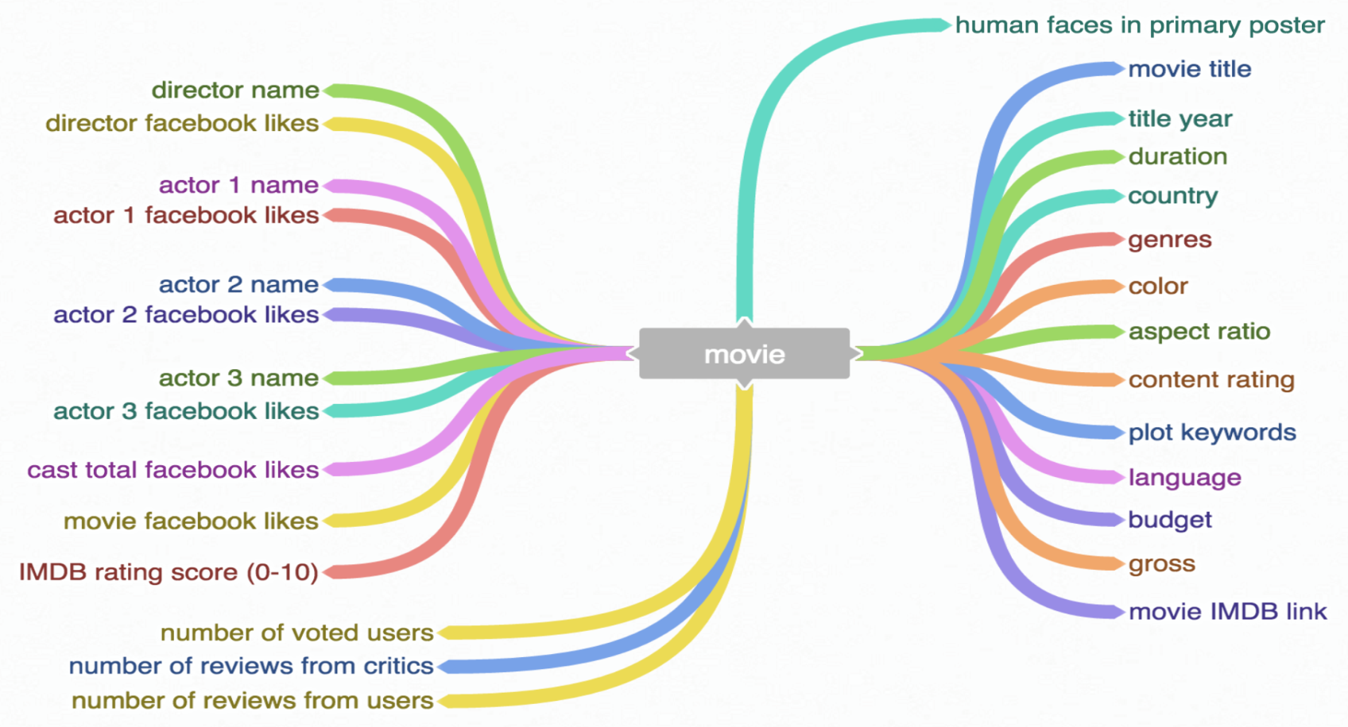
Data Description
https://www.kaggle.com/deepmatrix/imdb-5000-movie-dataset
5043 unique movies
spans over 100 years and 66 different countries
2399 unique director names and thousands of actors and actresses
28 attributes
Notes:
13 useable
numeric features, namely, [directorfacebooklikes, gross, numvotedusers, num-
criticforreviews, numuserforreviews, budget, moviefacebooklikes, duration, ac-
tor3facebooklikes, actor1facebooklikes, actor2facebooklikes, casttotalfacebook-
likes, facenumberinposter], and we have included the prot of a movie, which is
calculated by subtracting the budget from the gross. First, we have cleaned the
data by dropping those samples having NaN values (using 3756 out of 5043 for
modeling) and scaled all the features. For all analysis we have used the numpy,
scipy, sklearn, pandas, matplotlib, seaborn and bokeh libraries of python.
we observe that there are a few text features that might
be useful in predicting the imdbscore, namely genre, plotkeywords and
country, we need to add these to the numerical features.

Slide 4
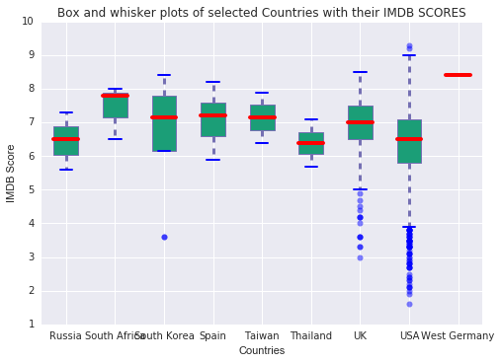
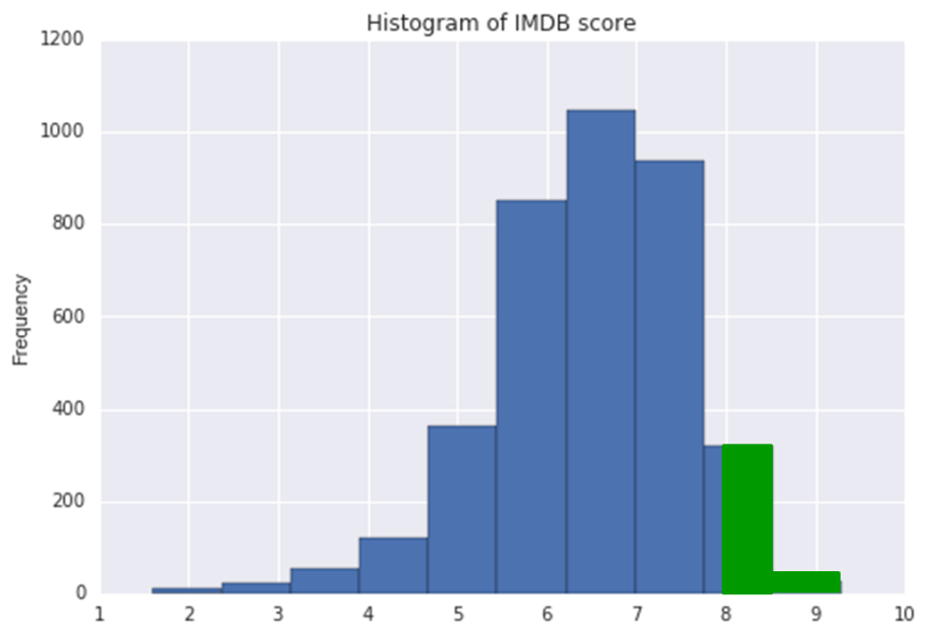
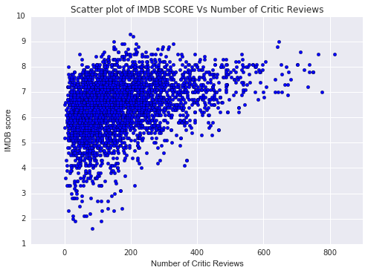
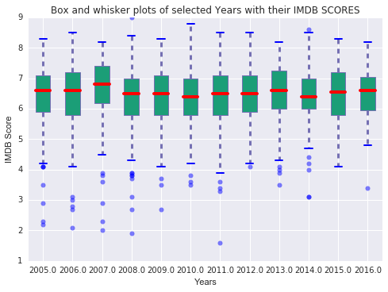
Data Observation and Analysis
Notes:
imdbscore is a score or rating provided to movies by
critics by an online databased platform for movies, IMDB. This score is able
to quantify how popular a movie is. Figure ?? shows a histogram plot for
the imdb scores. From the plot we can observe a normal distribution of the
score, with a mean = 6.4651.056, minimum value of 1.6 for the movie Justin
Beiber: Never say never and maximum of 9.3 for the movie Shawshank Redemp-
tion.

Slide 5
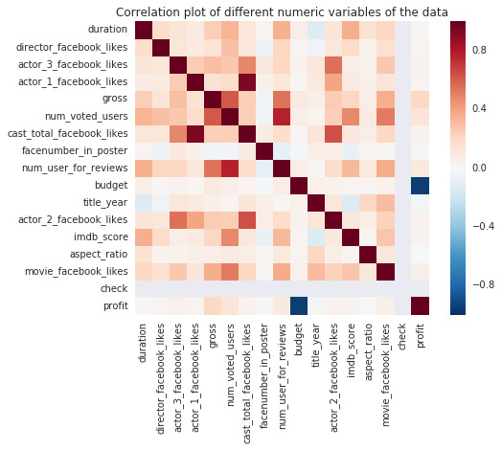
Data Observation and Analysis

Slide 6
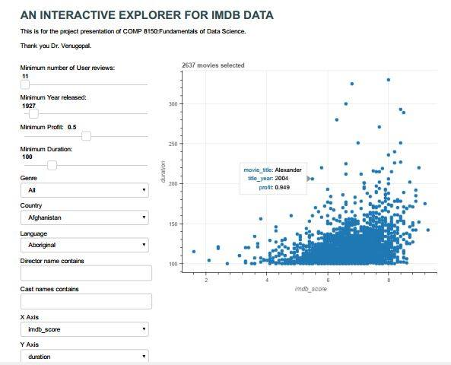
Data visualization tool

Slide 7
Problems
Value prediction problems:
Predict IMDb score of a movie
Predict the gross profit of a movie
Classification problems:
Classify/predict a movie as high rated movie or not
Classify/predict a movie as profitable or not
Clustering:
For a given movie name, suggest similar movies based on plot

Slide 8
Preprocessing
Data cleaning:
by dropping those samples having NaN values
Scaled all the features
Text data processing (for genre, plotKeyWords, Country)
obtain the tfidf scores with the tfidf vectorizer
use todense() to convert each feature from sparse to dense matrix
Merge both numerical features and processed text features to form final feature vector

Slide 9
Text processing
IMDB Score
R2 Score | Features
0.200678667 | actor_3_name
0.141500709 | plot_keywords, genres, director_name
0.141444101 | plot_keywords, genres, director_name, actor_1_name, movie_title
0.141212722 | plot_keywords, genres, director_name, actor_1_name, movie_title, actor_3_name, language
Gross
R2 Score | Features
0.758232465 | actor_1_name
0.751532255 | actor_3_name, language
0.654048948 | actor_3_name, language, country
0.605329414 | actor_3_name, language, country, color

Slide 10
Prediction of Imdb Score
Initial step: Simple linear regression using all the numerical features
The mean MSE is 0.013 and mean residual square is 0.296
Correlation analysis
Mean MSE is 0.0126 and mean residual square is 0.323
Text features + numerical features
The mean MSE is 0.011 and mean residual square is 0.455
LASSO regression
Mean cross-validation score of 0.471
Random Forest Resgression
Mean cross-validation score of 0.511

Slide 11
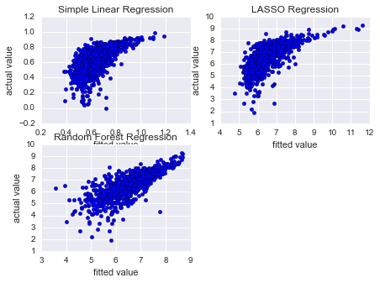
IMDb prediction

Slide 12
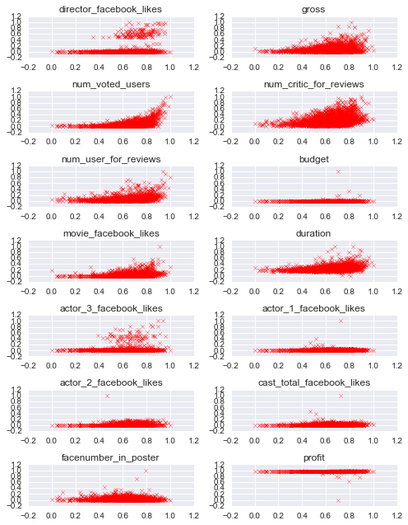
IMDb prediction

Slide 13
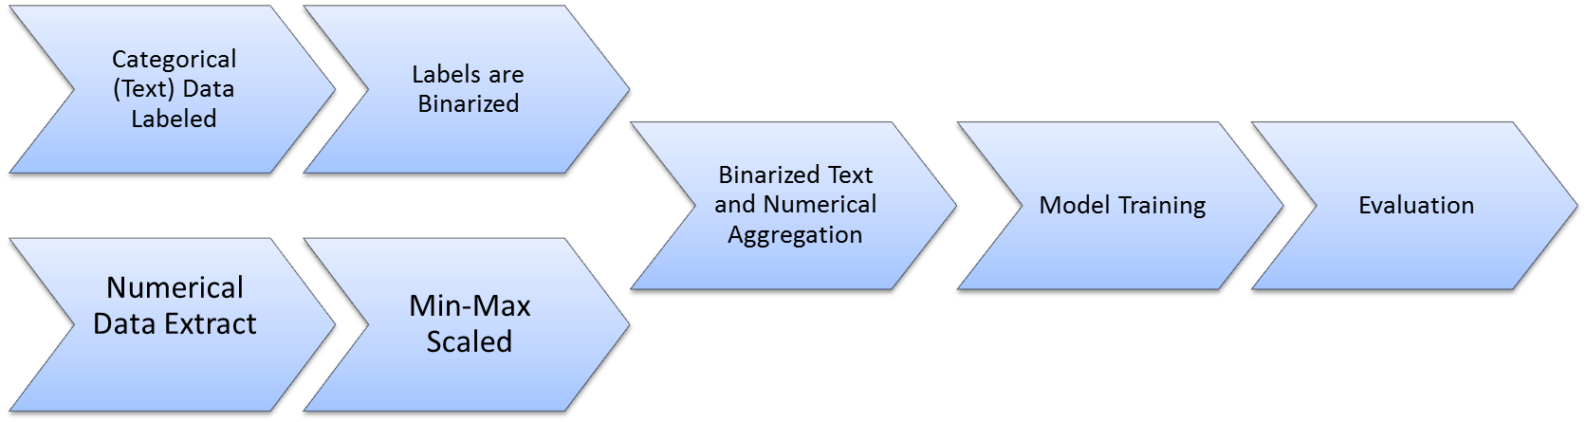
Movie Gross Prediction Process

Slide 14
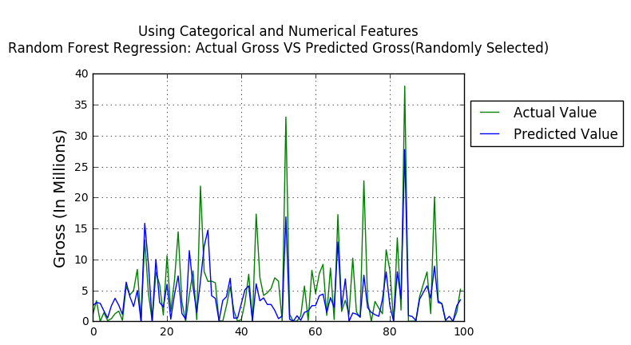
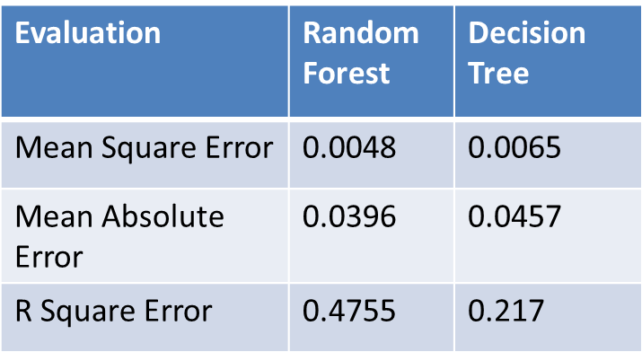
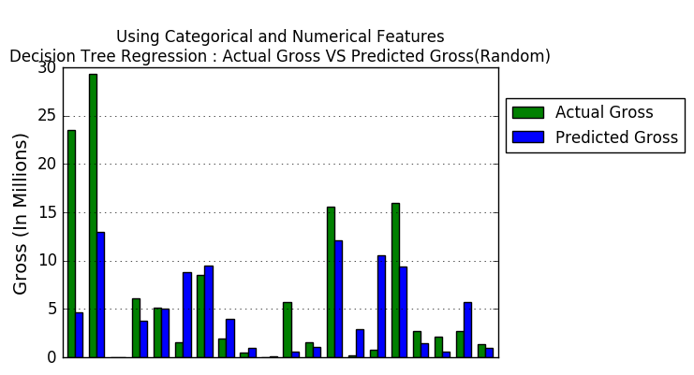
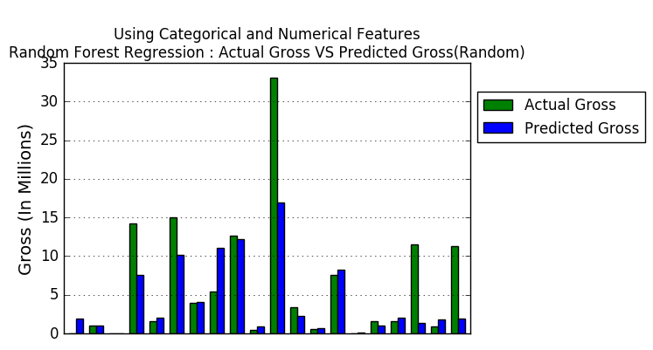
Gross profit Prediction

Slide 15
Classification
Mark a movie as a high rated movie if IMDB score is greater than 8.0
Create a new column,
Gross profit = gross – budget
Mark a movie as a profitable movie if gross profit is greater than zero
At first run different classification models with only numerical features
Then run different classification models with both numerical features and text features

Slide 16
Classification Results
Classification of High rated movie, if IMDB rating greater than 8
 | Numerical features |  |  | Numerical+ categorical features
 | precision | recall | f1-score | precision | recall | f1-score
Decision Tree method | 1.00 | 1.00 | 1.00 | 0.51 | 0.54 | 0.48
Extra Trees method | 0.94 | 0.74 | 0.88 | 0.84 | 0.27 | 0.35
Random Forest method | 1.00 | 1.00 | 1.00 | 0.85 | 0.41 | 0.49
Logistic regrassion l2 | 0.47 | 0.12 | 0.17 | 0.54 | 0.53 | 0.40
Logistic regrassion l1 | 0.96 | 0.93 | 0.95 | 0.80 | 0.63 | 0.67
Gaussian NaiveBayes method | 0.33 | 0.32 | 0.24 | 0.49 | 0.59 | 0.46
Classification of profitable movie, if gross is greater than budget
 | Numerical features |  |  | Numerical+ categorical features
 | precision | recall | f1-score | precision | recall | f1-score
Decision Tree method | 0.88 | 0.90 | 0.89 | 0..66 | 0.63 | 0.63
Extra Trees method | 0.87 | 0.84 | 0.82 | 0.72 | 0.66 | 0.67
Random Forest method | 0.88 | 0.79 | 0.85 | 0.72 | 0.64 | 0.69
Logistic regrassion l2 | 0.99 | 1.0 | 0.99 | 0.71 | 0.73 | 0.71
Logistic regrassion l1 | 0.99 | 0.99 | 0.99 | 0.74 | 0.71 | 0.73
Gaussian NaiveBayes method | 0.67 | 0.69 | 0.59 | 0.66 | 0.57 | 0.53

Slide 17
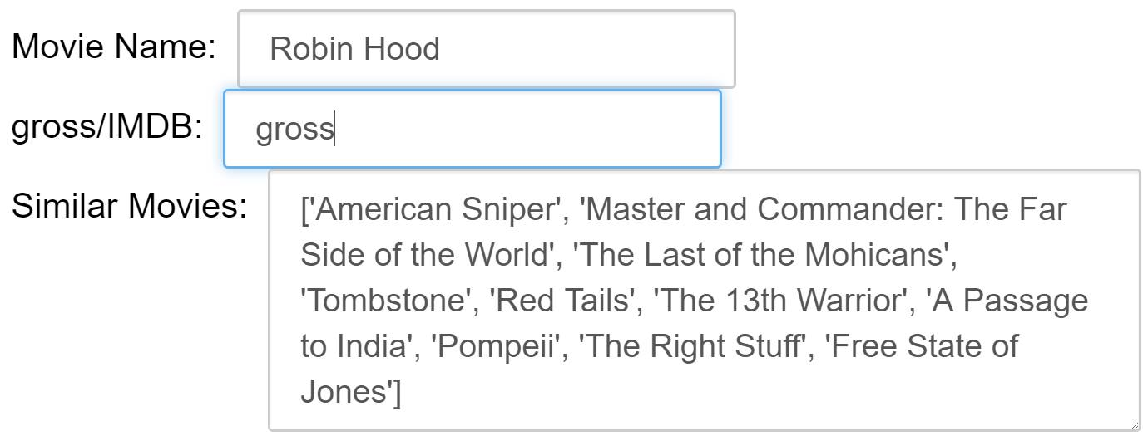
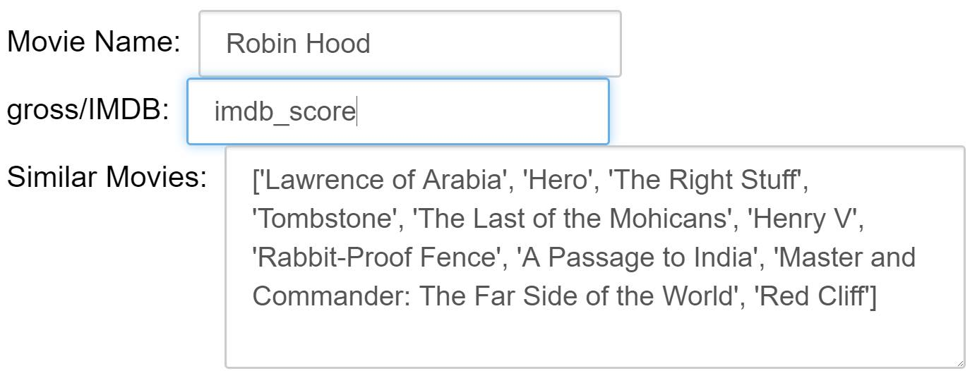
Movie suggestion-Clustering
Using k-means clustering suggest similar movies
Distance measures: plot, genre, cast and crew
Prioritize movie in same cluster based on gross/IMDB score.

Slide 18
Thank You

